Slide 1
Writing T-SQL Queries

Slide 2

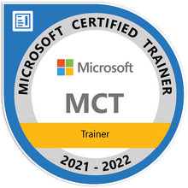
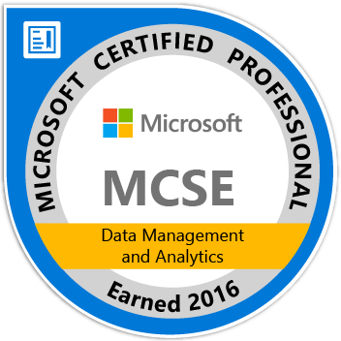
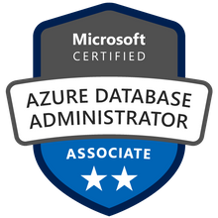



John Deardurff
Microsoft Customer Engineer (Global Technical Team)
Microsoft Certified Trainer (Regional Lead)
MVP: Data Platform (2016 – 2018)
Email: John.Deardurff@Microsoft.com
Twitter: @SQLMCT
Website: www.SQLMCT.com
GitHub: github.com\SQLMCT

Slide 3
Day One - Monday
Writing a SELECT Statement
Structure of a SELECT statement
Structure of object names
Concatenation and Aliases
Sorting and Filtering records
Choosing the right Data Type
What are Data Types?
Where are Data Types used?
Working with Integers
Working with Characters
Working with Dates and Times
What are columns and records?

Slide 4
Day Two - Tuesday
Working with Multiple Tables
Grouping and Functions
Selecting from Multiple Tables
Finding Table Relationships
Parent vs Child Tables
Inner Joins
Outer Joins
What is a Function?
Character string functions
Date and Time functions
Aggregate Functions
Group By and Having

Slide 5
Day Three - Wednesday
Data Manipulation Language
Creating and Modifying SQL Objects
What is DML?
Inserting Records into a table
IDENTITY and SEQUENCES
Updating Records in a table
Deleting Records in a table
Scalar Functions
Views and User-Defined Functions
Derived Tables and CTE’s
Stored Procedure

Slide 6
Getting Setup – AdventureWorks Database
SQL Server 2019 Developer Edition or Azure SQL Database
SQL Server Management Studio or Azure Data Studio
AdventureWorks2019 database
John’s Slides and Scripts

Slide 7
Notes:
Note: This should be the final slide for each presentation.

