Slide 1
Introduction to Intelligent Query Processing
John Deardurff

Slide 2







John Deardurff
Microsoft Customer Engineer (Global Technical Team)
Microsoft Certified Trainer (Regional Lead)
MVP: Data Platform (2016 – 2018)
Email: John.Deardurff@Microsoft.com
Twitter: @SQLMCT
Website: www.SQLMCT.com
GitHub: github.com\SQLMCT

Slide 3
What is in the session?
An Overview of Intelligent Query Processing?
Enabling and Disabling Features
What is Memory Grant Feedback?
Demonstration

Slide 4
Intelligent Query Processing (2022)
Interleaved Execution
Adaptive Joins
Intelligent Query Processing
Adaptive Query Processing
Batch Mode
Feedback Persistence
Table Variable Deferred Compilation
Batch Mode On Rowstore Indexes
Scalar UDF Inlining
Approximate Query Processing
Approximate Count Distinct
Memory Grant Feedback
Row Mode
Approximate Percentile
Parameter Sensitive Plan Optimization
CE Feedback
DOP Feedback
Optimized Plan Forcing
Azure SQL Database
2017
2019
2022
Notes:
Parameter-sensitive? GLOBAL query
GLOBAL: Do not capitalize generic terms. Please note that we do not capitalize terms unless they are from the UI or are feature or product names. Please consider lowercasing such terms throughout this document.
GLOBAL: Please avoid using first person (“we”, “I”) Always use “you” or “Microsoft” if that is applicable.
…have a lot of …?

Slide 5
Enabling and Disabling – Instance Level
For SQL Server 2017 Features
Enabled by default in Compatibility level 140 or higher
To disable change compatibility level to 130 or lower
For SQL Server 2019 Features
Enabled by default in Compatibility level 150 or higher
To disable change compatibility level to 140 or lower
For SQL Server 2022 Features
Enabled by default in Compatibility level 160 or higher
To disable change compatibility level to 150 or lower
Notes:
Parameter-sensitive? GLOBAL query
GLOBAL: Do not capitalize generic terms. Please note that we do not capitalize terms unless they are from the UI or are feature or product names. Please consider lowercasing such terms throughout this document.
GLOBAL: Please avoid using first person (“we”, “I”) Always use “you” or “Microsoft” if that is applicable.
…have a lot of …?

Slide 6
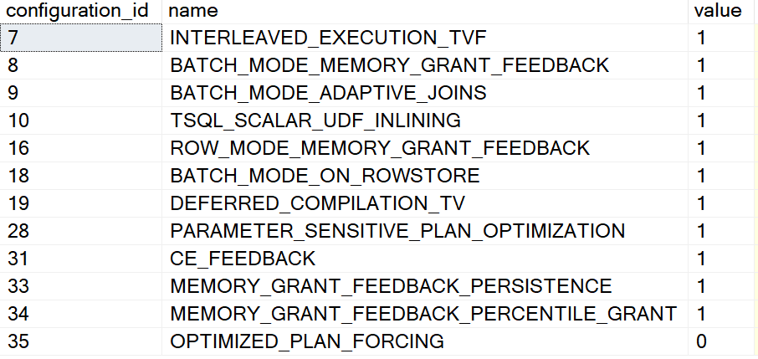
Enabling and Disabling – Database Level
Different settings for 2017 vs Azure SQL, SQL Server 2019 and higher
ALTER DATABASE SCOPED CONFIGURATION SET DISABLE_BATCH_MODE_ADAPTIVE_JOINS = ON|OFF;
ALTER DATABASE SCOPED CONFIGURATION SET BATCH_MODE_ADAPTIVE_JOINS = ON|OFF;
To get a list of Database Scoped Configuration settings
SELECT * From sys.database_scoped_configurations;
Notes:
Parameter-sensitive? GLOBAL query
GLOBAL: Do not capitalize generic terms. Please note that we do not capitalize terms unless they are from the UI or are feature or product names. Please consider lowercasing such terms throughout this document.
GLOBAL: Please avoid using first person (“we”, “I”) Always use “you” or “Microsoft” if that is applicable.
…have a lot of …?

Slide 7
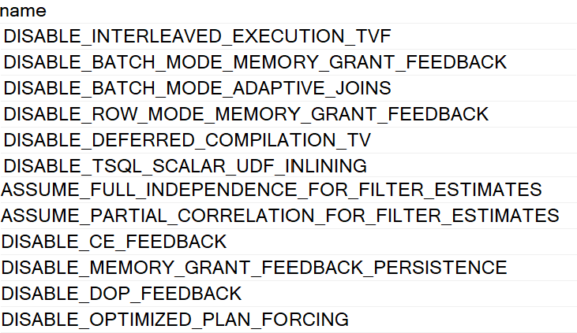
Enabling and Disabling – Statement Level
You can disable features at the statement scope if necessary.
<statement>
OPTION (USE HINT('DISABLE_BATCH_MODE_ADAPTIVE_JOINS'));
To get a list of valid query use hints
SELECT * FROM sys.dm_exec_valid_use_hints;
Notes:
Parameter-sensitive? GLOBAL query
GLOBAL: Do not capitalize generic terms. Please note that we do not capitalize terms unless they are from the UI or are feature or product names. Please consider lowercasing such terms throughout this document.
GLOBAL: Please avoid using first person (“we”, “I”) Always use “you” or “Microsoft” if that is applicable.
…have a lot of …?

Slide 8
Intelligent Query Processing
Interleaved Execution
Adaptive Joins
Intelligent Query Processing
Adaptive Query Processing
Batch Mode
Feedback Persistence
Table Variable Deferred Compilation
Batch Mode On Rowstore Indexes
Scalar UDF Inlining
Approximate Query Processing
Approximate Count Distinct
Memory Grant Feedback
Row Mode
Approximate Percentile
Parameter Sensitive Plan Optimization
CE Feedback
DOP Feedback
Optimized Plan Forcing
Azure SQL Database
2017
2019
2022
Notes:
Parameter-sensitive? GLOBAL query
GLOBAL: Do not capitalize generic terms. Please note that we do not capitalize terms unless they are from the UI or are feature or product names. Please consider lowercasing such terms throughout this document.
GLOBAL: Please avoid using first person (“we”, “I”) Always use “you” or “Microsoft” if that is applicable.
…have a lot of …?

Slide 9
Memory Grant Feedback
Query plan estimates how much memory is needed to store rows during join and sort operations.
Too much memory allocation may impact performance of other operations.
Not enough memory will cause a spill over to disk.
This feature recalculates memory on first execution and updates the cached plan.
Memory Grant Feedback
Adaptive Query Processing
Batch Mode
Row Mode
Feedback Persistence
Notes:
Parameter-sensitive? GLOBAL query
GLOBAL: Do not capitalize generic terms. Please note that we do not capitalize terms unless they are from the UI or are feature or product names. Please consider lowercasing such terms throughout this document.
GLOBAL: Please avoid using first person (“we”, “I”) Always use “you” or “Microsoft” if that is applicable.
…have a lot of …?

Slide 10
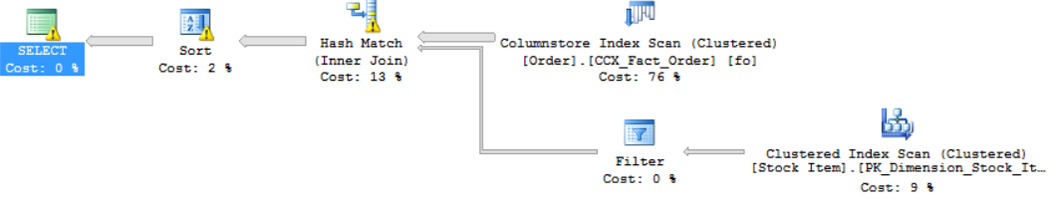
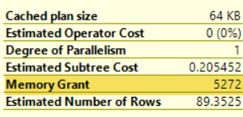
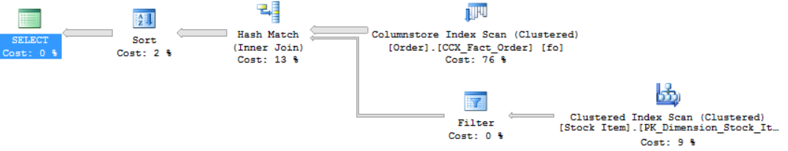
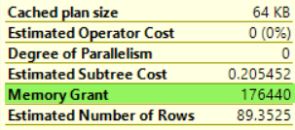
Batch Mode Memory Grant Feedback (2017)
First Execution (Spills detected; feedback generated)
Memory Grant Feedback (Batch Mode)
Second Execution (Memory grant adjusted)
Notes:
Parameter-sensitive? GLOBAL query
GLOBAL: Do not capitalize generic terms. Please note that we do not capitalize terms unless they are from the UI or are feature or product names. Please consider lowercasing such terms throughout this document.
GLOBAL: Please avoid using first person (“we”, “I”) Always use “you” or “Microsoft” if that is applicable.
…have a lot of …?

Slide 11
Row Mode Memory Grant Feedback (2019)
Interleaved Execution
Memory Grant Feedback
Adaptive Joins
Adaptive Query Processing
Batch Mode
Row Mode
Row Mode is just like Batch Mode, but different.
Notes:
Parameter-sensitive? GLOBAL query
GLOBAL: Do not capitalize generic terms. Please note that we do not capitalize terms unless they are from the UI or are feature or product names. Please consider lowercasing such terms throughout this document.
GLOBAL: Please avoid using first person (“we”, “I”) Always use “you” or “Microsoft” if that is applicable.
…have a lot of …?

Slide 12
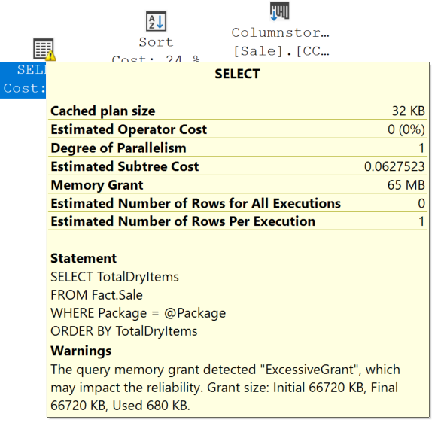
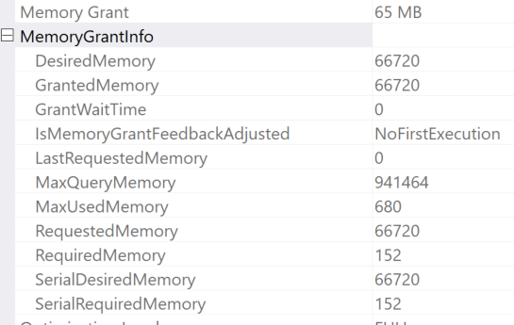
Row Mode Memory Grant Feedback (2019)
Expands on the batch mode memory grant feedback feature by also adjusting memory grant sizes for row mode operators.
Memory Grant Feedback (Row Mode)
Two new query plan attributes will be shown for actual post-execution plans.
Notes:
Parameter-sensitive? GLOBAL query
GLOBAL: Do not capitalize generic terms. Please note that we do not capitalize terms unless they are from the UI or are feature or product names. Please consider lowercasing such terms throughout this document.
GLOBAL: Please avoid using first person (“we”, “I”) Always use “you” or “Microsoft” if that is applicable.
…have a lot of …?

Slide 13
Feedback Persistence (2022)
Memory Grant Feedback
Adaptive Query Processing
Batch Mode
Row Mode
Feedback Persistence
Notes:
Parameter-sensitive? GLOBAL query
GLOBAL: Do not capitalize generic terms. Please note that we do not capitalize terms unless they are from the UI or are feature or product names. Please consider lowercasing such terms throughout this document.
GLOBAL: Please avoid using first person (“we”, “I”) Always use “you” or “Microsoft” if that is applicable.
…have a lot of …?

Slide 14
Feedback Persistence and Percentile (2022)
Problem: Cache Eviction
Feedback is not persisted if the plan is evicted from cache or failover
Solution: Persist the feedback
Persist the memory grant feedback in the Query Store
Record of how to adjust memory is lost and must re-learn
Problem: Oscillating Feedback
Memory grants adjusted based on last feedback
Parameter Sensitive Plans could change feedback
Solution: Percentile-based calculation
Smooths the grant size values based on execution usage history
Notes:
Parameter-sensitive? GLOBAL query
GLOBAL: Do not capitalize generic terms. Please note that we do not capitalize terms unless they are from the UI or are feature or product names. Please consider lowercasing such terms throughout this document.
GLOBAL: Please avoid using first person (“we”, “I”) Always use “you” or “Microsoft” if that is applicable.
…have a lot of …?

Slide 15
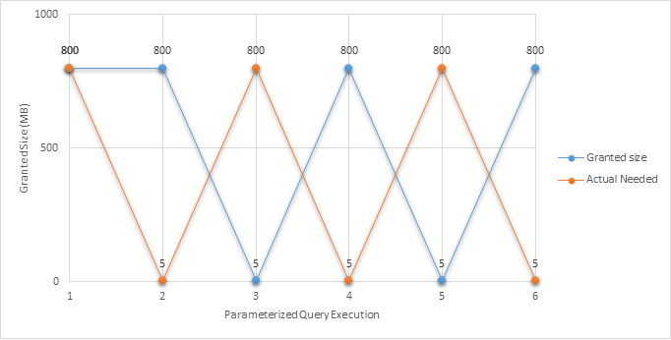
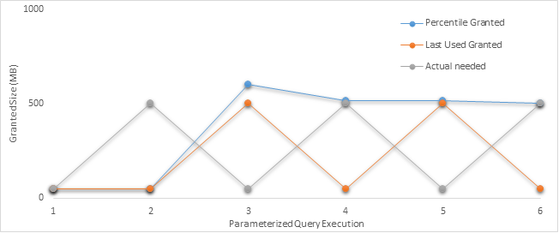
Feedback Persistence and Percentile (2022)
Notes:
Parameter-sensitive? GLOBAL query
GLOBAL: Do not capitalize generic terms. Please note that we do not capitalize terms unless they are from the UI or are feature or product names. Please consider lowercasing such terms throughout this document.
GLOBAL: Please avoid using first person (“we”, “I”) Always use “you” or “Microsoft” if that is applicable.
…have a lot of …?

Slide 16
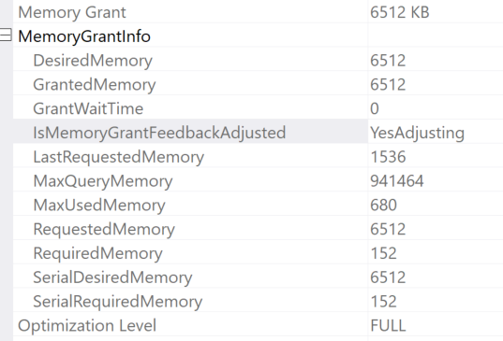
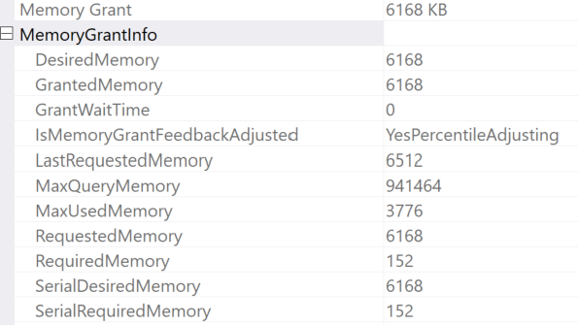
Feedback Persistence and Percentile (2022)
Notes:
Parameter-sensitive? GLOBAL query
GLOBAL: Do not capitalize generic terms. Please note that we do not capitalize terms unless they are from the UI or are feature or product names. Please consider lowercasing such terms throughout this document.
GLOBAL: Please avoid using first person (“we”, “I”) Always use “you” or “Microsoft” if that is applicable.
…have a lot of …?

Slide 17
Demonstration

Slide 18
Questions?

Slide 19


