Slide 1
Introduction to Optimized Plan Forcing
John Deardurff

Slide 2







John Deardurff
Microsoft Customer Engineer (Global Technical Team)
Microsoft Certified Trainer (Regional Lead)
MVP: Data Platform (2016 – 2018)
Email: John.Deardurff@Microsoft.com
Twitter: @SQLMCT
Website: www.SQLMCT.com
GitHub: github.com\SQLMCT

Slide 3
What is in the session?
An Overview of Intelligent Query Processing?
Enabling and Disabling Features
What is Optimized Plan Forcing?
Demonstration

Slide 4
Intelligent Query Processing (2022)
Interleaved Execution
Adaptive Joins
Intelligent Query Processing
Adaptive Query Processing
Batch Mode
Feedback Persistence
Table Variable Deferred Compilation
Batch Mode On Rowstore Indexes
Scalar UDF Inlining
Approximate Query Processing
Approximate Count Distinct
Memory Grant Feedback
Row Mode
Approximate Percentile
Parameter Sensitive Plan Optimization
CE Feedback
DOP Feedback
Optimized Plan Forcing
Azure SQL Database
2017
2019
2022
Notes:
Parameter-sensitive? GLOBAL query
GLOBAL: Do not capitalize generic terms. Please note that we do not capitalize terms unless they are from the UI or are feature or product names. Please consider lowercasing such terms throughout this document.
GLOBAL: Please avoid using first person (“we”, “I”) Always use “you” or “Microsoft” if that is applicable.
…have a lot of …?

Slide 5
Enabling and Disabling – Instance Level
For SQL Server 2017 Features
Enabled by default in Compatibility level 140 or higher
To disable change compatibility level to 130 or lower
For SQL Server 2019 Features
Enabled by default in Compatibility level 150 or higher
To disable change compatibility level to 140 or lower
For SQL Server 2022 Features
Enabled by default in Compatibility level 160 or higher
To disable change compatibility level to 150 or lower
Notes:
Parameter-sensitive? GLOBAL query
GLOBAL: Do not capitalize generic terms. Please note that we do not capitalize terms unless they are from the UI or are feature or product names. Please consider lowercasing such terms throughout this document.
GLOBAL: Please avoid using first person (“we”, “I”) Always use “you” or “Microsoft” if that is applicable.
…have a lot of …?

Slide 6
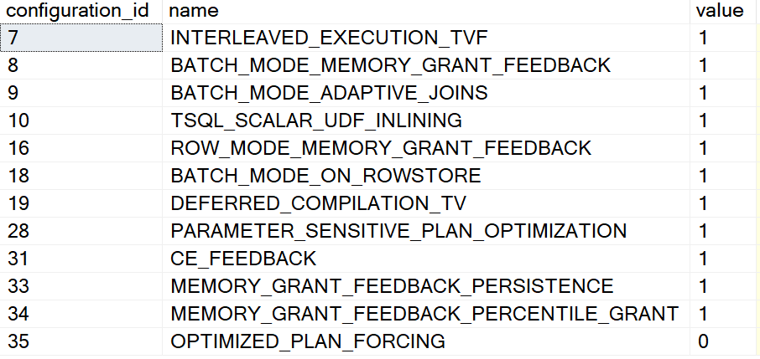
Enabling and Disabling – Database Level
Different settings for 2017 vs Azure SQL, SQL Server 2019 and higher
ALTER DATABASE SCOPED CONFIGURATION SET DISABLE_BATCH_MODE_ADAPTIVE_JOINS = ON|OFF;
ALTER DATABASE SCOPED CONFIGURATION SET BATCH_MODE_ADAPTIVE_JOINS = ON|OFF;
To get a list of Database Scoped Configuration settings
SELECT * From sys.database_scoped_configurations;
Notes:
Parameter-sensitive? GLOBAL query
GLOBAL: Do not capitalize generic terms. Please note that we do not capitalize terms unless they are from the UI or are feature or product names. Please consider lowercasing such terms throughout this document.
GLOBAL: Please avoid using first person (“we”, “I”) Always use “you” or “Microsoft” if that is applicable.
…have a lot of …?

Slide 7
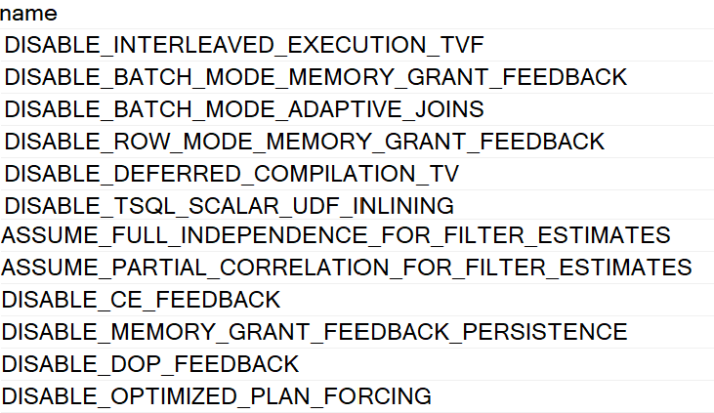
Enabling and Disabling – Statement Level
You can disable features at the statement scope if necessary.
<statement>
OPTION (USE HINT('DISABLE_BATCH_MODE_ADAPTIVE_JOINS'));
To get a list of valid query use hints
SELECT * FROM sys.dm_exec_valid_use_hints;
Notes:
Parameter-sensitive? GLOBAL query
GLOBAL: Do not capitalize generic terms. Please note that we do not capitalize terms unless they are from the UI or are feature or product names. Please consider lowercasing such terms throughout this document.
GLOBAL: Please avoid using first person (“we”, “I”) Always use “you” or “Microsoft” if that is applicable.
…have a lot of …?

Slide 8
Optimized Plan Forcing (2022)
Intelligent Query Processing
Table Variable Deferred Compilation
Batch Mode On Rowstore Indexes
Scalar UDF Inlining
Approximate Query Processing
Approximate Count Distinct
Approximate Percentile
Parameter Sensitive Plan Optimization
Optimized Plan Forcing
Notes:
Parameter-sensitive? GLOBAL query
GLOBAL: Do not capitalize generic terms. Please note that we do not capitalize terms unless they are from the UI or are feature or product names. Please consider lowercasing such terms throughout this document.
GLOBAL: Please avoid using first person (“we”, “I”) Always use “you” or “Microsoft” if that is applicable.
…have a lot of …?

Slide 9
Optimized Plan Forcing (2022)
Query Compilation Today
Query optimization and compilation is a multi-phased process of quickly generating a “good-enough” query execution plan
Query execution time includes compilation. Can be time and resource consuming
To reduce compilation overhead for repeating queries, SQL caches query plans for re-use
Plans can be evicted from cache due to restarts or memory pressure
Subsequent calls to the query require a full new compilation
Notes:
Parameter-sensitive? GLOBAL query
GLOBAL: Do not capitalize generic terms. Please note that we do not capitalize terms unless they are from the UI or are feature or product names. Please consider lowercasing such terms throughout this document.
GLOBAL: Please avoid using first person (“we”, “I”) Always use “you” or “Microsoft” if that is applicable.
…have a lot of …?

Slide 10
Optimized Plan Forcing (2022)
Query Compilation Replay
Targets previously forced plans through Query Store and Automatic Plan Correction
Uses those previously-recorded CRS to quickly reproduce and cache the original forced plan at a fraction of the original compilation cost
Compatible with Query Store hints and secondary replica support
Stores a compilation replay script (CRS) that persists key compilation steps in Query Store.
Stored in the hidden Optimization Replay attribute of the XML plan.
Notes:
Parameter-sensitive? GLOBAL query
GLOBAL: Do not capitalize generic terms. Please note that we do not capitalize terms unless they are from the UI or are feature or product names. Please consider lowercasing such terms throughout this document.
GLOBAL: Please avoid using first person (“we”, “I”) Always use “you” or “Microsoft” if that is applicable.
…have a lot of …?

Slide 11
Optimized Plan Forcing (2022)
Considerations
Only query plans that go through full optimization are eligible, which can be verified by the presence of the StatementOptmLevel="FULL" property.
Statements with RECOMPILE hint and distributed queries are not eligible.
Notes:
Parameter-sensitive? GLOBAL query
GLOBAL: Do not capitalize generic terms. Please note that we do not capitalize terms unless they are from the UI or are feature or product names. Please consider lowercasing such terms throughout this document.
GLOBAL: Please avoid using first person (“we”, “I”) Always use “you” or “Microsoft” if that is applicable.
…have a lot of …?

Slide 12
Intelligent Query Processing Feature Family
Interleaved Execution
Adaptive Joins
Intelligent Query Processing
Adaptive Query Processing
Batch Mode
Feedback Persistence
Table Variable Deferred Compilation
Batch Mode On Rowstore Indexes
Scalar UDF Inlining
Approximate Query Processing
Approximate Count Distinct
Memory Grant Feedback
Row Mode
Approximate Percentile
Parameter Sensitive Plan Optimization
CE Feedback
DOP Feedback
Optimized Plan Forcing
Azure SQL Database
2017
2019
2022
Notes:
Parameter-sensitive? GLOBAL query
GLOBAL: Do not capitalize generic terms. Please note that we do not capitalize terms unless they are from the UI or are feature or product names. Please consider lowercasing such terms throughout this document.
GLOBAL: Please avoid using first person (“we”, “I”) Always use “you” or “Microsoft” if that is applicable.
…have a lot of …?

Slide 13
Questions?

Slide 14


