Slide 1
Parameter Sensitive Plan Optimization in SQL Server 2022
John Deardurff

Slide 2







John Deardurff
Microsoft Customer Engineer (Global Technical Team)
Microsoft Certified Trainer (Regional Lead)
MVP: Data Platform (2016 – 2018)
Email: John.Deardurff@Microsoft.com
Twitter: @SQLMCT
Website: www.SQLMCT.com
GitHub: github.com\SQLMCT

Slide 3
What is in the session?
An Overview of Intelligent Query Processing?
Enabling and Disabling Features
What is Parameter Sensitive Plan Optimization?
Demonstration

Slide 4
Intelligent Query Processing (2022)
Interleaved Execution
Adaptive Joins
Intelligent Query Processing
Adaptive Query Processing
Batch Mode
Feedback Persistence
Table Variable Deferred Compilation
Batch Mode On Rowstore Indexes
Scalar UDF Inlining
Approximate Query Processing
Approximate Count Distinct
Memory Grant Feedback
Row Mode
Approximate Percentile
Parameter Sensitive Plan Optimization
CE Feedback
DOP Feedback
Optimized Plan Forcing
Azure SQL Database
2017
2019
2022
Notes:
Parameter-sensitive? GLOBAL query
GLOBAL: Do not capitalize generic terms. Please note that we do not capitalize terms unless they are from the UI or are feature or product names. Please consider lowercasing such terms throughout this document.
GLOBAL: Please avoid using first person (“we”, “I”) Always use “you” or “Microsoft” if that is applicable.
…have a lot of …?

Slide 5
Enabling and Disabling – Instance Level
For SQL Server 2017 Features
Enabled by default in Compatibility level 140 or higher
To disable change compatibility level to 130 or lower
For SQL Server 2019 Features
Enabled by default in Compatibility level 150 or higher
To disable change compatibility level to 140 or lower
For SQL Server 2022 Features
Enabled by default in Compatibility level 160 or higher
To disable change compatibility level to 150 or lower
Notes:
Parameter-sensitive? GLOBAL query
GLOBAL: Do not capitalize generic terms. Please note that we do not capitalize terms unless they are from the UI or are feature or product names. Please consider lowercasing such terms throughout this document.
GLOBAL: Please avoid using first person (“we”, “I”) Always use “you” or “Microsoft” if that is applicable.
…have a lot of …?

Slide 6
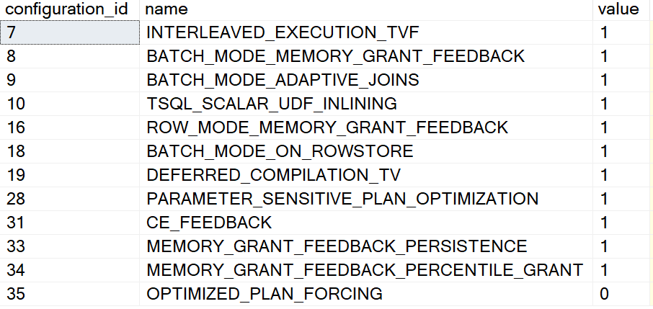
Enabling and Disabling – Database Level
Different settings for 2017 vs Azure SQL, SQL Server 2019 and higher
ALTER DATABASE SCOPED CONFIGURATION SET DISABLE_BATCH_MODE_ADAPTIVE_JOINS = ON|OFF;
ALTER DATABASE SCOPED CONFIGURATION SET BATCH_MODE_ADAPTIVE_JOINS = ON|OFF;
To get a list of Database Scoped Configuration settings
SELECT * From sys.database_scoped_configurations;
Notes:
Parameter-sensitive? GLOBAL query
GLOBAL: Do not capitalize generic terms. Please note that we do not capitalize terms unless they are from the UI or are feature or product names. Please consider lowercasing such terms throughout this document.
GLOBAL: Please avoid using first person (“we”, “I”) Always use “you” or “Microsoft” if that is applicable.
…have a lot of …?

Slide 7
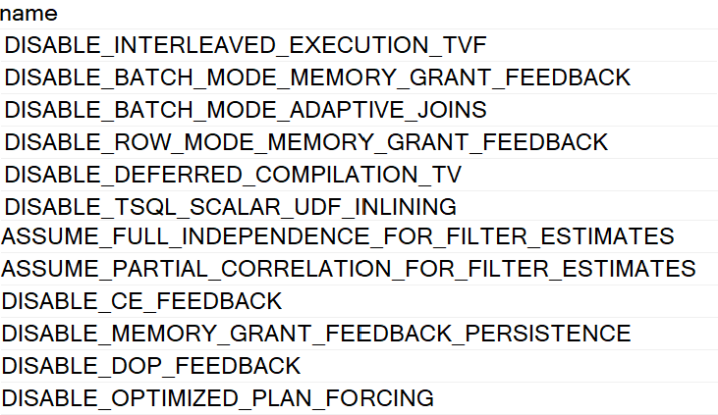
Enabling and Disabling – Statement Level
You can disable features at the statement scope if necessary.
<statement>
OPTION (USE HINT('DISABLE_BATCH_MODE_ADAPTIVE_JOINS'));
To get a list of valid query use hints
SELECT * FROM sys.dm_exec_valid_use_hints;
Notes:
Parameter-sensitive? GLOBAL query
GLOBAL: Do not capitalize generic terms. Please note that we do not capitalize terms unless they are from the UI or are feature or product names. Please consider lowercasing such terms throughout this document.
GLOBAL: Please avoid using first person (“we”, “I”) Always use “you” or “Microsoft” if that is applicable.
…have a lot of …?

Slide 8
Intelligent Query Processing
Interleaved Execution
Adaptive Joins
Intelligent Query Processing
Adaptive Query Processing
Batch Mode
Feedback Persistence
Table Variable Deferred Compilation
Batch Mode On Rowstore Indexes
Scalar UDF Inlining
Approximate Query Processing
Approximate Count Distinct
Memory Grant Feedback
Row Mode
Approximate Percentile
Parameter Sensitive Plan Optimization
CE Feedback
DOP Feedback
Optimized Plan Forcing
Azure SQL Database
2017
2019
2022
Notes:
Parameter-sensitive? GLOBAL query
GLOBAL: Do not capitalize generic terms. Please note that we do not capitalize terms unless they are from the UI or are feature or product names. Please consider lowercasing such terms throughout this document.
GLOBAL: Please avoid using first person (“we”, “I”) Always use “you” or “Microsoft” if that is applicable.
…have a lot of …?

Slide 9
Parameter Sensitive Plan Optimization (2022)
Intelligent Query Processing
Table Variable Deferred Compilation
Batch Mode On Rowstore Indexes
Scalar UDF Inlining
Approximate Query Processing
Approximate Count Distinct
Approximate Percentile
Optimized Plan Forcing
Parameter Sensitive Plan Optimization
Notes:
Parameter-sensitive? GLOBAL query
GLOBAL: Do not capitalize generic terms. Please note that we do not capitalize terms unless they are from the UI or are feature or product names. Please consider lowercasing such terms throughout this document.
GLOBAL: Please avoid using first person (“we”, “I”) Always use “you” or “Microsoft” if that is applicable.
…have a lot of …?

Slide 10

Parameter Sensitive Plans (2022)
Parameter Sensitive Plans Today
Parameter-sniffing problem refers to a scenario where a single cached plan for a parameterized query is not optimal for all possible input parameter values
RECOMPILE
Current Workarounds
If plan is not representative of most executions, you have a perceived “bad plan”
OPTION (OPTIMIZE FOR…)
OPTION (OPTIMIZE FOR UNKNOWN)
Disable parameter sniffing entirely
KEEPFIXEDPLAN
Force a known plan
Nested procedures
Dynamic string execution
Notes:
Parameter-sensitive? GLOBAL query
GLOBAL: Do not capitalize generic terms. Please note that we do not capitalize terms unless they are from the UI or are feature or product names. Please consider lowercasing such terms throughout this document.
GLOBAL: Please avoid using first person (“we”, “I”) Always use “you” or “Microsoft” if that is applicable.
…have a lot of …?

Slide 11
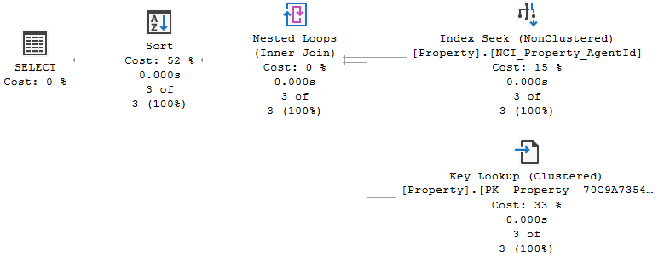

PSP today (Example of Real Estate agent's portfolio)
New compile on Agent 4

Slide 12
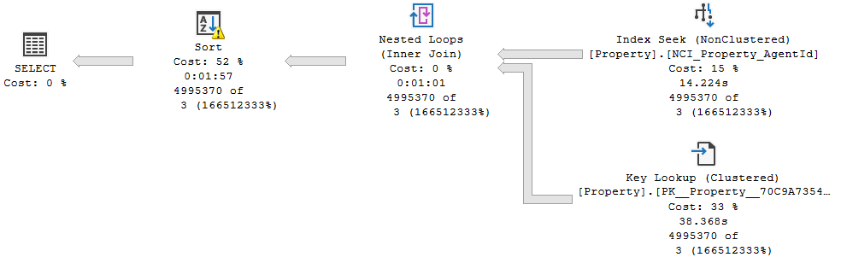

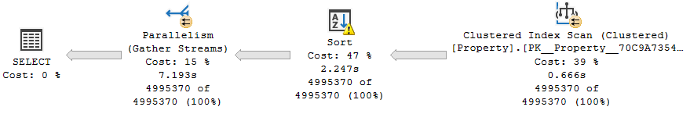

PSP today (Example of Real Estate agent's portfolio)
Using cached plan for Agent 2
New compile on Agent 2
Notes:
Using cached plan for Agent 2
New compile on Agent 2

Slide 13
PSP Optimization (2022)
Too many plans generated could create cache bloat, so limit # of plans in cache
Automatically enables multiple, active cached plans for a single parameterized statement
Cached execution plans will accommodate different data sizes based on the customer-provided runtime parameter value(s)
Design considerations
Overhead of PSP optimization must not outweigh downstream benefit
Compatible with Query Store plan forcing
Notes:
Parameter-sensitive? GLOBAL query
GLOBAL: Do not capitalize generic terms. Please note that we do not capitalize terms unless they are from the UI or are feature or product names. Please consider lowercasing such terms throughout this document.
GLOBAL: Please avoid using first person (“we”, “I”) Always use “you” or “Microsoft” if that is applicable.
…have a lot of …?

Slide 14
PSP Predicate Selection (2022)
During initial compilation PSP optimization will evaluate the most “at risk” parameterized predicates (up to three out of all available)
First version is scoped to equality predicates referencing statistics-covered columns; WHERE AgentId = @AgentId
Uses the statistics histogram to identify non-uniform distributions
Notes:
Parameter-sensitive? GLOBAL query
GLOBAL: Do not capitalize generic terms. Please note that we do not capitalize terms unless they are from the UI or are feature or product names. Please consider lowercasing such terms throughout this document.
GLOBAL: Please avoid using first person (“we”, “I”) Always use “you” or “Microsoft” if that is applicable.
…have a lot of …?

Slide 15
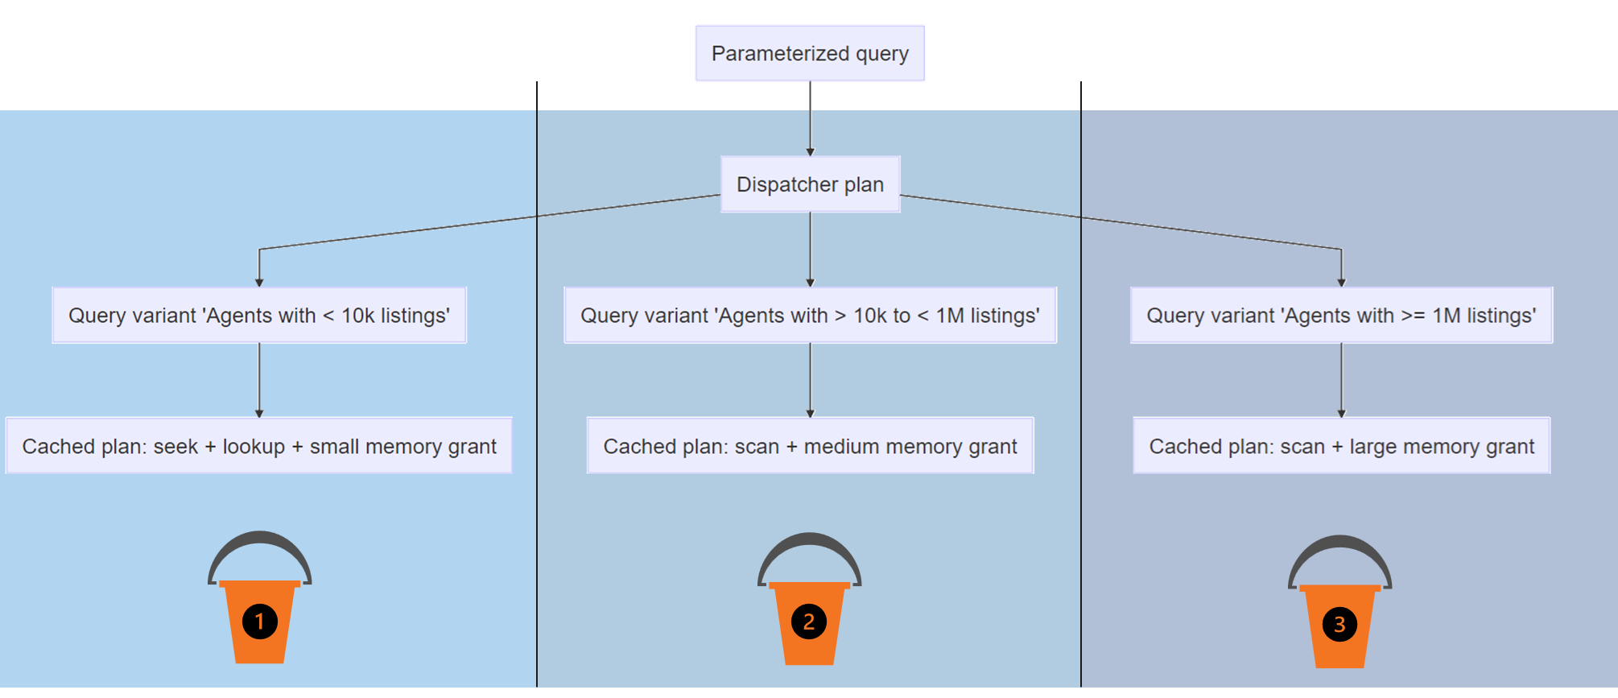
Boundary Value Selection (Dispatcher Plan)
Notes:
PSP optimization implementation
During the initial compilation, column statistics histograms will be used to identify non-uniform distributions and “at risk” predicates, up to three out of all available predicates.
For eligible plans, the initial compilation produces a dispatcher plan that contains the Parameter Sensitivity Plan optimization logic called a dispatcher expression. A dispatcher plan maps to query variants based on the predicates cardinality range boundary values.
For each predicate that is chosen, the Query Processor will bucketize them into predicate cardinality ranges based on the runtime cardinality, as seen here.
Dispatcher plans are automatically rebuilt if there are significant data distribution changes. Query variant plans will independently recompile as needed, the same as any other query plan type and subject to default recompilation events.
For each predicate chosen, we will bucketize them into predicate cardinality ranges based on the runtime cardinality.
Other Key Points
Query variants will have the same query hash value so customers can still determine the aggregate resource usage for queries that differ only by input values
Plans for a query variant in the same dispatcher will independently recompile as needed, the same way as is without the feature
It is important to note that these plan variants are NOT pre-generated and there are a maximum of 200 plans in Query Store, with 27 plans in cache (up to 3 predicates pwr 3).
Parameter-sensitive? GLOBAL query
GLOBAL: Do not capitalize generic terms. Please note that we do not capitalize terms unless they are from the UI or are feature or product names. Please consider lowercasing such terms throughout this document.
GLOBAL: Please avoid using first person (“we”, “I”) Always use “you” or “Microsoft” if that is applicable.
…have a lot of …?

Slide 16
Dispatcher Plan in XML
<Dispatcher>
<ParameterSensitivePredicate LowBoundary="100" HighBoundary="1000000">
<StatisticsInfo Database="[PropertyMLS]" Schema="[dbo]" Table="[Property]" Statistics="[NCI_Property_AgentId]" ModificationCount="0" SamplingPercent="100" LastUpdate="2019-09-07T15:32:16.89" />
<Predicate>
<ScalarOperator ScalarString="[PropertyMLS].[dbo].[Property].[AgentId]=[@AgentId]">
<Compare CompareOp="EQ">
<ScalarOperator>
<Identifier> <ColumnReference Database="[PropertyMLS]" Schema="[dbo]" Table="[Property]" Column="AgentId" /> </Identifier> </ScalarOperator>
<ScalarOperator> <Identifier> <ColumnReference Column="@AgentId" />
</Identifier> </ScalarOperator> </Compare> </ScalarOperator> </Predicate> </ParameterSensitivePredicate> </Dispatcher>
Notes:
Parameter-sensitive? GLOBAL query
GLOBAL: Do not capitalize generic terms. Please note that we do not capitalize terms unless they are from the UI or are feature or product names. Please consider lowercasing such terms throughout this document.
GLOBAL: Please avoid using first person (“we”, “I”) Always use “you” or “Microsoft” if that is applicable.
…have a lot of …?

Slide 17
Monitor with Extended Events
Parameter_sensitive_plan_optimization_skipped_reason
Parameter_sensitive_plan_optimization:
Parameter_sensitive_plan_testing:
Occurs when the parameter sensitive plan feature is skipped..
Occurs when a query uses Parameter Sensitive Plan (PSP) Optimization feature. Debug channel only.
Occurs when parameter-sensitive plan is tested. Debug channel only.
Notes:
Parameter-sensitive? GLOBAL query
GLOBAL: Do not capitalize generic terms. Please note that we do not capitalize terms unless they are from the UI or are feature or product names. Please consider lowercasing such terms throughout this document.
GLOBAL: Please avoid using first person (“we”, “I”) Always use “you” or “Microsoft” if that is applicable.
…have a lot of …?

Slide 18
Intelligent Query Processing Feature Family
Interleaved Execution
Adaptive Joins
Intelligent Query Processing
Adaptive Query Processing
Batch Mode
Feedback Persistence
Table Variable Deferred Compilation
Batch Mode On Rowstore Indexes
Scalar UDF Inlining
Approximate Query Processing
Approximate Count Distinct
Memory Grant Feedback
Row Mode
Approximate Percentile
Parameter Sensitive Plan Optimization
CE Feedback
DOP Feedback
Optimized Plan Forcing
Azure SQL Database
2017
2019
2022
Notes:
Parameter-sensitive? GLOBAL query
GLOBAL: Do not capitalize generic terms. Please note that we do not capitalize terms unless they are from the UI or are feature or product names. Please consider lowercasing such terms throughout this document.
GLOBAL: Please avoid using first person (“we”, “I”) Always use “you” or “Microsoft” if that is applicable.
…have a lot of …?

Slide 19
Questions?

Slide 20



Learn more
Learn more about SQL Server 2022
aka.ms/sqlserver2022
Watch a technical deep-dive on SQL Server 2022
aka.ms/sqlserver2022mechanics
Don’t miss out on Data Exposed (Look for SQL Server 2022 – Episode 3)
aka.ms/dataexposed
More information on Intelligent Query Processing (Currently does not have 2022 information.)
aka.ms/IQP
https://aka.ms/IQPDemos
https://aka.ms/SQLCE

Slide 21


