Slide 1
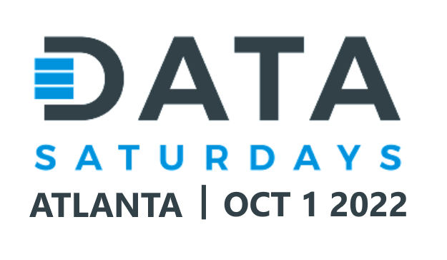
Introduction to Accelerated Database Recovery John Deardurff

Slide 2






A big thank you to our sponsors for making today possible!

Slide 3







John Deardurff
Cloud Solution Architect (Data & AI)
Microsoft Certified Trainer (Regional Lead)
MVP: Data Platform (2016 – 2018)
Email: John.Deardurff@Microsoft.com
Twitter: @SQLMCT
Website: www.SQLMCT.com
GitHub: github.com\SQLMCT

Slide 4
What does this session cover?
What is Database Recovery?
Accelerated Database Recovery Process
Accelerated Database Recovery Components
Demonstration
What is Accelerated Database Recovery?
Traditional Database Recovery Process
Frequently Asked Questions
Notes:
In this session we will discuss What Accelerated Database Recovery is and how to enable the feature in SQL Server 2019. Then we will look at the Current Database Recovery process and some of the issues that occur based on the existing recovery design. Next, we walk through the four core components of ADR before walking through the new Accelerated Database Recovery Process. Finally, we will have a demonstration on all the awesomeness that is of ADR!

Slide 5
What is Database Recovery?
After a server reboot
When does Database Recovery happen?
After a database restore
What is Database Recovery?
The process used to start each database in a transactionally consistent state.
Database Recovery uses the Transaction Log to…
Roll Forward committed transactions
Roll Back uncommitted transactions.
Notes:
Recovery and the transaction log
For most restore scenarios, it is necessary to apply a transaction log backup and allow the SQL Server Database Engine to run the recovery process for the database to be brought online. Recovery is the process used by SQL Server for each database to start in a transactionally consistent - or clean - state.
In case of a failover or other non-clean shut down, the databases may be left in a state where some modifications were never written from the buffer cache to the data files, and there may be some modifications from incomplete transactions in the data files. When an instance of SQL Server is started, it runs a recovery of each database, which consists of three phases, based on the last database checkpoint:
Analysis Phase analyzes the transaction log to determine what is the last checkpoint, and creates the Dirty Page Table (DPT) and the Active Transaction Table (ATT). The DPT contains records of pages that were dirty at the time the database was shut down. The ATT contains records of transactions that were active at the time the database was not cleanly shut down.
Redo Phase rolls forwards every modification recorded in the log that may not have been written to the data files at the time the database was shut down. The minimum log sequence number (minLSN) required for a successful database-wide recovery is found in the DPT, and marks the start of the redo operations needed on all dirty pages. At this phase, the SQL Server Database Engine writes to disk all dirty pages belonging to committed transactions.
Undo Phase rolls back incomplete transactions found in the ATT to make sure the integrity of the database is preserved. After rollback, the database goes online, and no more transaction log backups can be applied to the database.
Information about the progress of each database recovery stage is logged in the SQL Server error log. The database recovery progress can also be tracked using Extended Events. For more information, see the blog post New extended events for database recovery progress.

Slide 6
What is a Transaction?
A transaction is a series of statements that perform a logical unit of work.
Must Exhibit ACID properties, to qualify as a transaction.
A - Atomicity
A transaction is either fully completed or not at all.
C - Consistency
A transaction must leave data in a consistent state.
I - Isolation
Changes made by a transaction must be isolated from other concurrent transactions.
D - Durability
The modifications persist even in the event of a system failure.
Notes:
A transaction is a sequence of steps that perform a logical unit of work. They must exhibit four properties that are collectively known as ACID. Transactions ensure that multiple data modifications are processed as a unit. For example, a banking transaction might credit one account and debit another. Both steps must be completed together or not at all. SQL Server supports transaction processing to manage multiple transactions.
Atomicity
Atomicity means that either all the steps in the transaction must succeed or none of them must be performed. For example, when money is transferred between two bank accounts, both the debit and credit actions must be performed or none should be performed.
Consistency
Consistency ensures that when the transaction is complete, data must be in a consistent state. A consistent state is one where the data conforms to the business rules related to the data. Inconsistent data violates one or more business rules. In SQL Server, the database has to be in a consistent state after each statement within a transaction and not only at the end of the transaction.
Isolation
Isolation defines that changes made by a transaction must be isolated from other concurrent transactions.
Durability
Durability defines that when the transaction is complete, the changes must be made permanent in the database and must survive even system failures.
References:
For more information on Transactions (Database Engine), refer:
https://docs.microsoft.com/en-us/previous-versions/sql/sql-server-2008-r2/ms190612(v=sql.105)
For more information on Transaction Fundamentals, refer:
https://docs.microsoft.com/en-us/previous-versions/z80z94hz(v=vs.90)
For more information on Write-Ahead Transaction Log, refer:
https://docs.microsoft.com/en-us/previous-versions/sql/sql-server-2008-r2/ms186259(v=sql.105)

Slide 7
Current Database Recovery Process (ARIES)
Phase 1: Analysis
Determines the state of each transaction in the system at the time SQL Server stopped.
Phase 2: Redo
Returns the database to the state it was in at the time the SQL Server stopped.
[DB is PARTIALLY available after Redo]
Phase 3: Undo
Rolls back any uncommitted transaction(s) individually.
[DB is FULLY available after Undo]
Log
Start
Oldest
uncommitted Tx
(XACT_BEGIN_LSN)
Checkpoint
(or oldest dirty page LSN)
Log
End
Algorithms for Recovery and Isolation Exploiting Semantics
Notes:
Database recovery follows the ARIES recovery model, which stands for Algorithms for Recovery and Isolation Exploiting Semantics and consists of three phases,
Analysis phase
First, we have the Analysis phase that will scan the transaction log from the beginning of the last successful checkpoint (or the oldest dirty page LSN) until the end, to determine the state of each transaction at the time SQL Server stopped. This is normally a fairly quick process.
Redo phase
Next in our second phase, the recovery process will scan the transaction log from the oldest uncommitted transaction until the end, to bring the database to the state it was at the time of the crash by redoing all committed operations.
Undo phase
For each transaction that was active as of the time of the crash, this phase will scan the log backwards rolling back transactions since the oldest active uncommitted transaction. This is area that takes the longest amount of time during the recovery process and the primary bottle that ADR was designed to resolve.
https://docs.microsoft.com/en-us/azure/sql-database/sql-database-accelerated-database-recovery

Slide 8
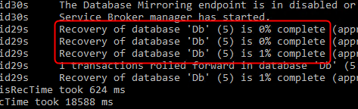
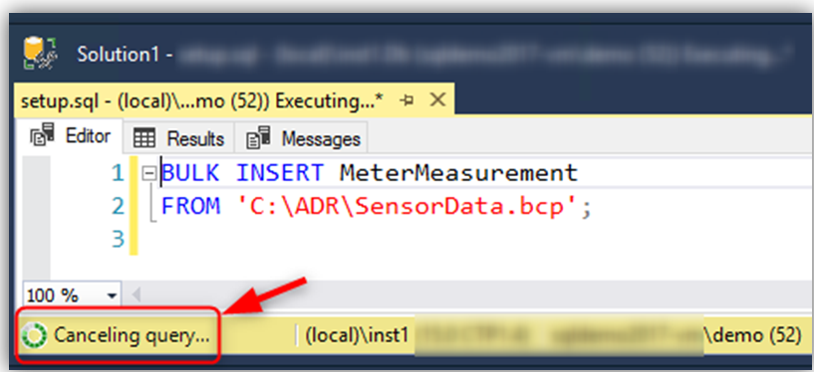

Most common implications
Recovery time is roughly proportional to the longest running transaction.
Rolling back large batch operations (such as bulk insert) takes a long time.
Transaction log may run out of space during long-running transactions.
Notes:
So based on the current design, the most common implications of having to rollback all incomplete transactions is that is that the length of time required is roughly proportional to the work that the transaction has performed and the length of time the transaction has been active. Therefore, the recovery process can take a long time in the presence of long-running transactions (such as large bulk insert operations or index build operations against a large table).
Also, cancelling/rolling back a large transaction based on the current recovery design can take a long time as it is using the same Undo recovery phase as previously described.
Finally, the SQL Server database engine cannot truncate the transaction log when there are long-running transactions because their corresponding log records are needed for the recovery and rollback processes.
As a result, some customers face the problem that the size of the transaction log grows very large and consumes huge amounts of drive space.

Slide 9
Accelerated Database Recovery
Accelerated Database Recovery is a new SQL Server Engine feature that greatly improves database availability by completely redesigning the current SQL Server recovery process.
Instantaneous Transaction Rollback
Aggressive Log Truncation
Benefits of Accelerated Database Recovery
Fast & Consistent Database Recovery
Reduces contention on TempDB database.
Notes:
Accelerated Database Recovery (ADR) is a SQL Server 2019 database engine feature that greatly improves database availability, especially in the presence of long running transactions, by redesigning the SQL Server database engine recovery process.
While ADR is available for SQL Server 2019 on-premises, it is also available for Azure SQL Database, Azure SQL Managed Instance, databases in Azure Synapse Analytics, and SQL Server on Azure VMs starting with SQL Server 2019.
The primary benefits of ADR are:
Available in Standard Edition
Fast and consistent database recovery
Since, long running transactions do not impact the overall recovery time, ADR allows for fast and consistent database recovery regardless of the number of active transactions in the system or transaction size.
Instantaneous transaction rollback
Additionally with ADR, Transaction rollback is instantaneous, regardless of the length time that the transaction has been active or the number of updates that has performed.
Aggressive log truncation
Finally, the transaction log is aggressively truncated, even in the presence of active long-running transactions, which will assist in preventing the transaction log from growing out of control.

Slide 10
How to enable ADR?
Azure SQL Database
It’s ON by default.
SQL Server 2019
ALTER DATABASE <db_name> SET ACCELERATED_DATABASE_RECOVERY = ON
(PERSISTENT_VERSION_STORE_FILEGROUP = [VersionStoreFG])
Notes:
https://docs.microsoft.com/en-us/sql/relational-databases/accelerated-database-recovery-management?view=sql-server-ver15

Slide 11
Accelerated Database Recovery Components
Persisted Version Store
Versions have the previous state of the data and the Transact-ID of the version;
Fast UNDO, instead of rolling back the active transactions (traditional recovery process) the row version is marked as Terminated.
Persists row versions in the database itself rather than TempDB.
PVS
Persisted Version Store
Logical Revert
sLog
Special
In-Memory Log Stream
Cleaner
Notes:
ADR recovery components
The four key components of ADR are:
Persisted version store (PVS)
The persisted version store is a new SQL Server database engine mechanism for persisting the row versions generated in the database itself instead of the traditional tempdb version store. PVS enables resource isolation as well as improves availability of readable secondaries.

Slide 12
Accelerated Database Recovery Components
Logical Revert
Asynchronous process that performs row-level version-based Undo;
Keeps track of all terminated transactions;
Performs rollback using recent committed transactions from PVS;
Release all locks immediately after transaction termination.
PVS
Persisted Version Store
Logical Revert
sLog
Special
In-Memory Log Stream
Cleaner
Notes:
Logical revert
Logical revert is the asynchronous process responsible for performing row-level version-based Undo - providing instant transaction rollback and undo for all versioned operations. Logical revert is accomplished by:
Keeping track of all aborted transactions and marking them invisible to other transactions.
Performing rollback by using PVS for all user transactions, rather than physically scanning the transaction log and undoing changes one at a time.
Releasing all locks immediately after transaction abort. Since abort involves simply marking changes in memory, the process is very efficient

Slide 13
Accelerated Database Recovery Components
sLog
Secondary in-memory log stream that stores log records for non-versioned operations (Example: Bulk operations, Lock acquisitions, etc…);
Persisted on disk by been serialized during SQL checkpoint;
Is periodically truncated as transactions commits;
It accelerates the redo and undo by processing only the non-versioned operations;
PVS
Persisted Version Store
Logical Revert
sLog
Special
In-Memory Log Stream
Cleaner
Notes:
sLog
sLog is a secondary in-memory log stream that stores log records for non-versioned operations (such as metadata cache invalidation, lock acquisitions, and so on). The sLog is:
Low volume and in-memory
Persisted on disk by being serialized during the checkpoint process
Periodically truncated as transactions commit
Accelerates redo and undo by processing only the non-versioned operations
Enables aggressive transaction log truncation by preserving only the required log records

Slide 14
Accelerated Database Recovery Components
Cleaner
Asynchronous process that periodically cleans row versions that are not needed.
PVS
Persisted Version Store
Logical Revert
sLog
Special
In-Memory Log Stream
Cleaner
Notes:
Cleaner
The cleaner is the asynchronous process that wakes up periodically and cleans page versions that are not needed.

Slide 15
Accelerated Database Recovery process
Phase 1:
Regular Analysis + Reconstructs sLog
Phase 2a: Redo from sLog
Phase 2b: Redo
Phase 2a: Redo from sLog
Phase 2b: Redo from Transaction Log
Starts from last checkpoint
Non-versioned operations since oldest uncommitted transaction
[DB is FULLY available and all locks
are released after Redo]
Only needs to scan log since last checkpoint. Instant Undo by using sLog and Persisted Version Store (PVS) with Logical Revert.
Phase 3: Undo from sLog
Log
Start
Oldest
uncommitted Tx
(XACT_BEGIN_LSN)
Checkpoint
(or oldest dirty page LSN)
Log
End
Notes:
ADR addresses these issues by completely redesigning the SQL Server database engine recovery process by making recovery instantaneous by avoiding having to scan the log from/to the beginning of the oldest active transaction.
With ADR, the transaction log is only processed from the last successful checkpoint (or oldest dirty page Log Sequence Number (LSN)). As a result, recovery time is not impacted by long running transactions.
Minimize the required transaction log space since there is no longer a need to process the log for the whole transaction. As a result, the transaction log can be truncated aggressively as checkpoints and backups occur.
At a high level, ADR achieves fast database recovery by versioning all physical database modifications and
only undoing logical operations, which are limited and can be undone almost instantly. Any transaction that was active as of the time of a crash are marked as aborted and, therefore, any versions generated by these transactions can be ignored by concurrent user queries.
Analysis phase
The process remains the same as today with the addition of reconstructing sLog and copying log records for non-versioned operations.
Redo phase
Broken into two phases (P)
Phase 1
Redo from sLog (oldest uncommitted transaction up to last checkpoint). Redo is a fast operation as it only needs to process a few records from the sLog.
Phase 2
Redo from Transaction Log starts from last checkpoint (instead of oldest uncommitted transaction)
Undo phase
The Undo phase with ADR completes almost instantaneously by using sLog to undo non-versioned operations and Persisted Version Store (PVS) with Logical Revert to perform row level version-based Undo.
The following types of workloads benefit most from ADR:
Workloads with long-running transactions.
Workloads that have seen cases where active transactions are causing the transaction log to grow significantly.
Workloads that have experienced long periods of database unavailability due to long running recovery (such as unexpected service restart or manual transaction rollback).
https://docs.microsoft.com/en-us/azure/sql-database/sql-database-accelerated-database-recovery

Slide 16
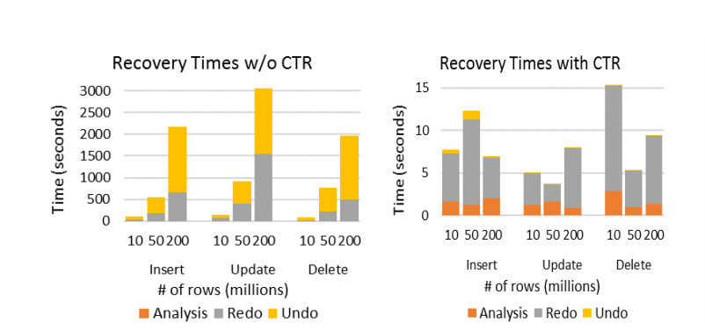
Recovery Time Comparison
Constant Time Recovery in SQL Server
Notes:
Constant Time Recovery in SQL Server (microsoft.com) https://www.microsoft.com/en-us/research/uploads/prod/2019/06/p700-antonopoulos.pdf

Slide 17
Accelerated Database Recovery FAQ
Will my database be larger?
Yes. Monitor to determine difference.
Will it affect performance?
It depends. Write-heavy (OLTP) workloads are most susceptible.
How is PVS different than the version store in TempDB?
PVS stores versions in the user database rather than TempDB
If ADR is enabled, PVS is used to support SNAPSHOT and READ_COMMITTED_SNAPSHOT_ISOLATION transactions
How does this affect Availability Groups?
PVS and log records replicate to secondaries, secondary communicates oldest versions needed to primary
ADR can speed up failover because Undo becomes fast
If the secondary must be restarted without ADR, TempDB is lost so versions are lost and queries must wait for data to commit on primary, with ADR, versions are persisted, so no delay before queries can be served
According to the CTR whitepaper, 50 million modifications add 1GB to database.
According to the CTR whitepaper, 13.8% utilization for Update heavy workloads, 2.4% for normal workloads.
Notes:
Constant Time Recovery in SQL Server (microsoft.com) https://www.microsoft.com/en-us/research/uploads/prod/2019/06/p700-antonopoulos.pdf

Slide 18
Demo Time

Slide 19
Questions?

Slide 20


