Slide 1
Introduction to Contained Databases?

Slide 2

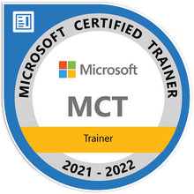
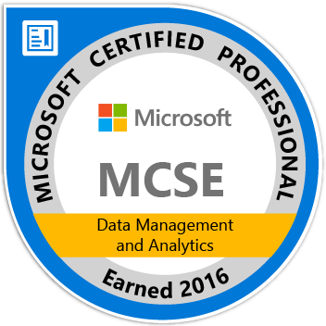
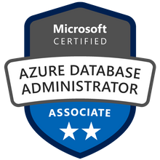
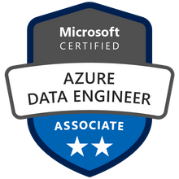
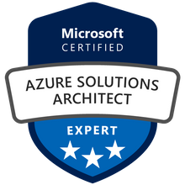

John Deardurff
Microsoft Customer Engineer (Global Technical Team)
Microsoft Certified Trainer (Regional Lead)
MVP: Data Platform (2016 – 2018)
Email: John.Deardurff@Microsoft.com
Twitter: @SQLMCT
Website: www.SQLMCT.com
GitHub: github.com\SQLMCT

Slide 3
What does this session cover?
What are Contained Databases?
Migrating Contained Databases
Contained Databases Security
Configuring Contained Databases

Slide 4
What is a Contained Database?
Contained databases are isolated from other databases and from the instance of SQL Server that hosts the database. (Introduced in SQL Server 2012)
SQL Server helps to isolate databases from the instance.
SQL Server uses partially contained databases
All metadata uses the same collation.
User authentication can be performed by the database.
The metadata that describes the database is maintained in the database.
Contained databases do not support replication, change data capture, or change tracking.
Notes:
A contained database is a database that is isolated from other databases and from the instance of SQL Server that hosts the database.
Contained Databases: https://docs.microsoft.com/en-us/sql/relational-databases/databases/contained-databases?view=sql-server-ver15
20462D
9: Managing SQL Server Security

Slide 5
Contained Database Usage
Use contained databases to:
Move databases between different SQL Server instances without having to migrate server-level dependencies (Such as server-level logins).
Develop databases when the developer does not know which instance will ultimately host the database.
Enable failover in a high-availability scenario without having to synchronize server-level logins.
Notes:
A contained database is a database that is isolated from other databases and from the instance of SQL Server that hosts the database.
Contained Databases: https://docs.microsoft.com/en-us/sql/relational-databases/databases/contained-databases?view=sql-server-ver15
20462D
9: Managing SQL Server Security

Slide 6
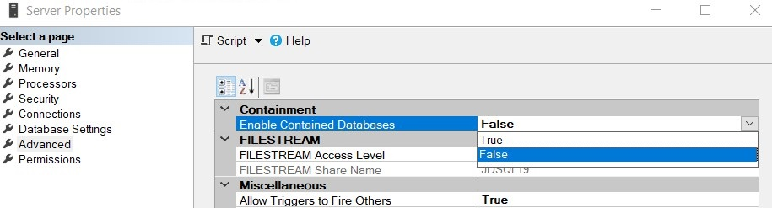

Enable at the Server Level
EXEC sys.sp_configure N'contained database authentication', N'1'
GO
RECONFIGURE WITH OVERRIDE
GO
Notes:
A contained database is a database that is isolated from other databases and from the instance of SQL Server that hosts the database.
Contained Databases: https://docs.microsoft.com/en-us/sql/relational-databases/databases/contained-databases?view=sql-server-ver15
20462D
9: Managing SQL Server Security

Slide 7
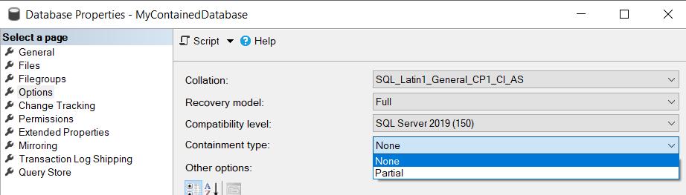

Enable at the Database Level
ALTER DATABASE [MyContainedDatabase]
SET CONTAINMENT = PARTIAL
GO
Notes:
A contained database is a database that is isolated from other databases and from the instance of SQL Server that hosts the database.
Contained Databases: https://docs.microsoft.com/en-us/sql/relational-databases/databases/contained-databases?view=sql-server-ver15
20462D
9: Managing SQL Server Security

Slide 8
Demonstration

Slide 9
Managing Users for a Contained Database
Contained database user with password
Contained database users with passwords are authenticated by the database.
Users mapped to Windows accounts (users or groups)
Windows users and members of Windows groups can connect directly to the database and do not need logins in the master database.
The database trusts the authentication by Windows.
Notes:
A contained database is a database that is isolated from other databases and from the instance of SQL Server that hosts the database.
Contained Databases: https://docs.microsoft.com/en-us/sql/relational-databases/databases/contained-databases?view=sql-server-ver15
Contained Database Users: https://docs.microsoft.com/en-us/sql/relational-databases/security/contained-database-users-making-your-database-portable?view=sql-server-ver15
Security Best Practices with Contained Databases:
https://docs.microsoft.com/en-us/sql/relational-databases/databases/security-best-practices-with-contained-databases?view=sql-server-ver15
20462D
9: Managing SQL Server Security

Slide 10
Contained Database Security
Restrict assigning the ALTER ANY USER Permission.
Users with this permission can grant access to the database without the knowledge or permission or the SQL Server administrator.
SQL Server administrators should periodically audit the users in a contained database.
Users could access other databases on the instance if the other databases have enabled the guest account.
Users with this permission can grant access to the database without the knowledge or permission or the SQL Server administrator.
Restrict assigning the ALTER ANY DATABASE Permission.
Notes:
A contained database is a database that is isolated from other databases and from the instance of SQL Server that hosts the database.
Contained Databases: https://docs.microsoft.com/en-us/sql/relational-databases/databases/contained-databases?view=sql-server-ver15
Contained Database Users: https://docs.microsoft.com/en-us/sql/relational-databases/security/contained-database-users-making-your-database-portable?view=sql-server-ver15
Security Best Practices with Contained Databases:
https://docs.microsoft.com/en-us/sql/relational-databases/databases/security-best-practices-with-contained-databases?view=sql-server-ver15
20462D
9: Managing SQL Server Security

Slide 11
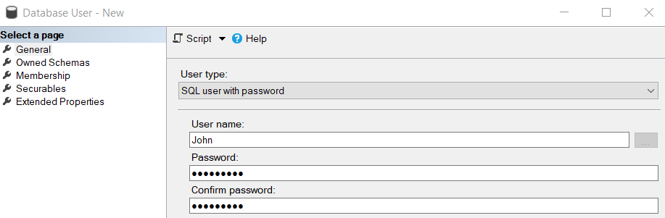

Creating User with Password
USE [MyContainedDatabase]
GO
CREATE USER [John] WITH PASSWORD = N'P@$$w0rd!'
DEFAULT_SCHEMA = [dbo]
GO
Notes:
A contained database is a database that is isolated from other databases and from the instance of SQL Server that hosts the database.
Contained Databases: https://docs.microsoft.com/en-us/sql/relational-databases/databases/contained-databases?view=sql-server-ver15
20462D
9: Managing SQL Server Security

Slide 12
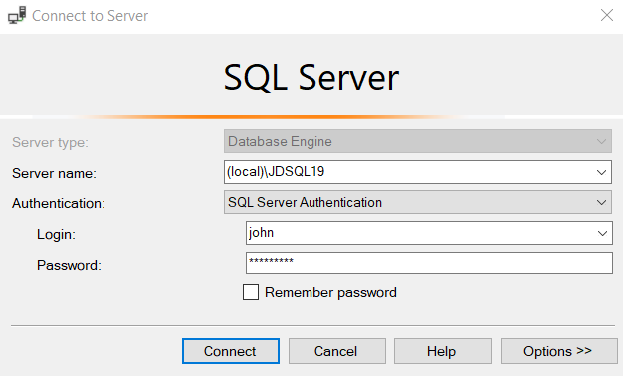
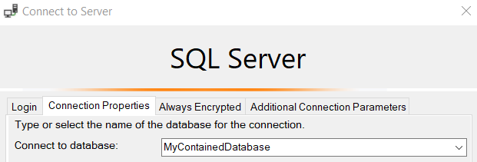
Login with Contained User
Must specify database when connecting.
Notes:
A contained database is a database that is isolated from other databases and from the instance of SQL Server that hosts the database.
Contained Databases: https://docs.microsoft.com/en-us/sql/relational-databases/databases/contained-databases?view=sql-server-ver15
20462D
9: Managing SQL Server Security

Slide 13
Demonstration

Slide 14

Migrating Contained Database
Logins
Agent Jobs
Linked Servers
Maintenance Plans
Migrate Anywhere
Server Instance
Notes:
A contained database is a database that is isolated from other databases and from the instance of SQL Server that hosts the database.
Contained Databases: https://docs.microsoft.com/en-us/sql/relational-databases/databases/contained-databases?view=sql-server-ver15
Contained Database Users: https://docs.microsoft.com/en-us/sql/relational-databases/security/contained-database-users-making-your-database-portable?view=sql-server-ver15
Security Best Practices with Contained Databases:
https://docs.microsoft.com/en-us/sql/relational-databases/databases/security-best-practices-with-contained-databases?view=sql-server-ver15
20462D
9: Managing SQL Server Security

Slide 15
Demonstration

Slide 16
Questions?

