Slide 1
Introduction to Indexing John Deardurff

Slide 2




John Deardurff – Premier Field Engineer
MCSA, MCSD, MCSE, MCDBA, MCITP, MCT
MBA: IT Management
MCT Regional Lead – United States
MVP: Data Platform (2016 – 2018)
John.Deardurff@Microsoft.com
www.SQLMCT.com

Slide 3
What does this session cover?
Data Pages and Data Files
Query Covering Indexes
Non-Clustered Indexes
Data Structures – Heaps and Clustered Indexes

Slide 4
Lesson 1 Data Pages and Data Files

Slide 5
What does this session cover?
Data Pages and Data Files
Query Covering Indexes
Non-Clustered Indexes
Data Structures – Heaps and Clustered Indexes

Slide 6
SQL Server Object Allocation
Data Row
Data Row
Data Row
Free Space
Data Row
Free Space
Data Row
Data Row
Data Row
Data Row
Free Space
Data Row
Free Space
Free Space
Free Space
Free Space
Data Row
Data Row
Data Row
Data Row
Data Row
Data Row
Free Space
Data Row
Data Row
Data Row
Data Row
Free Space
Data Row
Data Row
Free Space
Free Space
Primary Data File (.mdf)
Secondary Data File (.ndf)
Extent: Eight contiguous 8kb pages
Uniform extents: Pages used by a single object.
Mixed extents: Pages used by different objects.
Notes:
Databases are composed of 64 kilobytes (KB) extents
Extents are the basic unit used by SQL Server to manage space. An extent is eight physically contiguous pages, or 64 kilobytes (KB). SQL Server has two types of extents:
Uniform extents are owned by a single object, and only the owning object can use the eight pages in the extent.
Mixed extents contain eight pages that can be used by different objects.
Each extent is composed of eight pages of 8 KB each
To make its space allocation efficient, SQL Server does not allocate an entire extent to tables that contain small amounts of data. A new table or index is usually allocated using pages from mixed extents. When the table or index grows to the point where it needs to allocate more than 8 pages, then all allocations of new space will be done in uniform extents, but the original pages on mixed extents will not be moved into uniform extents. If you create an index on an existing table that has enough rows to generate eight pages in the index, all allocations of new space are uniform extents.
Allocation maps track allocations
SQL Server uses two types of allocation maps to record the allocation of extents:
Global Allocation Map (GAM). GAM pages record all extents. Each GAM covers 63,904 extents, or nearly 4 gigabytes (GB) of data. The GAM has one bit for each extent in the interval that it covers. If the bit is 1, the extent is free; if the bit is 0, the extent is allocated.
Shared Global Allocation Map (SGAM). SGAM pages record those extents that are currently used as mixed extents and have at least one unused page. Each SGAM covers 63,904 extents, or nearly 4 GB of data. The SGAM has one bit for each extent in the interval that it covers. If the bit is 1, the extent is being used as a mixed extent and has free pages; if the bit is 0, the extent is not used as a mixed extent, or it is a mixed extent whose all pages are in use.

Slide 7
Basic Page Structure
Page Header
(96 bytes)
Header contains Page Information such a Page Number and Page Type
Data Row 1
Data Row 2
Data Row 3
8060 bytes for Data Rows or Free Space
Free Space
Row Offset Array
How far from beginning of page that each row is located.
Notes:
Databases are composed of 64 kilobytes (KB) extents
Extents are the basic unit used by SQL Server to manage space. An extent is eight physically contiguous pages, or 64 kilobytes (KB). SQL Server has two types of extents:
Uniform extents are owned by a single object, and only the owning object can use the eight pages in the extent.
Mixed extents contain eight pages that can be used by different objects.
Each extent is composed of eight pages of 8 KB each
To make its space allocation efficient, SQL Server does not allocate an entire extent to tables that contain small amounts of data. A new table or index is usually allocated using pages from mixed extents. When the table or index grows to the point where it needs to allocate more than 8 pages, then all allocations of new space will be done in uniform extents, but the original pages on mixed extents will not be moved into uniform extents. If you create an index on an existing table that has enough rows to generate eight pages in the index, all allocations of new space are uniform extents.
Allocation maps track allocations
SQL Server uses two types of allocation maps to record the allocation of extents:
Global Allocation Map (GAM). GAM pages record all extents. Each GAM covers 63,904 extents, or nearly 4 gigabytes (GB) of data. The GAM has one bit for each extent in the interval that it covers. If the bit is 1, the extent is free; if the bit is 0, the extent is allocated.
Shared Global Allocation Map (SGAM). SGAM pages record those extents that are currently used as mixed extents and have at least one unused page. Each SGAM covers 63,904 extents, or nearly 4 GB of data. The SGAM has one bit for each extent in the interval that it covers. If the bit is 1, the extent is being used as a mixed extent and has free pages; if the bit is 0, the extent is not used as a mixed extent, or it is a mixed extent whose all pages are in use.

Slide 8
SQL Server Object Allocation
Databases are composed of 64 kilobytes (KB) extents
Each extent has eight pages of 8 KB each
Two types of extents:
Uniform extents
All pages belong to the same object
Mixed extents
Up to 8 distinct objects can reside in the same Mixed Extent
Notes:
Databases are composed of 64 kilobytes (KB) extents
Extents are the basic unit used by SQL Server to manage space. An extent is eight physically contiguous pages, or 64 kilobytes (KB). SQL Server has two types of extents:
Uniform extents are owned by a single object, and only the owning object can use the eight pages in the extent.
Mixed extents contain eight pages that can be used by different objects.
Each extent is composed of eight pages of 8 KB each
To make its space allocation efficient, SQL Server does not allocate an entire extent to tables that contain small amounts of data. A new table or index is usually allocated using pages from mixed extents. When the table or index grows to the point where it needs to allocate more than 8 pages, then all allocations of new space will be done in uniform extents, but the original pages on mixed extents will not be moved into uniform extents. If you create an index on an existing table that has enough rows to generate eight pages in the index, all allocations of new space are uniform extents.
Allocation maps track allocations
SQL Server uses two types of allocation maps to record the allocation of extents:
Global Allocation Map (GAM). GAM pages record all extents. Each GAM covers 63,904 extents, or nearly 4 gigabytes (GB) of data. The GAM has one bit for each extent in the interval that it covers. If the bit is 1, the extent is free; if the bit is 0, the extent is allocated.
Shared Global Allocation Map (SGAM). SGAM pages record those extents that are currently used as mixed extents and have at least one unused page. Each SGAM covers 63,904 extents, or nearly 4 GB of data. The SGAM has one bit for each extent in the interval that it covers. If the bit is 1, the extent is being used as a mixed extent and has free pages; if the bit is 0, the extent is not used as a mixed extent, or it is a mixed extent whose all pages are in use.

Slide 9
Basic Page Structure
One .mdf file per database
Might have one or more .ndf files
Random reads and writes
Write activity during checkpoints, recovery, and lazy writes
Read activity during backups and other activity varies depending on the query activity and the buffer pool size
Microsoft Confidential
Notes:
Databases are composed of 64 kilobytes (KB) extents
Extents are the basic unit used by SQL Server to manage space. An extent is eight physically contiguous pages, or 64 kilobytes (KB). SQL Server has two types of extents:
Uniform extents are owned by a single object, and only the owning object can use the eight pages in the extent.
Mixed extents contain eight pages that can be used by different objects.
Each extent is composed of eight pages of 8 KB each
To make its space allocation efficient, SQL Server does not allocate an entire extent to tables that contain small amounts of data. A new table or index is usually allocated using pages from mixed extents. When the table or index grows to the point where it needs to allocate more than 8 pages, then all allocations of new space will be done in uniform extents, but the original pages on mixed extents will not be moved into uniform extents. If you create an index on an existing table that has enough rows to generate eight pages in the index, all allocations of new space are uniform extents.
Allocation maps track allocations
SQL Server uses two types of allocation maps to record the allocation of extents:
Global Allocation Map (GAM). GAM pages record all extents. Each GAM covers 63,904 extents, or nearly 4 gigabytes (GB) of data. The GAM has one bit for each extent in the interval that it covers. If the bit is 1, the extent is free; if the bit is 0, the extent is allocated.
Shared Global Allocation Map (SGAM). SGAM pages record those extents that are currently used as mixed extents and have at least one unused page. Each SGAM covers 63,904 extents, or nearly 4 GB of data. The SGAM has one bit for each extent in the interval that it covers. If the bit is 1, the extent is being used as a mixed extent and has free pages; if the bit is 0, the extent is not used as a mixed extent, or it is a mixed extent whose all pages are in use.

Slide 10
SQL Server Data Files
One .mdf file per database
Might have one or more .ndf files
Random reads and writes
Write activity during checkpoints, recovery, and lazy writes
Read activity during backups and other activity varies depending on the query activity and the buffer pool size
Microsoft Confidential
Notes:
Key Points:
Data files are typically read from and written to randomly, however SQL Server does use readahead and scatter/gather mechanisms to improve the efficiency of I/O against the data files. All pages that are read from the data file are stored in the buffer cache as long as possible. Therefore, after the server has been up for some time, physical I/O against the data file should be at a minimum provided that the buffer pool is of sufficient size to accommodate the workload.
Because data file I/O is random and will only happen when a page cannot first be found in the cache, SQL Server typically will not benefit from the read cache on the disk subsystem. For this reason, it is recommended to favor the write cache on the disk subsystem for SQL Servers if possible. We also recommend to physically separate data files from log files to improve the I/O throughput.
Additional Reading:
Reading Pages (http://msdn.microsoft.com/en-us/library/ms191475.aspx)
Buffer Management (http://msdn.microsoft.com/en-us/library/aa337525.aspx)
Global: Please check if all instances of readahead should be a single word or two words

Slide 11
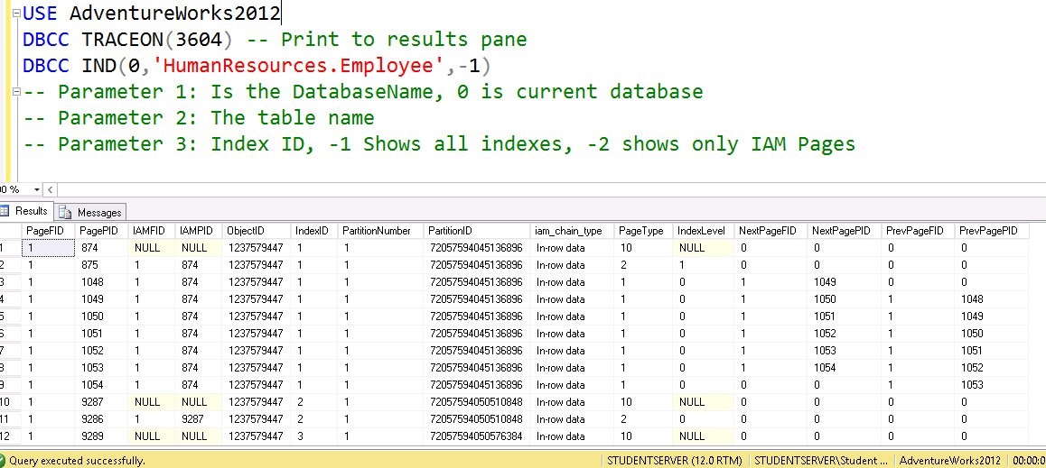
DBCC IND
Notes:
Databases are composed of 64 kilobytes (KB) extents
Extents are the basic unit used by SQL Server to manage space. An extent is eight physically contiguous pages, or 64 kilobytes (KB). SQL Server has two types of extents:
Uniform extents are owned by a single object, and only the owning object can use the eight pages in the extent.
Mixed extents contain eight pages that can be used by different objects.
Each extent is composed of eight pages of 8 KB each
To make its space allocation efficient, SQL Server does not allocate an entire extent to tables that contain small amounts of data. A new table or index is usually allocated using pages from mixed extents. When the table or index grows to the point where it needs to allocate more than 8 pages, then all allocations of new space will be done in uniform extents, but the original pages on mixed extents will not be moved into uniform extents. If you create an index on an existing table that has enough rows to generate eight pages in the index, all allocations of new space are uniform extents.
Allocation maps track allocations
SQL Server uses two types of allocation maps to record the allocation of extents:
Global Allocation Map (GAM). GAM pages record all extents. Each GAM covers 63,904 extents, or nearly 4 gigabytes (GB) of data. The GAM has one bit for each extent in the interval that it covers. If the bit is 1, the extent is free; if the bit is 0, the extent is allocated.
Shared Global Allocation Map (SGAM). SGAM pages record those extents that are currently used as mixed extents and have at least one unused page. Each SGAM covers 63,904 extents, or nearly 4 GB of data. The SGAM has one bit for each extent in the interval that it covers. If the bit is 1, the extent is being used as a mixed extent and has free pages; if the bit is 0, the extent is not used as a mixed extent, or it is a mixed extent whose all pages are in use.

Slide 12
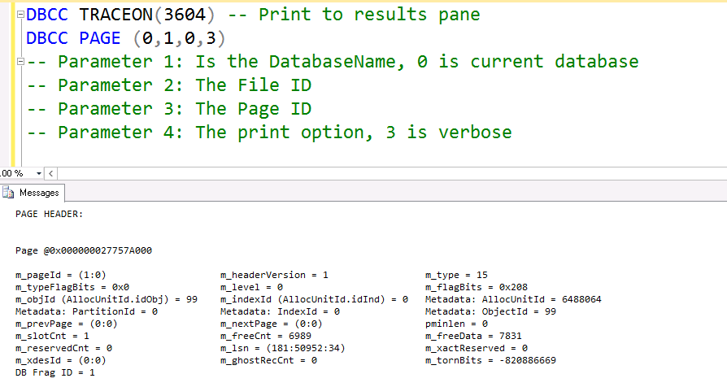
DBCC Page
Notes:
Databases are composed of 64 kilobytes (KB) extents
Extents are the basic unit used by SQL Server to manage space. An extent is eight physically contiguous pages, or 64 kilobytes (KB). SQL Server has two types of extents:
Uniform extents are owned by a single object, and only the owning object can use the eight pages in the extent.
Mixed extents contain eight pages that can be used by different objects.
Each extent is composed of eight pages of 8 KB each
To make its space allocation efficient, SQL Server does not allocate an entire extent to tables that contain small amounts of data. A new table or index is usually allocated using pages from mixed extents. When the table or index grows to the point where it needs to allocate more than 8 pages, then all allocations of new space will be done in uniform extents, but the original pages on mixed extents will not be moved into uniform extents. If you create an index on an existing table that has enough rows to generate eight pages in the index, all allocations of new space are uniform extents.
Allocation maps track allocations
SQL Server uses two types of allocation maps to record the allocation of extents:
Global Allocation Map (GAM). GAM pages record all extents. Each GAM covers 63,904 extents, or nearly 4 gigabytes (GB) of data. The GAM has one bit for each extent in the interval that it covers. If the bit is 1, the extent is free; if the bit is 0, the extent is allocated.
Shared Global Allocation Map (SGAM). SGAM pages record those extents that are currently used as mixed extents and have at least one unused page. Each SGAM covers 63,904 extents, or nearly 4 GB of data. The SGAM has one bit for each extent in the interval that it covers. If the bit is 1, the extent is being used as a mixed extent and has free pages; if the bit is 0, the extent is not used as a mixed extent, or it is a mixed extent whose all pages are in use.

Slide 13
Lesson 2 Heaps and Clustered Indexes

Slide 14
How Data is Stored in a Page
Data stored in a Heap is not stored in any order and normally does not have a Primary Key.
Heap
Data Row 8
Data Row 2
Data Row 7
Data Row 6
Data Row 5
Data Row 4
Data Row 1
Data Row 3
Data Row 9
Clustered Index data is stored in sorted order by the Clustering key. In many cases, this is the same value as the Primary Key.
Clustered Index
Data Row 1
Data Row 4
Data Row 7
Data Row 2
Data Row 5
Data Row 8
Data Row 3
Data Row 6
Data Row 9

Slide 15
Heap Tables
Tables without a clustered index
Unordered masses of data
Data rows are entered wherever they fit
You can only scan heaps – no facility to seek without a non-clustered index
Can be good for quickly importing large sets of data
No clustered index to maintain as data is entered
Not a good idea for production-level data structures
Clustered indexes are almost always a better choice
Use the ALTER TABLE…REBUILD command to “rebuild” a heap table

Slide 16
Clustered Indexes
An ordered data structure
Implemented as a Balanced (B) Tree
When a table is clustered, the leaf level of the index contains ALL data in the table
This means that the clustered index IS the table – this is also why there is only one per table.
The leaf level of the clustered index contains data pages

Slide 17
Clustered Indexes
An ordered data structure
Implemented as a Balanced (B) Tree
When a table is clustered, the leaf level of the index contains ALL data in the table
This means that the clustered index IS the table – this is also why there is only one per table.
The leaf level of the clustered index contains data pages

Slide 18
Characteristics of a Good Clustering Key
Small
Unique
Static
Increasing
Use a data type with a small number of bytes to conserve space in tables and indexes
Avoids SQL adding a 4-byte uniquifier
Allows data to stay constant without constant changes which could lead to page splits
Allows better write performance and reduces fragmentation issues
Notes:
What are the two store types that query store has?
Plan Store
Runtime Stats Store
What are the two QDS cleanup stages?
The two QDS cleanup stages are:
1. In the first stage, old runtime stats are cleaned.
2. In the second stage, queries together with associated plans and statistics are deleted.

Slide 19
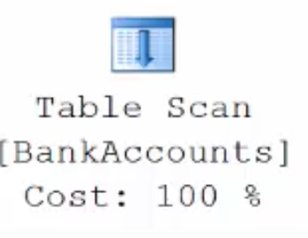
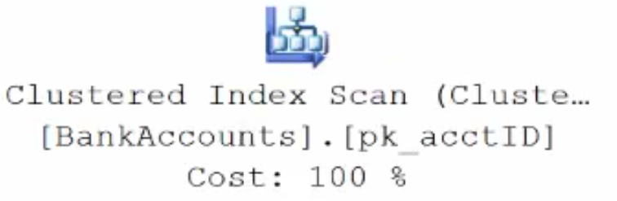
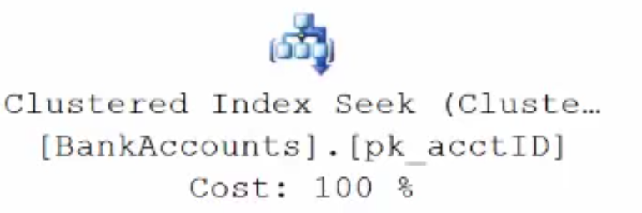
Execution Plan Table Operators
Data stored in a Heap is not stored in any order and normally does not have a Primary Key.
Clustered Index data is stored in sorted order by the Clustering key. In many cases, this is the same value as the Primary Key.
Using a WHERE statement on an Index could possibly have the Execution Plan seek the Index instead of scan.

Slide 20
Demonstration

Slide 21
Lesson 3 Non-Clustered Indexes

Slide 22
Non-Clustered Indexes
Root
AZ - IN
ND - WA
A Non–Clustered Index is built separate from the table
CA 3
IL 7
IN 9
FL 4
IN 1
KS 6
GA 10
IN 5
VA 8
Root
The table is stored in either a Clustered Index or Heap
1-5
6-10
1 John IN
4 Heather FL
7 Gary IL
2 Sharon NV
5 Enrique IN
8 Sidney VA
3 Armando CA
6 Bob KS
9 Frank IN

Slide 23
Non-clustered Indexes
Same B-tree data structure as a clustered index
Is NOT part of the table it is defined on
We do maintain it as if it were though
Only contains a subset of the columns in the base table
Think of it as a skinny table that is really fast for searching and sorting
Most likely far fewer pages in a NC index as compared to a Clustered table
The leaf level contains only the columns defined in the index as well as the clustered key/heap ID
There MUST be a way to point back to the base table to retrieve additional data

Slide 24
Included Columns
Including additional columns of data in the leaf level on a non-clustered (NC) index
Allows for covering more queries without adding columns to the index key definition
Included columns are not stored in the root or intermediate levels of the NC index, so searching is not permitted
Not restricted to the NC index 900 byte size restriction
You can use (n)varchar(max), but not (n)text or image data types

Slide 25
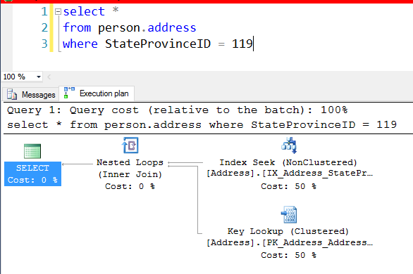
Key Lookups
When non-clustered indexes are accessed, if the SELECT clause references columns not contained in the NC index then the base table must be referenced
This can be VERY expensive
In some cases must more expensive than just scanning the table
Microsoft Confidential
Notes:
When nonclustered indexes are used, SQL Server may choose to use a different access method. When the nonclustered index is seeked or scanned, it is doing so to support WHERE clauses and JOINs. However, the nonclustered index often cannot support the SELECT clause. To put it another way, it cannot ‘cover’ the query. To get the columns needed for the select clause, SQL Server needs to look up those additional columns using a Key Lookup, which reaches back to the clustered index or heap. This is possible because each row in the nonclustered index has not only the columns that were defined, but also includes the clustering key or RID. When the nonclustered index seek/scan finds the rows that match the filter requested, it loops over each of the rows, gets the hidden key/RID, and gets the additional columns needed.
Key lookups are costly. In fact, they are so costly that SQL Server frequently decides that the cost of a nonclustered index seek + lookup is higher than simply scanning the clustered index. The ‘tipping point’ that determines when SQL Server will scan is pretty low, and is typically 10%.
Therefore, avoiding key lookups is often a good way to help query performance. The next lesson, ‘Indexing Strategy’, discusses ways that this can be done.

Slide 26
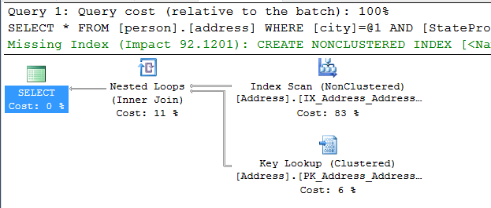
Missing indexes in Query Plans
Notes:
Estimated and actual query plans include missing index recommendations, when appropriate.
The impact represents the expected reduction in subtree cost. If the subtree cost in the example shown is 2.5, then the expected cost of the query with the index added would be 2.5 * (1 - .921201), which is 0.1969975. Therefore, each time the query executes, the cost savings is 2.304.

Slide 27
Demonstration

Slide 28
Questions?

