Slide 1
Allocation Units
John Deardurff

Slide 2
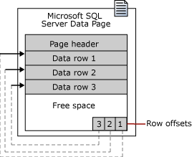
Pages and Extents architecture
A data page is the fundamental unit of data storage in SQL Server.
The disk space allocated to a data file (.mdf or .ndf) is logically divided into pages.
Each page is 8 KB in size
Pages are numbered contiguously from 0 to n.
Disk I/O operations are performed at the page level.
Extents are a collection of eight physically contiguous pages (64KB) and are used to efficiently manage the pages.
Notes:
The fundamental unit of data storage in SQL Server is the page. The disk space allocated to a data file (.mdf or .ndf) in a database is logically divided into pages numbered contiguously from 0 to n. Disk I/O operations are performed at the page level. That is, SQL Server reads or writes whole data pages.
Extents are a collection of eight physically contiguous pages and are used to efficiently manage the pages. All pages are stored in extents.
Pages
In SQL Server, the page size is 8 KB. This means SQL Server databases have 128 pages per megabyte. Each page begins with a 96-byte header that is used to store system information about the page. This information includes the page number, page type, the amount of free space on the page, and the allocation unit ID of the object that owns the page.
Additional Reading:
Pages and Extents Architecture Guide
From <https://docs.microsoft.com/en-us/sql/relational-databases/pages-and-extents-architecture-guide?view=sql-server-ver15>

Slide 3
Data Page
Page Header
(96 bytes)
Header contains Page Information such a Page Number and Page Type
Data Row 1
Data Row 2
Data Row 3
Data Rows or Free Space
Free Space
Row Offset Array
Displays how far from beginning of page each row is located.
Notes:
Pages
Take a regular book: all content in it is written on pages. Similar to a book, in SQL Server all the data rows are written on pages. In a book, all pages are the same physical size. Similarly, in SQL Server all data pages are the same size - 8 kilobytes. In a book most pages contain the data - the main content of the book - and some pages contain metadata about the content - for example table of contents and index. Again, SQL Server is not different: most pages contain actual rows of data which were stored by users; these are called Data pages and text/image pages (for special cases). The Index pages contain index references about where the data is and finally there are system pages that store variety of metadata about the organization of the data (PFS, GAM, SGAM, IAM, DCM, BCM pages). See table below for page types and their description.
As mentioned, in SQL Server, the page size is 8-KB. This means SQL Server databases have 128 pages per megabyte. Each page begins with a 96-byte header that is used to store system information about the page. This information includes the page number, page type, the amount of free space on the page, and the allocation unit ID of the object that owns the page.
Pages and Extents Architecture Guide
From <https://docs.microsoft.com/en-us/sql/relational-databases/pages-and-extents-architecture-guide?view=sql-server-ver15>

Slide 4
Page types
 | Page Type (ID) | Description
Data\Index | Data (1) | Data rows with all data, except text, ntext, image, nvarchar(max), varchar(max), varbinary(max), and xml data, when text in row is set to ON
 | Index (2) | Index Entries
 | Text/Image (3 or 4) | Large Object Data Type, variable length columns when the data row exceeds 8 kilobytes (KB)
Allocation | GAM, SGAM (8 and 9) | Extent Allocation information
 | PFS (11) | Information about page allocation and free space available on pages
 | IAM (10) | Information about extents used by a table or index per allocation unit
Restore | Bulk Changed Map (17) | Information about extents modified by bulk operations since the last BACKUP LOG statement per allocation unit
 | Differential Changed Map (16) | Information about extents that have changed since the last BACKUP DATABASE statement per allocation unit.
Metadata | Boot (13) | Information about the database; Each database has only one Boot page
 | File Header (15) | Information about the file. It is the first page (page 0) in every file
Notes:
Pages
Take a regular book: all content in it is written on pages. Similar to a book, in SQL Server all the data rows are written on pages. In a book, all pages are the same physical size. Similarly, in SQL Server all data pages are the same size - 8 kilobytes. In a book most pages contain the data - the main content of the book - and some pages contain metadata about the content - for example table of contents and index. Again, SQL Server is not different: most pages contain actual rows of data which were stored by users; these are called Data pages and text/image pages (for special cases). The Index pages contain index references about where the data is and finally there are system pages that store variety of metadata about the organization of the data (PFS, GAM, SGAM, IAM, DCM, BCM pages). See table below for page types and their description.
As mentioned, in SQL Server, the page size is 8-KB. This means SQL Server databases have 128 pages per megabyte. Each page begins with a 96-byte header that is used to store system information about the page. This information includes the page number, page type, the amount of free space on the page, and the allocation unit ID of the object that owns the page.
Pages and Extents Architecture Guide
From <https://docs.microsoft.com/en-us/sql/relational-databases/pages-and-extents-architecture-guide?view=sql-server-ver15>

Slide 5
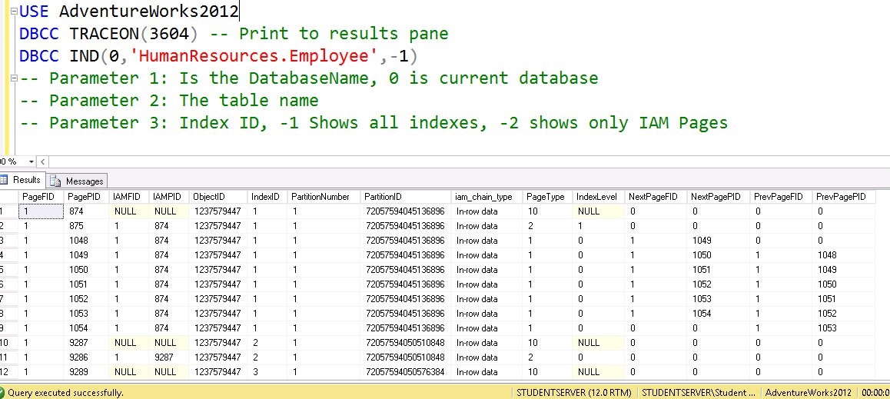
DBCC IND

Slide 6
DBCC IND – Column Headers
PageFID – The file ID of the current page
PagePID – The page number in the file
IAMFID – The file ID of the IAM page that maps this page
IAMPID – The page number in the file of the IAM page
ObjectID – The object id of the current page
IndexID – The ID of the index of the current page
PartitionNumber– Partition of the current page
PartitionID - The internal ID of the partition

Slide 7
DBCC IND – Column Headers
iam_chain_type: Type of allocation storage
Index Level: Level the page is in the index
NextPageFID: File ID of the Next File
NextPagePiD: Page ID of the Next Page
PrevPageFID: File ID of the Previous File
PrevPageFID: Page ID of the Previous Page
Page Type: Type of page (Data/Index, Allocation, Recovery, Metadata)

Slide 8
Row Storage
IN_ROW_DATA
LOB_DATA (For out of row storage)
ROW_OVERFLOW_DATA (SLOB)
Fixed length data must be store here.
Rows cannot extend beyond pages
Data Page is 8060 bytes
varchar(max) / nvarchar(max) / varbinary(max)
16-byte point to out of row tree
Uses text page to store a stream of data
varchar(8000) / nvarchar(4000) / varbinary(8000)
When a column can’t fit onto a page
No control over which column overflows

Slide 9
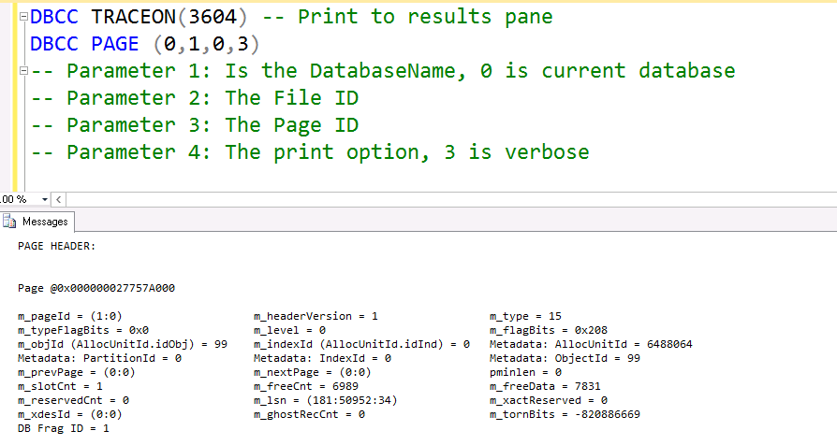
DBCC PAGE

Slide 10
New Dynamic Management Functions
Returns information about a page in a database.
These functions replace the need to use DBCC PAGE.
--New in SQL Server 2016
SELECT * FROM sys.dm_db_database_page_allocations
(DB_ID(), object_ID('Accounting.BankAccounts'), NULL, NULL, 'LIMITED')
--New in SQL Server 2019
SELECT * FROM sys.dm_db_page_info(DB_ID(), 1, 336, 'Detailed')
Notes:
https://docs.microsoft.com/en-us/sql/relational-databases/system-dynamic-management-views/sys-dm-db-page-info-transact-sql?view=sql-server-ver15
sys.dm_db_page_info can be used in place of the DBCC PAGE statement in many cases, but it returns only the page header information, not the body of the page. DBCC PAGE will still be needed for use cases where the entire contents of the page are required.

Slide 11
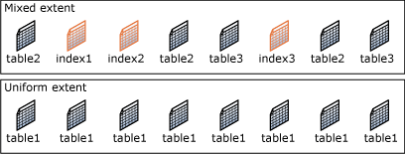
SQL Server object allocation
Data files are structured in extents.
Each extent (64 KB) has eight pages of 8 KB each.
Two types of extents:
Mixed extents (Managed by SGAM Page)
Up to 8 distinct objects can reside in the same Mixed Extent.
Uniform extents (Managed by GAM Page)
All pages belong to the same object.
Notes:
Extents
Extents are the basic unit in which space is managed. An extent is eight physically contiguous pages, or 64 KB. This means SQL Server databases have 16 extents per megabyte.
SQL Server has two types of extents:
Uniform extents are owned by a single object; all eight pages in the extent can only be used by the owning object.
Mixed extents are shared by up to eight objects. Each of the eight pages in the extent can be owned by a different object.
Additional Reading:
Pages and Extents Architecture Guide
From <https://docs.microsoft.com/en-us/sql/relational-databases/pages-and-extents-architecture-guide?view=sql-server-ver15>

Slide 12
The Role of Allocation Pages in Object Allocation
PFS and IAM are used to determine when an object needs a new extent allocated
GAMs and SGAMs are used to allocate the extent
Notes:
PFS and IAM are used to determine when an object needs a new extent allocated
When SQL Server needs to insert a new row, but there is no space available in the current page, SQL Server uses the IAM and PFS pages to find a page with enough space to hold the row. First, SQL Server uses the IAM pages to find the extents allocated to the object. Then, for each extent, SQL Server searches the PFS pages to see if there is a page with enough free space to hold the row. Each IAM and PFS page covers a large number of data pages, which are generally stored in the memory in the SQL Server buffer pool. This means that these pages can be searched quickly.
SQL allocates a new extent to an object only when it cannot quickly find a page in an existing extent with enough space to hold the row that is being inserted. It allocates extents from those available in the filegroup by using a proportional fill algorithm (files are used in proportion to their free space). Every file in a filegroup should have a similar percentage of space used.
Heaps have one row in sys.partitions with index_id = 0. The first_iam_page column in sys.system_internals_allocation_units points to the IAM chain for the collection of heap data pages in the specified partition. The server uses the IAM pages to find the pages in the data page collection.
SQL Server uses the IAM pages to navigate through the heap. Data pages and the rows within them are not in any specific order and are not linked together. The only logical connection between data pages in a heap is the connection recorded in the IAM pages.
The IAM pages can be scanned to perform table scans or serial reads of a heap to find the extents holding pages for the heap. Because the IAM represents extents in the same order that they exist in the data files, serial heap scans progress uniformly down each file. Using the IAM pages to set the scan sequence also means that rows from the heap are not typically returned in the order in which they were inserted.

Slide 13

Allocation objects
Page Free Space (PFS)
Tracks free space on a page uses 1 Byte/Page
Covers 64 MB worth of pages
Global Allocation Map (GAM)
Tracks Uniform extents that have been allocated uses 1 Bit/extent
Covers 64,000 extents (4 GB worth of data)
Shared Global Allocation Map (SGAM)
Tracks Mixed extents that have all 8 pages allocated uses 1 Bit/extent
Covers 64,000 extents (4 GB worth of data)
Index Allocation Map (IAM)
Tracks extents that are allocated to an allocation unit
Covers 4 GB worth of data
One IAM chain per table, per index, per partition, per allocation unit type
Notes:
PFS and IAM are used to determine when an object needs a new extent allocated
When SQL Server needs to insert a new row, but there is no space available in the current page, SQL Server uses the IAM and PFS pages to find a page with enough space to hold the row. First, SQL Server uses the IAM pages to find the extents allocated to the object. Then, for each extent, SQL Server searches the PFS pages to see if there is a page with enough free space to hold the row. Each IAM and PFS page covers a large number of data pages, which are generally stored in the memory in the SQL Server buffer pool. This means that these pages can be searched quickly.
SQL allocates a new extent to an object only when it cannot quickly find a page in an existing extent with enough space to hold the row that is being inserted. It allocates extents from those available in the filegroup by using a proportional fill algorithm (files are used in proportion to their free space). Every file in a filegroup should have a similar percentage of space used.
Heaps have one row in sys.partitions with index_id = 0. The first_iam_page column in sys.system_internals_allocation_units points to the IAM chain for the collection of heap data pages in the specified partition. The server uses the IAM pages to find the pages in the data page collection.
SQL Server uses the IAM pages to navigate through the heap. Data pages and the rows within them are not in any specific order and are not linked together. The only logical connection between data pages in a heap is the connection recorded in the IAM pages.
The IAM pages can be scanned to perform table scans or serial reads of a heap to find the extents holding pages for the heap. Because the IAM represents extents in the same order that they exist in the data files, serial heap scans progress uniformly down each file. Using the IAM pages to set the scan sequence also means that rows from the heap are not typically returned in the order in which they were inserted.

Slide 14

Database File page layout
Page Address is
DBID:FileID:Page#
5:1:1
MyDBFile2.ndf
MyDBFile1.mdf
0 | Header
1 | PFS
2 | GAM
3 | SGAM
… | IAM/Data /Index/others
8088 | PFS
… | IAM/Data /Index/others
511232 | GAM
511233 | SGAM
Header
0
1
2
3
…
8088
…
511232
511233
PFS
GAM
SGAM
Page Free Space
8,087 Pages
IAM/Data /Index/etc.
Global Allocation Map
Uniform Extents
63,904 Extents
PFS
Shared Global Allocation Map
Mixed Extents
63,904 Extents
IAM/Data /Index/others
GAM
SGAM
Notes:
SQL Server databases have at least one data file called the Primary data file, which will typically have a .mdf extension. They can also have secondary data files with .ndf extensions. This is the default naming convention, but any file extensions the user specifies will be accepted.
When a database has multiple files, the files are numbered from 1 to n, n being the total number of files. Each file consists of a collection of pages numbered from 0 to n-1, n being the number of pages in the file (total number of pages will depend on the size of the file).
The special Object Allocation pages mentioned on the previous slide will always appear in the same location in each data file contained in a database. A PFS page is the first page after the file header page in a data file and is marked as page 1. Following the PFS page is a GAM, marked as page 2, followed by an SGAM, marked as page 3. After the first PFS, there will be a new PFS page after every 8,087 pages. There is a new GAM for each 63,904 extents after the first GAM on page 2, and a new SGAM each 63,904 extents after the first SGAM on page 3.
The SQL Server engine addresses each of these pages using a combination of database id, file id, and page number. For example, the SGAM page in the first data file of a user database with a database id of 5 will be notated as 5:1:3. This becomes important when troubleshooting any type of page-related wait as the wait resource will be listed using this notation.
Additional Reading:
Database Files and Filegroups
From <https://docs.microsoft.com/en-us/sql/relational-databases/databases/database-files-and-filegroups?view=sql-server-ver15>

Slide 15
Extent Allocation Map Pages
GAM
01000010
SGAM
00011000
Unallocated Extent
Mixed Extent with free pages
Unallocated Extent
(1:550)
(1:557)
(1:558)
(1:565)
(1:566)
(1:573)
(1:574)
(1:581)
(1:582)
(1:589)
(1:590)
(1:597)
(1:598)
(1:605)
(1:606)
(1:613)
Full Extent
Full Extent
Full Extent
Full Extent
Notes:
SGAM pages record which extents are now used as mixed extents and have at least one unused page. Similar to a GAM, each SGAM covers about 64,000 extents, or almost 4 GB of data. The SGAM has a bit for each extent in the interval it covers. If the bit is 1, the extent being used is a mixed extent and has unallocated pages; if the bit is 0, the extent is not being used as a mixed extent, or it is a mixed extent whose pages are all in use.

Slide 16
SQL Server object allocation
Starting with SQL Server 2016 (13.x)
Default data page allocation is Uniform extents
Up to, and including, SQL Server 2014 (12.x)
On object creation two pages from a mixed extents are allocated
After 8 data pages, new allocation comes from Uniform Extent
Decreases contention on SGAM objects
Notes:
Up to, and including, SQL Server 2014 (12.x)
On object creation 2 pages from a mixed extents are allocated:
1st page is for the object itself
2nd page contains the list of all pages used by the object (IAM)
As more space is needed, additional pages are added:
Up to 8 data pages, new pages are added individually from mixed extents
After 8 data pages, new allocation comes from Uniform Extent – i.e. 8 pages are allocated
The corresponding IAM gets updated to reflect new page(s)
Additional Reading:
Pages and Extents Architecture Guide
From <https://docs.microsoft.com/en-us/sql/relational-databases/pages-and-extents-architecture-guide?view=sql-server-ver15>

Slide 17
SQL Server object allocation (Trace Flag 1118)
Up to, and including, SQL Server 2014 (12.x)
Trace flag 1118 is used to change default allocation to use uniform extents
Starting with SQL Server 2016 (13.x)
For TempDB: TF 1118 functionality is automatically enabled.
For user databases: behavior controlled with SET MIXED_PAGE_ALLOCATION option of ALTER DATABASE
Default value set to OFF
TF 1118 has no effect.
Notes:
Additional Reading:
Pages and Extents Architecture Guide
From <https://docs.microsoft.com/en-us/sql/relational-databases/pages-and-extents-architecture-guide?view=sql-server-ver15>

Slide 18
Tying it all together
Calculate the Record Size
Check if Table has pages (IAM Page)
YES
Do these pages have unallocated space (PFS Page)
YES
Insert record Update the PFS Page
NO
Allocate New Page
NO
Allocate a page from Mixed Extent (SGAM)
Update the allocation objects
NO
Is TF 1118 Enabled?
More than 8 Pages?
SQL Server>=13.X ?
YES
Allocate a Uniform Extent (GAM)
Update the allocation objects.
Notes:
Consider a scenario, where the user is trying to insert/update a record into the database table. Represented below is a very high level overview of the algorithm/process SQL Server uses to insert/update the record. There is another thing which SQL Server has to check when doing an INSERT operation. But those are not important for this discussion about the Allocation objects.
Calculate the space required for the inserted record (or could be updated record size).
Check if the Table already had some pages allocated (use IAM page/Clustered Index Root Page). In case of update, this would always be true.
Check if any of these pages has enough unallocated space to fit the new record (PFS Page/Page header). If there is enough space, insert record and update PFS page/Page header with the information related to unallocated space and other related information.
If there is not enough unallocated space on the pages, allocate a New Page.
Check if TF 1118 (uniform Extent allocation) is enabled or if the table has more than eight pages already allocated or if SQL Server is 13.x or later.
If yes, allocate a new Uniform extent to the table, else allocate a page from one of the Mixed extents (GAM/SGAM Pages). Update GAM/SGAM, to reflect the changes (mark the extent used in case it was uniform extent allocation, or if the mixed extent is full). Additionally, update the IAM Page with the information.
Insert the record on the newly allocated page, update the PFS Page, with the unallocated space information.

Slide 19


Slide 20
Microsoft

