Slide 1
Azure SQL Database Performance Tuning

Slide 2

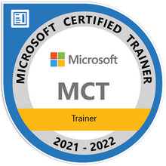

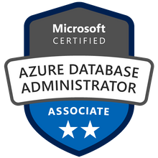



John Deardurff
Microsoft Customer Engineer (Global Technical Team)
Microsoft Certified Trainer (Regional Lead)
MVP: Data Platform (2016 – 2018)
Email: John.Deardurff@Microsoft.com
Twitter: @SQLMCT
Website: www.SQLMCT.com
GitHub: github.com\SQLMCT

Slide 3
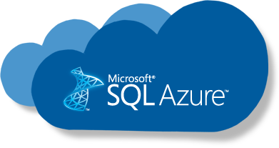
What does this session cover?
Query Performance Insight
Automatic Tuning
Performance Recommendations
Notes:
Azure Docs: Query Performance Insight - Azure SQL Database | Microsoft Docs
Deliver consistent performance with Azure SQL - Learn | Microsoft Docs

Slide 4

Next Week?
Brandon Lukes
Customer Engineer at Microsoft
Data Migration Assistant
In this session we will cover the Data Migration Assistant tool. DMA is the replacement for the old SQL Server Upgrade Advisor. We will look at the two main functions, assessing upgradability and migrating your SQL environment.
Notes:
Azure Docs: Query Performance Insight - Azure SQL Database | Microsoft Docs
Deliver consistent performance with Azure SQL - Learn | Microsoft Docs

Slide 5
Share the Links
Azure Docs: Query Performance Insight
Performance with Azure SQL – Learn
Azure SQL Workshop
Notes:
Azure Docs: Query Performance Insight - Azure SQL Database | Microsoft Docs
Deliver consistent performance with Azure SQL - Learn | Microsoft Docs
GitHub - microsoft/sqlworkshops-azuresqlworkshop: Azure SQL Workshop

Slide 6
Query Performance Insight

Slide 7
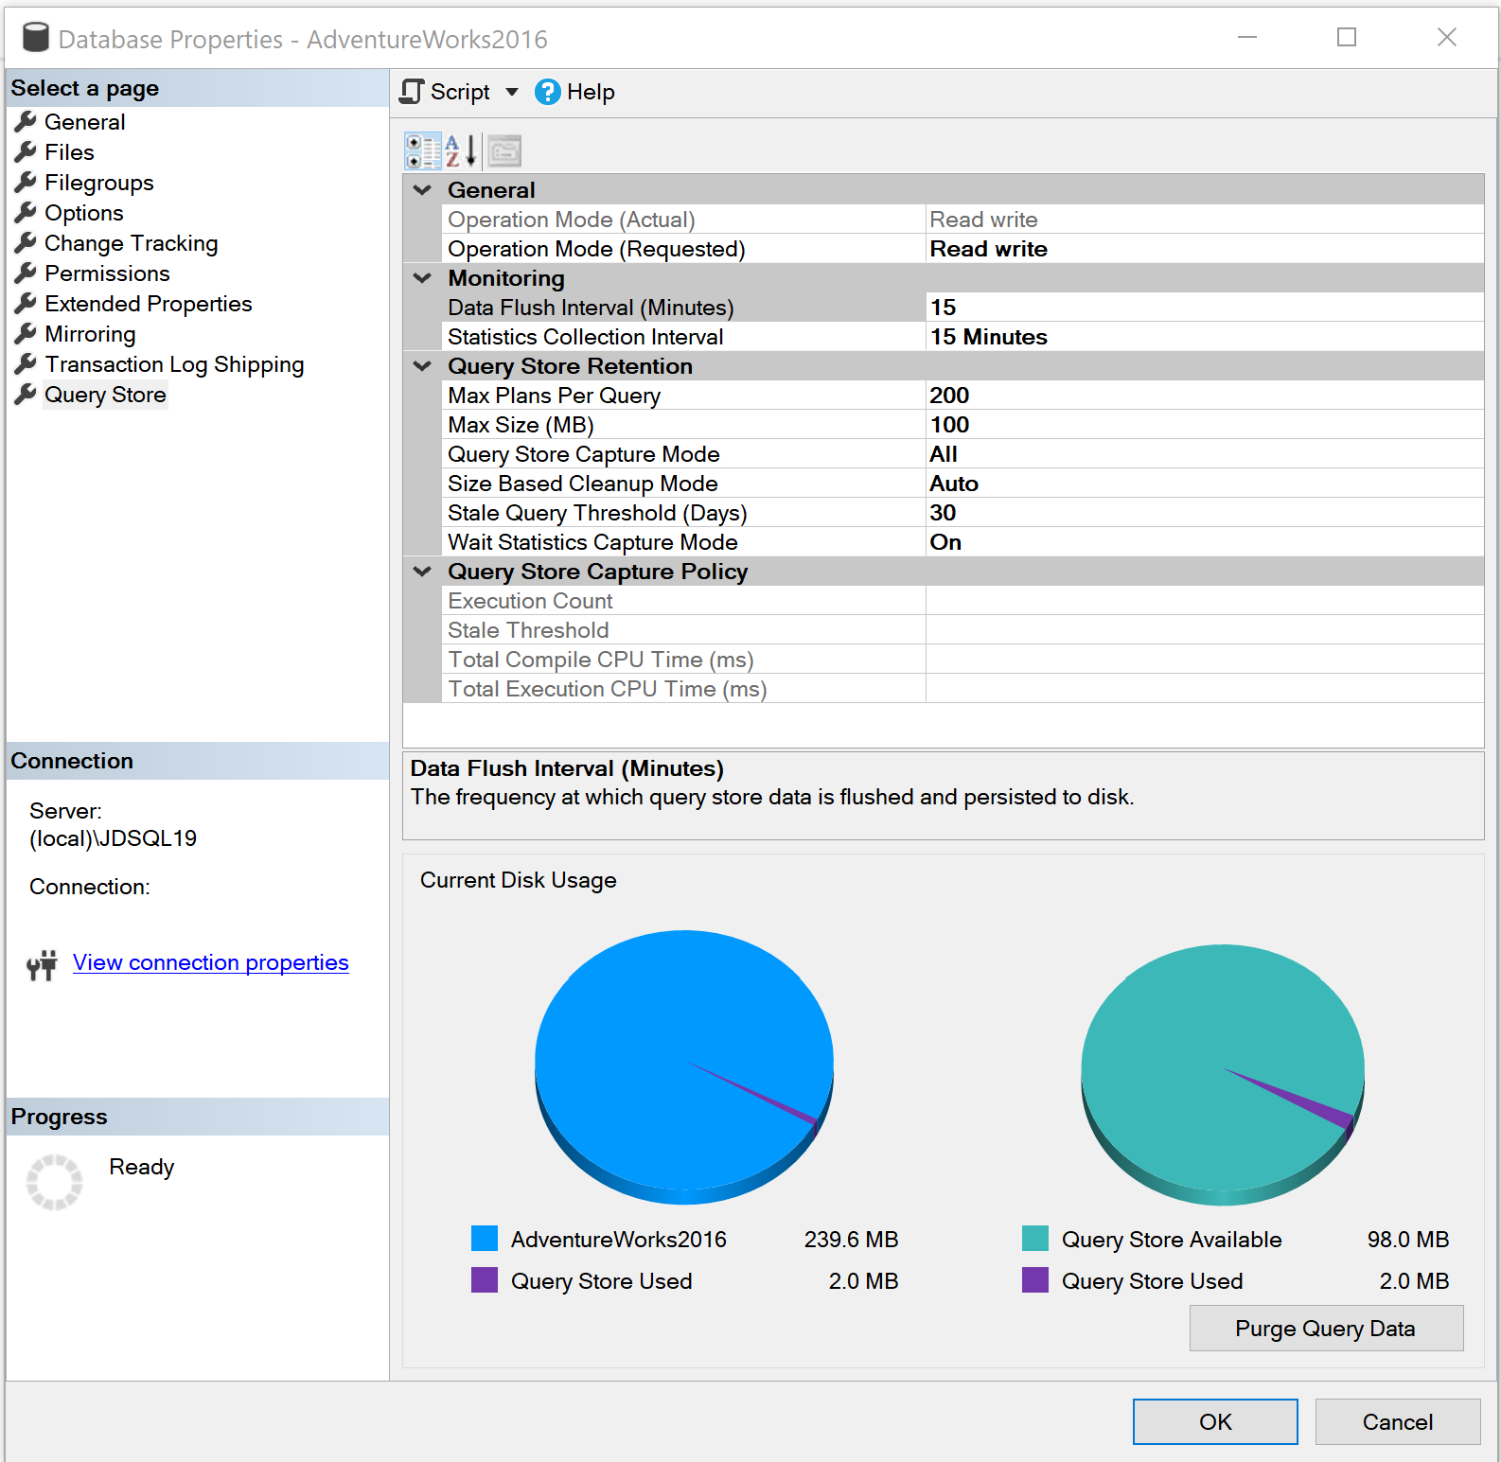
Query Performance Insight based on Query Store
Retention Policy
Size based – Auto cleanup when near max size.
Time based – Default 30 days.
Max Plans Per Query – Default 200.
Wait Statistics Capture Mode – Default On.
Capture Policy
All – Captures all queries.
Auto – Infrequent queries are ignored.
None – No queries are captured.
Custom – Advanced Options
Notes:
Please consider editing or deleting “Give me the top queries that have changed in performance compared to the number of executions. “

Slide 8
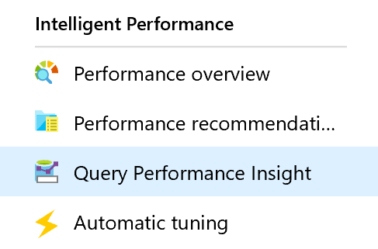
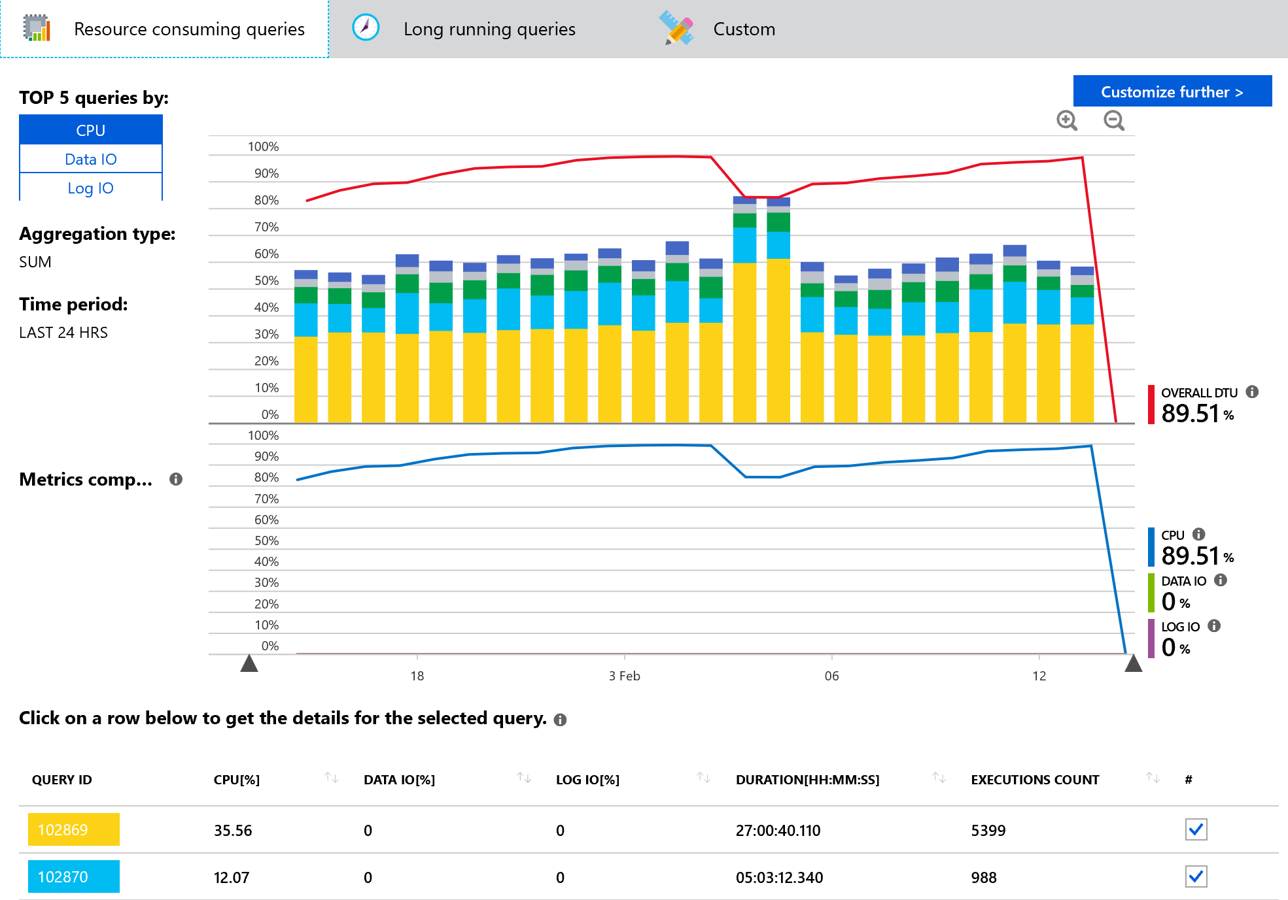
Query Performance Insight
Shows top performance degrading queries by showing most resource consuming queries, long running queries and custom configuration.
Can drill through the queries to see Query text, CPU, data IO and Log IO utilization %, Duration and Execution count.
Query Performance Insight

Slide 9
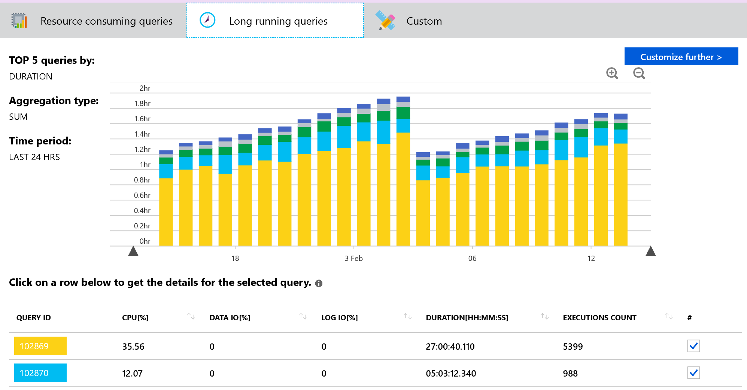
Query Performance Insight
Duration is one of the metrics showing potential bottleneck
Long-running queries has potential for:
Longer locks
Blocking other users
Limiting scalability

Slide 10
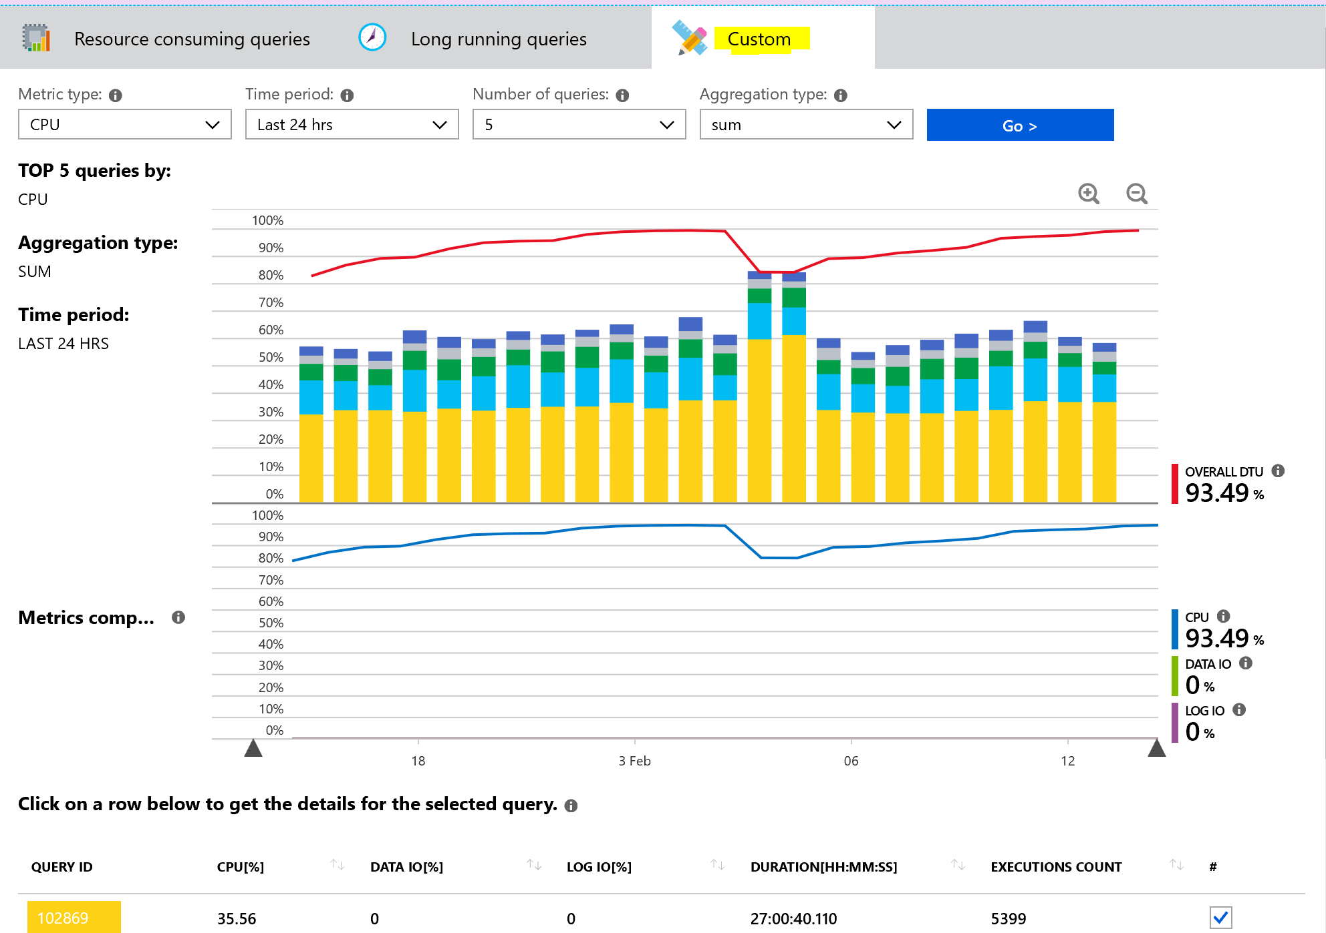
Query Performance Insight
Custom options:
Metric Type – CPU , Data IO, Log IO, Duration and Execution Count.
Time Period – Last 6 hrs, Last 24 hrs, Past Week, Past Month and Custom.
Number of Queries – 5, 10, 20.
Aggregation type – sum, max and avg.

Slide 11
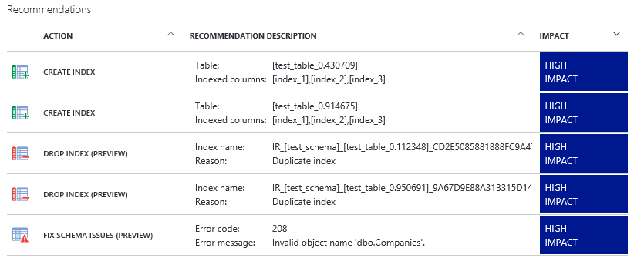
Performance Recommendations
High Impact
Recommendations should provide the most significant performance impact.
Medium Impact
Low Impact
Recommendations should provide better performance than without, but improvements might not be significant.
Recommendations should improve performance, but not substantially.
Notes:
Please consider editing or deleting “Give me the top queries that have changed in performance compared to the number of executions. “

Slide 12
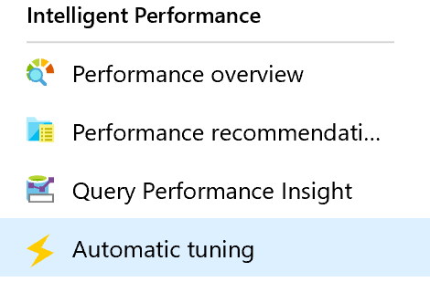
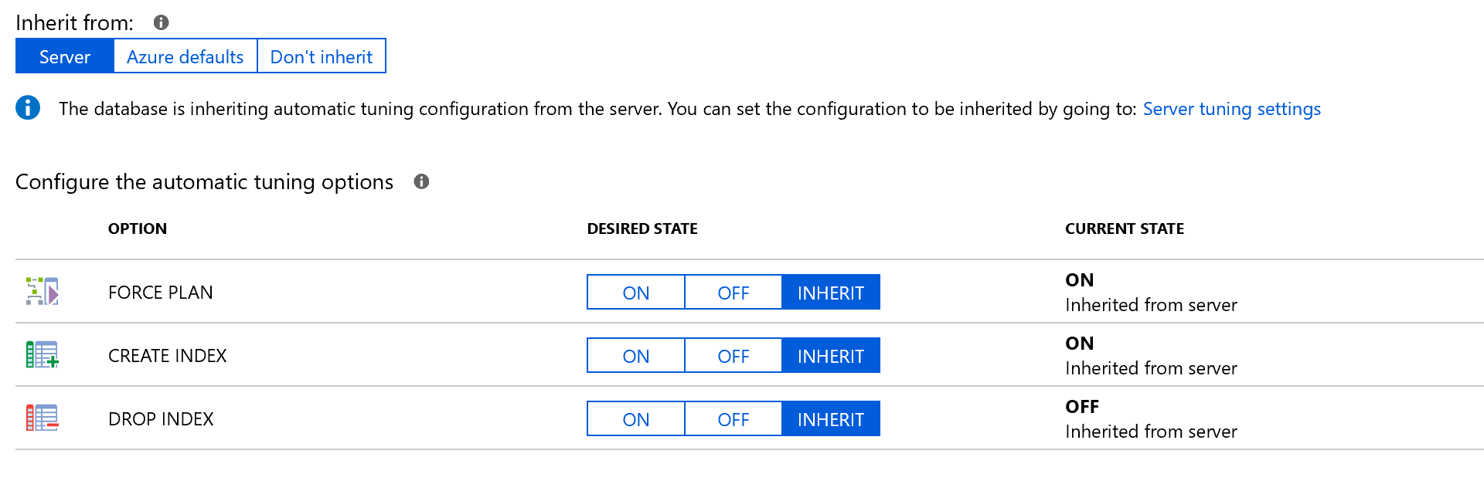
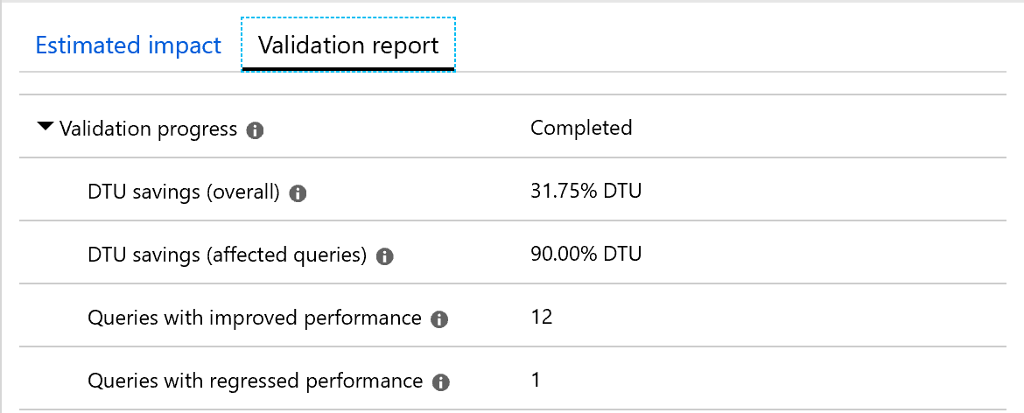
Automatic Tuning
Force Last Good Plan:
Identifies and creates Indexes, validates performance improvements and reverts the change if performance degrades.
Drop Index:
Identifies and drops unused Indexes, validates performance improvements and reverts the change if performance degrades.
Identifies regressed queries due to bad plan and replaces the bad plan with last Good Plan, validates performance improvements and reverts the change if performance does not improve.
Create Index:
Azure defaults for automatic tuning:
FORCE_LAST_GOOD_PLAN = enabled, CREATE_INDEX = disabled, and DROP_INDEX = disabled.
Notes:
Please consider editing or deleting “Give me the top queries that have changed in performance compared to the number of executions. “

Slide 13
Demonstration
Notes:
Demo setup instructions
The latest version of the SQL Server Management Studio
Steps
Connect to the Azure Portal, click on “Create a resource” and search for SQL Server (logical server)
Create a logical server
Server Name myazuresrv (if the name is already in use, try another name until you notice that it’s not yet in use)
Server Admin Login AzureAdmin
Password Passw0rd1
Confirm password Passw0rd1
Subscription Select your subscription
Resource Group Create New and specify the name AzureDB-RG
Location Select the location that is the closest to your location
3. Examine the different server options (Failover Groups, Manage backups, AD Admin, Security, Automatic Tuning…) Give a short overview, not in detail because this will be discussed later in the Workshop.
4. Create the firewall rules on the logical server. Add the Client IP address.
5. Create Azure SQL Database with the portal. Go to your logical server – Overview – Click on New database
Database name Salesdb
Source Database Blank Database
Server This should be your logical server name
Want to use SQL elastic pool? Not now
Pricing Tier Basic
Collation SQL_Latin1_General_CP1_CI_AS
Demo Requirements
Salesdb that was created in module 1
Use the script C:\Demos\M05L02Demo01\Workload.sql.
Make sure that you have already created and populated the table because this takes a few minutes to complete
SSMS
Steps:
Open your SSMS, connect to your logical server
Right click on the salesdb and select Properties → Query Store
Change the following settings:
Data Flush Interval → 1min
Statistics Collection Interval → 1 Minute
Click on “Purge Query Data” to empty the Query Store
Open the Workload.sql file and execute the stored procedure
EXEC dbo.proc_Emp_search 123
GO 20
EXEC dbo.proc_Emp_search 121023
GO 20
6. Create the non-clustered index and execute the stored procedure EXEC dbo.proc_Emp_search 123 again
7. Wait for 1 minute so that the query store can collect the execution times and the Query plans. You should see 2 query plans for the same query
8. Open the Azure Portal, go to the salesdb and click on Query Performance Insight
9. The query of the stored procedure should be available.
10. Show the dashboard of the resource consuming query and click on the query to drill down in more execution statistics of the query
11. Go back to the Object Explorer of SSMS → Query store → Top Resource Consuming Queries
12. Show the different option of the query store and also show that there are 2 different query plans for the same query.

Slide 14
Database Alerts
Proactively trigger various events related to database connectivity, high DTU usage or deadlocks, etc.
The alert triggers when the value of a specified metric crosses a threshold you assigned in either direction. It triggers when the condition is first met and then when that condition is no longer being met.
Activity log events
An alert can trigger on every event, or, only when a certain number of events occur.
You can configure an alert to do the following when it triggers:
Send email notifications to the service administrator and co-administrators.
Send email to additional emails that you specify.
Call a webhook
Metric values alerts
Notes:
Please consider editing or deleting “Give me the top queries that have changed in performance compared to the number of executions. “

Slide 15
SQL Database alert values
Metric Name | Aggregation Type | Minimum Alert Time Window
CPU percentage | Average | 5 minutes
Data IO percentage | Average | 5 minutes
Log IO percentage | Average | 5 minutes
DTU percentage | Average | 5 minutes
Total database size | Maximum | 30 minutes
Successful Connections | Total | 10 minutes
Failed Connections | Total | 10 minutes
Blocked by Firewall | Total | 10 minutes
Deadlocks | Total | 10 minutes
Database size percentage | Maximum | 30 minutes
Workers percentage | Average | 5 minutes
Sessions percent | Average | 5 minutes
DTU limit | Average | 5 minutes
DTU used | Average | 5 minutes
Notes:
https://docs.microsoft.com/en-us/azure/sql-database/sql-database-insights-alerts-portal

Slide 16
Questions?

