Slide 1


The Basics of Data Manipulation
John Deardurff
Website: ThatAwesomeTrainer.com
Twitter: @John_Deardurff
Email: John@Deardurff.com

Slide 2
SQL Statement Categories
DML (Manipulation) | DCL (Control) | DDL (Definition) | TCL (Transactional)
INSERT | GRANT | CREATE | BEGIN
UPDATE | DENY | ALTER | COMMIT
DELETE | REVOKE | DROP | ROLLBACK
SELECT (DQL) |  | TRUNCATE | SAVE

Slide 3
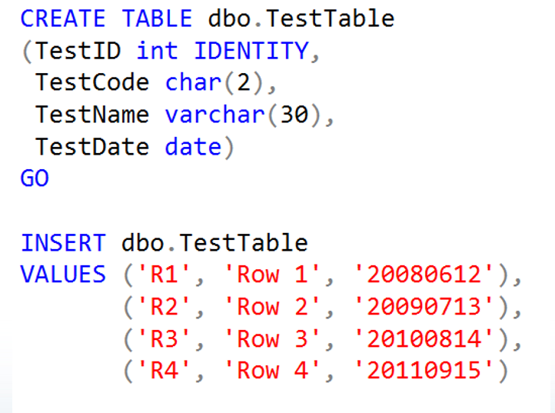
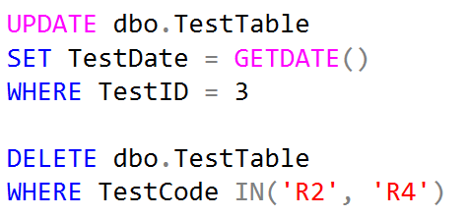

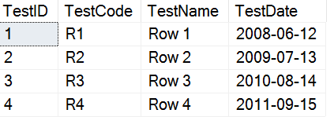
Data Manipulation Language (DML)

Slide 4
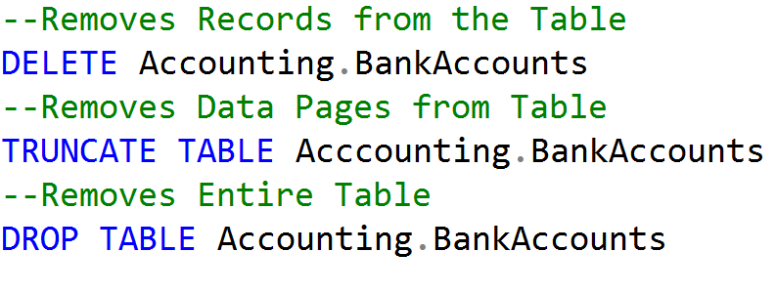
Delete vs Truncate vs Drop
TABLE
Page Header
(96 bytes)
Page Header
(96 bytes)
Page Header
(96 bytes)
Page Header
(96 bytes)
Data Row 1
Data Row 4
Data Row 7
Data Row 10
Data Row 2
Data Row 5
Data Row 8
Data Row 11
Data Row 3
Data Row 6
Data Row 9
Data Row 12
Free Space
Free Space
Free Space
Free Space
Row Offest Array
Row Offest Array
Row Offest Array
Row Offest Array

Slide 5
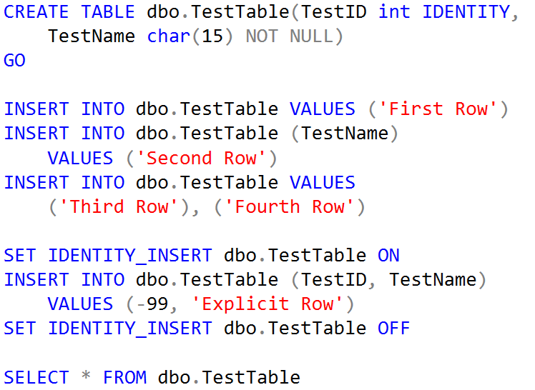
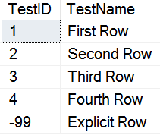
Inserting Values into IDENTITY Columns
The column_list must be used to insert values into an identity column, and the SET IDENTITY_INSERT option must be ON for the table

Slide 6
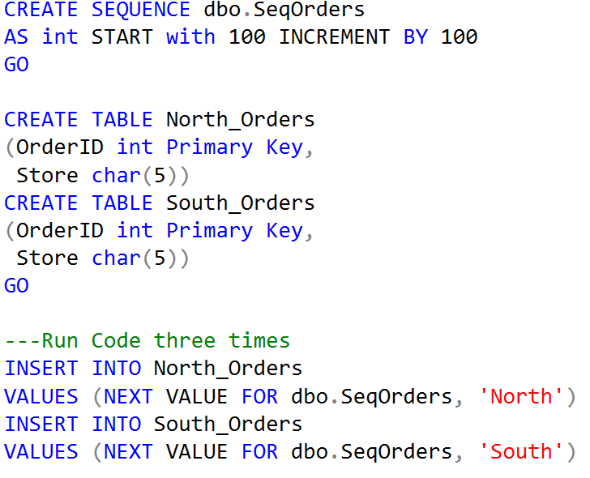
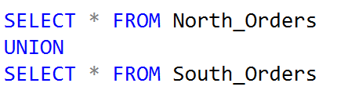
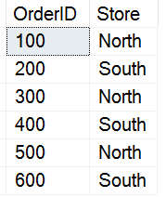
SEQUENCES
Sequences allow the ability to increment numbers across more than one table.

Slide 7
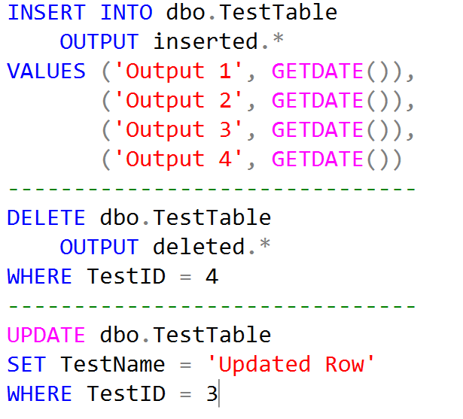
Using the OUTPUT Clause
Using OUTPUT in a DML statement returns information from each affected row

Slide 8
Virtual Tables
Inserted and Deleted Virtual Tables allow the ability to access data before and after data modification.
Available in AFTER and INSTEAD of Triggers.
Created at the beginning of a statement.
Statement | Inserted | Deleted
INSERT | Rows just inserted
DELETE |  | Rows just deleted
UPDATE | Modified row contents | Original row contents
Notes:
Point out which data types consume the least storage.

Slide 9
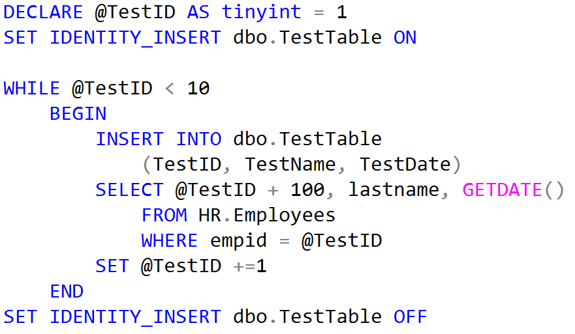
Adding Records using a WHILE Loop

Slide 10
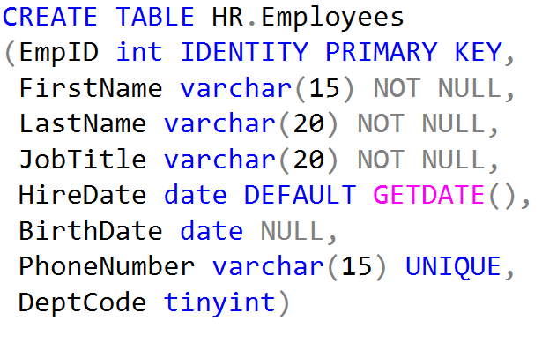
Constraints
PRIMARY KEY – Ensures that a column has a unique value for each record.
NOT NULL – Enforces that every record has a value for the column
DEFAULT – Specifies a value for the column when a value is not included
UNIQUE – Enforces that each column uses distinct and unique values
CHECK – Enforces specific rules that a column must follow
FOREIGN KEY – Enforces the child relationship with a parent table

Slide 11
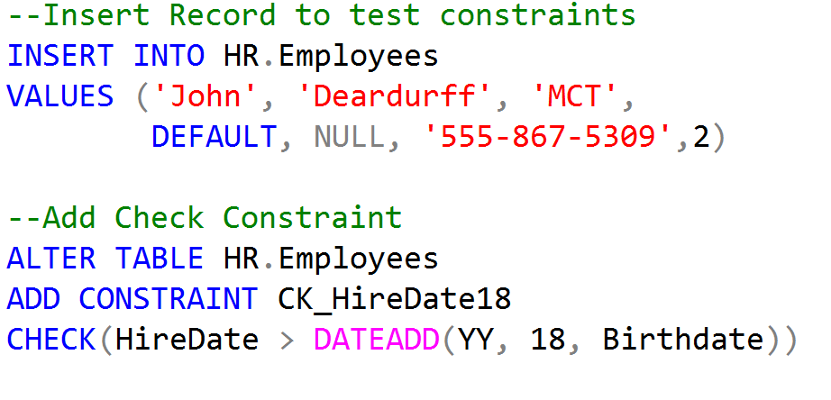
Adding a CHECK constraint

Slide 12
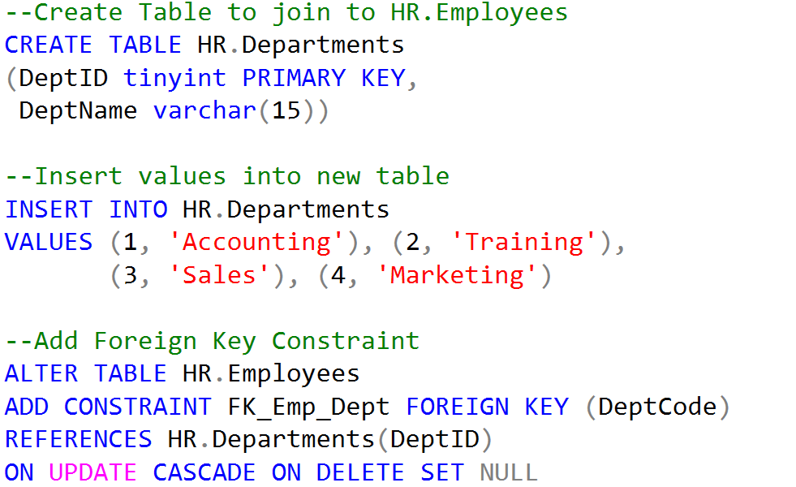
Foreign Key Constraints

Slide 13
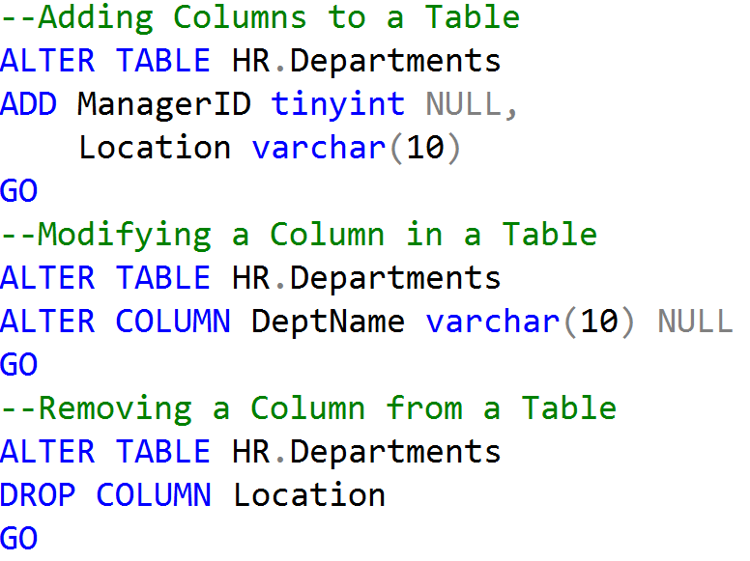
Altering Tables

