Slide 1

What is your Character Data Type?
John Deardurff
Website: http://john.deardurff.com
Twitter: @John_Deardurff
Email: John@Deardurff.com
March 5, 2016

Slide 2
Presentation Topics
We will learn about the basic SQL Server Data Types
Used for Columns, Variables, Expressions, & Parameters
Fundamental to writing queries in T-SQL
Fundamental to designing tables.
Choosing the right data type ensures data integrity and accuracy by creating a constraint on data input
Choosing the right data type can save hard drive space, space in memory, and bandwidth on your network

Slide 3
Presentation Topics
What are Data Types
Character Data Types
Number Data Types
Date and Time Data Types
LEN and DATALENGTH functions
CAST and CONVERT functions
TRY_PARSE and TRY_CONVERT functions.
Other Data Types

Slide 4

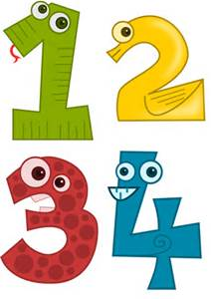

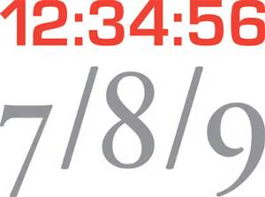
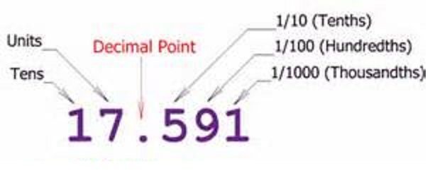
SQL Server Data Types
Data types determine what kind of data can be held:
Integers, characters, dates, money, decimals, etc.

Slide 5



Data Types Associations
Columns
Expressions
Variables
Parameters

Slide 6
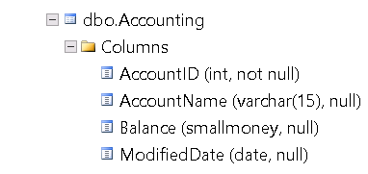
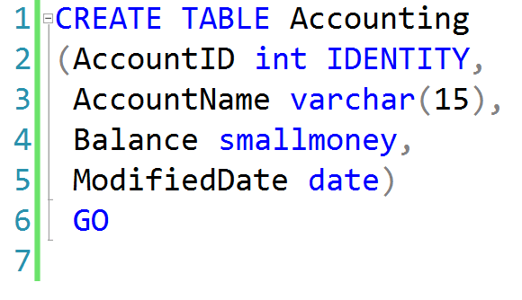
Data Types with Columns

Slide 7
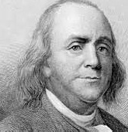
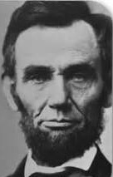
A Byte saved is a Byte earned. ~ Benjamin Franklin
The problem with quotes from the internet is it is hard to verify their authenticity.
~ Abraham Lincoln

Slide 8
Character Data Types
Data Type | Range | Storage
CHAR(n), NCHAR(n) | 1-8000 characters 1-4000 characters | bytes 2*n bytes
VARCHAR(n), NVARCHAR(n) | 1-8000 characters 1-4000 characters | n+2 bytes (2*n) +2 bytes
VARCHAR(MAX), NVARCHAR(MAX) | 1-2^31-1 characters | Actual length + 2

Slide 9
Character Data Types
Fixed
Variable
Regular
char
varchar
1 byte per char
Unicode
nchar
nvarchar
2 bytes per char

Slide 10
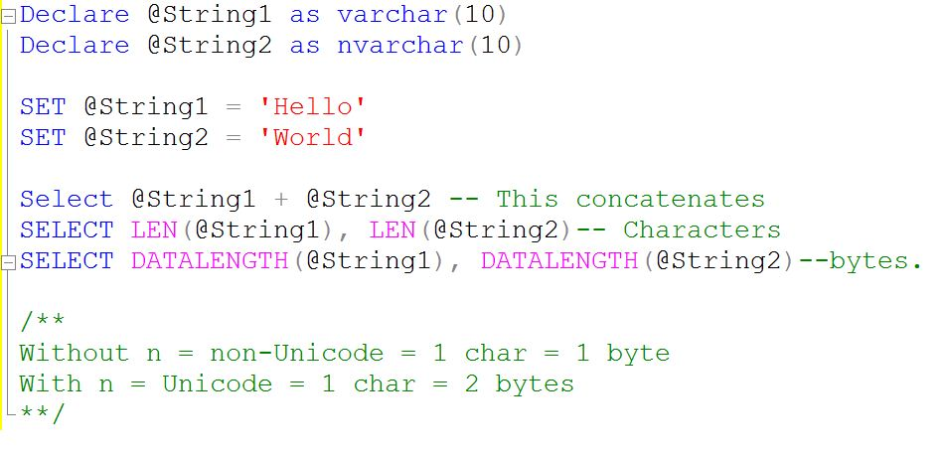
Character Data Types Coding Example

Slide 11
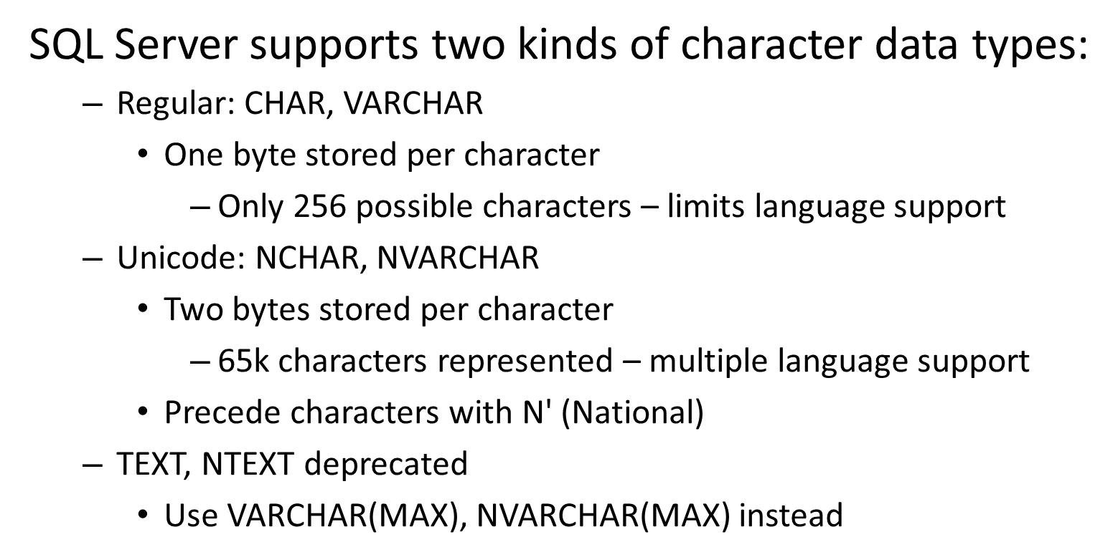
Character Data Types

Slide 12
Data Pages
Page Header
(96 bytes)
Header contains Page Information such a Page Number and Page Type
Data Row 1
Data Row 2
Data Row 3
Data Rows or Free Space
Free Space
Row Offest Array
Displays how far from beginning of page each row is located.

Slide 13
How Data Rows are Stored
IN_ROW_DATA
Fixed length data must be stored here.
Rows cannot extend beyond pages
Data Page is 8060 bytes
ROW_OVERFLOW_DATA
varchar(8000) / nvarchar(8000) / varbinary(8000)
When a column can’t fit onto a page
No control over which column overflows
LOB_DATA (For out of row storage)
varchar(max) / nvarchar(max) / varbinary(max)
16 byte pointer to out of row tree.

Slide 14
FIXVAR Format
Header
Fixed
Null
Variable
Length of Fixed Width Columns
2 bytes
Variable Width
Offset Array
2 bytes per
Variable Column
NULL Bitmap
1 Byte per
8 Null Columns
Number of Variable Width Columns
(2 Bytes)
Number of Total Columns (2 Bytes)
Header Byte 1
Header Byte 2
Fixed Width Data
Variable Width Data
Notes:
This is the FixVar format for a column for IN ROW Data Storage.

Slide 15
Integer Data Types
Data type | Range | Storage (bytes)
tinyint | 0 to 255 | 1
smallint | -32,768 to 32,767 | 2
int | 2^31 (-2,147,483,648) to 2^31-1 (2,147,483,647) | 4
Bigint | -2^63 - 2^63-1 (+/- 9 quintillion) | 8
bit | 1, 0 or NULL | 1

Slide 16
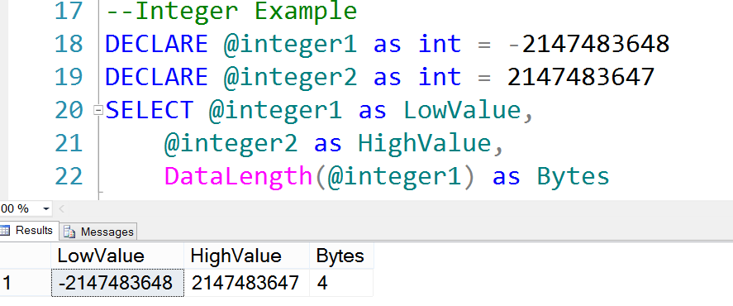
Integer Data Types Coding Example

Slide 17
Other Numeric Data Types
Data type | Range | Storage (bytes)
decimal/numeric | 10^38 +1 through 10^38 – 1 when maximum precision is used | 5-17
money | -922,337,203,685,477.5808 to 922,337,203,685,477.5807 | 8
smallmoney | - 214,748.3648 to 214,748.3647 | 4
float /real | Approximate data type for floating point numeric data | 4-8

Slide 18
Date and Time Data Types
Data Type | Storage (bytes) | Date Range | Accuracy
DATETIME | 8 | January 1, 1753 to December 31, 9999 | 3-1/3 milliseconds
SMALLDATETIME | 4 | January 1, 1900 to June 6, 2079 | 1 minute
DATETIME2 | 6 to 8 | January 1, 0001 to December 31, 9999 | 100 nanoseconds
DATE | 3 | January 1, 0001 to December 31, 9999 | 1 day
TIME | 3 to 5 |  | 100 nanoseconds
DATETIMEOFFSET | 8 to 10 | January 1, 0001 to December 31, 9999 | 100 nanoseconds

Slide 19
Date and Time Data Types
Older versions of SQL Server supported only DATETIME and SMALLDATETIME
DATE, TIME, DATETIME2, and DATETIMEOFFSET introduced in SQL Server 2008
SQL Server doesn't offer an option for entering a date or time value explicitly
Dates and times are entered as character literals and converted explicitly or implicitly
For example, CHAR converted to DATETIME due to precedence

Slide 20
Working with Date and Time Separately
DATETIME, SMALLDATETIME, DATETIME2, and DATETIMEOFFSET include both date and time data
If only date is specified, time set to midnight (all zeroes)
If only time is specified, date set to base date (January 1, 1900)
DECLARE @DateOnly DATETIME = '20120212';
SELECT @DateOnly;
RESULT
-----------------------
2012-02-12 00:00:00.000

Slide 21
Data Type Precedence
Data type precedence determines which data type will be chosen when expressions of different types are combined
Data type with the lower precedence is implicitly converted to the data type with the higher precedence
Conversion to type of lower precedence must be made explicitly (with CAST or CONVERT function)
CHAR -> VARCHAR -> NCHAR -> NVARCHAR -> BIT -> TINYINT -> SMALLINT -> INT -> BIGINT -> MONEY -> DECIMAL -> TIME -> DATE -> DATETIME2 -> XML
https://msdn.microsoft.com/en-us/library/ms190309.aspx

Slide 22
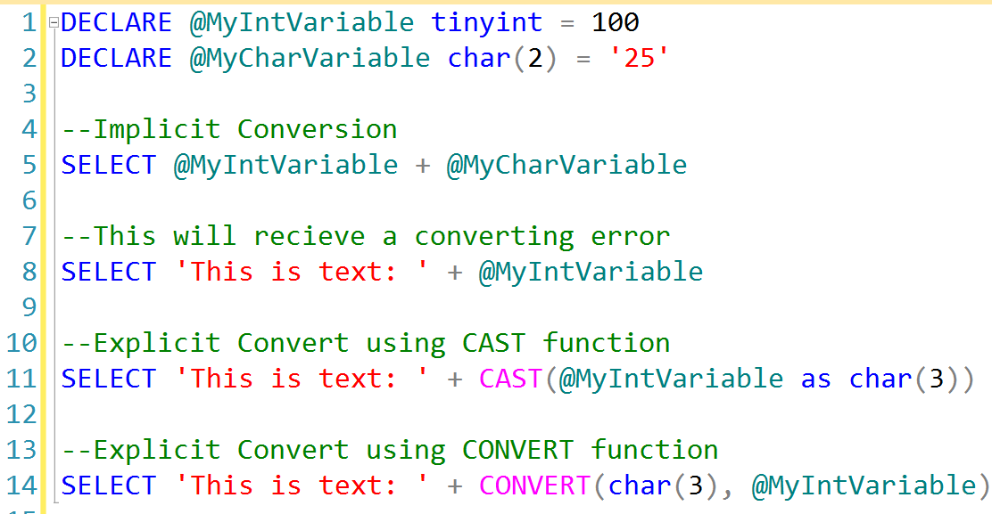
Data Type Conversion

Slide 23
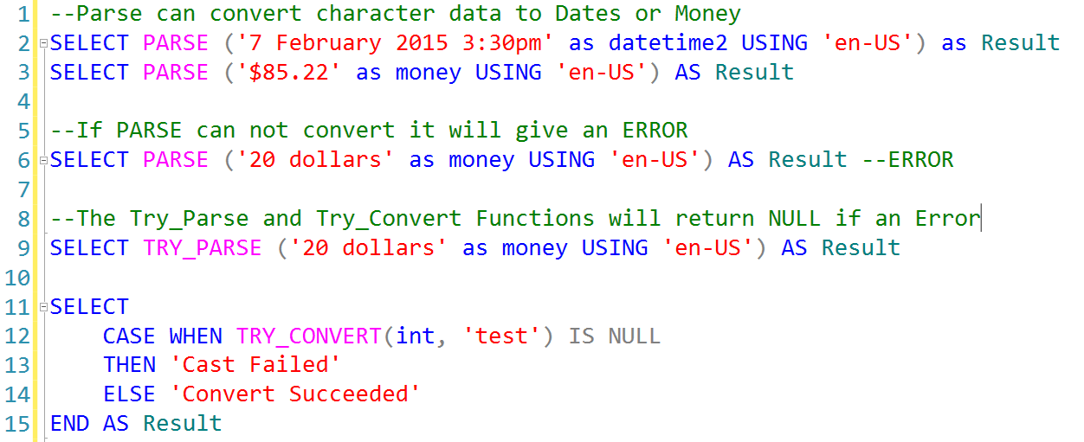
New Data Type Conversion Functions

Slide 24
Other Data Types
Data type | Range | Storage (bytes)
rowversion | Auto-Generated | 8
uniqueidentifier | Auto-Generated | 16
xml | 0-2 GB | 0-2 GB
cursor | NA | NA
hierarchyid | NA | Depends on content
sql_variant | 0-8000 bytes | Depends on content
table | NA | NA

