Slide 1
Query Processing and Execution Plans John Deardurff

Slide 2



Query Processing and Execution Plans
John Deardurff
Website: SQLMCT.com
Twitter: @SQLMCT
May 5th, 2020

Slide 3
What does this session cover?
How Queries are Processed
What is an Execution Plan?
Join Operators
Nested Loops
Cardinality and Statistics
Table Operators

Slide 4
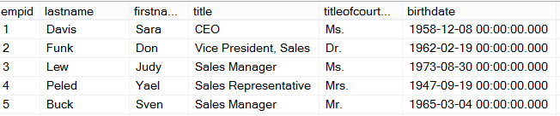
Ad Hoc Query
Stored Procedure
First Execution
or Recompile
Syntax
Parse
Execution Context
Resolve
(Binding)
Compile
Optimize
Estimated
Execution Plan
Procedure Cache
Compile
Compile
Actual
Run Time
Execute
Execute
Execute
Execute
SQL
SQL
Sets
Sets

Slide 5
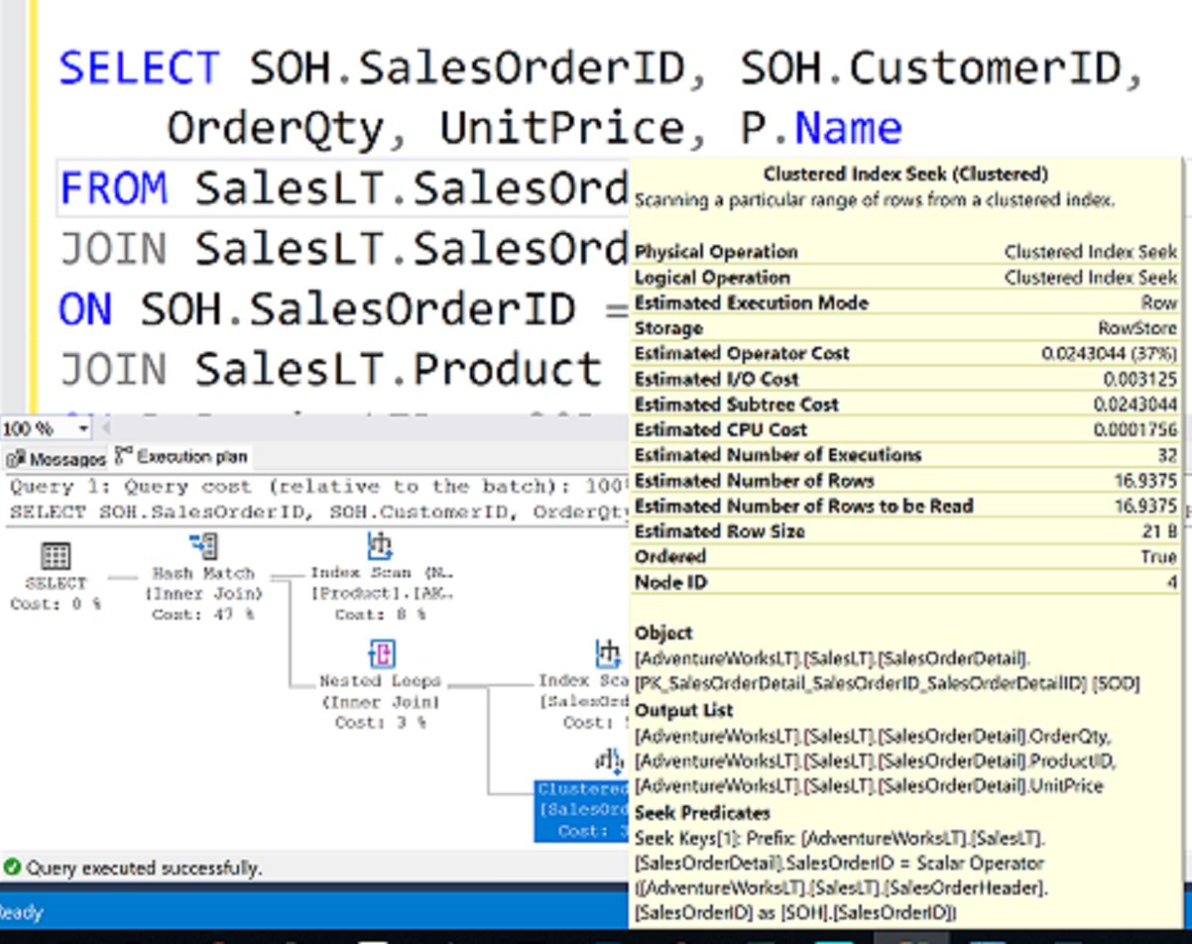
What is an Execution Plan?

Slide 6
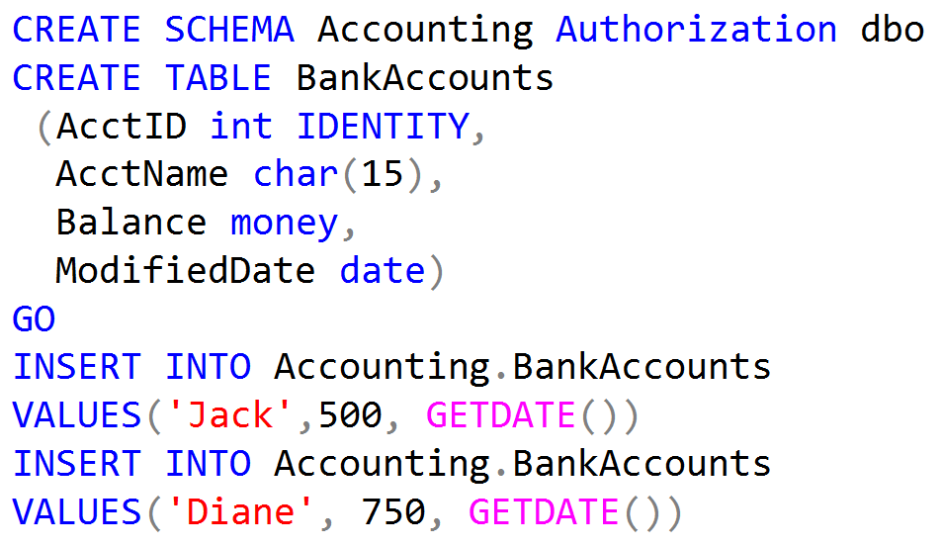
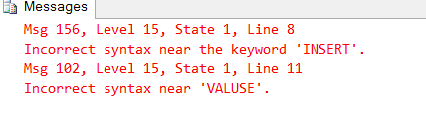
Code for Table Operators Demo

Slide 7
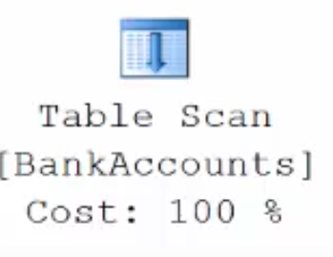
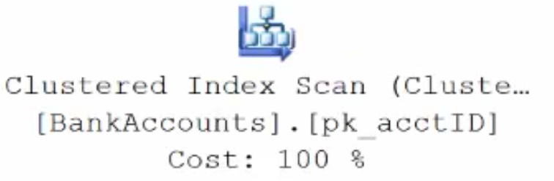
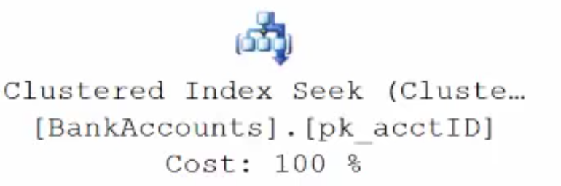
Execution Plan Table Operators
Data stored in a Heap is not stored in any order and normally does not have a Primary Key.
Clustered Index data is stored in sorted order by the Clustering key. In many cases, this is the same value as the Primary Key.
Using a WHERE statement on an Index could possibly have the Execution Plan seek the Index instead of scan.

Slide 8
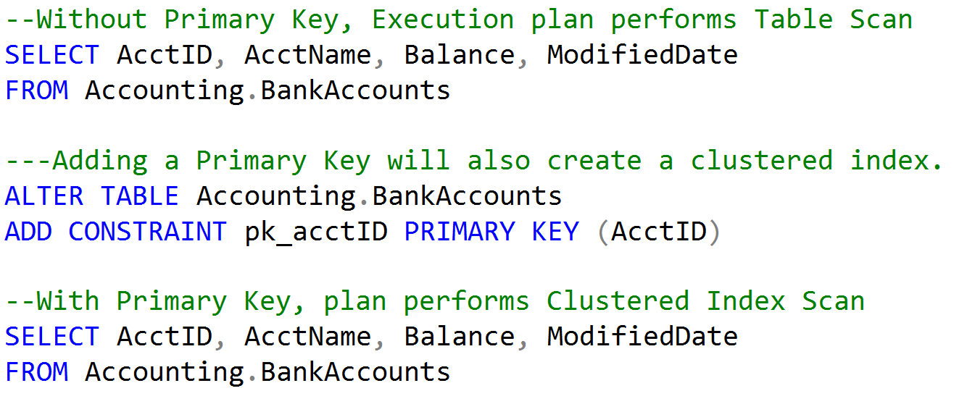
Table Scan vs Clustered Index Scan

Slide 9
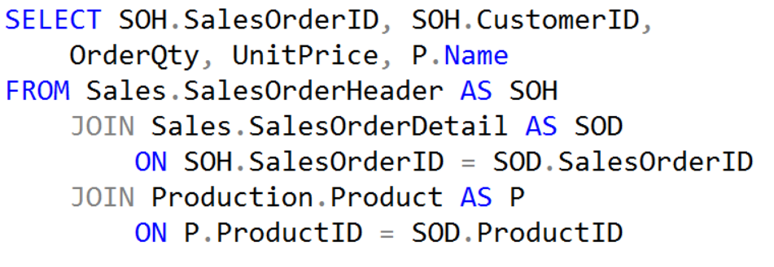
Execution Plan Join Operators (Code)

Slide 10
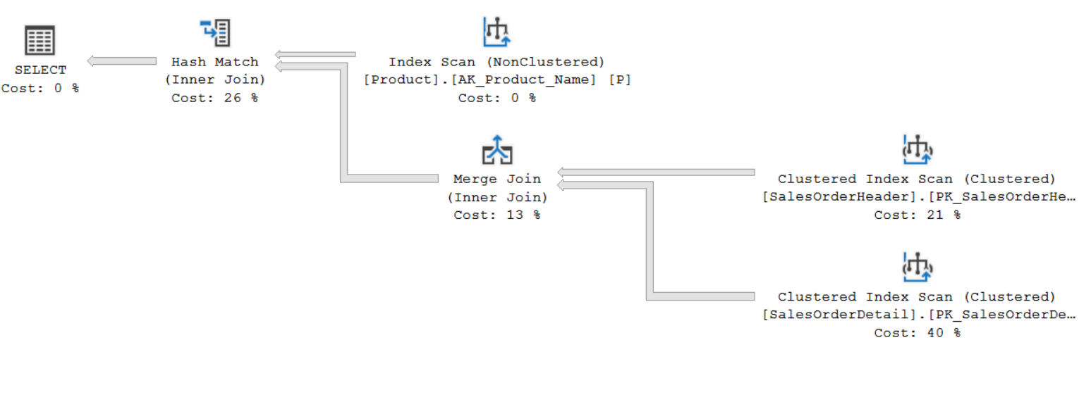
Execution Plan Join Operators (Plan)

Slide 11



Execution Plan Join Operators
A Merge Join is useful if both table inputs are in the same sorted order on the same value.
A Hash Match is used when the tables being joined are not in the same sorted order.
A Nested Loop is use when a small (outer) table is used to lookup a value in a larger (inner) table.

Slide 12
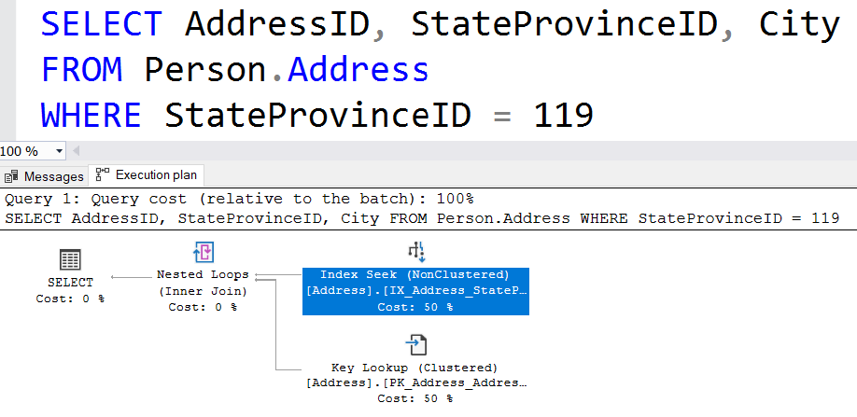
Nested Loops and Key Lookups
The City column is not part of the non-clustered index and must be retrieved from the base table.
Notes:
When nonclustered indexes are used, SQL Server may choose to use a different access method. When the nonclustered index is seeked or scanned, it is doing so to support WHERE clauses and JOINs. However, the nonclustered index often cannot support the SELECT clause. To put it another way, it cannot ‘cover’ the query. To get the columns needed for the select clause, SQL Server needs to look up those additional columns using a Key Lookup, which reaches back to the clustered index or heap. This is possible because each row in the nonclustered index has not only the columns that were defined, but also includes the clustering key or RID. When the nonclustered index seek/scan finds the rows that match the filter requested, it loops over each of the rows, gets the hidden key/RID, and gets the additional columns needed.
Key lookups are costly. In fact, they are so costly that SQL Server frequently decides that the cost of a nonclustered index seek + lookup is higher than simply scanning the clustered index. The ‘tipping point’ that determines when SQL Server will scan is pretty low, and is typically 10%.
Therefore, avoiding key lookups is often a good way to help query performance. The next lesson, ‘Indexing Strategy’, discusses ways that this can be done.

Slide 13
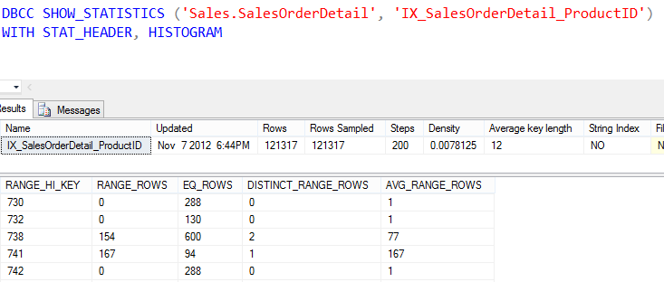
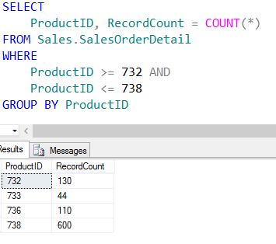
Show Statistics
Notes:
When nonclustered indexes are used, SQL Server may choose to use a different access method. When the nonclustered index is seeked or scanned, it is doing so to support WHERE clauses and JOINs. However, the nonclustered index often cannot support the SELECT clause. To put it another way, it cannot ‘cover’ the query. To get the columns needed for the select clause, SQL Server needs to look up those additional columns using a Key Lookup, which reaches back to the clustered index or heap. This is possible because each row in the nonclustered index has not only the columns that were defined, but also includes the clustering key or RID. When the nonclustered index seek/scan finds the rows that match the filter requested, it loops over each of the rows, gets the hidden key/RID, and gets the additional columns needed.
Key lookups are costly. In fact, they are so costly that SQL Server frequently decides that the cost of a nonclustered index seek + lookup is higher than simply scanning the clustered index. The ‘tipping point’ that determines when SQL Server will scan is pretty low, and is typically 10%.
Therefore, avoiding key lookups is often a good way to help query performance. The next lesson, ‘Indexing Strategy’, discusses ways that this can be done.

Slide 14
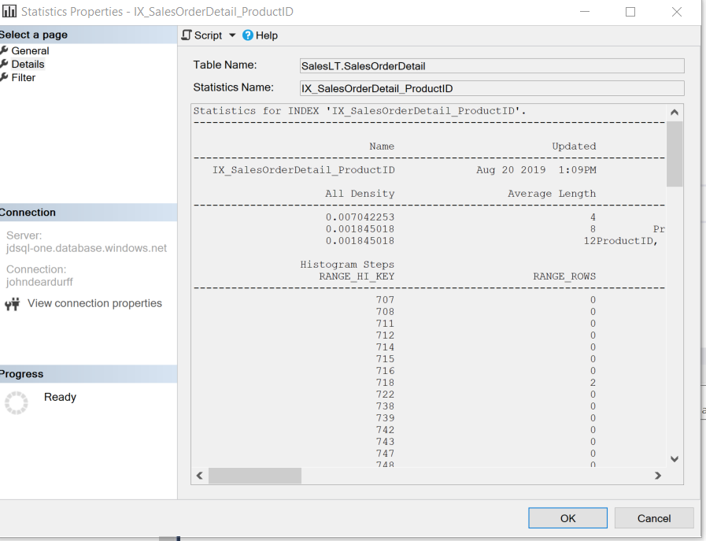
Cardinality Estimator and Statistics

Slide 15
Demonstration

Slide 16
Questions?

