Slide 1
A Beginners Guide to Transactions John Deardurff

Slide 2



A Beginners Guide to Transactions
SQL Saturday – St. Louis
John Deardurff
Website: SQLMCT.com
Twitter: @SQLMCT
February 8th, 2020

Slide 3
What does this session cover?
What are Transactions?
How Data is Modified in SQL Server
Auto-Commit vs Explicit Transactions
ACID properties of Transactions
Demo: Working with Transactions
What are Locks?

Slide 4
What is a Transaction?
A transaction is a series of one or more statements that need to operate as a single logical unit of work.
To qualify as a transaction, the logical unit of work must possess all four of the ACID properties.

Slide 5
Transactions must pass the ACID test
Atomicity – All or Nothing
Consistent – Only valid data
Isolated – No interference
Durable – Data is recoverable

Slide 6


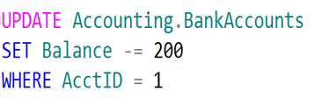
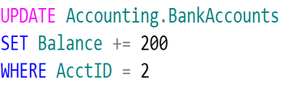
Logical Units of Work – Auto Commit Transactions
$200
John
Jane
Transaction 1
Transaction 2

Slide 7
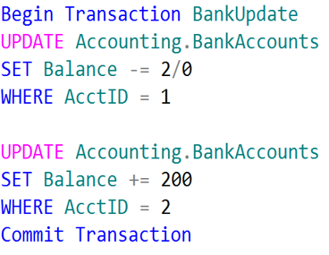
Single Logical Unit of Work – Explicit Transactions
John
Jane
$200

Slide 8

SQL Server Disk I/O (Write-Ahead Logging)
4
1. Data modification is sent to buffer cache in memory.
1
2
4. Log cache record is flushed to the transaction log
2. Modification is recorded in the log cache.
3
5. At checkpoint, dirty data pages are written to the database file.
Data Page
Data Row
3. Data pages are located or read into the buffer cache and then modified.
Data Row
5
Data Row
Free Space
Notes:
This section describes the role of the write-ahead transaction log in recording data modifications to disk. SQL Server uses a write-ahead logging (WAL) algorithm, which guarantees that no data modifications are written to disk before the associated log record is written to disk. This maintains the ACID properties for a transaction.
To understand how the write-ahead log works, it is important for you to know how modified data is written to disk. SQL Server maintains a buffer cache into which it reads data pages when data must be retrieved. When a page is modified in the buffer cache, it is not immediately written back to disk; instead, the page is marked as dirty. A data page can have more than one logical write made before it is physically written to disk. For each logical write, a transaction log record is inserted in the log cache that records the modification. The log records must be written to disk before the associated dirty page is removed from the buffer cache and written to disk. The checkpoint process periodically scans the buffer cache for buffers with pages from a specified database and writes all dirty pages to disk. Checkpoints save time during a later recovery by creating a point at which all dirty pages are guaranteed to have been written to disk.
Writing a modified data page from the buffer cache to disk is called flushing the page. SQL Server has logic that prevents a dirty page from being flushed before the associated log record is written. Log records are written to disk when the log buffers are flushed. This happens whenever a transaction commits or the log buffers become full.
Key Points:
SQL Server uses the buffer pool to minimize the amount of disk I/O that must be done against the data file. When a page is required for a read or write operation, the buffer pool is checked first. If the page is already in the buffer pool, the operation can be satisfied from memory only.
When a modification happens, the change is made to the data page in memory first, and then a log record is written to the transaction log file. The page will not be written out to disk until the CHECKPOINT process comes through and flushes changes out to the data file. If the SQL Server process is shut down unexpectedly and the memory space is lost, SQL Server uses the transaction log to bring the data file up to date with any changes that were committed before the crash but not persisted to disk. This is called recovery.
To optimize the I/O, SQL Server will attempt to gather pages together so that larger chunks of a file can be read or written in a single operation. For reads, SQL Server has a read ahead mechanism that will read contiguous pages from an object in a single request if needed by a query. For writes, SQL Server will gather together a chunk of contiguous pages that have been modified so they can be written in a single request.
Additional Reading:
SQL Server Transaction Log Architecture and Management Guide
From <https://docs.microsoft.com/en-us/sql/relational-databases/sql-server-transaction-log-architecture-and-management-guide?view=sql-server-ver15>
ACID properties
From <https://docs.microsoft.com/en-us/previous-versions/office/developer/server-technologies/aa480356(v=msdn.10)>
Write-Ahead Transaction Log
From <https://docs.microsoft.com/en-us/sql/relational-databases/sql-server-transaction-log-architecture-and-management-guide?view=sql-server-ver15#WAL>
Writing Pages
From <https://docs.microsoft.com/en-us/sql/relational-databases/writing-pages?view=sql-server-ver15>
Analyzing I/O Characteristics and Sizing Storage Systems for SQL Server Database Applications
From <https://docs.microsoft.com/en-us/previous-versions/sql/sql-server-2008/ee410782(v=sql.100)>

Slide 9
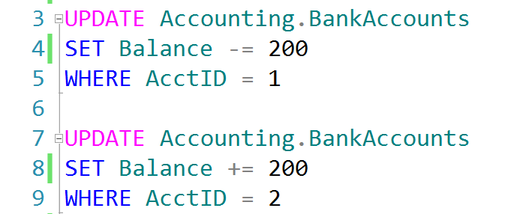
Auto-Commit Transactions without Error Handling
AdventureWorks.ldf
Checkpoint
AdventureWorks.mdf
John, don’t forget to demonstrate
SET XACT_ABORT ON

Slide 10
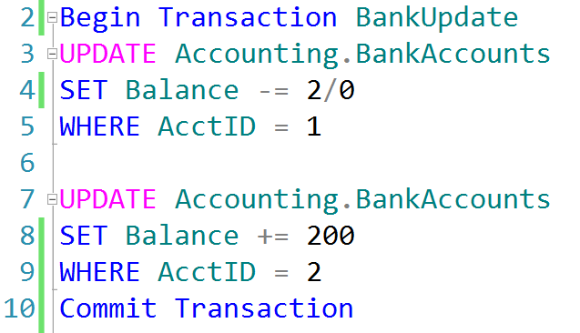
Explicit Transactions without Error Handling
AdventureWorks.ldf
Checkpoint
AdventureWorks.mdf

Slide 11
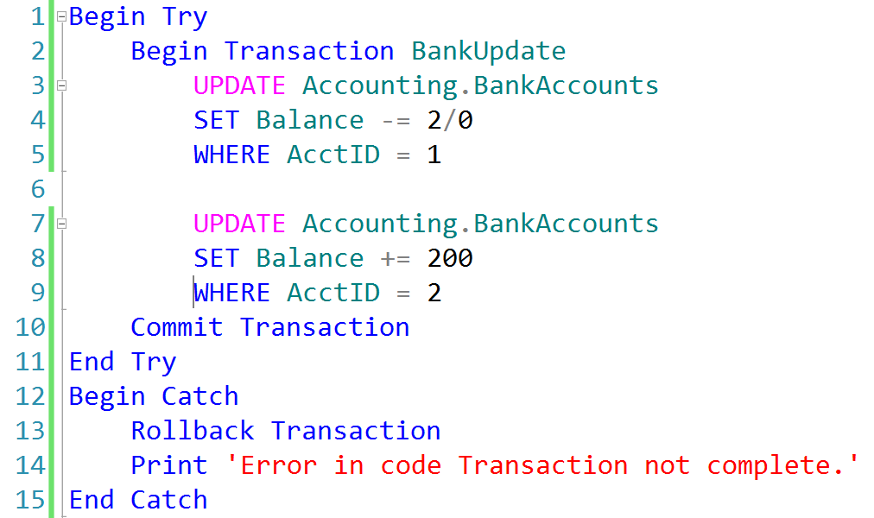
Explicit Transactions with Error Handling
AdventureWorks.ldf
AdventureWorks.mdf
Checkpoint

Slide 12
What is a Transaction?
A transaction is a series of one or more statements that need to operate as a single logical unit of work.
To qualify as a transaction, the logical unit of work must possess all four of the ACID properties.

Slide 13
Demonstration

Slide 14
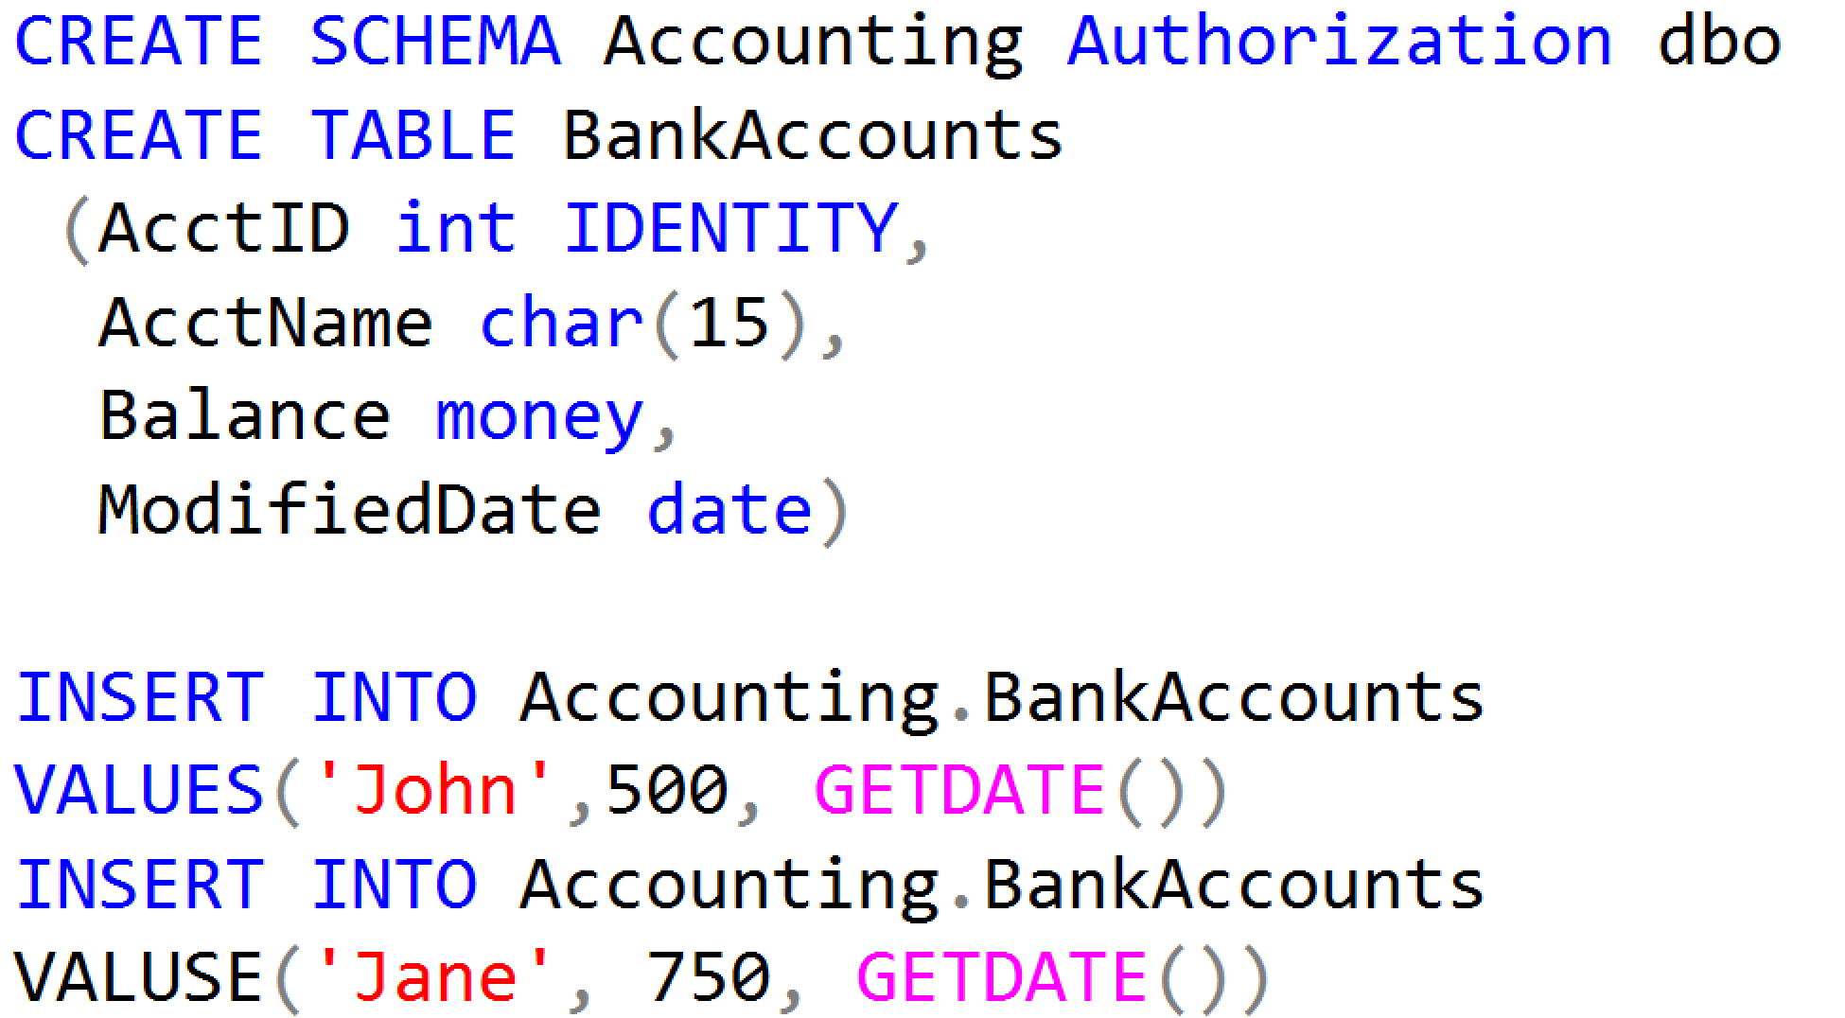
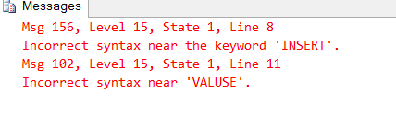
Working with Transactions

Slide 15
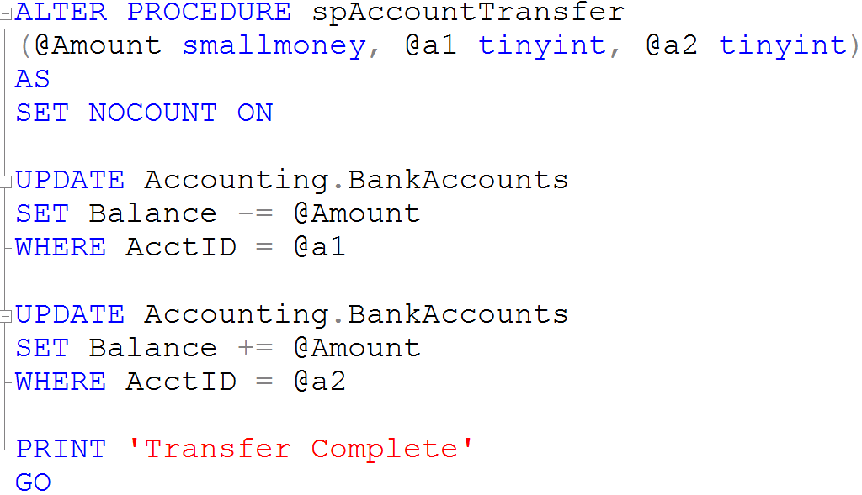
Creating Stored Procedures

Slide 16
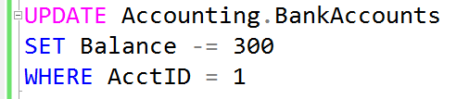


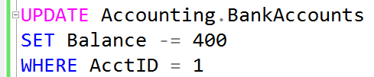
What is a Lock?
Transaction 1
Transaction 2
TSQL2012.mdf

Slide 17
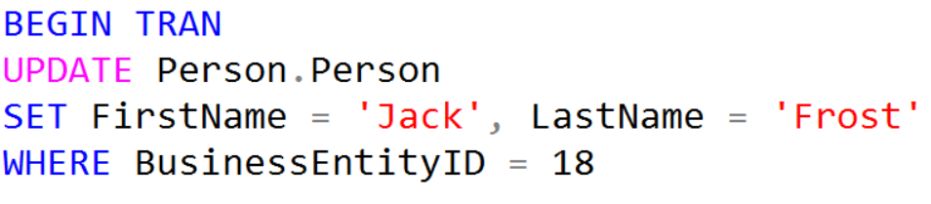


What is Blocking?
Transaction 1
Transaction 2
Blocked
TSQL2012.mdf

Slide 18
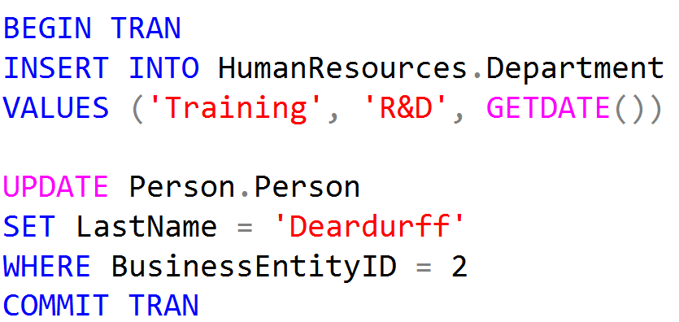
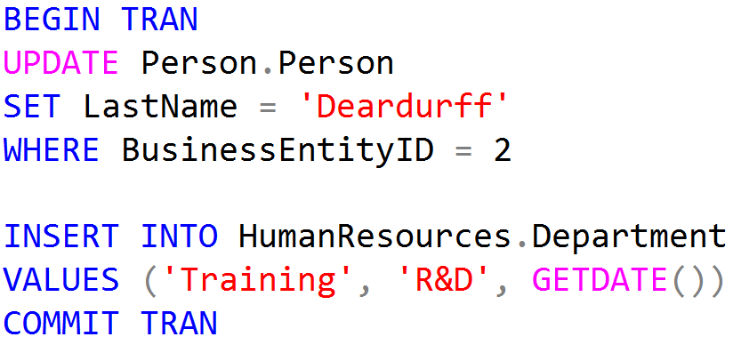
What is a Deadlock?
Person.Person
Blocked
Transaction 1
Transaction 2
Blocked
HumanResources.Department

Slide 19
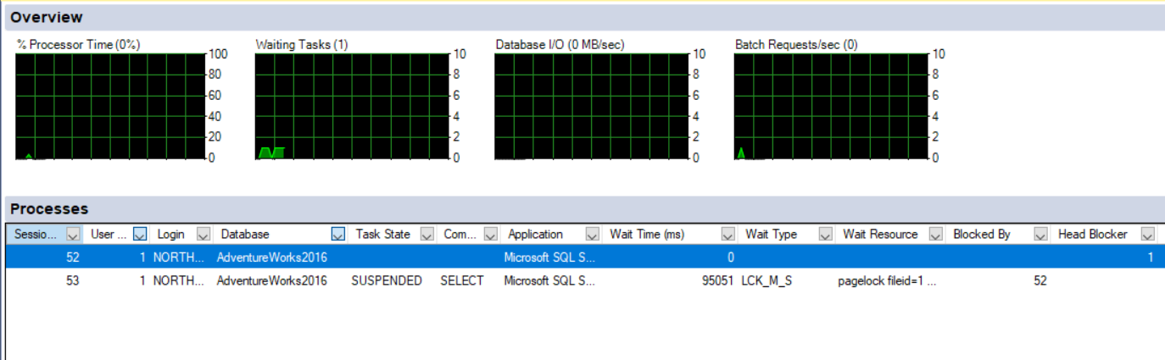
Activity Monitor

Slide 20

QUESTIONS

