Slide 1
Transaction Isolation Levels John Deardurff

Slide 2
Concurrency
Avoids inconsistency result or abnormal behavior
Pessimistic concurrency
This is the default concurrency model in SQL Server
Uses locks to avoid concurrency problems
Optimistic concurrency
Uses row versions to support concurrency
Notes:
Key Points: Concurrency is controlled using isolation level
References
https://docs.microsoft.com/en-us/dotnet/framework/data/adonet/transactions-and-concurrency
https://docs.microsoft.com/en-us/dotnet/framework/data/adonet/optimistic-concurrency
https://docs.microsoft.com/en-us/sql/connect/jdbc/understanding-concurrency-control?view=sql-server-ver15

Slide 3
What is a Transaction?
A transaction is a sequence of steps that perform a logical unit of work.
Must Exhibit ACID properties, to qualify as a transaction.
A - Atomicity
A transaction is either fully completed or not at all.
C - Consistency
A transaction must leave data in a consistent state.
I - Isolation
Changes made by a transaction must be isolated from other concurrent transactions.
D - Durability
The modifications persist even in the event of a system failure.
Notes:
A transaction is a sequence of steps that perform a logical unit of work. They must exhibit four properties that are collectively known as ACID. Transactions ensure that multiple data modifications are processed as a unit. For example, a banking transaction might credit one account and debit another. Both steps must be completed together or not at all. SQL Server supports transaction processing to manage multiple transactions.
Atomicity
Atomicity means that either all the steps in the transaction must succeed or none of them must be performed. For example, when money is transferred between two bank accounts, both the debit and credit actions must be performed or none should be performed.
Consistency
Consistency ensures that when the transaction is complete, data must be in a consistent state. A consistent state is one where the data conforms to the business rules related to the data. Inconsistent data violates one or more business rules. In SQL Server, the database has to be in a consistent state after each statement within a transaction and not only at the end of the transaction.
Isolation
Isolation defines that changes made by a transaction must be isolated from other concurrent transactions.
Durability
Durability defines that when the transaction is complete, the changes must be made permanent in the database and must survive even system failures.
References:
For more information on Transactions (Database Engine), refer:
https://docs.microsoft.com/en-us/previous-versions/sql/sql-server-2008-r2/ms190612(v=sql.105)
For more information on Transaction Fundamentals, refer:
https://docs.microsoft.com/en-us/previous-versions/z80z94hz(v=vs.90)
For more information on Write-Ahead Transaction Log, refer:
https://docs.microsoft.com/en-us/previous-versions/sql/sql-server-2008-r2/ms186259(v=sql.105)

Slide 4
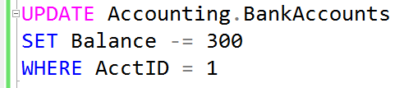


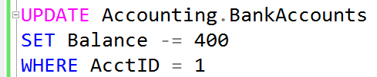
What is a Lock?
Transaction 1
Transaction 2
TSQL2012.mdf

Slide 5
Types of concurrency problems
Non-Repeatable Read
Data may change between two reads.
If you execute a SELECT twice within a single transaction, the values returned may differ as other processes could have modify data between SELECTs.
Phantom Read
If a range query is repeated within a single transaction, it may return additional rows not present in the first results.
It’s still possible that another session can insert rows that belongs to the range of the initial select.
Lost Update:
Problem occurs when there are two transactions that are unaware of each other.
Later transaction overwrites the earlier update
The values retrieved may reflect uncommitted changes that could be rolled back.
Dirty Read
Reads data pages from the buffer cache.
Notes:
Key Points:
Dirty Read: Other users can see uncommitted data.
Lost Update: Problem occurs when there are two transactions are unaware of each other. Later transaction overwrites the earlier update..
Non-Repeatable Read: Update made by another session can be seen by transaction which are not completed yet.
Phantom Read: Insert made by another session can be seen by session whose transaction is not completed yet.

Slide 6
ANSI SQL Isolation Levels
Isolation is a trade-off between correctness and concurrency.
Isolation Level | Locking Duration and Range | Dirty Read | Lost Update | Non-Repeatable Read | Phantom
READ UNCOMMITTED | No exclusive locks are taken, so locks taken by other processes aren’t blocking. | Yes | Yes | Yes | Yes
READ COMMITTED (Default) | Shared locks are taken on resources being read. They are held only for the duration of the read. | No | Yes | Yes | Yes
REPEATABLE READ | Shared locks are taken on resources being read. They are held for the duration of the transaction. | No | No | No | Yes
SERIALIZABLE | Shared range locks are taken on resources being read and adjacent resources. They are held for the duration of the transaction. | No | No | No | No
Notes:
Discuss the effects that each of the transaction isolation levels has on data access. Be sure that students understand the READ COMMITTED isolation level, and that it is the default transaction isolation level.
References:
SET TRANSACTION ISOLATION LEVEL (Transact-SQL): http://go.microsoft.com/fwlink/?LinkID=233927
Transaction Isolation Levels: http://go.microsoft.com/fwlink/?LinkID=209385
Key Points:
An isolation level defines the degree to which one transaction must be isolated from resource or data modifications made by other transactions.
By default, SQL Server operates at an isolation level of READ COMMITTED.
===============
More Information
===============
Isolation levels are described in terms of which concurrency side-effects, such as dirty reads or phantom reads, are allowed.
To make use of either more or less-strict isolation levels in applications, you can customize locking for an entire session by setting the isolation level of the session with the SET TRANSACTION ISOLATION LEVEL statement.
SNAPSHOT isolation is not an ANSI standard isolation level, it is an isolation level introduced in SQL Server 2005 to provide serializable-like consistency without the same concurrency issues. SNAPSHOT isolation makes use of the row-version store in tempdb to create a copy of a row undergoing modification. In a SNAPSHOT transaction, SQL Server will not acquire Shared locks for reading data, it will read the row-version instead. Because of the added overhead of maintaining the row-version store for all data modifications, SNAPSHOT isolation is not on by default and must be enabled in the database(s) where it will be used.
References:
For more information on Isolation Levels in the Database Engine, refer: https://docs.microsoft.com/en-us/previous-versions/sql/sql-server-2008-r2/ms189122(v=sql.105)?redirectedfrom=MSDN
For more information on Understanding Row Versioning-Based Isolation Levels, refer: https://docs.microsoft.com/en-us/previous-versions/sql/sql-server-2008-r2/ms189050(v=sql.105)?redirectedfrom=MSDN

Slide 7
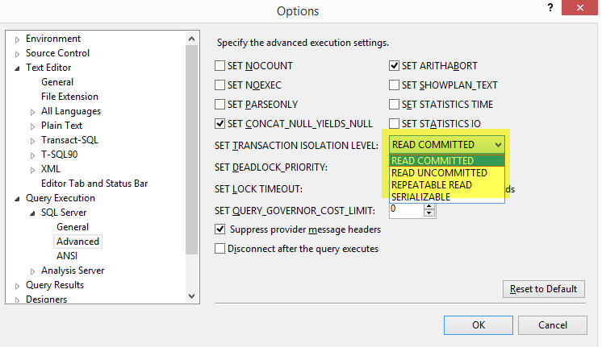
Transaction Isolation Levels
Isolation Levels

Slide 8
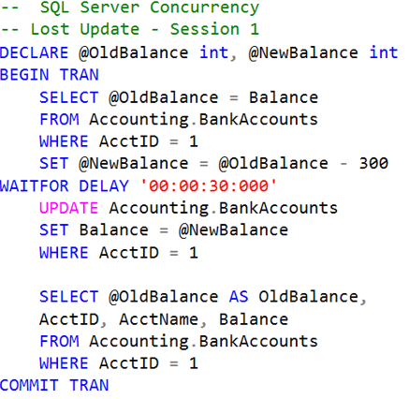
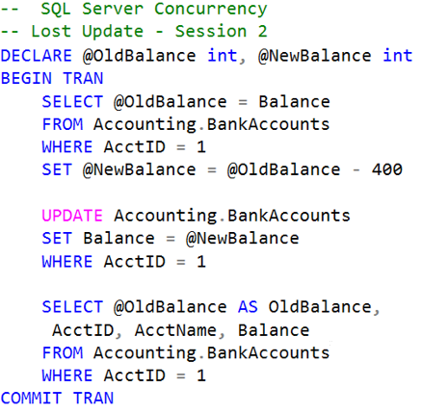


Lost Updates

Slide 9
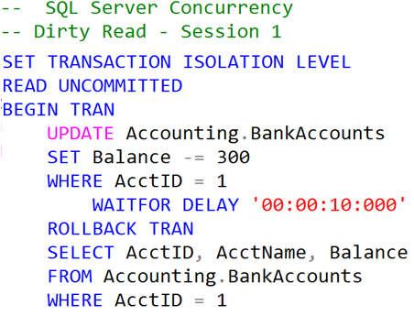

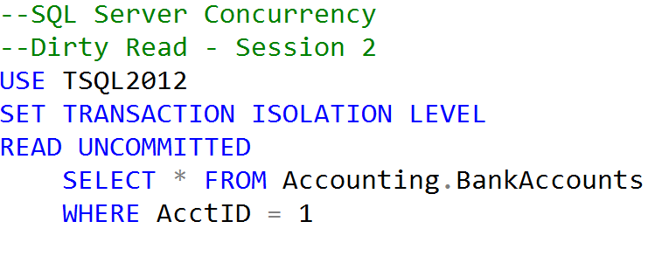

Uncommitted dependency (dirty read)
Clean Read
Dirty Read

Slide 10
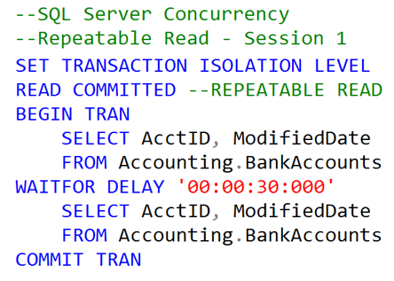
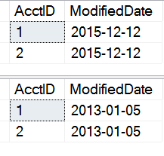
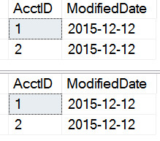
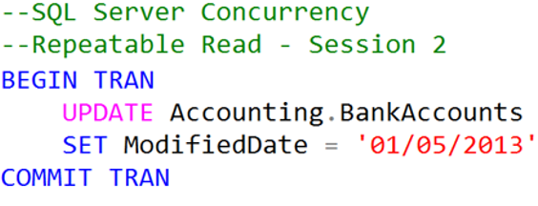
Inconsistent analysis (non-repeatable read)
Dates Change
Dates Remain
READ COMMITTED
REPEATABLE READ

Slide 11
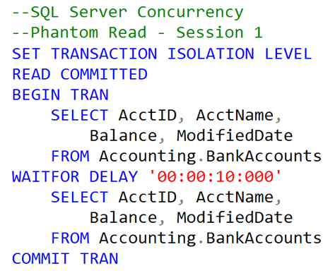
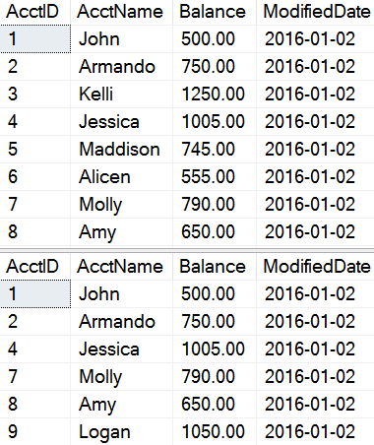
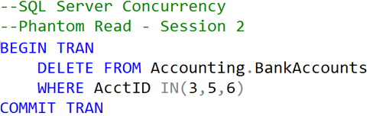
Phantom Reads
Original records
Missing records

Slide 12

QUESTIONS

