Slide 1
Introduction to Kusto Query Language (KQL)
John Deardurff

Slide 2



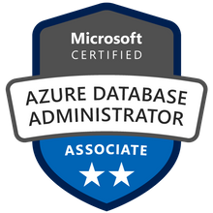



John Deardurff
Microsoft Customer Engineer (Global Technical Team)
Microsoft Certified Trainer (Regional Lead)
MVP: Data Platform (2016 – 2018)
Email: John.Deardurff@Microsoft.com
Twitter: @SQLMCT
Website: www.SQLMCT.com
GitHub: github.com\SQLMCT
Notes:
While all this has been running, several other parts of SQLOS have been active:
Monitoring: DMVs, Extended Events (xEvents), and so on.
Deadlock Monitor thread: Monitors for and deals with deadlocks.
Lazy Writer threads: Clock sweeping the buffer pool to maintain the free lists and responsible for writing dirty pages to disk between checkpoints.
Scheduler Monitor thread: Monitors scheduler health and detects issues such as non-yielding scenarios.
Resource Monitor thread: Monitors available memory from operating system and internal to SQL Server and notifies the Clerks.
The Hosting APIs for external components interface with Microsoft Data Access Components (MDAC) and common language runtime (CLR).
The Storage Engine manages all data access, both through transaction-based commands (with the Transaction Manager) and bulk operations such as backup, bulk insert, and certain Database Console Command (DBCC) commands.
Access Methods is an important component of the Storage Engine, and contains components to open a table, retrieve qualified data, and update data.
The Access Methods code does not actually retrieve the pages, it will make a request to the Buffer Manager, which holds a copy of the requested data pages in memory (and if the requested page is not in memory, it will retrieve it from disk). By memory, we mean specifically the Buffer Pool, which is part of the SQLOS.
The Transaction Manager ensures that transactions adhere to the ACID properties: atomicity, consistency, isolation, and durability.
It also outlines the boundaries of statements that must be grouped together to form an operation, and it allows “nested” transactions by managing savepoints, if any. Furthermore, it also coordinates with the Lock Manager regarding when locks can be released, based on the isolation level in effect. It also coordinates with Access Methods to determine when old versions of rows are no longer needed and can be removed from the version store.
The File Manager handles actual physical access to data and log files, as well as access to backup devices.
Also included in the storage engine are components for controlling utilities such as Bulk Load, DBCC commands, and Backup/Restore operations.
The SQLOS layer handles activities that are normally considered to be operating system-like responsibilities, such as Thread Scheduling, Synchronization services (latching and deadlock detection), Memory management (including the Buffer Pool), Lock management, I/O management (which establish the completion routines for read/write operations from memory to disk and vice-versa) , and Monitoring (such as DMVs and xEvents).
Locking is a crucial function of a multi-user Remote Desktop Management Services (RDMS) such as SQL Server, even if you are operating an optimistic concurrency model such as snapshot isolation level, to help ensure the isolation and consistency properties of ACID. This is handled by the Lock Manager, whose main job is to provide hierarchical access to data in a concurrent fashion (as allowed by the Isolation Level of the transaction), by managing compatibility between the lock types. It also resolves deadlocks (with the aid of the Deadlock Monitor thread), and escalates locks if needed. Other components such as the other threads in the figure will be explained in an upcoming lesson in this module.

Slide 3
What is in the session?
What is Kusto Query Language (KQL)
Basic Operators
KQL Language Concepts
Writing KQL statements
Quick References

Slide 4

Kusto Query Language

Slide 5
What is Kusto Query Language (KQL)?
KQL is the query language, and the Kusto Engine is what receives the queries to execute them, specifically large datasets from Azure
Azure Application Insights
Azure Log Analytics
Azure Security Center
Azure Synapse Analytics
Azure Sentinel
Data can also be ingested from external sources as well to be used inside Azure Data Explorer
Notes:
SQL Server Certificates and Asymmetric Keys: https://docs.microsoft.com/en-us/sql/relational-databases/security/sql-server-certificates-and-asymmetric-keys?view=sql-server-ver15
Certificates
A certificate is a digitally signed document that consists of a public/private key pair. You make the public part of the key available to anyone with whom you want to securely communicate, but you must keep the private part of the key secure and accessible only by you. You can use digital certificates to authenticate and/or encrypt messages between two parties. These certificates contain information that can either verify the sender of a message or encrypt and decrypt algorithms.
Authentication
Messages signed with your private key identify you as the sender of the message. A third party can use your public key to ensure that the message was signed by the person or organization named in the certificate and not someone impersonating you.
Encryption
You can also use certificates to encrypt and decrypt information. If a message is encrypted by using a public key, it can only be decrypted by using the corresponding private key. Similarly, if data is encrypted by using the private key, it can only be decrypted by using the public key.
This mechanism helps ensure that only services to which you make your public key available can decrypt the messages that you send. For example, if you send information over a public network such as the Internet, that information can be decrypted only by organizations that have a copy of your public key. If they then want to send you secure information, they can encrypt the information by using your public key, and only you can decrypt it by using your private key.

Slide 6
KQL Language Concepts
A Kusto query is a read-only request that consumes and outputs tabular data.
Filtering statements
Joining tables
Aggregating data
Querying columns
The query uses a data structure hierarchy similar to relational databases
Databases
Tables
Columns
Familiar querying operations
Notes:
SQL Server Certificates and Asymmetric Keys: https://docs.microsoft.com/en-us/sql/relational-databases/security/sql-server-certificates-and-asymmetric-keys?view=sql-server-ver15
Certificates
A certificate is a digitally signed document that consists of a public/private key pair. You make the public part of the key available to anyone with whom you want to securely communicate, but you must keep the private part of the key secure and accessible only by you. You can use digital certificates to authenticate and/or encrypt messages between two parties. These certificates contain information that can either verify the sender of a message or encrypt and decrypt algorithms.
Authentication
Messages signed with your private key identify you as the sender of the message. A third party can use your public key to ensure that the message was signed by the person or organization named in the certificate and not someone impersonating you.
Encryption
You can also use certificates to encrypt and decrypt information. If a message is encrypted by using a public key, it can only be decrypted by using the corresponding private key. Similarly, if data is encrypted by using the private key, it can only be decrypted by using the public key.
This mechanism helps ensure that only services to which you make your public key available can decrypt the messages that you send. For example, if you send information over a public network such as the Internet, that information can be decrypted only by organizations that have a copy of your public key. If they then want to send you secure information, they can encrypt the information by using your public key, and only you can decrypt it by using your private key.

Slide 7
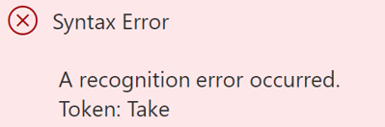
KQL Language Concepts
KQL commands are case-sensitive
Combine statements with a | pipe operator
Comments are noted with //
StormEvents //let's list 10 sampling rows
| take 10
StormEvents //same query taking wrong command name
| Take 10
Notes:
SQL Server Certificates and Asymmetric Keys: https://docs.microsoft.com/en-us/sql/relational-databases/security/sql-server-certificates-and-asymmetric-keys?view=sql-server-ver15
Certificates
A certificate is a digitally signed document that consists of a public/private key pair. You make the public part of the key available to anyone with whom you want to securely communicate, but you must keep the private part of the key secure and accessible only by you. You can use digital certificates to authenticate and/or encrypt messages between two parties. These certificates contain information that can either verify the sender of a message or encrypt and decrypt algorithms.
Authentication
Messages signed with your private key identify you as the sender of the message. A third party can use your public key to ensure that the message was signed by the person or organization named in the certificate and not someone impersonating you.
Encryption
You can also use certificates to encrypt and decrypt information. If a message is encrypted by using a public key, it can only be decrypted by using the corresponding private key. Similarly, if data is encrypted by using the private key, it can only be decrypted by using the public key.
This mechanism helps ensure that only services to which you make your public key available can decrypt the messages that you send. For example, if you send information over a public network such as the Internet, that information can be decrypted only by organizations that have a copy of your public key. If they then want to send you secure information, they can encrypt the information by using your public key, and only you can decrypt it by using your private key.

Slide 8
Basic operators
Take
Join
Project
Extend
Count
Summarize
Search
Distinct
Notes:
Overview of key management for Always Encrypted: https://docs.microsoft.com/en-us/sql/relational-databases/security/encryption/overview-of-key-management-for-always-encrypted?view=sql-server-ver15

Slide 9
KQL Language Concepts
StormEvents
|search 'Indiana'
|count
StormEvents
|count
StormEvents
|where State == 'INDIANA'
|count
Notes:
SQL Server Certificates and Asymmetric Keys: https://docs.microsoft.com/en-us/sql/relational-databases/security/sql-server-certificates-and-asymmetric-keys?view=sql-server-ver15
Certificates
A certificate is a digitally signed document that consists of a public/private key pair. You make the public part of the key available to anyone with whom you want to securely communicate, but you must keep the private part of the key secure and accessible only by you. You can use digital certificates to authenticate and/or encrypt messages between two parties. These certificates contain information that can either verify the sender of a message or encrypt and decrypt algorithms.
Authentication
Messages signed with your private key identify you as the sender of the message. A third party can use your public key to ensure that the message was signed by the person or organization named in the certificate and not someone impersonating you.
Encryption
You can also use certificates to encrypt and decrypt information. If a message is encrypted by using a public key, it can only be decrypted by using the corresponding private key. Similarly, if data is encrypted by using the private key, it can only be decrypted by using the public key.
This mechanism helps ensure that only services to which you make your public key available can decrypt the messages that you send. For example, if you send information over a public network such as the Internet, that information can be decrypted only by organizations that have a copy of your public key. If they then want to send you secure information, they can encrypt the information by using your public key, and only you can decrypt it by using your private key.

Slide 10
KQL Language Concepts
Operation | KQL Query
Count Rows : keyword count Ref : count() (aggregation function) - Azure Data Explorer | Microsoft Docs | StormEvents | count StormEvents | where StartTime >= datetime(2007-11-01) and StartTime < datetime(2007-12-01) | where State == "FLORIDA" | count // inline comment
Show n rows : Keyword take Ref: take operator - Azure Data Explorer | Microsoft Docs | // take 5 rows StormEvents | take 5 //Take n rows and select columns StormEvents | take 5 | project StartTime, EndTime , State , EventType , EpisodeNarrative
Show Distinct values: distinct Operator Produces a table with the distinct combination of the provided columns of the input table. Ref: distinct operator - Azure Data Explorer | Microsoft Docs | // show distinct State in StormEvents StormEvents | distinct State
Notes:
SQL Server Certificates and Asymmetric Keys: https://docs.microsoft.com/en-us/sql/relational-databases/security/sql-server-certificates-and-asymmetric-keys?view=sql-server-ver15
Certificates
A certificate is a digitally signed document that consists of a public/private key pair. You make the public part of the key available to anyone with whom you want to securely communicate, but you must keep the private part of the key secure and accessible only by you. You can use digital certificates to authenticate and/or encrypt messages between two parties. These certificates contain information that can either verify the sender of a message or encrypt and decrypt algorithms.
Authentication
Messages signed with your private key identify you as the sender of the message. A third party can use your public key to ensure that the message was signed by the person or organization named in the certificate and not someone impersonating you.
Encryption
You can also use certificates to encrypt and decrypt information. If a message is encrypted by using a public key, it can only be decrypted by using the corresponding private key. Similarly, if data is encrypted by using the private key, it can only be decrypted by using the public key.
This mechanism helps ensure that only services to which you make your public key available can decrypt the messages that you send. For example, if you send information over a public network such as the Internet, that information can be decrypted only by organizations that have a copy of your public key. If they then want to send you secure information, they can encrypt the information by using your public key, and only you can decrypt it by using your private key.

Slide 11
KQL Language Concepts
Operation | KQL Query
Select a subset of columns: project Use project to pick out only the columns you want. Ref : Project operator - Azure Data Explorer | Microsoft Docs | //Project specific columns StormEvents | where StartTime > datetime(2007-02-01) and StartTime < datetime(2007-03-01) | where EventType == 'Flood' and State == 'CALIFORNIA’ | project StartTime, EndTime , State , EventType , EpisodeNarrative
Order results: sort, top Show me the first n rows, ordered by a specific column: Ref : sort operator - Azure Data Explorer | Microsoft Docs top operator - Azure Data Explorer | Microsoft Docs | //Show me the first n rows, ordered by a specific column: StormEvents | top 5 by StartTime desc | project StartTime, EndTime, EventType, State, EventNarrative StormEvents | sort by StartTime desc | take 5 | project StartTime, EndTime, EventType, State, EventNarrative
Compute Derived Columns : extend Create a new column by computing a value in every row Ref : extend operator - Azure Data Explorer | Microsoft Docs | StormEvents | limit 5 | extend Duration = EndTime - StartTime | project StartTime, EndTime, Duration, EventType, State
Notes:
SQL Server Certificates and Asymmetric Keys: https://docs.microsoft.com/en-us/sql/relational-databases/security/sql-server-certificates-and-asymmetric-keys?view=sql-server-ver15
Certificates
A certificate is a digitally signed document that consists of a public/private key pair. You make the public part of the key available to anyone with whom you want to securely communicate, but you must keep the private part of the key secure and accessible only by you. You can use digital certificates to authenticate and/or encrypt messages between two parties. These certificates contain information that can either verify the sender of a message or encrypt and decrypt algorithms.
Authentication
Messages signed with your private key identify you as the sender of the message. A third party can use your public key to ensure that the message was signed by the person or organization named in the certificate and not someone impersonating you.
Encryption
You can also use certificates to encrypt and decrypt information. If a message is encrypted by using a public key, it can only be decrypted by using the corresponding private key. Similarly, if data is encrypted by using the private key, it can only be decrypted by using the public key.
This mechanism helps ensure that only services to which you make your public key available can decrypt the messages that you send. For example, if you send information over a public network such as the Internet, that information can be decrypted only by organizations that have a copy of your public key. If they then want to send you secure information, they can encrypt the information by using your public key, and only you can decrypt it by using your private key.

Slide 12
Aggregate groups of rows: summarize
Summarize groups together rows that have the same values in the by clause, and then uses an aggregation function (for example, count) to combine each group in a single row.
StormEvents
| summarize event_count = count() by State
StormEvents
| summarize StormCount = count(), TypeOfStorms = dcount(EventType) by State
| top 5 by StormCount desc
Notes:
SQL Server Certificates and Asymmetric Keys: https://docs.microsoft.com/en-us/sql/relational-databases/security/sql-server-certificates-and-asymmetric-keys?view=sql-server-ver15
Certificates
A certificate is a digitally signed document that consists of a public/private key pair. You make the public part of the key available to anyone with whom you want to securely communicate, but you must keep the private part of the key secure and accessible only by you. You can use digital certificates to authenticate and/or encrypt messages between two parties. These certificates contain information that can either verify the sender of a message or encrypt and decrypt algorithms.
Authentication
Messages signed with your private key identify you as the sender of the message. A third party can use your public key to ensure that the message was signed by the person or organization named in the certificate and not someone impersonating you.
Encryption
You can also use certificates to encrypt and decrypt information. If a message is encrypted by using a public key, it can only be decrypted by using the corresponding private key. Similarly, if data is encrypted by using the private key, it can only be decrypted by using the public key.
This mechanism helps ensure that only services to which you make your public key available can decrypt the messages that you send. For example, if you send information over a public network such as the Internet, that information can be decrypted only by organizations that have a copy of your public key. If they then want to send you secure information, they can encrypt the information by using your public key, and only you can decrypt it by using your private key.

Slide 13
Aggregate groups of rows: summarize by scalar values
We can use scalar (numeric, time, or interval) values in the by clause, but you'll want to put the values into bins by using the bin() function:
bin() function simply reduces every value to the nearest multiple of the value that you supply, so that summarize can assign the rows to groups.
StormEvents
| where StartTime > datetime(2007-02-14) and StartTime < datetime(2007-02-21)
| summarize event_count = count() by bin(StartTime, 1d)
Notes:
SQL Server Certificates and Asymmetric Keys: https://docs.microsoft.com/en-us/sql/relational-databases/security/sql-server-certificates-and-asymmetric-keys?view=sql-server-ver15
Certificates
A certificate is a digitally signed document that consists of a public/private key pair. You make the public part of the key available to anyone with whom you want to securely communicate, but you must keep the private part of the key secure and accessible only by you. You can use digital certificates to authenticate and/or encrypt messages between two parties. These certificates contain information that can either verify the sender of a message or encrypt and decrypt algorithms.
Authentication
Messages signed with your private key identify you as the sender of the message. A third party can use your public key to ensure that the message was signed by the person or organization named in the certificate and not someone impersonating you.
Encryption
You can also use certificates to encrypt and decrypt information. If a message is encrypted by using a public key, it can only be decrypted by using the corresponding private key. Similarly, if data is encrypted by using the private key, it can only be decrypted by using the public key.
This mechanism helps ensure that only services to which you make your public key available can decrypt the messages that you send. For example, if you send information over a public network such as the Internet, that information can be decrypted only by organizations that have a copy of your public key. If they then want to send you secure information, they can encrypt the information by using your public key, and only you can decrypt it by using your private key.

Slide 14
Commonly Used Aggregate Functions
Function Name | Description
avg() | Returns an average value across the group.
avgif() | Returns an average value across the group (with predicate).
count(), countif() | Returns a count of the group without/with a predicate.
dcount(), dcountif() | Returns an approximate distinct count of the group elements without/with a predicate.
max(), maxif() | Returns the maximum value across the group without/with a predicate.
merge_tdigest() | Returns the merged tdigest value across the group, is an alias of tdigest_merge.
min(), minif() | Returns the minimum value across the group without/with a predicate.
stdev(), stdevif() | Returns the standard deviation across the group for a population that is considered a sample without/with a predicate.
sum(), sumif() | Returns the sum of the elements within the group without/with a predicate.
variance(), varianceif() | Returns the variance across the group without/with a predicate.
Notes:
SQL Server Certificates and Asymmetric Keys: https://docs.microsoft.com/en-us/sql/relational-databases/security/sql-server-certificates-and-asymmetric-keys?view=sql-server-ver15
Certificates
A certificate is a digitally signed document that consists of a public/private key pair. You make the public part of the key available to anyone with whom you want to securely communicate, but you must keep the private part of the key secure and accessible only by you. You can use digital certificates to authenticate and/or encrypt messages between two parties. These certificates contain information that can either verify the sender of a message or encrypt and decrypt algorithms.
Authentication
Messages signed with your private key identify you as the sender of the message. A third party can use your public key to ensure that the message was signed by the person or organization named in the certificate and not someone impersonating you.
Encryption
You can also use certificates to encrypt and decrypt information. If a message is encrypted by using a public key, it can only be decrypted by using the corresponding private key. Similarly, if data is encrypted by using the private key, it can only be decrypted by using the public key.
This mechanism helps ensure that only services to which you make your public key available can decrypt the messages that you send. For example, if you send information over a public network such as the Internet, that information can be decrypted only by organizations that have a copy of your public key. If they then want to send you secure information, they can encrypt the information by using your public key, and only you can decrypt it by using your private key.

Slide 15
Frequently Used Functions
Function Name | Description
ago() | Subtracts the given timespan from the current UTC clock time.
datetime_add() | Calculates a new datetime from a specified datepart multiplied by a specified amount, added to a specified datetime.
now() | Returns the current UTC clock time, optionally offset by a given timespan.
case() | Evaluates a list of predicates and returns the first result expression whose predicate is satisfied.
coalesce() | Evaluates a list of expressions and returns the first non-null (or non-empty for string) expression.
iif()/iff() | Evaluates the first argument (the predicate), and returns the value of either the second or third arguments, depending on whether the predicate evaluated to true (second) or false (third).
now() | Returns the current UTC clock time, optionally offset by a given timespan.
case() | Evaluates a list of predicates and returns the first result expression whose predicate is satisfied.
Notes:
SQL Server Certificates and Asymmetric Keys: https://docs.microsoft.com/en-us/sql/relational-databases/security/sql-server-certificates-and-asymmetric-keys?view=sql-server-ver15
Certificates
A certificate is a digitally signed document that consists of a public/private key pair. You make the public part of the key available to anyone with whom you want to securely communicate, but you must keep the private part of the key secure and accessible only by you. You can use digital certificates to authenticate and/or encrypt messages between two parties. These certificates contain information that can either verify the sender of a message or encrypt and decrypt algorithms.
Authentication
Messages signed with your private key identify you as the sender of the message. A third party can use your public key to ensure that the message was signed by the person or organization named in the certificate and not someone impersonating you.
Encryption
You can also use certificates to encrypt and decrypt information. If a message is encrypted by using a public key, it can only be decrypted by using the corresponding private key. Similarly, if data is encrypted by using the private key, it can only be decrypted by using the public key.
This mechanism helps ensure that only services to which you make your public key available can decrypt the messages that you send. For example, if you send information over a public network such as the Internet, that information can be decrypted only by organizations that have a copy of your public key. If they then want to send you secure information, they can encrypt the information by using your public key, and only you can decrypt it by using your private key.

Slide 16
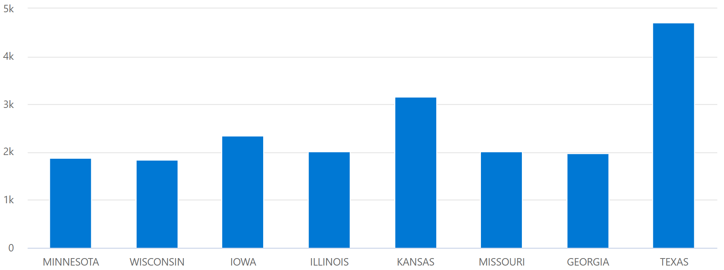
Display a Chart or table : render
We can project two columns and use them as the x-axis and the y-axis of a chart:
StormEvents
| summarize event_count=count(), mid = avg(BeginLat) by State
| sort by mid
| where event_count > 1800
| project State, event_count
| render columnchart

Slide 17
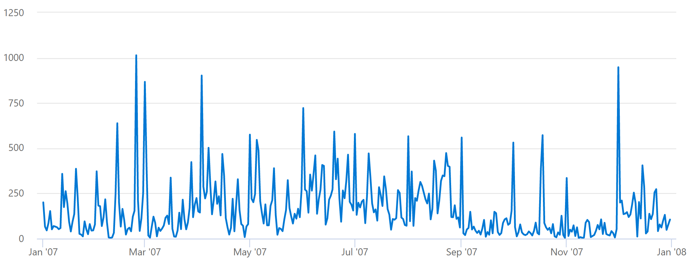
Display a chart or table: Timecharts
We can project two columns and use them as the x-axis and the y-axis of a chart:
StormEvents
| summarize event_count=count() by bin(StartTime, 1d)
| render timechart

Slide 18
Additional Resources
KQL Quick Reference
SQL to Kusto query translation
Log Analytics Demo: https://aka.ms/lademo
Azure Data Explorer Demo
Tutorial: Using Kusto Queries in Azure Data Explorer

Slide 19
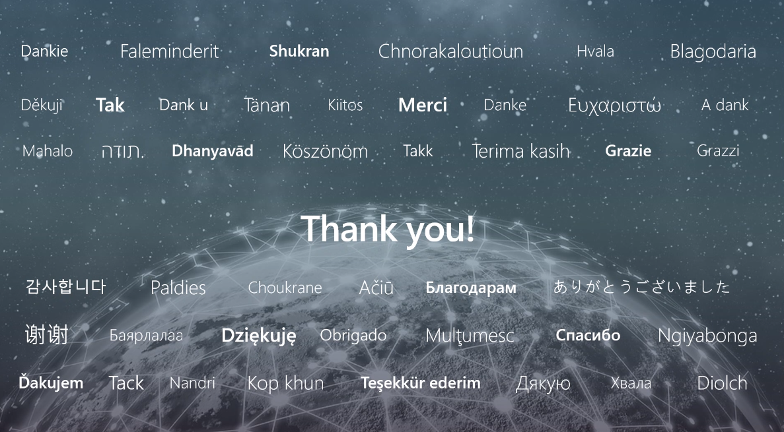

Slide 20
Microsoft

