Slide 1
Row Level Security and Dynamic Data Masking

Slide 2







John Deardurff
Microsoft Customer Engineer (Global Technical Team)
Microsoft Certified Trainer (Regional Lead)
MVP: Data Platform (2016 – 2018)
Email: John.Deardurff@Microsoft.com
Twitter: @SQLMCT
Website: www.SQLMCT.com
GitHub: github.com\SQLMCT

Slide 3
What does this session cover?
What is Row-Level Security?
Demo: Implementing Row-Level Security
What is Dynamic Data Masking?
Demo: Implementing Dynamic Data Masking

Slide 4
What is Row-Level Security?
A security feature available in SQL Server 2016 or later that will restrict access to specific rows in a table based on values in a column.

Slide 5



Row-Level Security scenarios
A hospital can restrict doctors and nurses to only view data about their specific patients.
A bank can restrict access to data based on the location of their branch offices.
A bicycle company can restrict sales leads to only specific salespeople.

Slide 6


Salespeople for the Adventure Works Bicycle Company
Jack
Diane

Slide 7
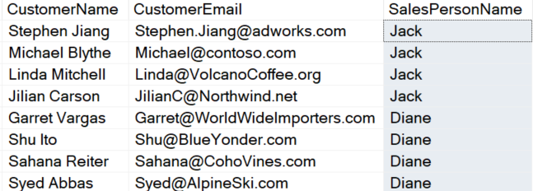
Salespeople for the Adventure Works Bicycle Company
Jack
Diane

Slide 8
Salespeople for the Adventure Works Bicycle Company
Jack
Diane

Slide 9
Salespeople for the Adventure Works Bicycle Company
Jack
Diane

Slide 10
Salespeople for the Adventure Works Bicycle Company
Jack
Diane

Slide 11
Demonstration

Slide 12
What is Dynamic Data Masking?
A security feature available in SQL Server 2016 or later that will restrict unauthorized users from viewing sensitive data.

Slide 13



Dynamic Data Masking scenarios
Developers can troubleshoot production data without viewing sensitive information.
Customer Service representatives can view parts of sensitive data like credit card information.
Reports can be distributed with sensitive data obfuscated at the data layer.

Slide 14
Dynamic Data Masking Functions
Default
Random
Custom
Email

Slide 15
Default Data Masking Function
The default function of Dynamic Data Masking masks data based on the column's data type.
Data and Time – 1900-01-01 00:00:00.000
Numeric – 0
String – Adds maximum of 4 X’s
Default

Slide 16
Random Data Masking Function
The Random Data Masking function is only applied on numeric data types. It displays a random value for the specified range.
Random

Slide 17
Custom Data Masking Function
The Custom masking function allows the ability to create a custom mask using the Partial function.
Syntax : Partial(prefix,[padding],suffix)
Prefix – Starting characters to display.
Padding –Custom string for masking.
Suffix – Last characters to be displayed.
Custom

Slide 18
Email Data Masking Function
The email masking function will display the first character of an email address and will then mask the rest of the address with XXX@XXXX and will include the .com email suffix.
Example: JXXX@XXXX.com
Email

Slide 19
Dynamic Data Masking Functions
Default
Random
Custom
Email

Slide 20
Demonstration

Slide 21
What does this session cover?
What is Row-Level Security?
Demo: Implementing Row-Level Security
What is Dynamic Data Masking?
Demo: Implementing Dynamic Data Masking

Slide 22
Questions?

