Slide 1


John Deardurff Senior Technical Instructor MCSA, MCSD, MCSE, MCDBA, MCITP, MCT, MVP
Welcome to New Horizons Computer Learning Center
Indiana Electric Cooperatives

Slide 2
Agenda
Time | Topic
9:00 | Roles and Permissions: Assigning roles and authorizing user access to resources
10:00 | Automating SQL Server Management: Simplify management using SQL Server agent and jobs
11:00 | Monitoring and Troubleshooting: Monitor with alerts and notifications
12:00 | Lunch

Slide 3
Securing SQL Server with Roles and Permissions
Welcome to New Horizons Computer Learning Center
Indiana Electric Cooperatives

Slide 4






Principals vs Securables
Tables
Permissions
Views
Sales Role
Sales Schema
Database Users
Stored Procedures
Principals
Securables

Slide 5






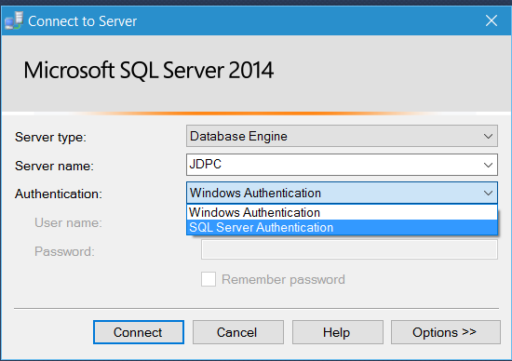





Security Principals
Authenticated by Windows
SQL Server Instance
User name
&
Password
Windows User
Windows Group
Windows Login
SQL Server Login
Authenticated by SQL Server
Server Role
Database
Database User
Database Role
Application Role

Slide 6



Securables
SQL Server Instance
SQL Server Instance
Server-level objects
Server-level objects
Database
Database
Database-level objects
Database-level objects
Schema
Schema
Schema
Schema
Objects
Objects
Objects
Objects

Slide 7
Automating SQL Server with SQL Server Agent Services
Welcome to New Horizons Computer Learning Center
Indiana Electric Cooperatives

Slide 8
Benefits of Automating SQL Server Management
Reduce administrative workload by automating and scheduling regular tasks
Execute routine tasks reliably and consistently
Proactive management:
Monitor performance
Recognize and respond to potential problems
Notes:
Talk the students through the benefits of automation, using the examples and scenarios in the student notes.
20764A
8: Automating SQL Server Management

Slide 9
Defining Jobs, Job Types, and Job Categories
Jobs consist of a series of steps
Job step types include:
Command-line script, batch of commands or application
Transact-SQL statement
PowerShell script
SSIS and SSAS commands and queries
Jobs can be assigned to categories
Notes:
Explain that a job is a specified series of operations performed sequentially by SQL Server Agent.
Talk through the job step types on the slide, and then the code sample in the student manual.
20764A
8: Automating SQL Server Management

Slide 10
Creating Job Steps
Backup Database
Job Started
Failed
Success
Transfer Data
Failed
Success
Execute App
Job Failed
Write to Application Log
Notify Operator
Job Succeeded
Notify Operator
Failed
Success
Notes:
Explain how a job consists of individual steps that can be of different types. Review the arguments in the table and show the same properties of a job step in SSMS. Discuss the graphic shown on the slide associated with this topic, noting the different actions taken, depending on the step outcome.
20764A
8: Automating SQL Server Management

Slide 11
Scheduling Jobs for Execution
Job: Backup Transaction Log
Recurrence:
One time
When SQL Server Agent starts
Whenever the CPU is idle
One job can have multiple schedules
Multiple jobs can share one schedule
Schedule: Mon-Sun Shift 1
Daily Schedule
Every 1 Hours
From: 8:00 A.M. To: 5:00 P.M.
Schedule: Mon-Sun Shift 2
Daily Schedule
Every 4 Hours
From: 5:01 P.M. To: 7:59 A.M.
Notes:
Explain the different types of schedules and point out that they can be shared. Use the graphic on the slide to explain that one job may have more than one schedule.
Point out that only one instance of a job can run at any one time.
20462D
12: Automating SQL Server 2014 Management

Slide 12
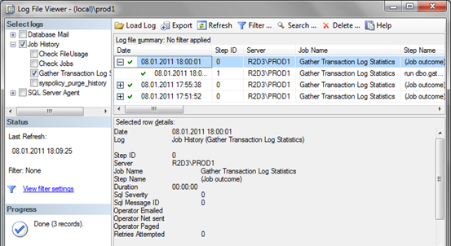
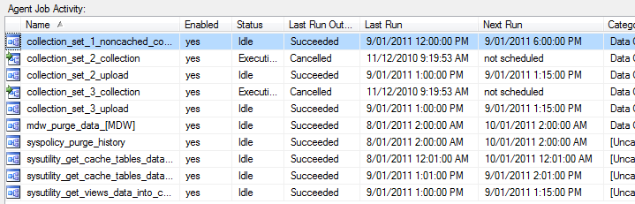
Viewing Job History
SQL Server Agent writes job history to msdb and optionally to log files
Job Activity Monitor shows current job activity
Notes:
Explain that SQL Server Agent keeps track of job and job step outcomes in system tables in msdb and that writing to the Windows Application and SQL Server log files is an optional extra.
Mention that querying the system tables will be discussed in the next topic.
Explain that students can configure the retention policy, based on time or size, in the property window of SQL Server Agent.
20462D
12: Automating SQL Server 2014 Management

Slide 13
Querying SQL Server Agent-related System Tables
Configuration and history in msdb.dbo
Use history tables to automate collection of job history over several systems
SELECT j.name, jh.run_date, jh.run_time, jh.message
FROM msdb.dbo.sysjobhistory AS jh
INNER JOIN msdb.dbo.sysjobs AS j
ON jh.job_id = j.job_id
WHERE jh.step_id = 0;
GO
Notes:
Talk students through the example on the slide and briefly show the SQL Server Agent Tables (Transact-SQL) page in Books Online to detail the variety of tables available.
Be sure to point out that the step_id = 0 limits the result set to the job outcome only. To query the steps, use step_id > 0.
20462D
12: Automating SQL Server 2014 Management

Slide 14
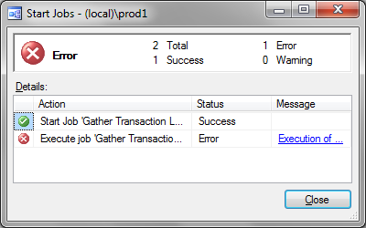
Troubleshooting Failed Jobs
SQL Server Agent status:
Is the service account valid?
Is the msdb database online?
Job history:
Job outcome identifies the last step to execute
Job step outcome identifies why the step failed
Job execution:
Is the job enabled?
Is the job scheduled?
Is the schedule enabled?
Access to dependencies:
Are all dependent objects available?
Notes:
Talk the students through the key troubleshooting steps for job issues.
20462D
12: Automating SQL Server 2014 Management

Slide 15
Monitoring SQL Server with Alerts and Notifications
Welcome to New Horizons Computer Learning Center
Indiana Electric Cooperatives

Slide 16
Overview of SQL Server Alerts
An alert is a predefined response to an event
Alerts can be triggered by:
Logged SQL Server events
SQL Server performance conditions
WMI events
Alerts can:
Notify an operator
Start a job
Notes:
Explain that alerts are predefined responses to specific events that can occur in a SQL Server solution. You can define alerts to perform a job or to notify an operator when a particular event occurs or a performance threshold is exceeded.
Note that the error message has to be written to the Windows Application Event Log being used for SQL Agent Alerts.
When you create an alert to fire a response after a SQL Server error occurs, you can specify a single error number or all errors of a specific severity level. You can define an alert for all databases, or for a particular database.
Emphasize that it is good practice to configure notifications for error messages with severity level 19 and above.
20764A
10: Monitoring SQL Server with Alerts and Notifications

Slide 17
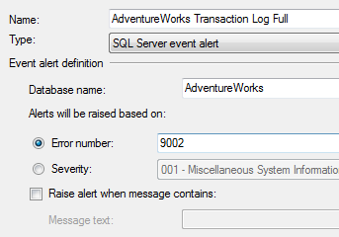
Creating Alerts
Create by using SQL Server Management Studio or sp_add_alert
Define action to take
EXEC msdb.dbo.sp_add_alert
@name=N'AdventureWorks Transaction Log Full',
@message_id=9002, @delay_between_responses=0,
@database_name=N'AdventureWorks';
GO
Notes:
Explain how to create alerts. Point out again that event alerts only work if the message is written to Windows Application Event Log.
20462D
13: Monitoring SQL Server 2014 with Notifications and Alerts

Slide 18
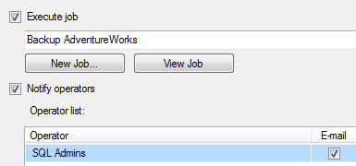
Configuring Alert Actions
Actions:
Execute a job
Notify an operator
Create Notifications
EXEC msdb.dbo.sp_add_notification
@alert_name = N'AdventureWorks Transaction Log Full',
@operator_name=N'SQL Admins',
@notification_method = 1;
GO
Notes:
Explain that the actions taken can be starting a job and/or notifying operators. Point out that only one job can be started and that you configure which that is by using SSMS or the sp_add_alert or sp_update_alert stored procedures.
Note that, in contrast to the job to run, you define which operators to notify by using a special stored procedure, sp_add_notification, and not directly at the alert.
Explain that special tokens are available for working with alerts.
20462D
13: Monitoring SQL Server 2014 with Notifications and Alerts

Slide 19
QUESTIONS?
Welcome to New Horizons Computer Learning Center
Indiana Electric Cooperatives

