Slide 1
XML Tutorial for the 70-461 exam
John Deardurff
Microsoft Certified Trainer
Website: http://john.deardurff.com
Twitter: @John_Deardurff

Slide 2
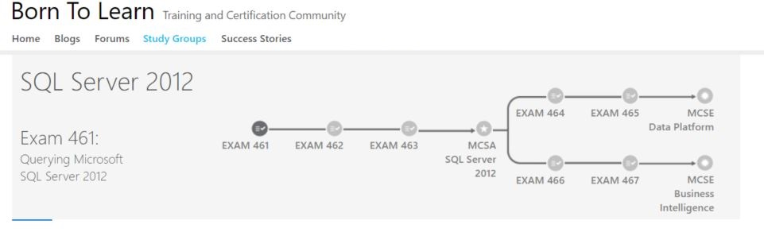
https://borntolearn.mslearn.net/certification/

Slide 3
Presentation Topics
What is XML?
XML Data Types
Retrieving XML from SQL
Importing XML into SQL

Slide 4
What is XML?
HTML
Pre-defined tags that formats data
<Strong>Smith</Strong>
XML
Custom elements that describes data
<LastName>Smith</LastName>

Slide 5
XML Elements and Attributes
<People>
<Person ID=“1”>
<FirstName>Winston</FirstName>
<LastName>Smith</LastName>
</Person>
<Person ID=“2”>
<FirstName>Bjorn</FirstName>
<LastName>Wilde</LastName>
</Person>
</People>

Slide 6



How SQL Server Implements XML
XML Data Type that stores data within a column.
XQuery support allows query based interaction
with data stored in XML format.
XML
The FOR XML T-SQL clause provides the
ability to display query results in XML format.
XML
The OpenXML function provides the ability to
display XML into a rowset view. This rowset
can then be queried as relational data.
XML

Slide 7
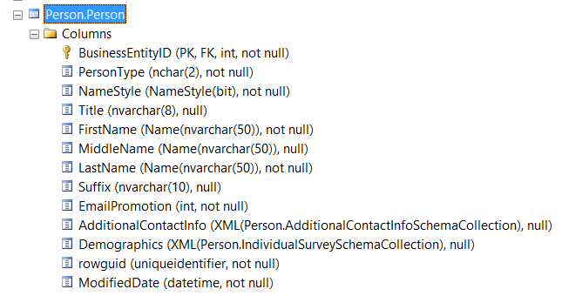
What is the XML data type?

Slide 8
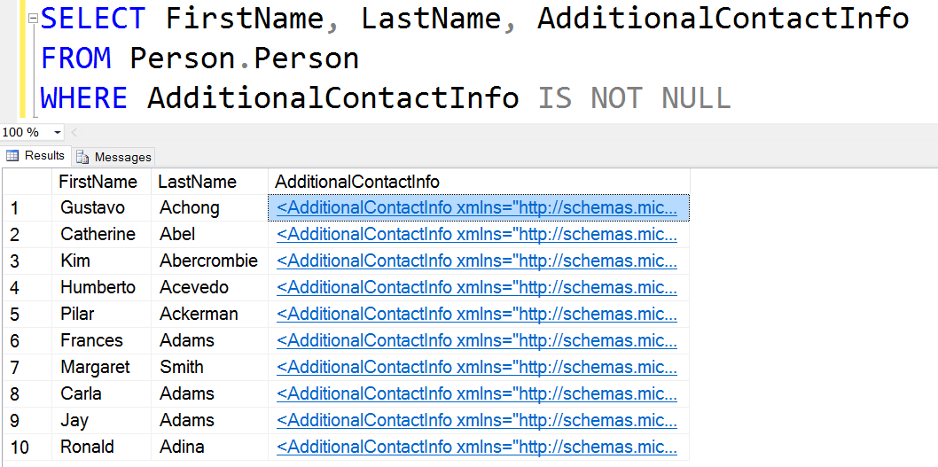
What is the XML data type?

Slide 9
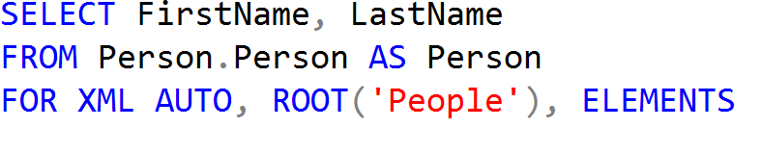
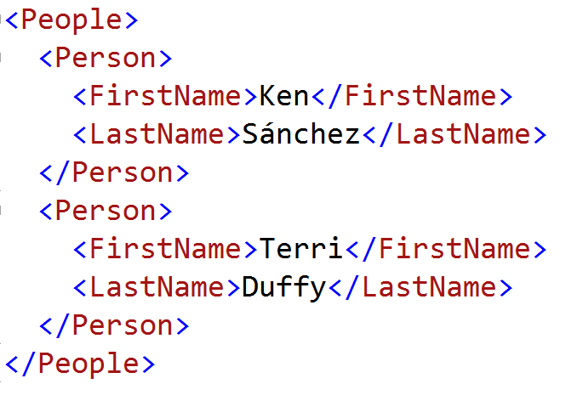
Using the FOR XML statement

Slide 10
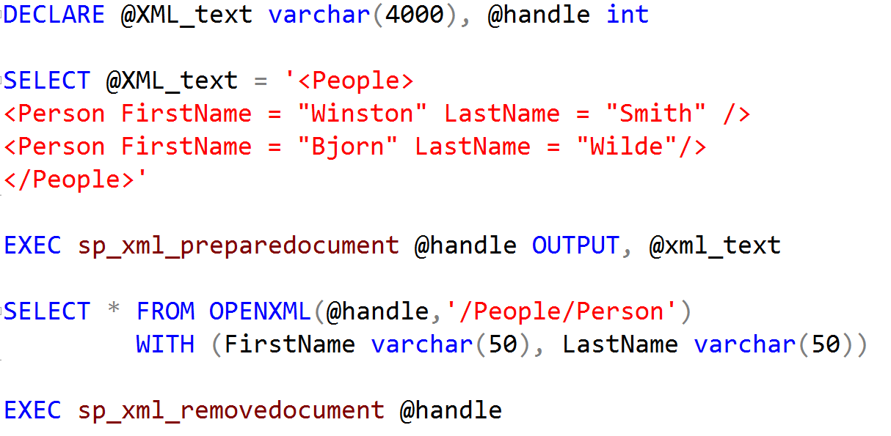
Using the OPENXML function

Slide 11


