Slide 1
Deep Dive into Non-Clustered Indexes
John Deardurff

Slide 2




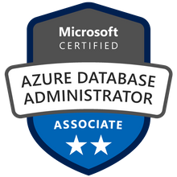



John Deardurff
Cloud Solution Architect - Engineer
Microsoft Certified Trainer
MVP: Data Platform (2016 – 2018)
Email: John.Deardurff@Microsoft.com
Twitter: @SQLMCT
Website: www.SQLMCT.com
GitHub: github.com\SQLMCT

Slide 3
What does this session cover?
Multi-Column Non-Clustered Indexes
Structure of Non-Clustered Indexes
Bookmark and RID Lookups
INCLUDE columns in a Non-Clustered Index
Demonstration

Slide 4
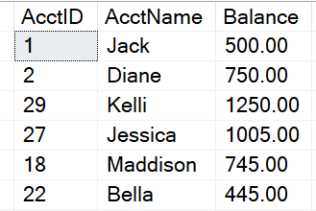
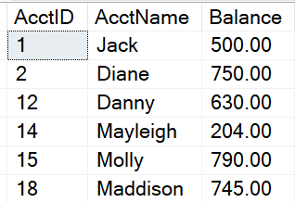
Base Tables - How Data is Stored in Data Pages
Heap
Data stored in a Heap is not stored in any order and normally does not have a Primary Key.
Clustered Index
Clustered Index data is stored in sorted order by the Clustering key. In many cases, this is the same value as the Primary Key.

Slide 5
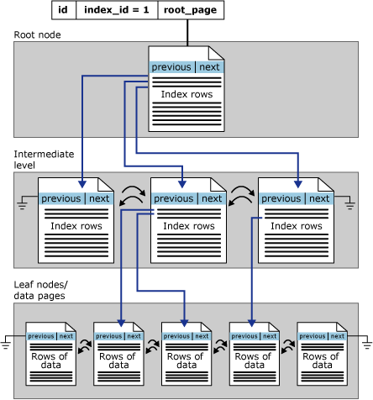
Clustered Index Structure
Leaf Node Contains Data Pages

Slide 6
Non-Clustered Indexes
It is a separate structure built on top of a Heap or Clustered Index.
Only contains a subset of the columns in the base table
The leaf level contains only the columns defined in the index as well as the clustered key/heap ID that points to the base table structure.
Notes:
NonClustered Index
Same B-tree data structure as in a clustered index, except for Leaf Level.
Non-Clustered Index Data is kept in synch with base table, but its data is stored separately.
Contains a subset of the columns in the base table.
Think of it as a skinny table that is really fast for searching and sorting.
Most likely far fewer pages in a NC index as compared to a Clustered table.
Leaf level contents:
Columns defined in the index key.
A ‘pointer’ to link back to the base table (to retrieve additional data).
clustered key for Clustered Objects or
ROW ID for heap objects
Any Included Columns
As Leaf level contains fewer columns in comparison to base table, Non-Clustered indexes have fewer pages than the corresponding base table.
References https://docs.microsoft.com/en-us/sql/relational-databases/sql-server-index-design-guide?view=sql-server-ver15

Slide 7

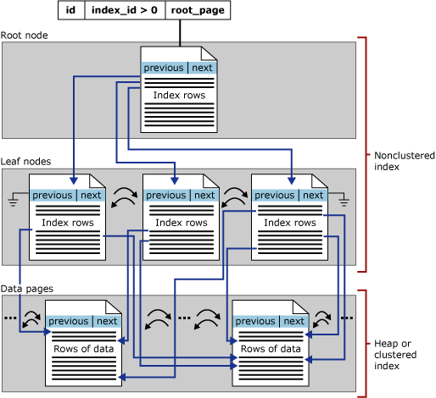
Non-Clustered Index Structure
Leaf Node has Pointers to Base Table
Base Table (Heap or Clustered Index

Slide 8
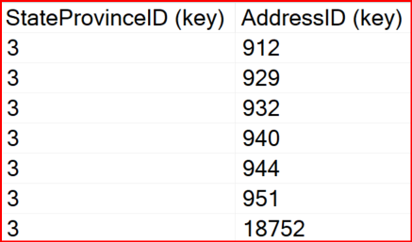
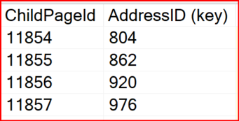
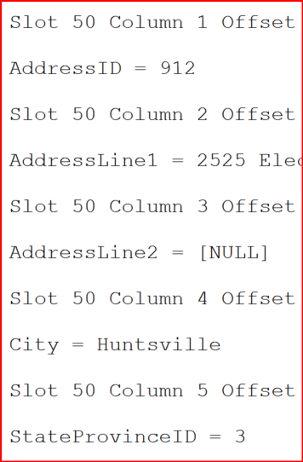
Non-Clustered Index Structure
Non-Clustered Index
Leaf Level
Clustered Index
Non-Leaf Level
--SELECT * will need to find all columns
SELECT *
FROM Person.Address
WHERE StateProvinceID = 3
Data Page 11855
Leaf Level

Slide 9
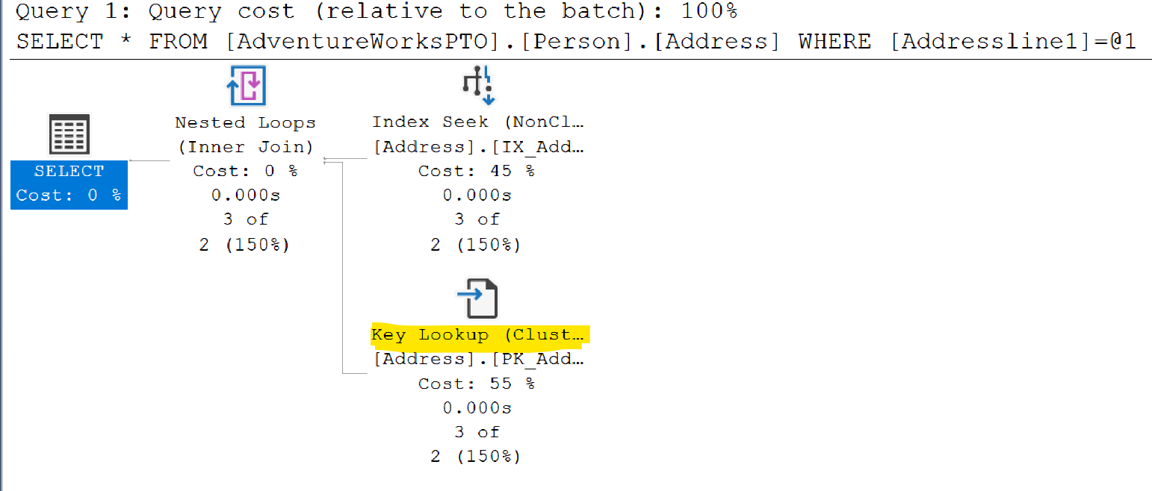
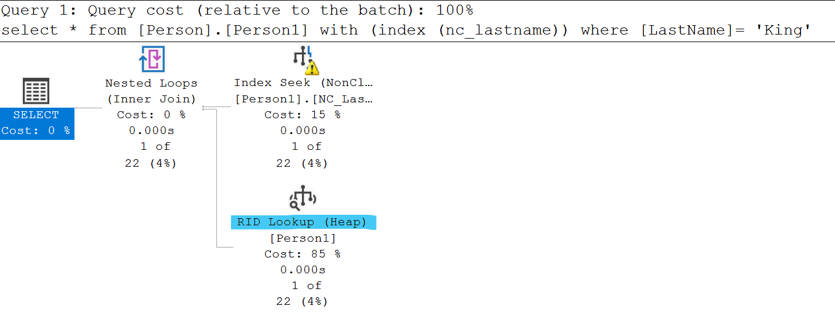
Bookmark or RID Lookups
Occurs when SQL uses a nonclustered index to satisfy all or some of a query’s predicates, but it doesn’t contain all the information needed to cover the query.
If table has clustered index, it is called bookmark lookup (or key lookup)
If the table is a heap with a non-clustered index, it is called RID lookup
Lookup effectively join the nonclustered index back to the clustered index or heap.
Notes:
Key Points:
When nonclustered indexes are used, SQL Server may choose to use a different access method.
When the nonclustered index is sought or scanned, it is doing so to support WHERE clauses and JOINs.
However, the nonclustered index often cannot support the SELECT clause hence need to join with base table.
To put it another way, it cannot ‘cover’ the query.
=============
More Information
=============
To get the columns needed for the select clause, SQL Server needs to look up those additional columns using a Key Lookup, which reaches back to the clustered index or heap.
This is possible because each row in the nonclustered index has not only the columns that were defined, but also includes the clustering key or RID.
When the nonclustered index seek/scan finds the rows that match the filter requested, it loops over each of the rows, gets the hidden key/RID, and gets the additional columns needed.
Key lookups are costly. In fact, they are so costly that SQL Server frequently decides that the cost of a nonclustered index seek + lookup is higher than simply scanning the clustered index.
To improve Query performance one must remove the lookup from the Execution plan.
The ‘tipping point’ that determines when SQL Server will scan is pretty low, and is typically 10%.
Therefore, avoiding key lookups is often a good way to help query performance. The next lesson, “Indexing Strategy”, discusses ways that this can be done.

Slide 10
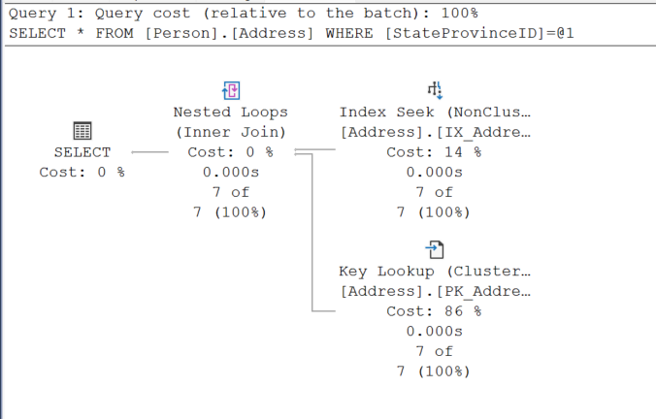
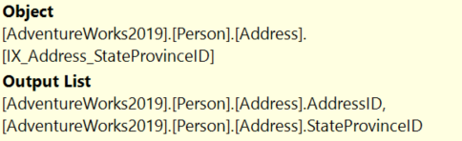
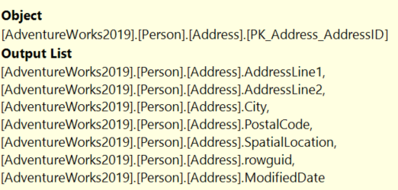
Key Lookup
Notes:
Key Points:
When nonclustered indexes are used, SQL Server may choose to use a different access method.
When the nonclustered index is sought or scanned, it is doing so to support WHERE clauses and JOINs.
However, the nonclustered index often cannot support the SELECT clause hence need to join with base table.
To put it another way, it cannot ‘cover’ the query.
=============
More Information
=============
To get the columns needed for the select clause, SQL Server needs to look up those additional columns using a Key Lookup, which reaches back to the clustered index or heap.
This is possible because each row in the nonclustered index has not only the columns that were defined, but also includes the clustering key or RID.
When the nonclustered index seek/scan finds the rows that match the filter requested, it loops over each of the rows, gets the hidden key/RID, and gets the additional columns needed.
Key lookups are costly. In fact, they are so costly that SQL Server frequently decides that the cost of a nonclustered index seek + lookup is higher than simply scanning the clustered index.
To improve Query performance one must remove the lookup from the Execution plan.
The ‘tipping point’ that determines when SQL Server will scan is pretty low, and is typically 10%.
Therefore, avoiding key lookups is often a good way to help query performance. The next lesson, “Indexing Strategy”, discusses ways that this can be done.

Slide 11
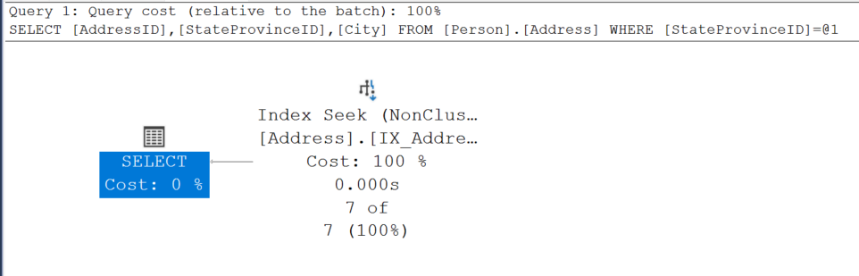
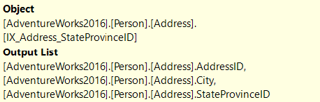
Non-Clustered Index with Included Column
Notes:
Key Points:
When nonclustered indexes are used, SQL Server may choose to use a different access method.
When the nonclustered index is sought or scanned, it is doing so to support WHERE clauses and JOINs.
However, the nonclustered index often cannot support the SELECT clause hence need to join with base table.
To put it another way, it cannot ‘cover’ the query.
=============
More Information
=============
To get the columns needed for the select clause, SQL Server needs to look up those additional columns using a Key Lookup, which reaches back to the clustered index or heap.
This is possible because each row in the nonclustered index has not only the columns that were defined, but also includes the clustering key or RID.
When the nonclustered index seek/scan finds the rows that match the filter requested, it loops over each of the rows, gets the hidden key/RID, and gets the additional columns needed.
Key lookups are costly. In fact, they are so costly that SQL Server frequently decides that the cost of a nonclustered index seek + lookup is higher than simply scanning the clustered index.
To improve Query performance one must remove the lookup from the Execution plan.
The ‘tipping point’ that determines when SQL Server will scan is pretty low, and is typically 10%.
Therefore, avoiding key lookups is often a good way to help query performance. The next lesson, “Indexing Strategy”, discusses ways that this can be done.

Slide 12
Non-Clustered Index Strategy
Index columns used in WHERE clauses and JOINs.
Keep indexes to a minimum, to minimize impact on DML and log writes.
Single column indexes or Multicolumn indexes
Easy to create too many nonclustered indexes.
Specific indexes are appropriate for high-impact queries.
Ideally the focus should be writing queries to use existing indexes, rather than on adding more indexes.
Notes:
Key Points:
Index columns used in WHERE clauses and JOINs
Start with foreign keys, and remove later if not used
This strategy is easy for nonclustered indexes, for any single query. Build an index to support joins and WHERE clauses, and you are done. The challenge comes when you need to address indexing a table with a lot of different queries used against it, each of which may filter on different combinations of columns.
You cannot build specific indexes for every combination of fields that may ever be used, because:
Of storage issues.
A lot of nonclustered indexes would impact DML.
Of the increased maintenance overhead.
=============
More Information
=============
Deciding on an indexing strategy is never easy and is never a one-time effort.
The queries against a table change over time, and therefore, indexing strategies have to be reviewed and adjusted as needed.
Ideally, the first column in a multi-column index will be used in every query. However, that is not likely to happen.
One solution is to create every possible combination of indexes, but that will not scale.
Even though index scans are not as efficient as seeks, the fact is that nonclustered indexes only have a few columns as compared to the clustered index, which could have dozens of columns.
This means that scanning a nonclustered index to find records may result in acceptable query performance.
Ideally the focus should be on writing queries to use existing indexes, rather than on adding more indexes

Slide 13
Multi-Column Indexing Access
Seek only happens if you search for the columns in the specified order.
Effect of column in different WHERE clause.
WHERE PostalCode = 98011 – seek
WHERE PostalCode = 98011 – seek AND City = Bothell -- scan
WHERE StateID = 79 -- scan
CREATE INDEX IX1 ON TABLE (PostalCode, StateID, City)
WHERE PostalCode = 98011 AND StateID = 79 – seek both
Notes:
When trying to decide whether your index should be on Col1, Col2 or Col2, Col1 (or both), remember that even though SQL Server performs best when it can seek the index, scanning the index may still perform a lot better than scanning the clustered index.
That Is because the clustered index holds all the data for the rows and is therefore typically much larger than any nonclustered index, which typically only has a few columns.
Therefore, if you are frequently searching for Col1 or Col1, Col2, and only occasionally searching for Col2, it may be OK to accept the index scan needed when you do query Col2 alone, instead of creating both indexes and incurring that maintenance and DML overhead.

Slide 14
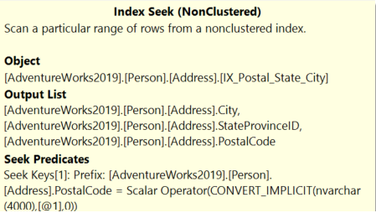
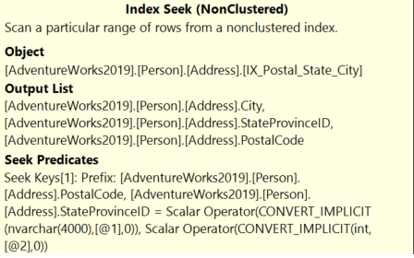
Multi-Column Indexing Access (Seek Predicates)
--Single value performs Index Seek.
SELECT City, StateProvinceID, PostalCode
FROM Person.Address
WHERE PostalCode = '98011'
--Index Seek on both columns
--Search condition in same order as Index.
SELECT City, StateProvinceID, PostalCode
FROM Person.Address
WHERE PostalCode = '98011' AND StateProvinceID = 79
Notes:
When trying to decide whether your index should be on Col1, Col2 or Col2, Col1 (or both), remember that even though SQL Server performs best when it can seek the index, scanning the index may still perform a lot better than scanning the clustered index.
That Is because the clustered index holds all the data for the rows and is therefore typically much larger than any nonclustered index, which typically only has a few columns.
Therefore, if you are frequently searching for Col1 or Col1, Col2, and only occasionally searching for Col2, it may be OK to accept the index scan needed when you do query Col2 alone, instead of creating both indexes and incurring that maintenance and DML overhead.

Slide 15
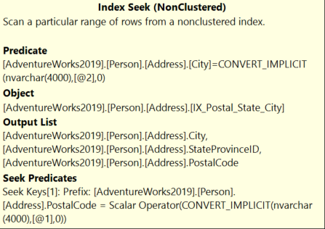
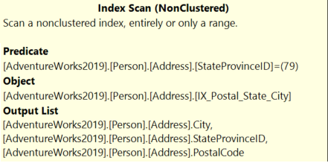
Multi-Column Indexing Access (Scan Predicates)
--Search condition not in same order as Index.
--Performs Index Scan.
SELECT City, StateProvinceID, PostalCode
FROM Person.Address
WHERE StateProvinceID = 79
--Index Seek on first column
--After seek, will scan second column
SELECT City, StateProvinceID, PostalCode
FROM Person.Address
WHERE PostalCode = '98011' AND City = 'Bothell'
Notes:
When trying to decide whether your index should be on Col1, Col2 or Col2, Col1 (or both), remember that even though SQL Server performs best when it can seek the index, scanning the index may still perform a lot better than scanning the clustered index.
That Is because the clustered index holds all the data for the rows and is therefore typically much larger than any nonclustered index, which typically only has a few columns.
Therefore, if you are frequently searching for Col1 or Col1, Col2, and only occasionally searching for Col2, it may be OK to accept the index scan needed when you do query Col2 alone, instead of creating both indexes and incurring that maintenance and DML overhead.

Slide 16
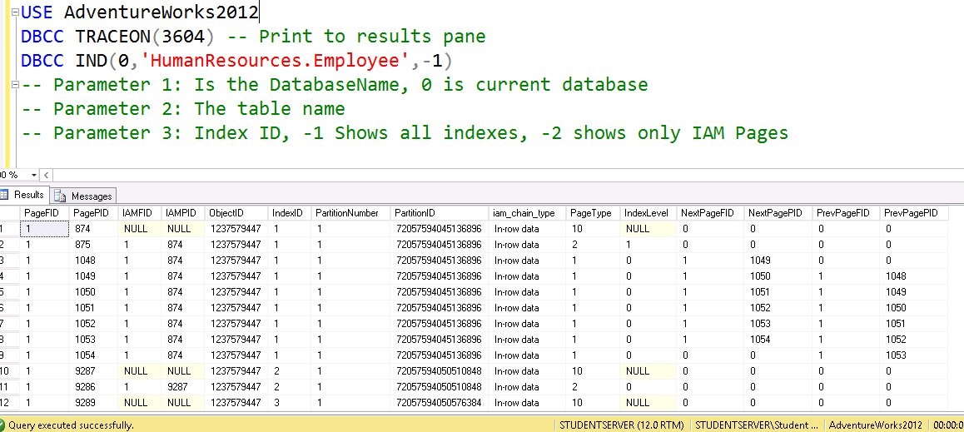
DBCC IND
Page Types
Data (1) | Index (2) | Text/Image (3 or 4) | IAM (10)

Slide 17
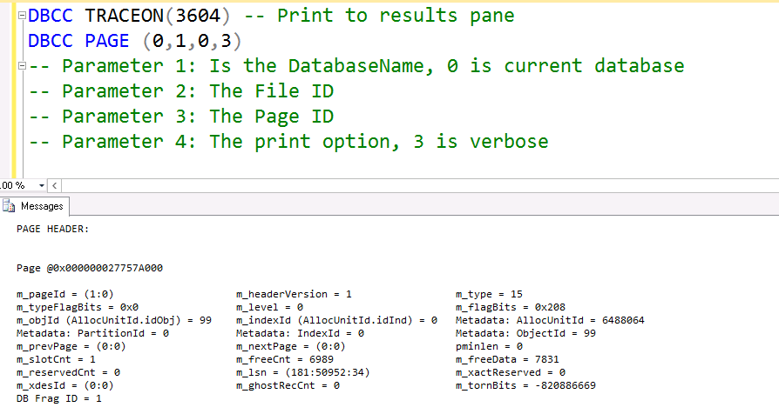
DBCC PAGE
New DMF sys.dm_db_page_info is supported in SQL Server 2019 (15.x) and later.

Slide 18


Slide 19
Microsoft

