Slide 1
Environment Automation
Adam Anderson
Notes:
Welcome to Delivering business value faster.

Slide 2
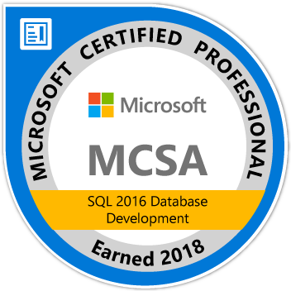
About Me
Adam Anderson
@SQLPioneer
sqlpioneer.wordpress.com
www.linkedin.com/in/adam-anderson-dba
https://github.com/SQLPioneer/
Notes:
My name is Adam Anderson, and I have been a database developer for over 10 years and in IT for more than 20. I am MCSA certified and will be taking my final test in a month or two to get my MCSE.
So I have a friend that is a financial accountant and he always droned on about ROI and how most people didn’t understand it. When I asked what he meant he told me that if you invest 100,000 dollars and a year later you get 12,000 dollars in return that was a 12% ROI and most companies would take that and run. However, if you can start making a 1000 dollars a month it is still the same money

Slide 3
Agenda
Introduction
Docker Environment
PowerShell Automation
Software Management using Chocolatey
Use Case Review

Slide 4
Docker

Slide 5
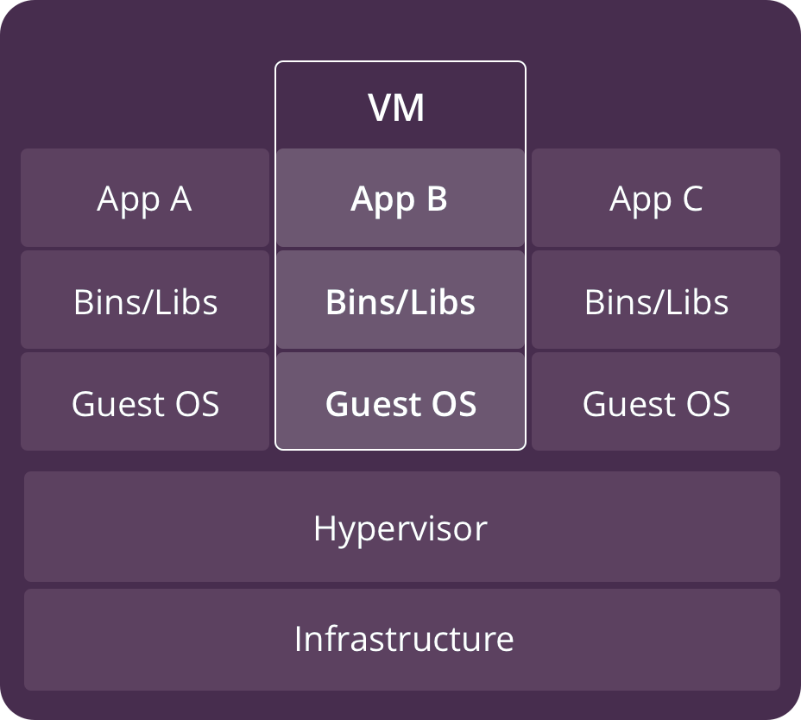
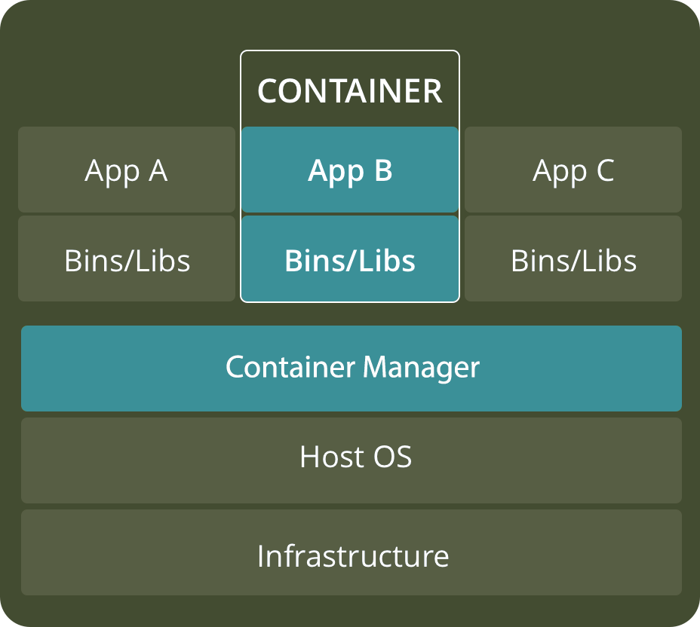
VM versus Container
https://www.backblaze.com/blog/vm-vs-containers/

Slide 6
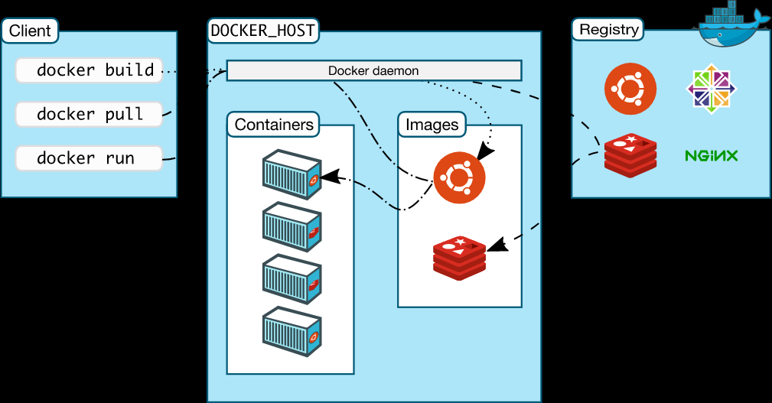
Docker Architecture
https://docs.docker.com/engine/docker-overview/

Slide 7
Docker Images to Support Test and Dev
Full Prod Data
Confidential Data Removed
Full Data
Pre-Production Image
Testing Image
Development image
90% Delete
Confidential Data Removed

Slide 8
Chocolatey / NuGet

Slide 9
Application Installations
NuGet
Chocolatey
Packaged Code
Pulls from NuGet Repos
Fully Configurable
Private Repo
Shared Components for reuse

Slide 10
NuGet
Single ZIP file with the .nupkg extension
Contains any files associated with package
Descriptive Manifest
Version Number format must be 1.0.2

Slide 11

Chocolatey
Pulls packages from public and private repositories
Creates NuGet packages
Works with common Configuration Managers

Slide 12
Environment Overview

Slide 13
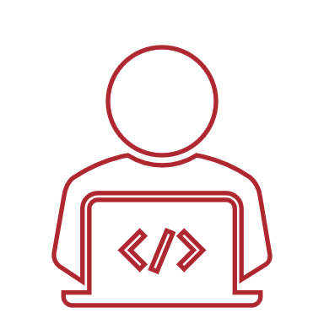
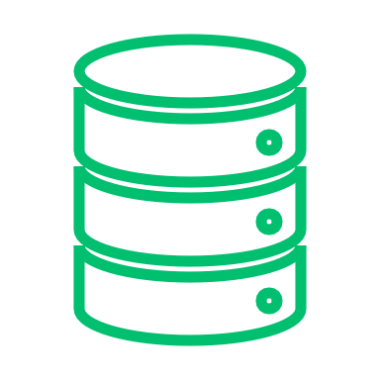


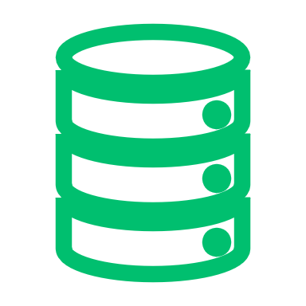
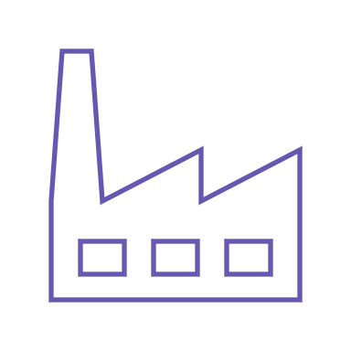

Docker Setup
Development
Dev 1
Docker Environment
Port: 1435
Base Images
SQL Server Image
Database
Dev 2
Version
Control
Port: 1436
Dev Image
Database
Docker Bind Mount
Database
Testing
Backup
QA Image
QA 1
Build Server
Port: 1437
Database
Database
Docker Volume
Prod Like Image
Prod Like
DB.mdf
DB_log.ldf
PreProd
Port: 1433
Artifact Repository

Slide 14





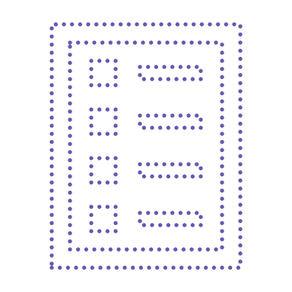
Volumes
Development
Dev 1
Docker Environment
Port: 1435
Base Images
SQL Server Image
Database
Dev 2
Version
Control
Port: 1436
Dev Image
Database
Docker Bind Mount
Database
Testing
Backup
QA Image
QA 1
Build Server
Port: 1437
Database
Database
Docker Volume
Prod Like Image
Prod Like
DB.mdf
DB_log.ldf
PreProd
Port: 1433
Artifact Repository

Slide 15


Docker Images
Development
Dev 1
Docker Environment
Port: 1435
Base Images
SQL Server Image
Database
Dev 2
Version
Control
Port: 1436
Dev Image
Database
Docker Bind Mount
Database
Testing
Backup
QA Image
QA 1
Build Server
Port: 1437
Database
Database
Docker Volume
Prod Like Image
Prod Like
DB.mdf
DB_log.ldf
PreProd
Port: 1433
Artifact Repository

Slide 16
Containers
Development
Dev 1
Docker Environment
Port: 1435
Base Images
SQL Server Image
Database
Dev 2
Version
Control
Port: 1436
Dev Image
Database
Docker Bind Mount
Database
Testing
Backup
QA Image
QA 1
Build Server
Port: 1437
Database
Database
Docker Volume
Prod Like Image
Prod Like
DB.mdf
DB_log.ldf
PreProd
Port: 1433
Artifact Repository

Slide 17
Developer Workflow
Development
Dev 1
Docker Environment
Port: 1435
Base Images
SQL Server Image
Database
Dev 2
Version
Control
Port: 1436
Dev Image
Database
Docker Bind Mount
Database
Testing
Backup
QA Image
QA 1
Build Server
Port: 1437
Database
Database
Docker Volume
Prod Like Image
Prod Like
DB.mdf
DB_log.ldf
PreProd
Port: 1433
Artifact Repository

Slide 18
Summary
Docker can be used to create dynamic database environments that can be used for
Testing
Development

Slide 19
Contact Information
Adam Anderson
@SQLPioneer
sqlpioneer.wordpress.com
www.linkedin.com/in/adam-anderson-dba
https://github.com/SQLPioneer/
Notes:
My name is Adam Anderson, and I have been a database developer for over 10 years and in IT for more than 20. I am MCSA certified and will be taking my final test in a month or two to get my MCSE.
So I have a friend that is a financial accountant and he always droned on about ROI and how most people didn’t understand it. When I asked what he meant he told me that if you invest 100,000 dollars and a year later you get 12,000 dollars in return that was a 12% ROI and most companies would take that and run. However, if you can start making a 1000 dollars a month it is still the same money

