Slide 1
Environment Automation
Adam Anderson
Notes:
Welcome to Delivering business value faster.

Slide 2
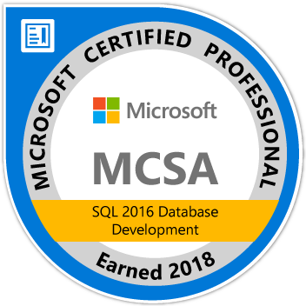
About Me
Adam Anderson
@SQLPioneer
sqlpioneer.wordpress.com
www.linkedin.com/in/adam-anderson-dba
https://github.com/SQLPioneer/
Notes:
My name is Adam Anderson, and I have been a database developer for over 10 years and in IT for more than 20. I am MCSA certified and will be taking my final test in a month or two to get my MCSE.
So I have a friend that is a financial accountant and he always droned on about ROI and how most people didn’t understand it. When I asked what he meant he told me that if you invest 100,000 dollars and a year later you get 12,000 dollars in return that was a 12% ROI and most companies would take that and run. However, if you can start making a 1000 dollars a month it is still the same money

Slide 3
Agenda
Introduction
Docker Overview
Use Case Review
PowerShell Automation

Slide 4
Docker

Slide 5
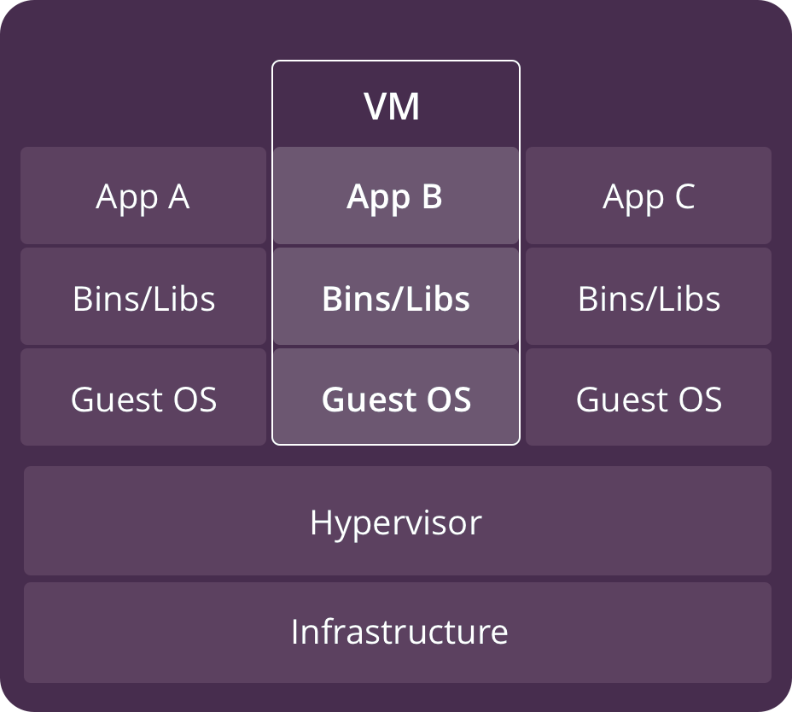
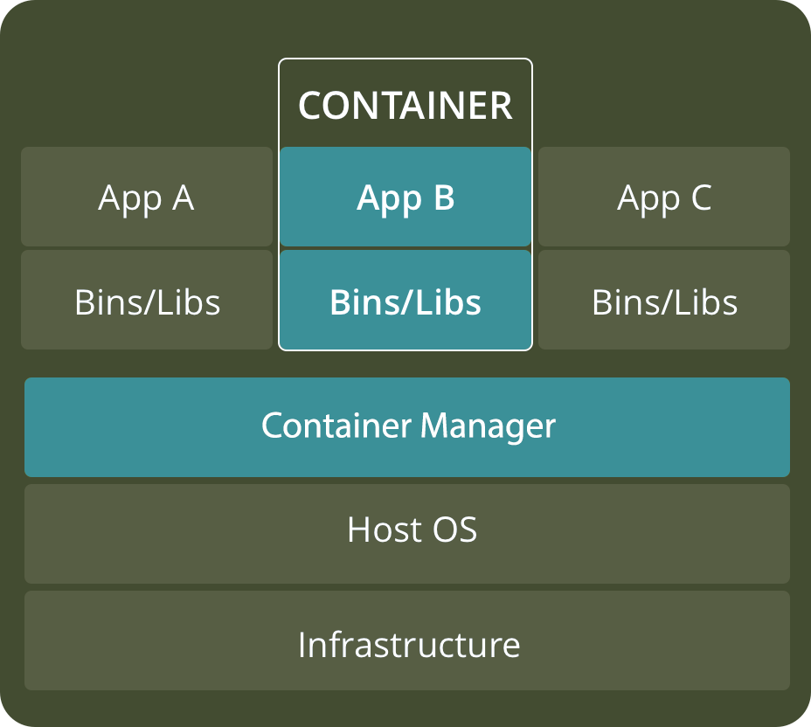
VM versus Container
https://www.backblaze.com/blog/vm-vs-containers/

Slide 6
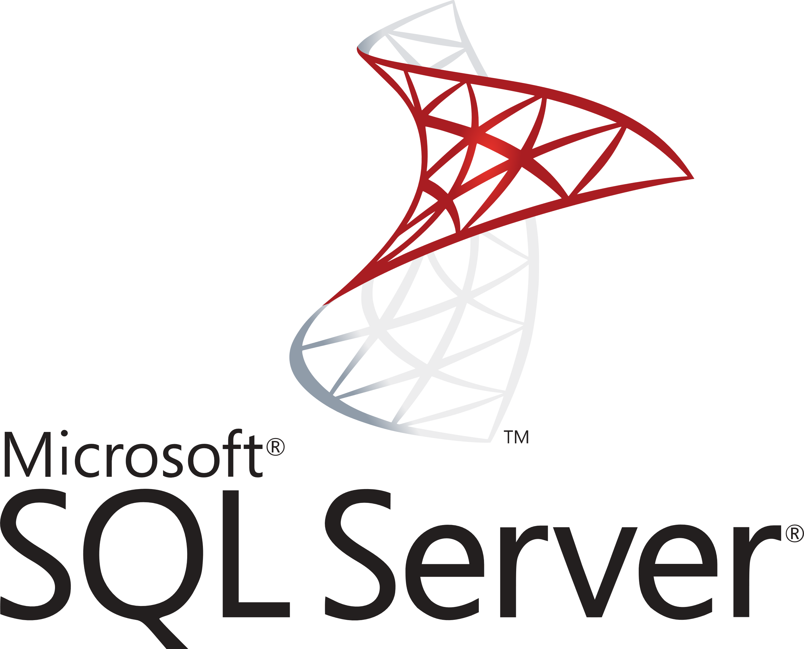


Docker Architecture
Docker Host
Registry
Client
Docker pull
Docker run
Docker Start
Docker Daemon
Containers
Images
https://www.backblaze.com/blog/vm-vs-containers/

Slide 7
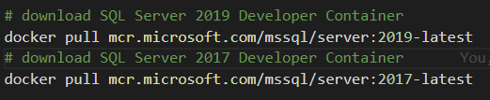
Download SQL Server Container

Slide 8
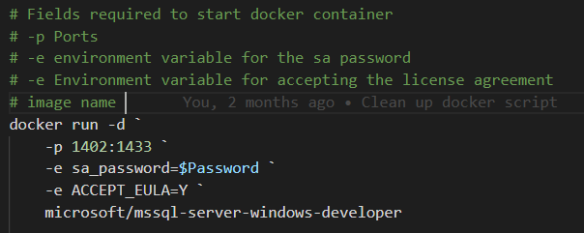
Create a Container from an Image

Slide 9
Optional Parameters
--name: Name of the container
--hostname or -h: Network alias
--volume or –v: volume path (OS:Container)
--env or –e: Environment variable
--rm: Remove container when stopped
--detatched or -d: Start container detatched

Slide 10
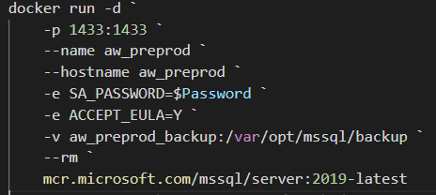
Create Container with Optional Parameters

Slide 11
Docker Commands to get Started
Docker pull: Download an image from the docker repository
Docker run: Create a container from the image.
Docker start: Start a container that has been stopped
Docker stop: Stop a container that is running
Docker help: Show help for Docker commands

Slide 12
Docker Commands to Manage Containers
Docker ps: Show running containers
Docker ps -a: Show all containers
Docker rm: Remove stopped container
Docker Exec: Execute a command in a running container

Slide 13
Docker Commands to Manage Images
Docker images: Show and work with images
Docker rmi: Remove image
Docker commit: Create an image from a container

Slide 14
Environment Overview

Slide 15
Docker Images to Support Test and Dev
Full Prod Data
Confidential Data Removed
Full Data
Pre-Production Image
Testing Image
Development Image
90% Delete
Confidential Data Removed

Slide 16

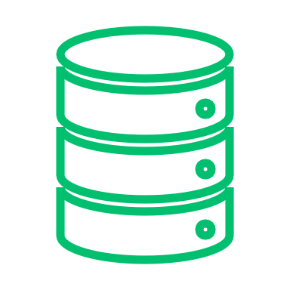


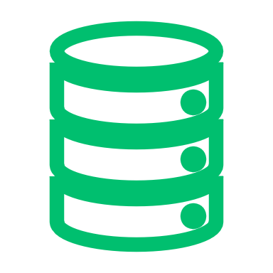


Docker Setup
Development
Dev 1
Docker Environment
Port: 1435
Base Images
SQL Server Image
Database
Dev 2
Version
Control
Port: 1436
Dev Image
Database
Docker Bind Mount
Database
Testing
Backup
QA Image
QA 1
Build Server
Port: 1437
Database
Database
Docker Volume
Prod Like Image
Prod Like
DB.mdf
DB_log.ldf
PreProd
Port: 1433
Artifact Repository

Slide 17






Volumes
Development
Dev 1
Docker Environment
Port: 1435
Base Images
SQL Server Image
Database
Dev 2
Version
Control
Port: 1436
Dev Image
Database
Docker Bind Mount
Database
Testing
Backup
QA Image
QA 1
Build Server
Port: 1437
Database
Database
Docker Volume
Prod Like Image
Prod Like
DB.mdf
DB_log.ldf
PreProd
Port: 1433
Artifact Repository

Slide 18


Docker Images
Development
Dev 1
Docker Environment
Port: 1435
Base Images
SQL Server Image
Database
Dev 2
Version
Control
Port: 1436
Dev Image
Database
Docker Bind Mount
Database
Testing
Backup
QA Image
QA 1
Build Server
Port: 1437
Database
Database
Docker Volume
Prod Like Image
Prod Like
DB.mdf
DB_log.ldf
PreProd
Port: 1433
Artifact Repository

Slide 19
Containers
Development
Dev 1
Docker Environment
Port: 1435
Base Images
SQL Server Image
Database
Dev 2
Version
Control
Port: 1436
Dev Image
Database
Docker Bind Mount
Database
Testing
Backup
QA Image
QA 1
Build Server
Port: 1437
Database
Database
Docker Volume
Prod Like Image
Prod Like
DB.mdf
DB_log.ldf
PreProd
Port: 1433
Artifact Repository

Slide 20
Developer Workflow
Development
Dev 1
Docker Environment
Port: 1435
Base Images
SQL Server Image
Database
Dev 2
Version
Control
Port: 1436
Dev Image
Database
Docker Bind Mount
Database
Testing
Backup
QA Image
QA 1
Build Server
Port: 1437
Database
Database
Docker Volume
Prod Like Image
Prod Like
DB.mdf
DB_log.ldf
PreProd
Port: 1433
Artifact Repository

Slide 21
Powershell

Slide 22


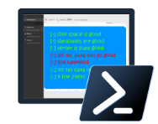
Powershell for the Win
Easy to automate
Community Tools
Dbatools
Dbachecks
Security
Short development cycle, quick return on investment (ROI)
dbachecks

Slide 23
T-SQL versus DBATools backup
DECLARE @filename nvarchar(200) SELECT @filename + 'D:\BKP\Core\MyDB_Log_' + convert(varchar(23), getdate(), 126) + '.bak' BACKUP DATABASE MyDB TO DISK = @filename
Backup-DbaDatabase -SqlInstance localhost

Slide 24
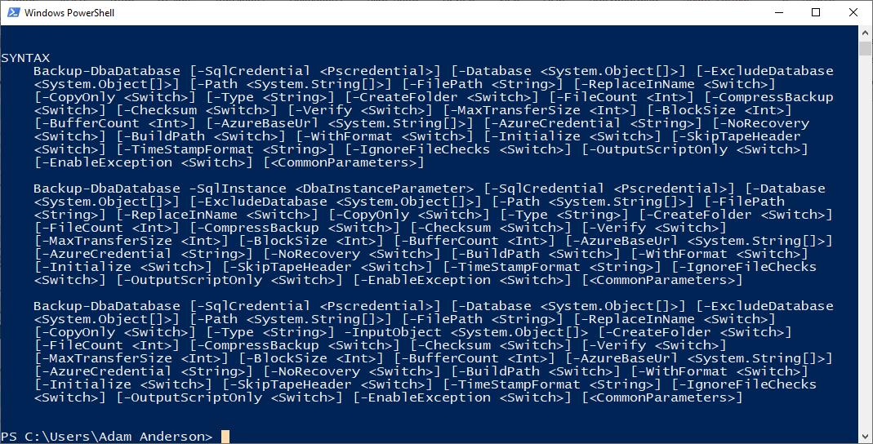
Help Backup-dbaDatabase

Slide 25
Backup and Restore
Backup-DbaDatabase `
-SqlInstance $Prod `
-SqlCredential $mycred `
-Database AdventureWorks `
-Path c:\backup\ `
-BackupFileName dbname.bak `
-ReplaceInName
Restore-DbaDatabase `
-SqlInstance $HostName `
-SqlCredential $mycred `
-Path c:\backup\AdventureWorks.bak `
-DatabaseName AdventureWorks `
-DestinationDataDirectory c:\data\ `
-DestinationLogDirectory c:\data

Slide 26
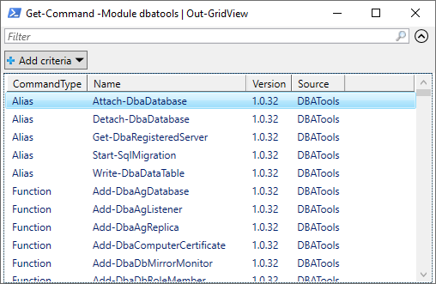
Get-Command -Module dbatools | Out-GridView

Slide 27
Powershell Basics
$Twittter = “@sqlpioneer”
Set-Alias -Name Edit -Value "notepad++.exe"
Edit $profile
New-PSDrive -name Pres -PSProvider FileSystem -Root "C:\git\GitHub\Presentations“
Set-Location Pres:
Cd Pres:

Slide 28
Hash Table
$Config = @{
"ServerInstance"="localhost,1401"
"Database"="FIFA"
"Username"=$user
"Password"=$password
"Query"="SELECT @@ServerName AS ServerName"
}
$Config.ServerInstance
Invoke-Sqlcmd @Config

Slide 29
Database Testing
$Check = @{
"SqlInstance"=$HostName
"SqlCredential"=$mycred
"Tags"="InstanceConnection"
}
Invoke-DbcCheck @Check -PassThru | Update-DbcPowerBiDataSource

Slide 30
Summary
Powershell is a DBAs best friend and can be used to automate almost anything.
DBATools, SQLServer, DBACheck
Docker can be used to create dynamic database environments that can be used for
Testing
Development
Even Production

Slide 31
Contact Information
Adam Anderson
@SQLPioneer
sqlpioneer.wordpress.com
www.linkedin.com/in/adam-anderson-dba
https://github.com/SQLPioneer/
Notes:
My name is Adam Anderson, and I have been a database developer for over 10 years and in IT for more than 20. I am MCSA certified and will be taking my final test in a month or two to get my MCSE.
So I have a friend that is a financial accountant and he always droned on about ROI and how most people didn’t understand it. When I asked what he meant he told me that if you invest 100,000 dollars and a year later you get 12,000 dollars in return that was a 12% ROI and most companies would take that and run. However, if you can start making a 1000 dollars a month it is still the same money

