Slide 2
The Quick Version
We are dedicated to a harassment-free experience for everyone, regardless of who you are and what makes you you. We recognize the right of any individual to attend and participate. Anyone. This is included but not limited to gender identity and expression, sexual orientation, disability, physical appearance, body size, race, religion, or any other classification, affiliation, or label.
We do not tolerate harassment in any form. For the duration of your engagement with GroupBy and its programs, you are expected to act appropriately and to adhere to this Code of Conduct. This includes conduct in-person and online, at the conference itself, as well as any non-conference programs that may include participants: including talks, workshops, parties, on social media, and other online forums. GroupBy participants violating these rules may be sanctioned or expelled without a refund (if that applies) at the discretion of the conference organizers.
You can review the full policy at: GroupBy.org/Code-of-Conduct
Notes:
You do not need to read this full policy, just give people time to read this and explain they can review the full policy at the provided link.

Slide 3
Environment Automation

Slide 4






Adam Anderson
www.linkedin.com/in/adam-anderson-dba
@SQLPioneer
https://github.com/SQLPioneer/

Slide 5




GROUPBY 2021 | OCT 26-27
Core Sponsors
Media Sponsors
Virtual Group Sponsors

Slide 6
The Quick Version
We are dedicated to a harassment-free experience for everyone, regardless of who you are and what makes you you. We recognize the right of any individual to attend and participate. Anyone. This is included but not limited to gender identity and expression, sexual orientation, disability, physical appearance, body size, race, religion, or any other classification, affiliation, or label.
We do not tolerate harassment in any form. For the duration of your engagement with GroupBy and its programs, you are expected to act appropriately and to adhere to this Code of Conduct. This includes conduct in-person and online, at the conference itself, as well as any non-conference programs that may include participants: including talks, workshops, parties, on social media, and other online forums. GroupBy participants violating these rules may be sanctioned or expelled without a refund (if that applies) at the discretion of the conference organizers.
You can review the full policy at: GroupBy.org/Code-of-Conduct
Notes:
You do not need to read this full policy, just give people time to read this and explain they can review the full policy at the provided link.

Slide 7
Agenda
Introduction
Docker Overview
Use Case Review
PowerShell Automation
Question & Answer

Slide 8
Docker

Slide 9
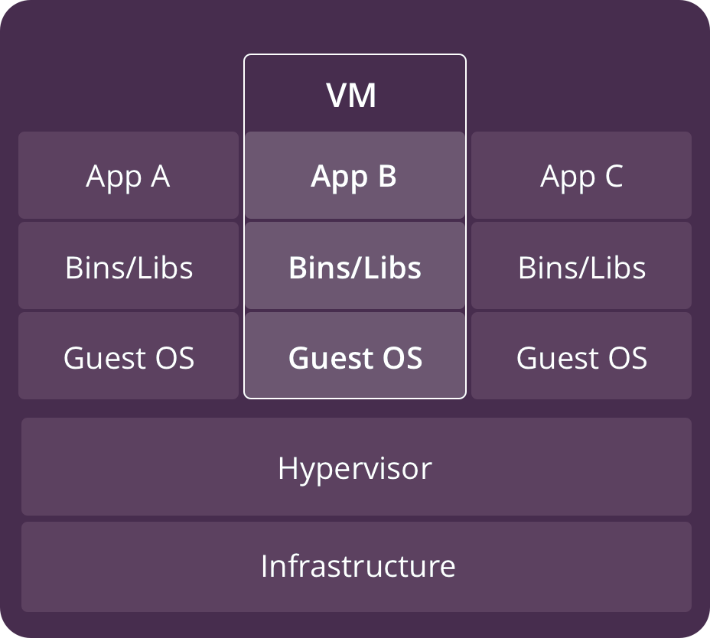
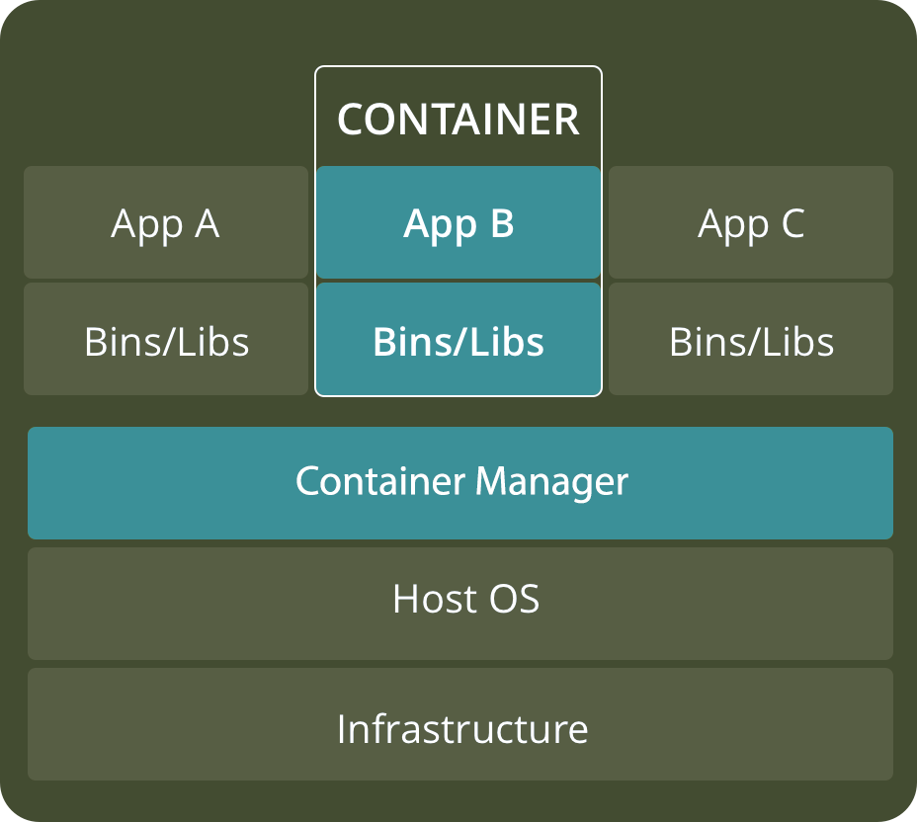
VM versus Container
https://www.backblaze.com/blog/vm-vs-containers/

Slide 10



Docker Architecture
Docker Host
Registry
Client
Docker pull
Docker run
Docker Start
Docker Daemon
Containers
Images
https://www.backblaze.com/blog/vm-vs-containers/

Slide 11
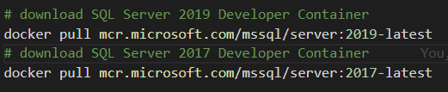
Download SQL Server Image

Slide 12
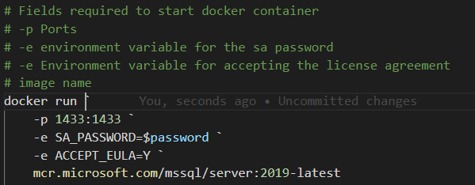
Create a Container from an Image

Slide 13
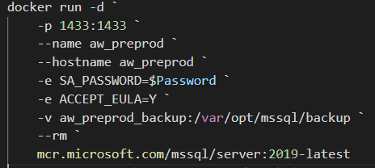
Create Container with Optional Parameters

Slide 14
Optional Parameters
--name: Name of the container
--hostname or -h: Network alias
--volume or –v: volume path (OS:Container)
--env or –e: Environment variable
--rm: Remove container when stopped
--detatched or -d: Start container detatched

Slide 15
Docker Commands to get Started
Docker pull: Download an image from the docker repository
Docker run: Create a container from the image.
Docker start: Start a container that has been stopped
Docker stop: Stop a container that is running
Docker help: Show help for Docker commands

Slide 16
Docker Commands to Manage Containers
Docker ps: Show running containers
Docker ps -a: Show all containers
Docker rm: Remove stopped container
Docker Exec: Execute a command in a running container
Docker cp: Copy files to and from a container

Slide 17
Docker Commands to Manage Images
Docker images: Show and work with images
Docker rmi: Remove image
Docker commit: Create an image from a container

Slide 18
Docker
Use Case

Slide 19
Docker Images to Support Test and Dev
Full Prod Data
Confidential Data Removed
Full Data
Pre-Production Image
Testing Image
Development Image
90% Delete
Confidential Data Removed

Slide 20








Environment Setup
Development
Dev 1
Docker Environment
Port: 1435
Database
Version
Control
Base Images
SQL Server Image
Docker Bind Mount
Dev 2
Dev Image
Port: 1436
Database
Backup
Database
Testing
QA 1
Build Server
QA Image
Port: 1437
Docker Volume
Database
Database
Prod Like
DB.mdf
DB_log.ldf
Prod Like Image
PreProd
Artifact Repository
Port: 1433

Slide 21

Volumes
Development
Dev 1
Docker Environment
Port: 1435
Database
Version
Control
Base Images
SQL Server Image
Docker Bind Mount
Dev 2
Dev Image
Port: 1436
Database
Backup
Database
Testing
QA 1
Build Server
QA Image
Port: 1437
Docker Volume
Database
Database
Prod Like
DB.mdf
DB_log.ldf
Prod Like Image
PreProd
Artifact Repository
Port: 1433

Slide 22
Images
Development
Dev 1
Docker Environment
Port: 1435
Database
Version
Control
Base Images
SQL Server Image
Docker Bind Mount
Dev 2
Dev Image
Port: 1436
Database
Backup
Database
Testing
QA 1
Build Server
QA Image
Port: 1437
Docker Volume
Database
Database
Prod Like
DB.mdf
DB_log.ldf
Prod Like Image
PreProd
Artifact Repository
Port: 1433

Slide 23

Containers
Development
Dev 1
Docker Environment
Port: 1435
Database
Version
Control
Base Images
SQL Server Image
Docker Bind Mount
Dev 2
Dev Image
Port: 1436
Database
Backup
Database
Testing
QA 1
Build Server
QA Image
Port: 1437
Docker Volume
Database
Database
Prod Like
DB.mdf
DB_log.ldf
Prod Like Image
PreProd
Artifact Repository
Port: 1433

Slide 24



Developer Workflow
Dev 1
Dev 2
Test
UAT
Production
Port: 1435
Port: 1436
Port: 1435
Port: 1438
Port: 1433
Version
Control
Build Server
Artifact Repository

Slide 25
Powershell

Slide 26


Powershell for the Win
Easy to automate
DbaTools
Security
Short development cycle, quick return on investment (ROI)

Slide 27
T-SQL versus DBATools backup
DECLARE @filename nvarchar(200) SELECT @filename + 'D:\BKP\Core\MyDB_Log_' + convert(varchar(23), getdate(), 126) + '.bak' BACKUP DATABASE MyDB TO DISK = @filename
Backup-DbaDatabase -SqlInstance localhost

Slide 28
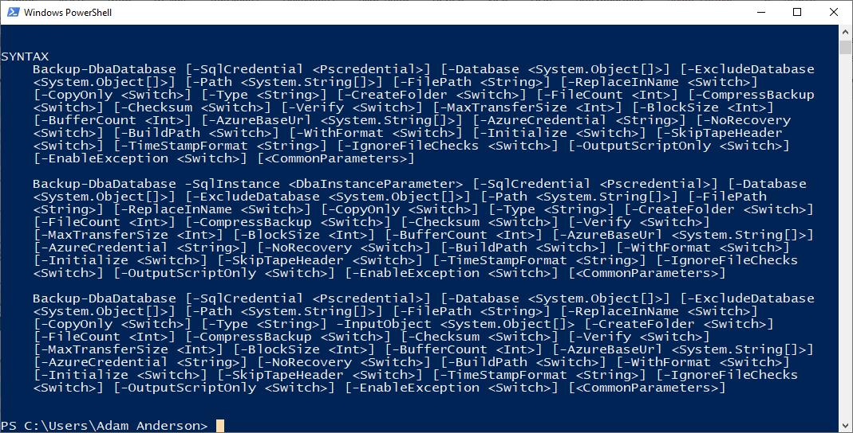
Help Backup-DbaDatabase

Slide 29
Backup and Restore with DbaTools
Backup-DbaDatabase `
-SqlInstance $Prod `
-SqlCredential $mycred `
-Database AdventureWorks `
-Path c:\backup\ `
-BackupFileName dbname.bak `
-ReplaceInName
Restore-DbaDatabase `
-SqlInstance $HostName `
-SqlCredential $mycred `
-Path c:\backup\AdventureWorks.bak `
-DatabaseName AdventureWorks `
-DestinationDataDirectory c:\data\ `
-DestinationLogDirectory c:\data

Slide 30
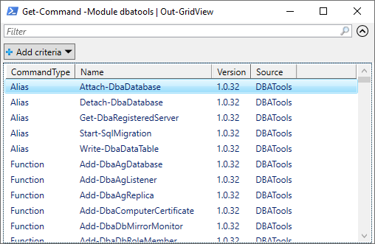
Get-Command –Module DbaTools | out-GridView

Slide 31
Powershell Basics
$Twittter = “@sqlpioneer”
Set-Alias -Name Edit -Value "notepad++.exe"
Edit $profile
New-PSDrive -name Pres -PSProvider FileSystem -Root "C:\git\GitHub\Presentations“
Set-Location Pres:
Cd Pres:

Slide 32
Hash Table
$Config = @{
"ServerInstance"="localhost,1401"
"Database"="FIFA"
"Username"=$user
"Password"=$password
"Query"="SELECT @@ServerName AS ServerName"
}
$Config.ServerInstance
Invoke-Sqlcmd @Config

Slide 33
Docker Commands to Do Things
docker run -p 1433:1433 -e SA_PASSWORD=$password -e ACCEPT_EULA=Y mcr.microsoft.com/mssql/server:2019-latest
Docker exec –it aw_preprod mkdir /var/opt/mssql/backup
Docker cp c:\backup\wwi.bak aw_preprod:/var/opt/mssql/backup
docker exec -it aw_preprod /bin/bash

Slide 34
Powershell Commands to Do Things
Invoke-Sqlcmd -ServerInstance localhost -Username sa -Password $password -Query "SELECT @@ServerName as ServerName“
Restore-DbaDatabase -SqlInstance localhost -SqlCredential $mycred -Path /var/opt/mssql/backup/WideWorldImporters-Full.bak -DatabaseName WWI

Slide 35
Create Container and restore DB
docker run -d `
-p 1433:1433 `
--name aw_preprod `
--hostname aw_preprod `
-e SA_PASSWORD=$Password `
-e ACCEPT_EULA=Y `
-v aw_preprod_backup:/var/opt/mssql/backup `
--rm `
mcr.microsoft.com/mssql/server
docker exec -it aw_preprod mkdir /var/opt/mssql/backup
docker cp C:\data\Backup\WideWorldImporters-Full.bak aw_preprod:/var/opt/mssql/backup
Restore-DbaDatabase -SqlInstance localhost -SqlCredential $mycred -Path /var/opt/mssql/backup/WideWorldImporters-Full.bak -DatabaseName WWI

Slide 36
Manage Volume Data with Helper Container
docker run -v backup:/backup --name helper -it mcr.microsoft.com/powershell
docker cp .\WWI.bck helper:/backup
docker cp helper:/backup/WWI.bck .
docker start -i helper
docker rm helper

Slide 37
Summary
Powershell is a DBAs best friend and can be used to automate almost anything.
DBATools, SQLServer, DBACheck
Docker can be used to create dynamic database environments that can be used for
Testing
Development
Even Production

