Slide 1
Environment Automation
Adam Anderson
Notes:
Welcome to Delivering business value faster.

Slide 2













Platinum Sponsor:
Visit the Sponsor Booths
Lots of Great Raffle Prizes!
Get your parking paid via Sponsor Bingo
Thank you Sponsors!
Gold Sponsors:
Global Alliance Partners:

Slide 3

PASSMN – News/Info
Thanks to all our sponsors of 2019!
We need Speakers & Sponsors for 2020 PASSMN Meetings!
Sign up to present at one of the monthly meetings!
Monthly Meetup: 3rd Tuesday of Each Month (except Oct) at Microsoft MTC in Edina (food usually provided)
Signup on Meetup: https://www.meetup.com/MN-SQL-Server-User-Group-PASSMN/
Board Member Elections in November/December:
Your chance to help out the MN SQL community!

Slide 4

Join the brightest data professionals focused on the Microsoft Data Platform!
November 3th Through November 8th
Pre-Conference Sessions – Monday/Tuesday
Conference – Wednesday through Friday

Slide 5

SQLSaturday #913 – After Party
Location: 4th Floor of Mall of America
Time: 6:30PM – 10PM
There will be drinks and appetizers as well as free game cards and bowling!
Hang out with some new friends you’ve made.

Slide 6
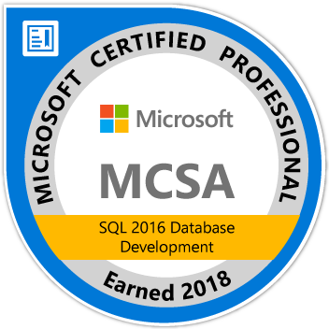
About Me
Adam Anderson
@SQLPioneer
sqlpioneer.wordpress.com
www.linkedin.com/in/adam-anderson-dba
https://github.com/SQLPioneer/
Notes:
My name is Adam Anderson, and I have been a database developer for over 10 years and in IT for more than 20. I am MCSA certified and will be taking my final test in a month or two to get my MCSE.
So I have a friend that is a financial accountant and he always droned on about ROI and how most people didn’t understand it. When I asked what he meant he told me that if you invest 100,000 dollars and a year later you get 12,000 dollars in return that was a 12% ROI and most companies would take that and run. However, if you can start making a 1000 dollars a month it is still the same money

Slide 7
Agenda
Introduction
Docker Environment
PowerShell Automation
Software Management using Chocolatey
Use Case Review

Slide 8
Docker

Slide 9
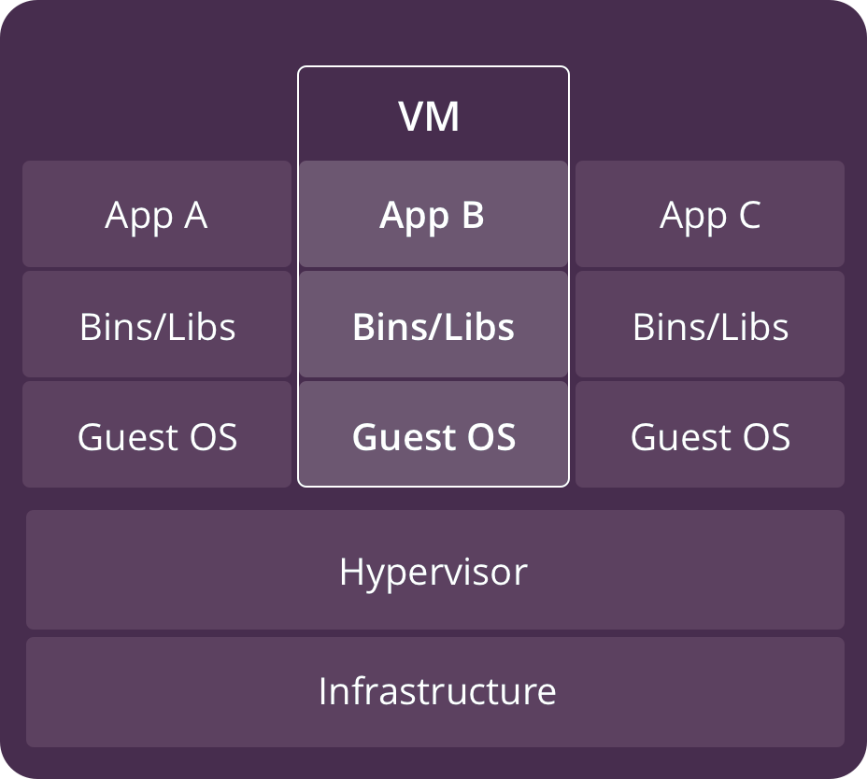
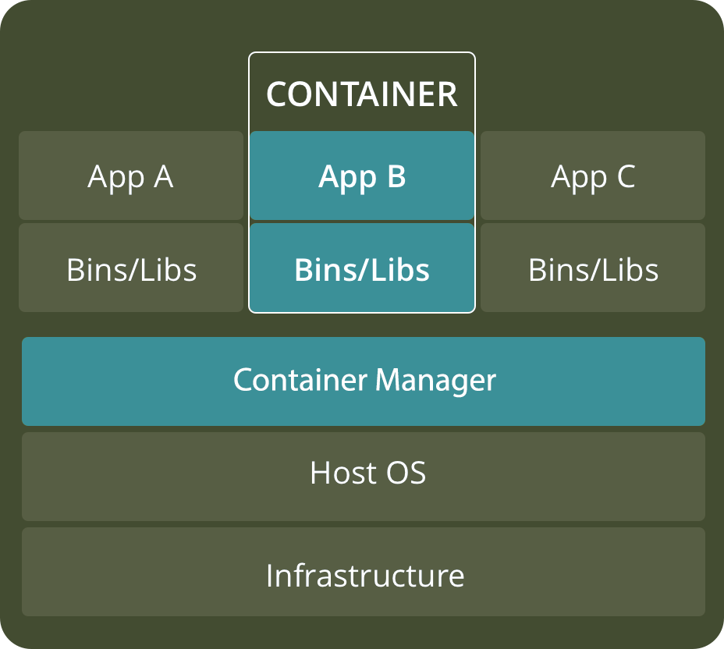
VM versus Container
https://www.backblaze.com/blog/vm-vs-containers/

Slide 10
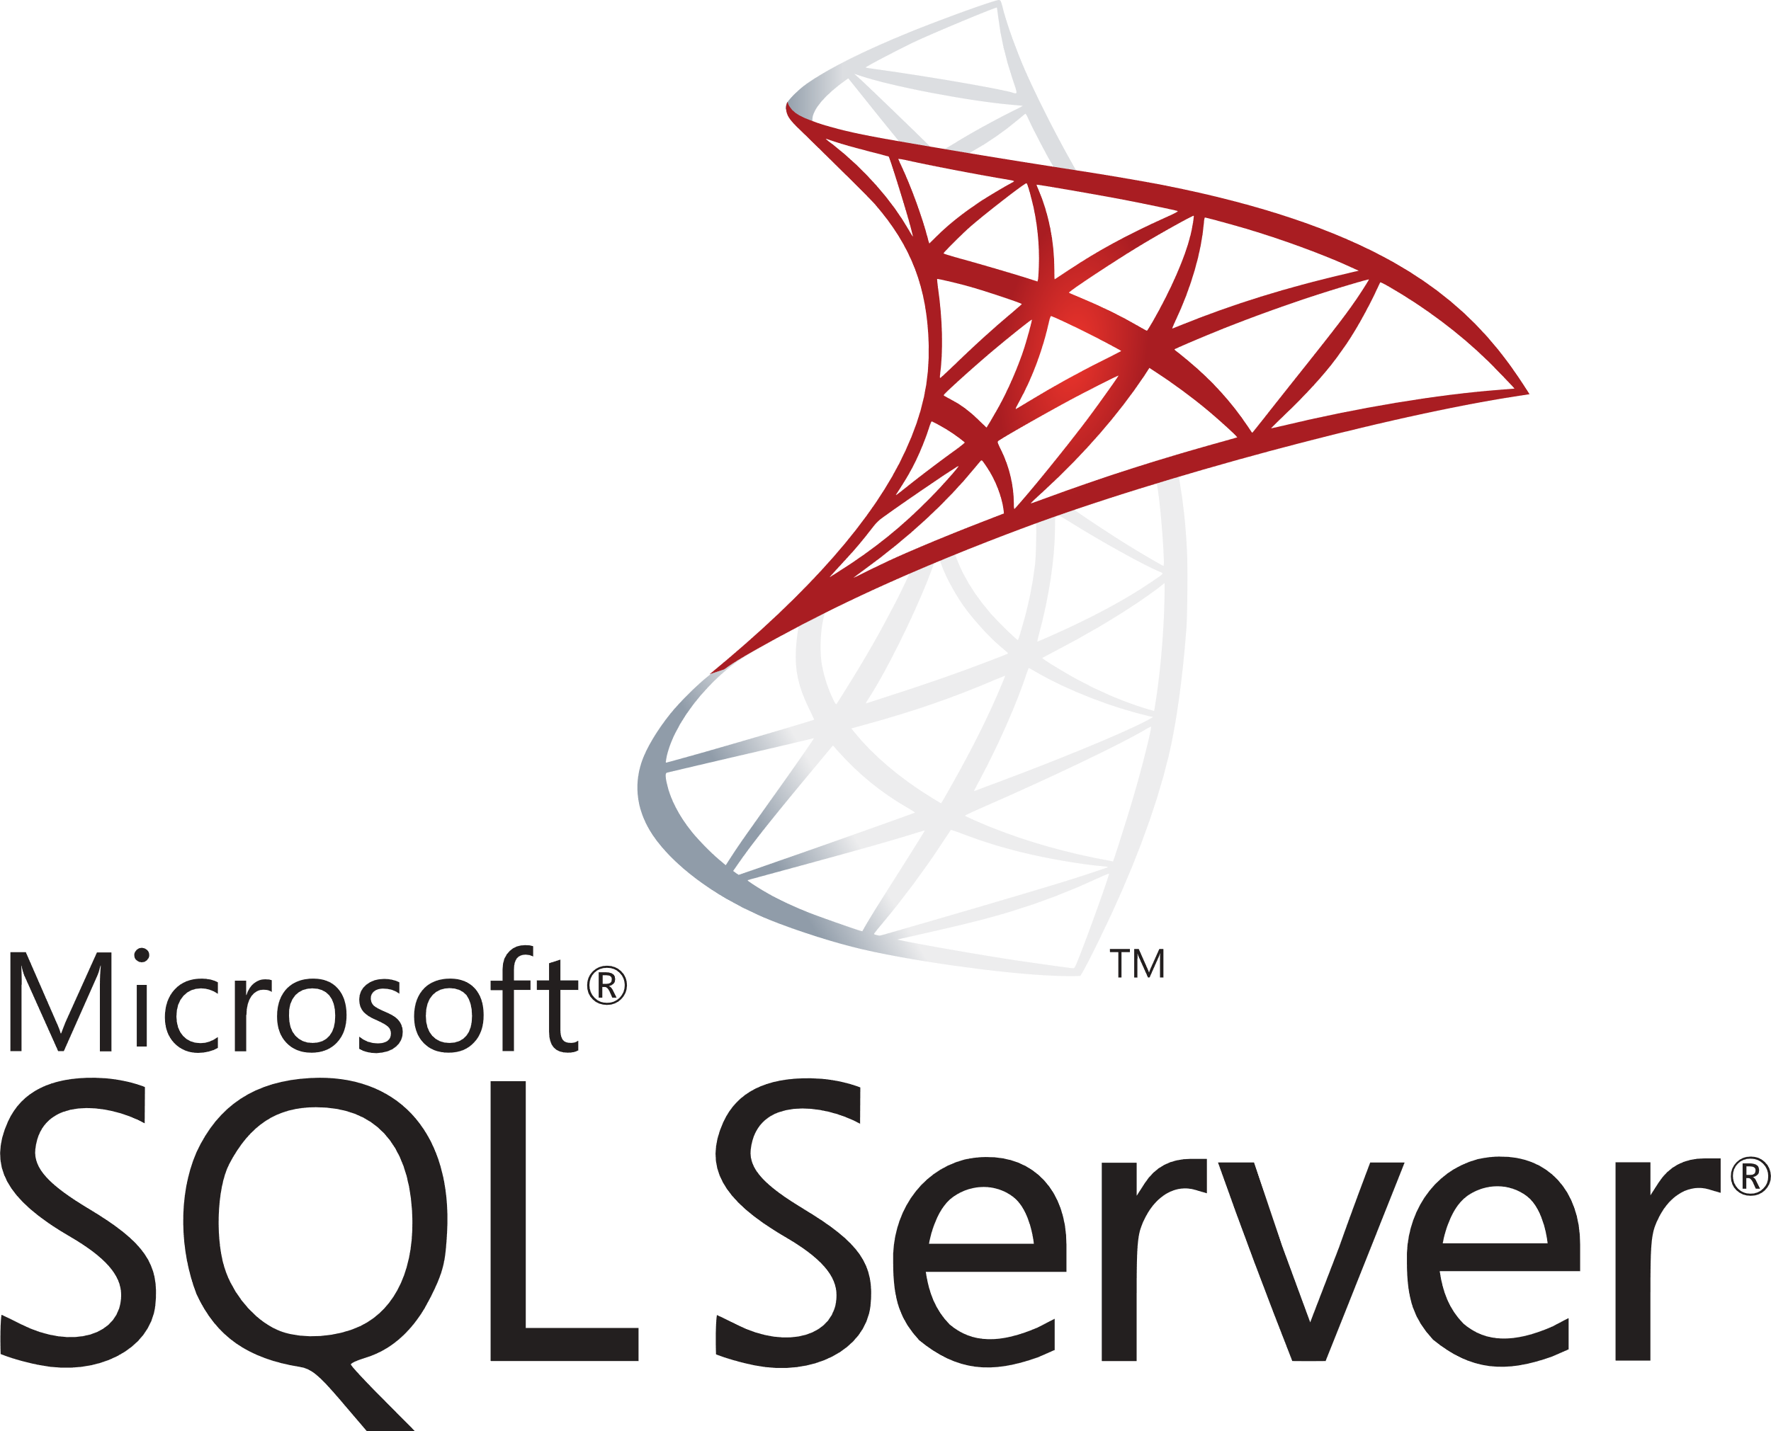


Docker Architecture
Docker Host
Registry
Client
Docker Daemon
Docker build
Docker pull
Docker run
Containers
Images
https://www.backblaze.com/blog/vm-vs-containers/

Slide 11

Download SQL Server 2017 Container

Slide 12
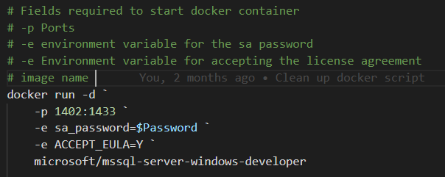
Create a Container from an Image

Slide 13
Optional Parameters
--name: Name of the container
--hostname or -h: Network alias
--volume or –v: volume path (OS:Container)
--env or –e: Environment variable
--rm Remove container when stopped
--detatch or -d: Start container detatched

Slide 14
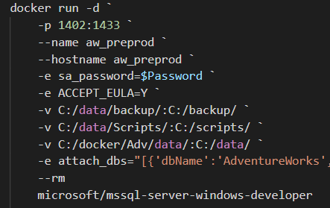
Create Container with Optional Parameters

Slide 15
Docker Commands to get Started
Docker pull: Download an image from the docker repository
Docker run: Create a container from the image.
Docker start: Start a container that has been stopped
Docker stop: Stop a container that is running
Docker help: Show help for Docker commands

Slide 16
Docker Commands to Manage Containers
Docker ps: Show running containers
Docker ps -a: Show all containers
Docker rm: Remove stopped container
Docker Exec: Execute a command in a running container

Slide 17
Docker Commands to Manage Images
Docker images: Show and work with images
Docker rmi: Remove image
Docker commit: Create an image from a container

Slide 18
Powershell

Slide 19


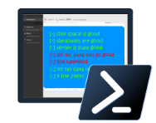
Powershell for the Win
Easy to automate
Community Tools
Dbatools
Dbachecks
Security
Short development cycle, long ROI
dbachecks

Slide 20
T-SQL versus DBATools backup
DECLARE @filename nvarchar(200) SELECT @filename + 'D:\BKP\Core\MyDB_Log_' + convert(varchar(23), getdate(), 126) + '.bak' BACKUP DATABASE MyDB TO DISK = @filename
Backup-DbaDatabase -SqlInstance localhost

Slide 21
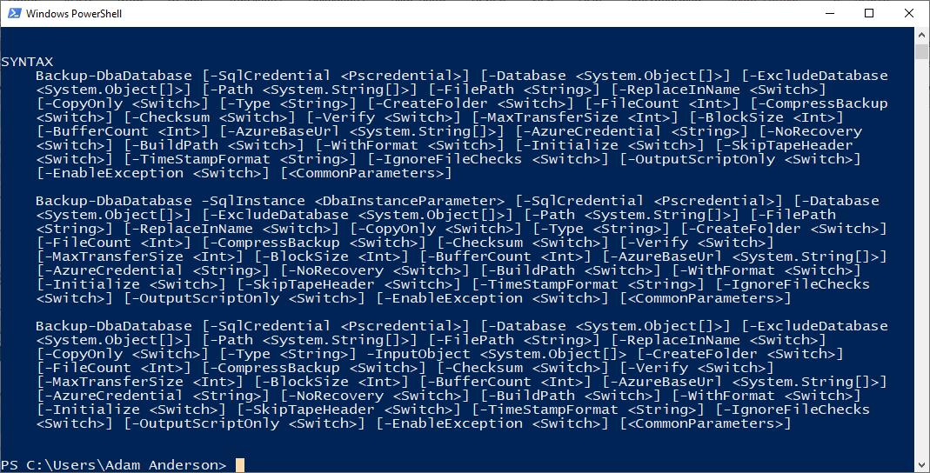
Help Backup-dbaDatabase

Slide 22
Backup and Restore
Backup-DbaDatabase `
-SqlInstance $Prod `
-SqlCredential $mycred `
-Database AdventureWorks `
-Path c:\backup\ `
-BackupFileName dbname.bak `
-ReplaceInName
Restore-DbaDatabase `
-SqlInstance $HostName `
-SqlCredential $mycred `
-Path c:\backup\AdventureWorks.bak `
-DatabaseName AdventureWorks `
-DestinationDataDirectory c:\data\ `
-DestinationLogDirectory c:\data

Slide 23
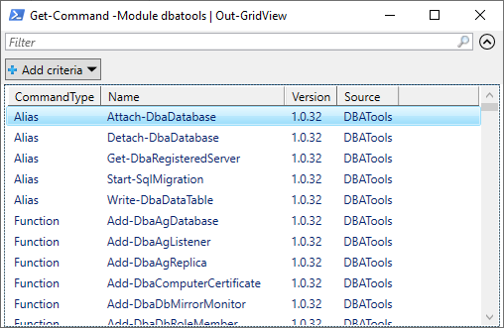
Get-Command -Module dbatools | Out-GridView

Slide 24
Powershell Basics
$Twittter = “@sqlpioneer”
Set-Alias -Name Edit -Value "notepad++.exe"
Edit $profile
New-PSDrive -name Pres -PSProvider FileSystem -Root "C:\git\GitHub\Presentations“
Set-Location Pres:

Slide 25
Hash Table
$Config = @{
"ServerInstance"="localhost,1401"
"Database"="FIFA"
"Username"=$user
"Password"=$password
"Query"="SELECT @@ServerName AS ServerName"
}
$Config.ServerInstance
Invoke-Sqlcmd @Config

Slide 26
Database Testing
$Check = @{
"SqlInstance"=$HostName
"SqlCredential"=$mycred
"Tags"="InstanceConnection"
}
Invoke-DbcCheck @Check -PassThru | Update-DbcPowerBiDataSource

Slide 27
Chocolatey / NuGet

Slide 28
Application Installations
NuGet
Chocolatey
Packaged Code
Pulls from NuGet Repos
Fully Configurable
Private Repo
Shared Components for Reuse

Slide 29
NuGet
Single ZIP file with the .nupkg extension
Contains any files associated with package
Descriptive Manifest
Version Number format must be 1.0.2

Slide 30

Chocolatey
Pulls packages from public and private repositories
Creates NuGet packages
Works with common Configuration Managers

Slide 31
Docker Images to Support Test and Dev
Full Prod Data
Confidential Data Removed
Full Data
Pre-Production Image
Testing Image
Development Image
90% Delete
Confidential Data Removed

Slide 32
Environment Overview

Slide 33

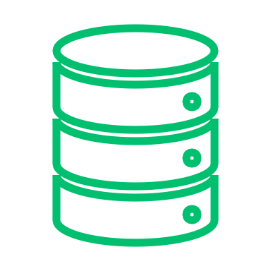





Docker Setup
Development
Dev 1
Docker Environment
Port: 1435
Base Images
SQL Server Image
Database
Dev 2
Version
Control
Port: 1436
Dev Image
Database
Docker Bind Mount
Database
Testing
Backup
QA Image
QA 1
Build Server
Port: 1437
Database
Database
Docker Volume
Prod Like Image
Prod Like
DB.mdf
DB_log.ldf
PreProd
Port: 1433
Artifact Repository

Slide 34






Volumes
Development
Dev 1
Docker Environment
Port: 1435
Base Images
SQL Server Image
Database
Dev 2
Version
Control
Port: 1436
Dev Image
Database
Docker Bind Mount
Database
Testing
Backup
QA Image
QA 1
Build Server
Port: 1437
Database
Database
Docker Volume
Prod Like Image
Prod Like
DB.mdf
DB_log.ldf
PreProd
Port: 1433
Artifact Repository

Slide 35


Docker Images
Development
Dev 1
Docker Environment
Port: 1435
Base Images
SQL Server Image
Database
Dev 2
Version
Control
Port: 1436
Dev Image
Database
Docker Bind Mount
Database
Testing
Backup
QA Image
QA 1
Build Server
Port: 1437
Database
Database
Docker Volume
Prod Like Image
Prod Like
DB.mdf
DB_log.ldf
PreProd
Port: 1433
Artifact Repository

Slide 36
Containers
Development
Dev 1
Docker Environment
Port: 1435
Base Images
SQL Server Image
Database
Dev 2
Version
Control
Port: 1436
Dev Image
Database
Docker Bind Mount
Database
Testing
Backup
QA Image
QA 1
Build Server
Port: 1437
Database
Database
Docker Volume
Prod Like Image
Prod Like
DB.mdf
DB_log.ldf
PreProd
Port: 1433
Artifact Repository

Slide 37
Developer Workflow
Development
Dev 1
Docker Environment
Port: 1435
Base Images
SQL Server Image
Database
Dev 2
Version
Control
Port: 1436
Dev Image
Database
Docker Bind Mount
Database
Testing
Backup
QA Image
QA 1
Build Server
Port: 1437
Database
Database
Docker Volume
Prod Like Image
Prod Like
DB.mdf
DB_log.ldf
PreProd
Port: 1433
Artifact Repository

Slide 38
Summary
Docker can be used to create dynamic database environments that can be used for
Testing
Development

Slide 39
Contact Information
Adam Anderson
@SQLPioneer
sqlpioneer.wordpress.com
www.linkedin.com/in/adam-anderson-dba
https://github.com/SQLPioneer/
Notes:
My name is Adam Anderson, and I have been a database developer for over 10 years and in IT for more than 20. I am MCSA certified and will be taking my final test in a month or two to get my MCSE.
So I have a friend that is a financial accountant and he always droned on about ROI and how most people didn’t understand it. When I asked what he meant he told me that if you invest 100,000 dollars and a year later you get 12,000 dollars in return that was a 12% ROI and most companies would take that and run. However, if you can start making a 1000 dollars a month it is still the same money

Slide 40
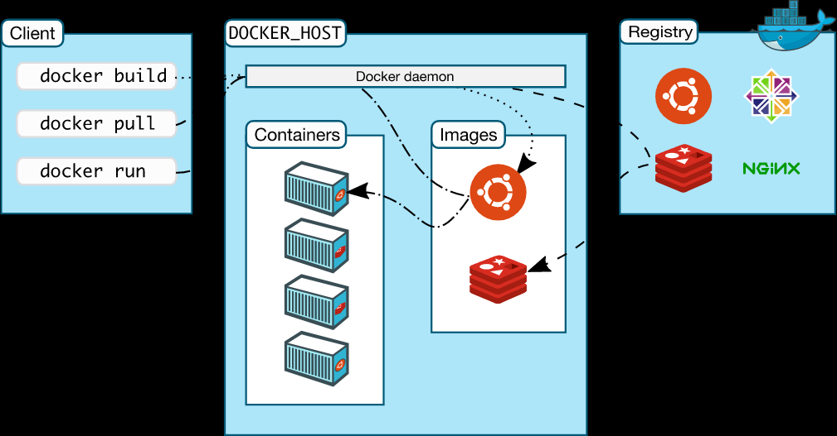
Docker Architecture
https://docs.docker.com/engine/docker-overview/

