Slide 1
Environment Automation
Adam Anderson
Notes:
Welcome to Delivering business value faster.

Slide 2
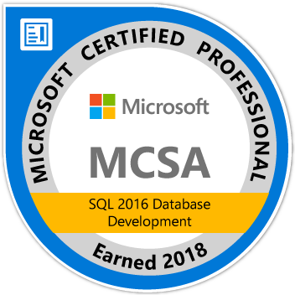
About Me
Adam Anderson
@SQLPioneer
sqlpioneer.wordpress.com
www.linkedin.com/in/adam-anderson-dba
Notes:
My name is Adam Anderson, and I have been a database developer for over 10 years and in IT for more than 20. I am MCSA certified and will be taking my final test in a month or two to get my MCSE.
So I have a friend that is a financial accountant and he always droned on about ROI and how most people didn’t understand it. When I asked what he meant he told me that if you invest 100,000 dollars and a year later you get 12,000 dollars in return that was a 12% ROI and most companies would take that and run. However, if you can start making a 1000 dollars a month it is still the same money

Slide 3
Agenda
Introduction
Docker Environment
PowerShell Automation
Software Management using Chocolatey
Use Case Review

Slide 4
Docker

Slide 5
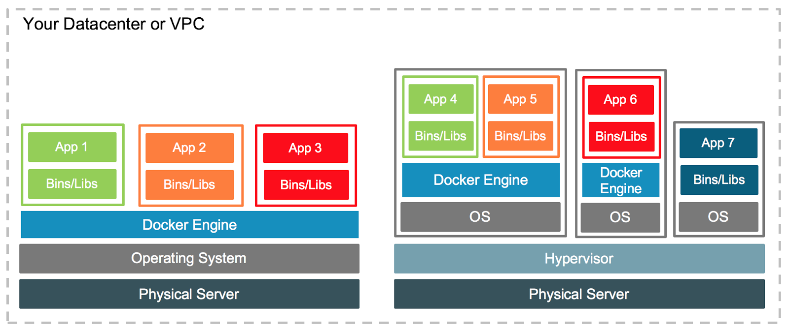
Virtual Machine Versus Docker
https://blog.docker.com/2016/04/containers-and-vms-together

Slide 6
PowerShell Automation

Slide 7
PowerShell Overview
SQLCMD
DBATools
Pester
Run any SQL command on any SQL Server
Opensource module by the community
Testing framework

Slide 8
PowerShell Links
https://powershellexplained.com
https://dbatools.io/commands/
https://sqldbawithabeard.com

Slide 9
Chocolatey / NuGet

Slide 10
Application Installations
NuGet
Chocolatey
Packaged Code
Pulls from NuGet Repos
Fully Configurable
Private Repo
Shared Components for reuse

Slide 11
NuGet
Single ZIP file with the .nupkg extension
Contains any files associated with package
Descriptive Manifest
Version Number format must be 1.0.2

Slide 12

Chocolatey
Pulls packages from public and private repositories
Creates NuGet packages
Works with common Configuration Managers

Slide 13
Environment Overview

Slide 14
Data Story
Data Setup
Production Data
Pre-Production
User Acceptance Testing and signoff
Testing
Integration Testing
Development
Supports the business needs
Performance Testing
Experimentation
Unit Testing
Code Work
Security Increases

Slide 15
Environment Use Case Requirements
Production Like
Full Size Dataset
Testing
Full Size Dataset
Dev
Small Dataset
Controlled Environment
Confidential Data
Less Controls
No Confidential Data
No Confidential Data
Little to no Controls

Slide 16

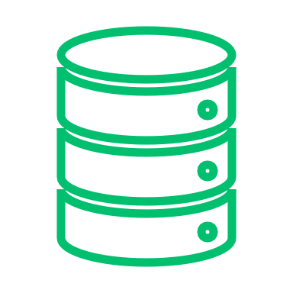


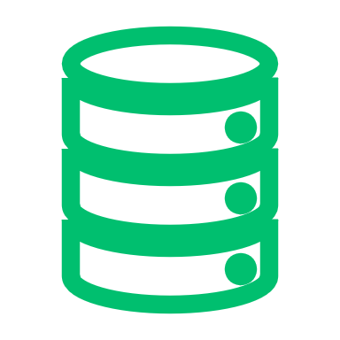


Docker Setup
Development
Dev 1
Docker Environment
Port: 1435
Base Images
SQL Server Image
Database
Dev 2
Version
Control
Port: 1436
Dev Image
Database
Docker Bind Mount
Database
Testing
Backup
QA Image
QA 1
Build Server
Port: 1437
Database
Database
Docker Volume
Prod Like Image
Prod Like
DB.mdf
DB_log.ldf
PreProd
Port: 1433
Artifact Repository

Slide 17






Volumes
Development
Dev 1
Docker Environment
Port: 1435
Base Images
SQL Server Image
Database
Dev 2
Version
Control
Port: 1436
Dev Image
Database
Docker Bind Mount
Database
Testing
Backup
QA Image
QA 1
Build Server
Port: 1437
Database
Database
Docker Volume
Prod Like Image
Prod Like
DB.mdf
DB_log.ldf
PreProd
Port: 1433
Artifact Repository

Slide 18


Docker Images
Development
Dev 1
Docker Environment
Port: 1435
Base Images
SQL Server Image
Database
Dev 2
Version
Control
Port: 1436
Dev Image
Database
Docker Bind Mount
Database
Testing
Backup
QA Image
QA 1
Build Server
Port: 1437
Database
Database
Docker Volume
Prod Like Image
Prod Like
DB.mdf
DB_log.ldf
PreProd
Port: 1433
Artifact Repository

Slide 19
Environments
Development
Dev 1
Docker Environment
Port: 1435
Base Images
SQL Server Image
Database
Dev 2
Version
Control
Port: 1436
Dev Image
Database
Docker Bind Mount
Database
Testing
Backup
QA Image
QA 1
Build Server
Port: 1437
Database
Database
Docker Volume
Prod Like Image
Prod Like
DB.mdf
DB_log.ldf
PreProd
Port: 1433
Artifact Repository

Slide 20
Workflow
Development
Dev 1
Docker Environment
Port: 1435
Base Images
SQL Server Image
Database
Dev 2
Version
Control
Port: 1436
Dev Image
Database
Docker Bind Mount
Database
Testing
Backup
QA Image
QA 1
Build Server
Port: 1437
Database
Database
Docker Volume
Prod Like Image
Prod Like
DB.mdf
DB_log.ldf
PreProd
Port: 1433
Artifact Repository

