Slide 1
Environment Automation
Adam Anderson
Notes:
Welcome to Delivering business value faster.

Slide 2
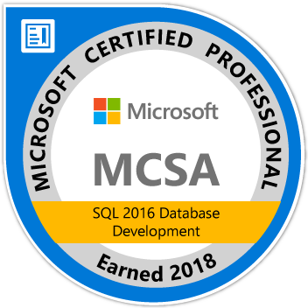
About Me
Adam Anderson
@SQLPioneer
sqlpioneer.wordpress.com
www.linkedin.com/in/adam-anderson-dba
Notes:
My name is Adam Anderson, and I have been a database developer for over 10 years and in IT for more than 20. I am MCSA certified and will be taking my final test in a month or two to get my MCSE.
So I have a friend that is a financial accountant and he always droned on about ROI and how most people didn’t understand it. When I asked what he meant he told me that if you invest 100,000 dollars and a year later you get 12,000 dollars in return that was a 12% ROI and most companies would take that and run. However, if you can start making a 1000 dollars a month it is still the same money

Slide 3
Agenda
Introduction
Software Management using Chocolatey
Use Case Review
PowerShell Automation
Docker Environment

Slide 4
Automation Use Case Why

Slide 5
Environment Use Case Requirements
Production Like
Full Size Dataset
QA
Full Size Dataset
Dev
Small Dataset
Controlled Environment
Confidential Data
Less Controls
No Confidential Data
No Confidential Data
Little to no Controls

Slide 6
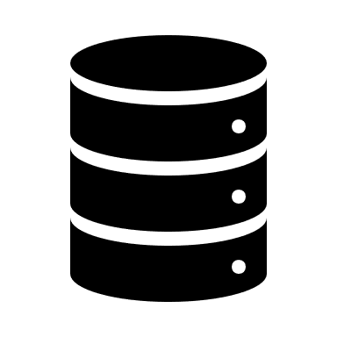








Slide 7
Environment Usage
Refresh Env
Deploy Code
Do Something
Check in Code

Slide 8
Chocolatey / NuGet

Slide 9
Application Installations
NuGet
Chocolatey
Packaged Code
Pulls from NuGet Repos
Fully Configurable
Private Repo
Shared Components for reuse

Slide 10
NuGet
Single ZIP file with the .nupkg extension
Contains any files associated with package
Descriptive Manifest
Version Number format must be 1.0.2

Slide 11

Chocolatey
Pulls packages from public and private repositories
Creates NuGet packages
Works with common Configuration Managers

Slide 12
PowerShell Automation

Slide 13
Docker

