Slide 1
Environment Automation
Adam Anderson
Notes:
Welcome to Delivering business value faster.

Slide 2
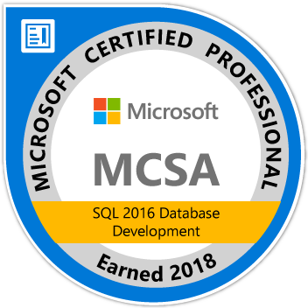
About Me
Adam Anderson
@SQLPioneer
sqlpioneer.wordpress.com
www.linkedin.com/in/adam-anderson-dba
https://github.com/SQLPioneer/
Notes:
My name is Adam Anderson, and I have been a database developer for over 10 years and in IT for more than 20. I am MCSA certified and will be taking my final test in a month or two to get my MCSE.
So I have a friend that is a financial accountant and he always droned on about ROI and how most people didn’t understand it. When I asked what he meant he told me that if you invest 100,000 dollars and a year later you get 12,000 dollars in return that was a 12% ROI and most companies would take that and run. However, if you can start making a 1000 dollars a month it is still the same money

Slide 3
Agenda
Introduction
Docker Environment
PowerShell Automation
Use Case Review

Slide 4
Docker

Slide 5
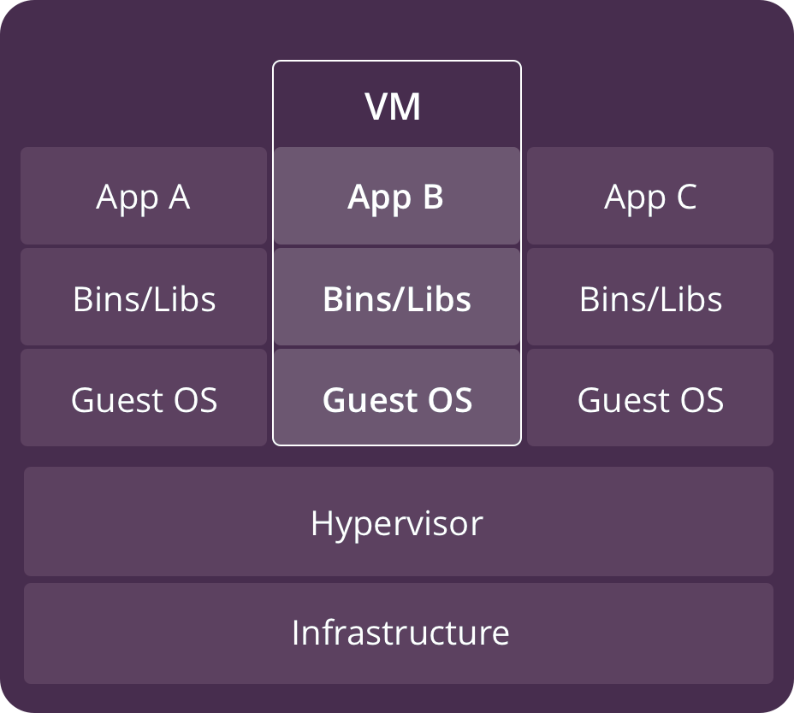
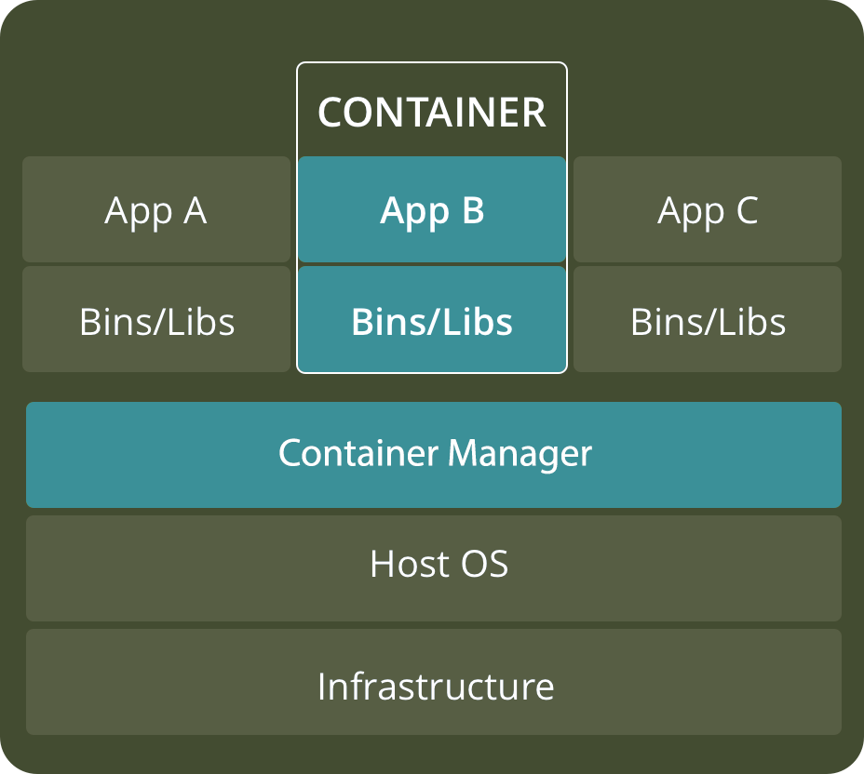
VM versus Container
https://www.backblaze.com/blog/vm-vs-containers/

Slide 6
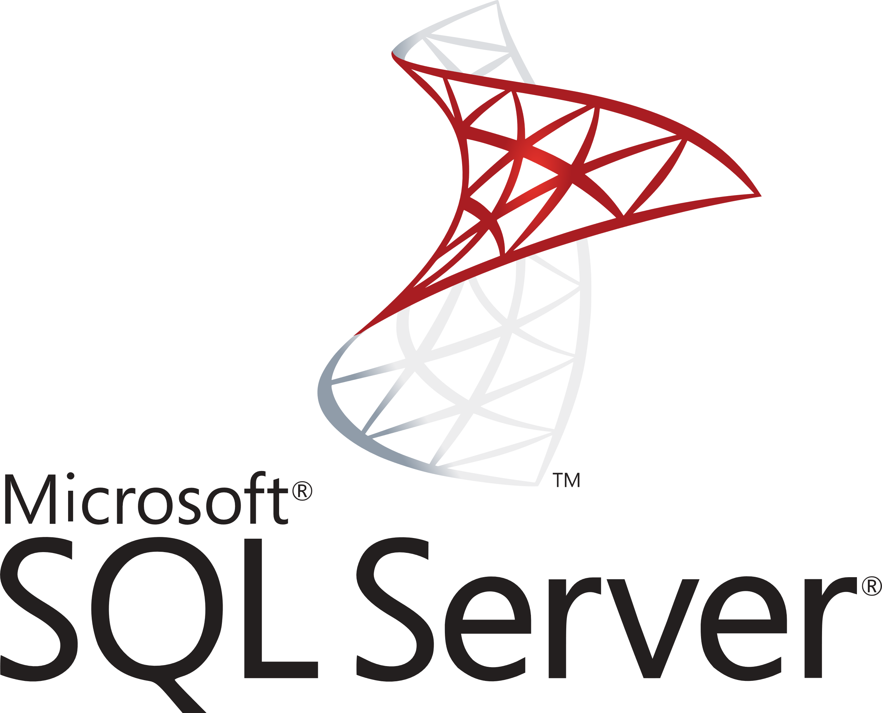

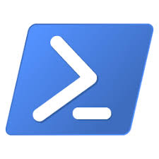
Docker Architecture
Docker Host
Registry
Client
Docker Daemon
Docker build
Docker pull
Docker run
Containers
Images
https://www.backblaze.com/blog/vm-vs-containers/

Slide 7

Download SQL Server 2017 Container

Slide 8
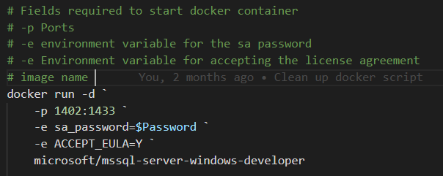
Create a Container from an Image

Slide 9
Optional Parameters
--name: Name of the container
--hostname or -h: Network alias
--volume or –v: volume path (OS:Container)
--env or –e: Environment variable
--rm: Remove container when stopped
--detatched or -d: Start container detatched

Slide 10
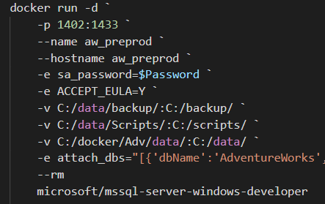
Create Container with Optional Parameters

Slide 11
Docker Commands to get Started
Docker pull: Download an image from the docker repository
Docker run: Create a container from the image.
Docker start: Start a container that has been stopped
Docker stop: Stop a container that is running
Docker help: Show help for Docker commands

Slide 12
Docker Commands to Manage Containers
Docker ps: Show running containers
Docker ps -a: Show all containers
Docker rm: Remove stopped container
Docker Exec: Execute a command in a running container

Slide 13
Docker Commands to Manage Images
Docker images: Show and work with images
Docker rmi: Remove image
Docker commit: Create an image from a container

Slide 14
Powershell

Slide 15
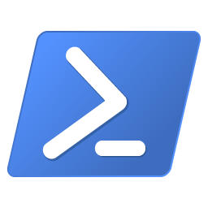

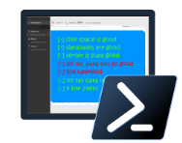
Powershell for the Win
Easy to automate
Community Tools
Dbatools
Dbachecks
Security
Short development cycle, long ROI
dbachecks

Slide 16
T-SQL versus DBATools backup
DECLARE @filename nvarchar(200) SELECT @filename + 'D:\BKP\Core\MyDB_Log_' + convert(varchar(23), getdate(), 126) + '.bak' BACKUP DATABASE MyDB TO DISK = @filename
Backup-DbaDatabase -SqlInstance localhost

Slide 17
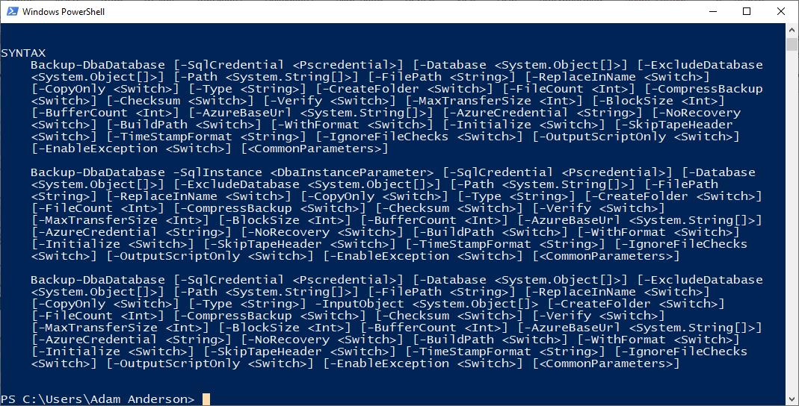
Help Backup-dbaDatabase

Slide 18
Backup and Restore
Backup-DbaDatabase `
-SqlInstance $Prod `
-SqlCredential $mycred `
-Database AdventureWorks `
-Path c:\backup\ `
-BackupFileName dbname.bak `
-ReplaceInName
Restore-DbaDatabase `
-SqlInstance $HostName `
-SqlCredential $mycred `
-Path c:\backup\AdventureWorks.bak `
-DatabaseName AdventureWorks `
-DestinationDataDirectory c:\data\ `
-DestinationLogDirectory c:\data

Slide 19
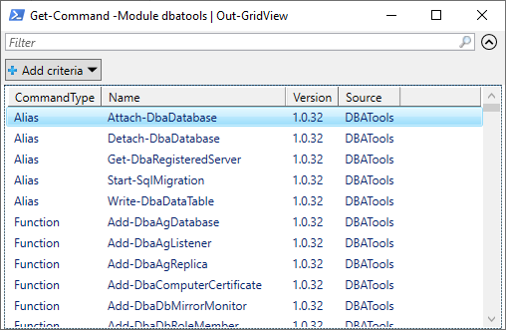
Get-Command -Module dbatools | Out-GridView

Slide 20
Powershell Basics
$Twittter = “@sqlpioneer”
Set-Alias -Name Edit -Value "notepad++.exe"
Edit $profile
New-PSDrive -name Pres -PSProvider FileSystem -Root "C:\git\GitHub\Presentations“
Set-Location Pres:
Cd Pres:

Slide 21
Hash Table
$Config = @{
"ServerInstance"="localhost,1401"
"Database"="FIFA"
"Username"=$user
"Password"=$password
"Query"="SELECT @@ServerName AS ServerName"
}
$Config.ServerInstance
Invoke-Sqlcmd @Config

Slide 22
Database Testing
$Check = @{
"SqlInstance"=$HostName
"SqlCredential"=$mycred
"Tags"="InstanceConnection"
}
Invoke-DbcCheck @Check -PassThru | Update-DbcPowerBiDataSource

Slide 23
Docker Images to Support Test and Dev
Full Prod Data
Confidential Data Removed
Full Data
Pre-Production Image
Testing Image
Development Image
90% Delete
Confidential Data Removed

Slide 24
Environment Overview

Slide 25

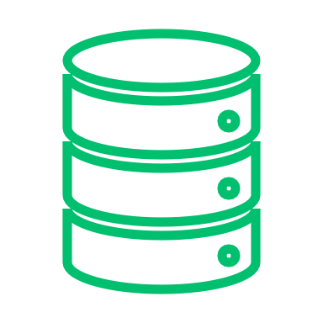


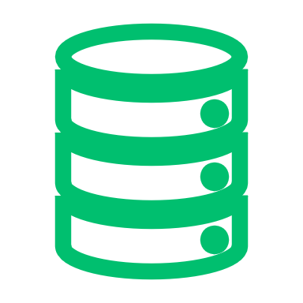


Docker Setup
Development
Dev 1
Docker Environment
Port: 1435
Base Images
SQL Server Image
Database
Dev 2
Version
Control
Port: 1436
Dev Image
Database
Docker Bind Mount
Database
Testing
Backup
QA Image
QA 1
Build Server
Port: 1437
Database
Database
Docker Volume
Prod Like Image
Prod Like
DB.mdf
DB_log.ldf
PreProd
Port: 1433
Artifact Repository

Slide 26






Volumes
Development
Dev 1
Docker Environment
Port: 1435
Base Images
SQL Server Image
Database
Dev 2
Version
Control
Port: 1436
Dev Image
Database
Docker Bind Mount
Database
Testing
Backup
QA Image
QA 1
Build Server
Port: 1437
Database
Database
Docker Volume
Prod Like Image
Prod Like
DB.mdf
DB_log.ldf
PreProd
Port: 1433
Artifact Repository

Slide 27


Docker Images
Development
Dev 1
Docker Environment
Port: 1435
Base Images
SQL Server Image
Database
Dev 2
Version
Control
Port: 1436
Dev Image
Database
Docker Bind Mount
Database
Testing
Backup
QA Image
QA 1
Build Server
Port: 1437
Database
Database
Docker Volume
Prod Like Image
Prod Like
DB.mdf
DB_log.ldf
PreProd
Port: 1433
Artifact Repository

Slide 28
Containers
Development
Dev 1
Docker Environment
Port: 1435
Base Images
SQL Server Image
Database
Dev 2
Version
Control
Port: 1436
Dev Image
Database
Docker Bind Mount
Database
Testing
Backup
QA Image
QA 1
Build Server
Port: 1437
Database
Database
Docker Volume
Prod Like Image
Prod Like
DB.mdf
DB_log.ldf
PreProd
Port: 1433
Artifact Repository

Slide 29
Developer Workflow
Development
Dev 1
Docker Environment
Port: 1435
Base Images
SQL Server Image
Database
Dev 2
Version
Control
Port: 1436
Dev Image
Database
Docker Bind Mount
Database
Testing
Backup
QA Image
QA 1
Build Server
Port: 1437
Database
Database
Docker Volume
Prod Like Image
Prod Like
DB.mdf
DB_log.ldf
PreProd
Port: 1433
Artifact Repository

Slide 30
Summary
Docker can be used to create dynamic database environments that can be used for
Testing
Development

Slide 31
Contact Information
Adam Anderson
@SQLPioneer
sqlpioneer.wordpress.com
www.linkedin.com/in/adam-anderson-dba
https://github.com/SQLPioneer/
Notes:
My name is Adam Anderson, and I have been a database developer for over 10 years and in IT for more than 20. I am MCSA certified and will be taking my final test in a month or two to get my MCSE.
So I have a friend that is a financial accountant and he always droned on about ROI and how most people didn’t understand it. When I asked what he meant he told me that if you invest 100,000 dollars and a year later you get 12,000 dollars in return that was a 12% ROI and most companies would take that and run. However, if you can start making a 1000 dollars a month it is still the same money

