Slide 1
Introduction to SQL Azure
Thomas LaRock
Hartford SQL Server Users Group
April 7th, 2010

Slide 2

Who Am I?
Database Administrator
Ten+ years experience
SQL MVP
PASS Board of Directors
http://thomaslarock.com
SQLRockstar@gmail.com

Slide 3

Who Is Rob?
Author
Patents
Smart
Works for MS

Slide 4

PASS
http://sqlpass.org/
50,000 members
161 Chapters

Slide 5

http://dbasurvivor.com/

Slide 6
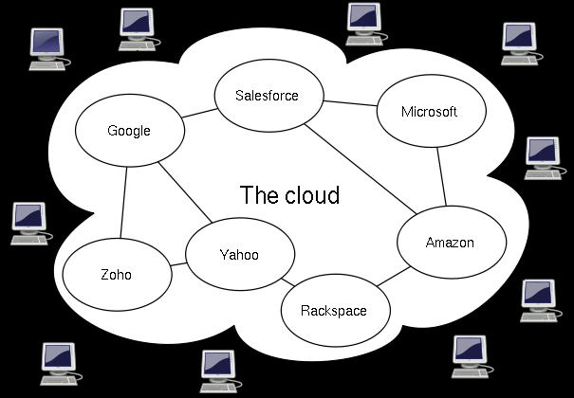
Cloud? What Cloud?
http://en.wikipedia.org/wiki/File:Cloud_computing.svg

Slide 7
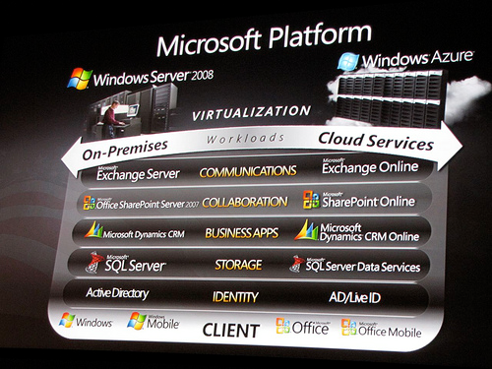
What Is Available Right Now?
http://farm4.static.flickr.com/3628/3346666019_893040b851.jpg

Slide 8

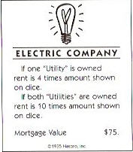
How I Think Of The ‘Cloud’

Slide 9
Benefits
Measurable
Scalability
Lower cost
Maintenance
Reliability
Connect from anywhere

Slide 10
Job Security?
As of today, are you concerned about losing your job as a DBA to the Cloud?
Tweet answer using #hssug

Slide 11
Who Else?
Amazon EC2 (http://aws.amazon.com/)
Google
Terremark (http://vcloudexpress.terremark.com/)

Slide 12

Welcome Our New Overlord
http://blog.ehuna.org/liveimages/e47b483f9afe_9C3C/image.png

Slide 13
Notable Limitations
Comes in all sizes! (that = 1 or 10GB)
English only
Currently no RESTORE or ATTACH
Currently no OPENDATASOURCE, OPENROWSET, or Linked Servers allowed
http://msdn.microsoft.com/en-us/library/ee336245.aspx

Slide 14
How To Push Data To the Cloud?
SSMS Scripts
SSIS
Not as you might think!
BCP
SQL Azure Migration Wizard
Microsoft Sync

Slide 15

SQL Azure Administration
http://www.securitycatalyst.com/wp-content/uploads/2009/10/Yawn-333-x-500.jpg

Slide 16
Question
Have you ever had a SP cause an application issue?
Tweet answer using #hssug

Slide 17

Cloud Patching
http://www.hhdataprotection.com/uploads/image/clouds_1_bg_082403%281%29.jpg

Slide 18
When Would You Use This?
Small-ish applications
Tolerance for data loss
Tolerance for latency

Slide 19
For More Information
http://msdn.microsoft.com/en-us/library/ee336279.aspx
http://thomaslarock.com/presentations
http://speakerrate.com/talks/2888-cloud-computing-with-sql-azure

Slide 20

24 Hours of PASS
http://www.sqlpass.org/24hours/2010/default.aspx
http://www.ustream.tv/channel/24-hours-of-pass

Slide 21
Questions?
?

