Slide 1
SQL Server 2008 Audit
by
Thomas LaRock
April 24th, 2010

Slide 2

Who Am I?
Database Administrator
Ten+ years experience
SQL MVP
PASS Board of Directors
Twitter: @SQLRockstar
http://thomaslarock.com

Slide 3

http://dbasurvivor.com/

Slide 4
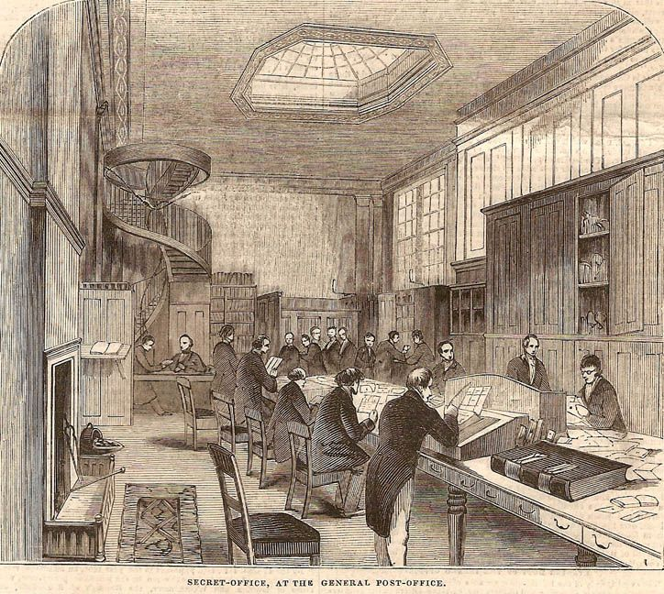
Notes:
http://www.earlyofficemuseum.com/1844_Secret_Office_General_Post_Office_Illus_London_News_June_29.jpg

Slide 5
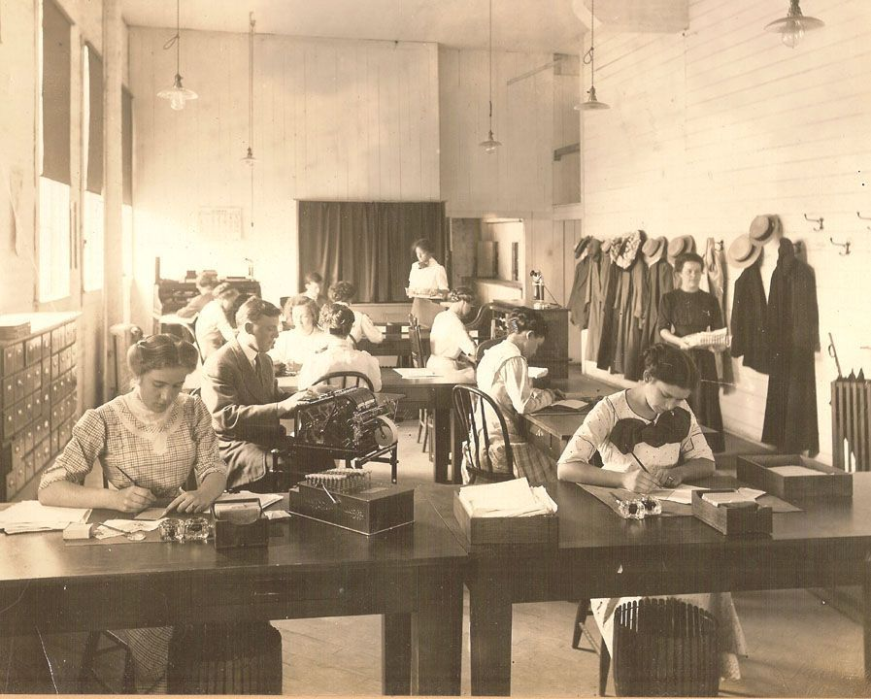
Notes:
http://www.earlyofficemuseum.com/Office_Gaint_Clothing_Store__Muskegon_MI.jpg

Slide 6
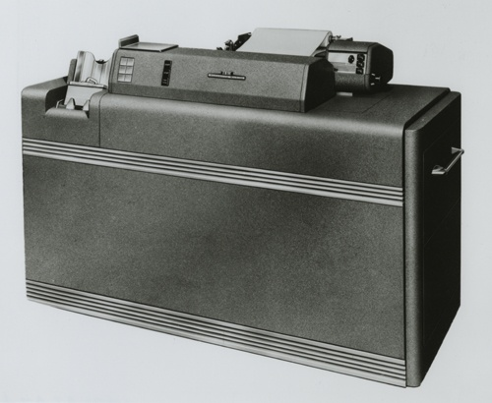
Notes:
http://archive.computerhistory.org/resources/still-image/ibm/IBM_Card_Computing/IBM.CardComputing.19xx.102645470.lg.jpg

Slide 7
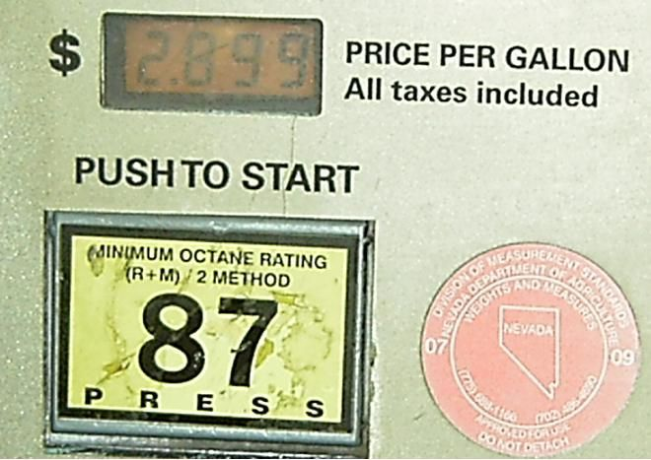
Notes:
http://upload.wikimedia.org/wikipedia/commons/9/92/Weights_and_Measures_Nevada_Seal.JPG

Slide 8

Notes:
http://www.auditing.com/gcptraining.jpg

Slide 9
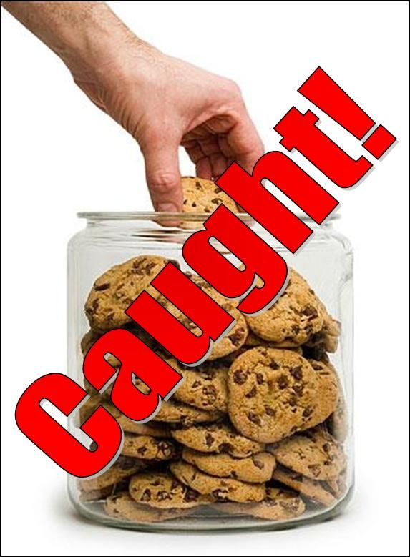
Notes:
http://www.vonyaglobal.com/images/hand_in_cookie_jar1.jpg

Slide 10
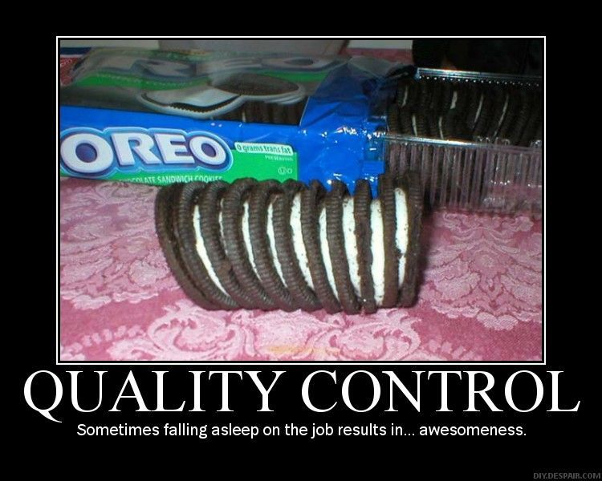
Notes:
http://tf2.digitaljedi.com/wp-content/uploads/2008/11/quality-control.jpg

Slide 11
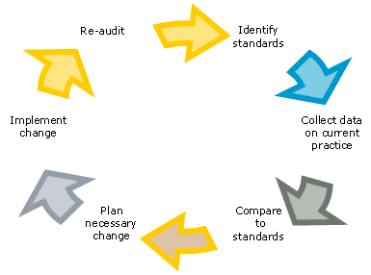
Notes:
http://www.rcpath.org/resources/other/AuditCycleBM.bmp

Slide 12

Notes:
http://thesituationist.files.wordpress.com/2007/07/do-it-or-else.gif

Slide 13
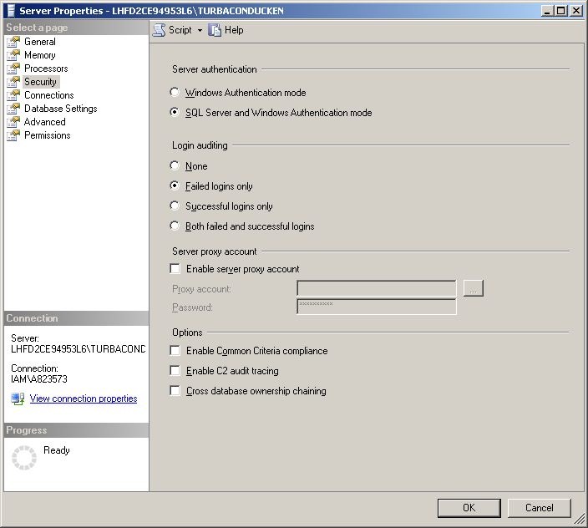
Pre-SQL 2008 Options
Failed Logins
Triggers
C2
SQL Trace

Slide 14
SQL Server 2008 Audit
New feature
Design considerations
Security
Performance
Management
Discoverability
Notes:
Security – The audit feature, and its objects, must be truly secure.
Performance - Performance impact must be minimized.
Management – The audit feature must be easy to manage.
Discoverability - Audit-centric questions must be easy to answer.

Slide 15
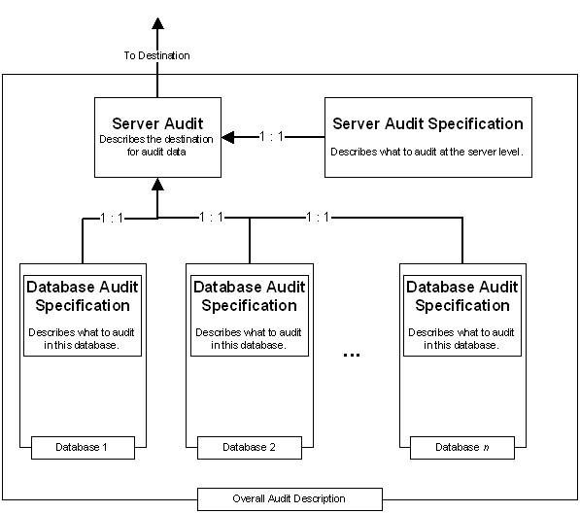
Notes:
http://msdn.microsoft.com/en-us/library/dd392015.aspx

Slide 16
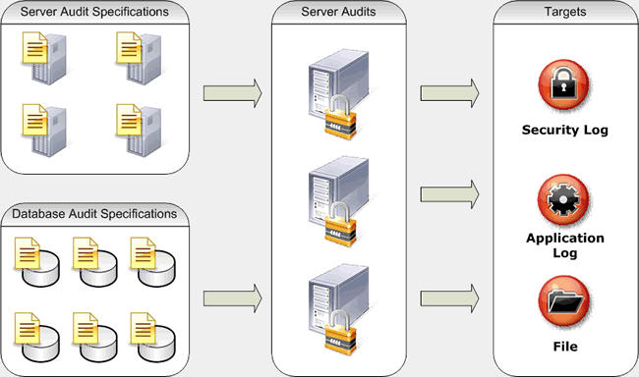
Notes:
http://sqlblogcasts.com/blogs/sqldbatips/audit.gif

Slide 17
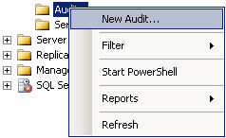
Demo

Slide 18

Notes:
http://himic.org/template/secass00.gif
Security – The audit feature, and its objects, must be truly secure. The audit extended events are protected, cannot be altered

Slide 19
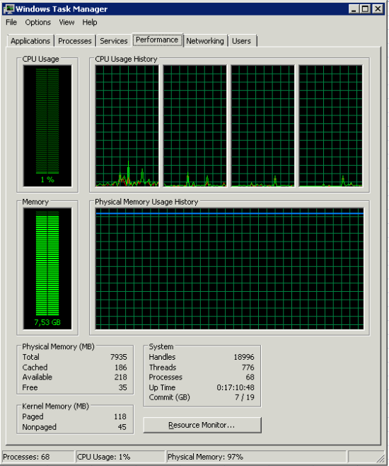
Notes:
Performance - Performance impact must be minimized.
Queue delay is in ms, default is 1000. for synchronous, choose 0. higher values could be problems should server error occur.

Slide 20
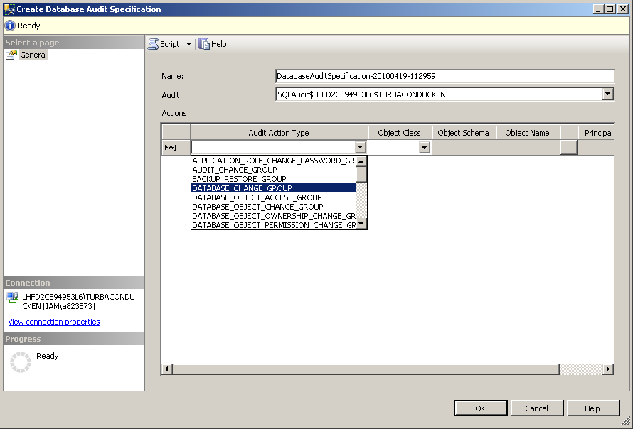
Notes:
Management – The audit feature must be easy to manage.
http://msdn.microsoft.com/en-us/library/dd392015.aspx

Slide 21

Notes:
http://www.notcot.com/images/usabilityday06.jpg

Slide 22
Discoverability
Log Viewer
Uses TVF to select from audit trail
Event Viewer
Operations Manager
Custom Reporting
SQLCAT
http://sqlcat.codeplex.com/wikipage?title=sqlauditcentral&referringTitle=Home
Notes:
OpsMgr has an Audit Collection Service (ties to Security Log)

Slide 23
For More Information
http://msdn.microsoft.com/en-us/library/dd392015.aspx
http://thomaslarock.com/presentations
http://speakerrate.com/talks/3021-sql-server-2008-audit

Slide 24

http://www.sqlpass.org/24hours/2010/

Slide 25

Notes:
What happens if it cannot write to the audit log, and it is not set to SHUTDOWN? It is kept in memory, 4MB worth or 170 audit events, and then no more.
And what do you do if server fails to start? Put server into single user mode, “-m”, or “-f”.
“-m” leaves audit active and can be modified
“-f” disables the audit and it can be modified

Slide 26
THANK YOU!

