Slide 1

What Are You Waiting For? A Performance Tuning Process Thomas LaRock Senior DBA, Confio Software
Notes:
1

Slide 2

Who Am I?
Database Administrator
Ten+ years experience
SQL MVP
PASS Board of Directors
Twitter: @SQLRockstar
http://thomaslarock.com

Slide 3
24 Hours of PASS
Join us online on September 15-16 2010 for 24 hours of free, nonstop SQL Server training
Show you how to take better advantage of the SQL Server capabilities already at your fingertips
Give you an in-depth look at the hottest SQL and BI topics, including relational database design, performance tuning and troubleshooting, SSIS tips and tricks, data warehousing foundations, and much more…
Take your questions directly and answer them live!
Register now at 24hours.sqlpass.org

Slide 4

http://dbasurvivor.com/
I Wrote A Book!

Slide 5
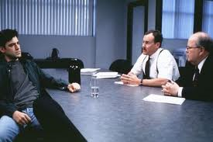
Do You Have Value?
Notes:
Does your boss truly understand your value to the company? Well, what are you waiting for? Let’s find out how to show him!

Slide 6
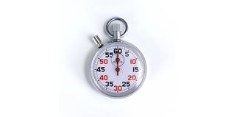
What Are You Measured By?
Notes:
http://unwrongest-cdn.appspot.com/images/article-clock.png

Slide 7
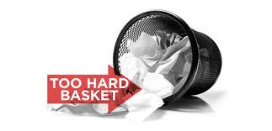
Performance Tuning is Hard!
3-5 Day Classes are typical
Cannot be everything to everyone
Requires expertise in many areas
Takes time
Low Priority
Where do you begin?
Notes:
http://www.toohardbasket.com/img/toohardbasket2.jpg

Slide 8
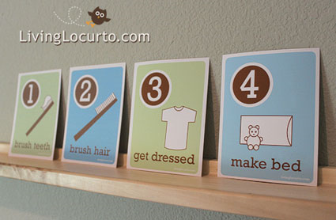
What Do People Crave?
Notes:
http://assets.unclutterer.com/wp-content/uploads/090929-cards.jpg

Slide 9
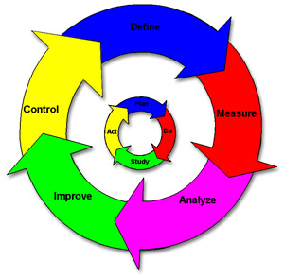
Same Thing For Adults
Notes:
http://www.medicaldevicesolutions.ie/wp-content/uploads/Six-Sigma.jpg

Slide 10

Six Sigma Lessons
DMAIC
Define
Measure
Analyze
Improve
Control

Slide 11
What Can DMAIC Do For Me?
Help you locate bottlenecks
Help you resolve bottlenecks
Help you become efficient
Help you to demonstrate your value
Notes:
http://www.biol.canterbury.ac.nz/newsletter/news126_promotion.jpg

Slide 12
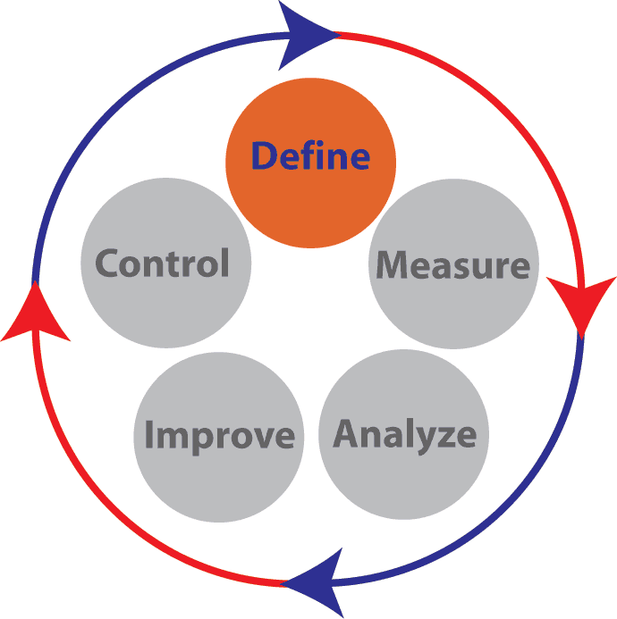
DMAIC: Define
How are issues defined?
What are the challenges you face when trying to define issues?
Notes:
http://www.insyte-consulting.com/Home/Resources/Articles/UnderstandingthePhasesofSixSigma

Slide 13
DMAIC: Define
Common sources for issues:
Benchmarks
User experience
Business requirements
Common challenges:
User perception
OLTP vs. OLAP
Business requirements keep changing
Notes:
Or, you could use a 3rd party tool…and I know of one!

Slide 14
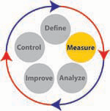
DMAIC: Measure
What are you measuring?
How do you measure?

Slide 15
DMAIC: Measure
Common measures:
Memory
CPU
Disk I/O
Network
How are metrics gathered?
SQL Trace
DMVs
3rd party tools
“Roll Your Own”

Slide 16
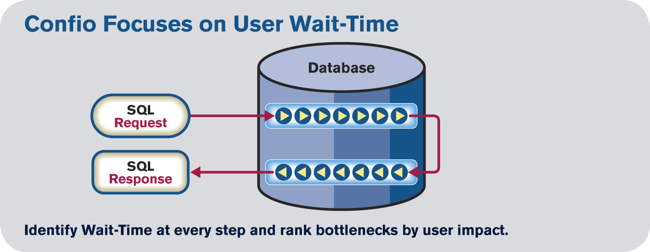
DMAIC: Measure
Focus on End User Response Time
Understand the total time a Query spends in Database
Measure time while Query executes
SQL Server helps by providing Wait Types
Notes:
Understanding wait types is key to effective performance tuning. When configuring your measures, make certain you are able to tie waits directly to the statements and queries that are running.
16

Slide 17
DMAIC: Measure
Common Wait Types:
ASYNC_NETWORK_IO
CXPACKET
LATCH_x
LOCK_x
PAGEIOLATCH_x
WRITELOG
http://technet.microsoft.com/en-us/library/cc966413.aspx

Slide 18
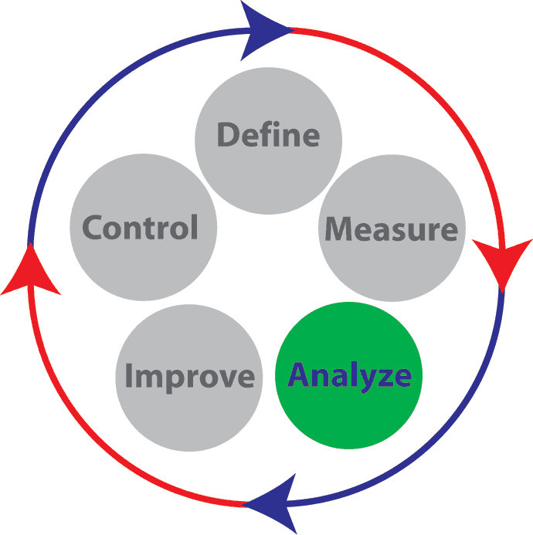
DMAIC: Analyze
Is it a problem?
Experience is valued here the most
How do you analyze?

Slide 19
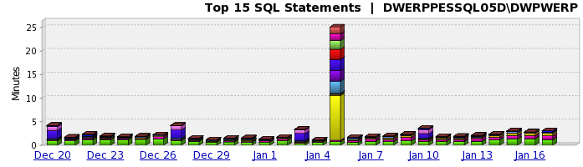
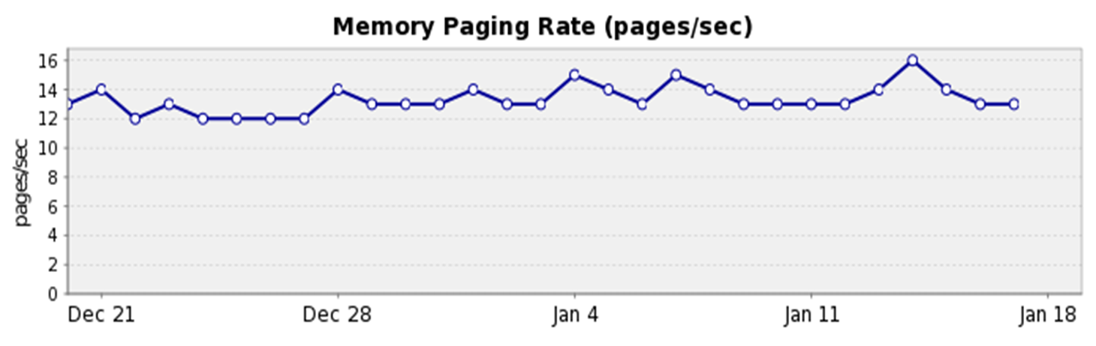
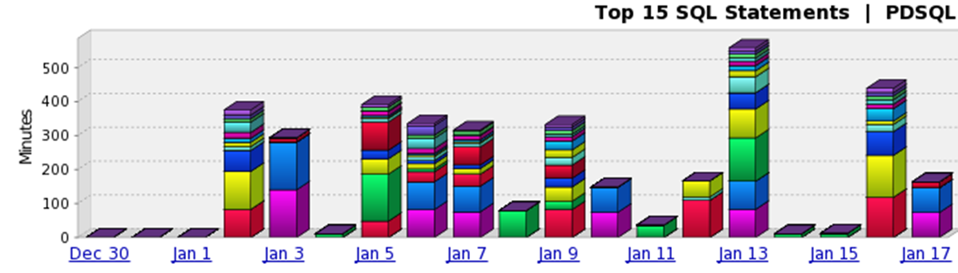
DMAIC: Analyze
Notes:
Are problems always this easy to locate? How do you focus your analysis? Simple: you refer back to your definitions!

Slide 20
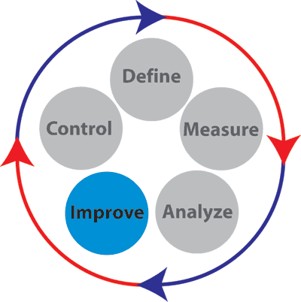
DMAIC: Improve
How do you make improvements?
Where do you look to make changes first?
Notes:
Have you tied your issue back to a particular statement or query?

Slide 21
DMAIC: Improve
Which scenario is worse?
SQL Statement 1
Executed 100 times
Caused 10 minutes of wait time for end user
Waited 90% of time on “PAGEIOLATCH_SH”
SQL Statement 2
Executed 1 time
Caused 10 minutes of wait time for end user
Waited 90% on “LCK_M_X”

Slide 22
DMAIC: Improve
Where would you begin to improve this?
SELECT Top 50 T_ID, T_DTS, ST_NAME, TT_NAME, T_S_SYMB, T_QTY,T_EXEC_NAME, T_CHRG, S_NAME, EX_NAME
FROM E_TRADE, E_STATUS_TYPE,
E_TRADE_TYPE, E_SECURITY, E_EXCHANGE
WHERE T_CA_ID = 490
AND ST_ID = T_ST_ID
AND TT_ID = T_TT_ID
AND S_SYMB = T_S_SYMB
AND EX_ID = S_EX_ID
ORDER BY T_DTS desc;
Notes:
Typical of a statement that we get handed. We didn’t build it, but we need to fix it. Where do you start?

Slide 23
DMAIC: Improve
SQL Diagramming
Dan Tow
http://www.singingsql.com/index.html

Slide 24
DMAIC: Improve
When handed a query to build or tune, perform the following 12 steps:
List all tables in query
Gather rowcounts for each table
Find all filters
WHERE clause
JOIN clause
Calculate the selectivity

Slide 25
DMAIC: Improve
Customers
Orders
Details
19k rows
31k rows
121k rows
Need 18k rows
Need 12k rows
Need 3k rows
0.947 selectivity
0.387 selectivity
0.024 selectivity
Notes:
The “trick” is to have the optimizer to start with the most selective set of data. This can be achieved through proper design and indexing (i.e., building covering indexes).

Slide 26
DMAIC: Improve
Next Steps:
Gather info on additional columns used
Gather info on existing keys and indexes
Examine the execution plan
SET STATISTICS IO ON
SET STATISTICS TIME ON
DBCC DROPCLEANBUFFERS
Record results

Slide 27
DMAIC: Improve
Demo script:
SELECT c.CustomerID, soh.ShipDate
FROM Sales.SalesOrderDetail sod
INNER JOIN Sales.SalesOrderHeader soh ON sod.SalesOrderID = soh.SalesOrderID
INNER JOIN Sales.Customer c ON c.CustomerID = soh.CustomerID
WHERE sod.SpecialOfferID = 2
AND soh.ShipDate between '2003-01-01 00:00:00.000' and '2004-01-01 00:00:00.000'
AND c.CustomerType = 'I'

Slide 28
DMAIC: Improve
Adjust indexes for table with lowest selectivity first
Re-run query and examine results and execution plans
Repeat on next lowest selectivity table
Continue on, reducing your logical and physical reads
WARNING: Adding additional indexes is not always the right thing to do!
Compare volume of other DUI statements!

Slide 29
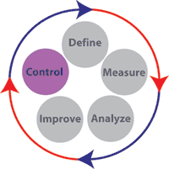
DMAIC: Control
Run the same measures again!

Slide 30

Now What?

Slide 31
Show Your Value!
You can track your progress
Note significant improvements
Create “Top Ten” lists
Provide weekly summaries
Note success for high-profile projects
Ask for a raise/promotion/training
Explain “what do you do here?”

Slide 32
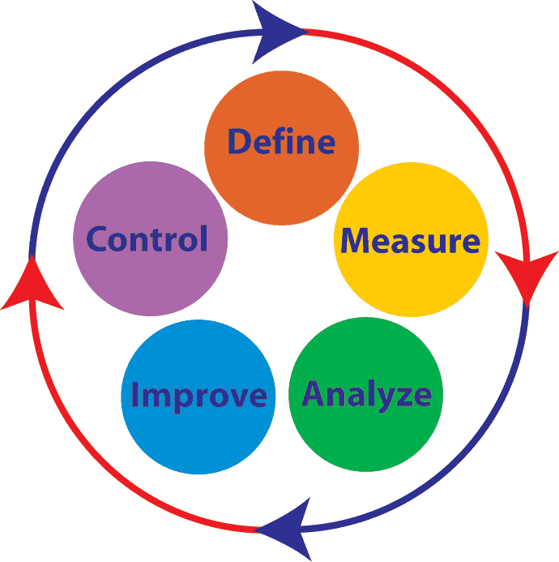
What Are You Waiting For?
Get your definitions
Get your measures in place
Start analyzing
Suggest improvements
Control reports
Rinse, lather, repeat

Slide 33
For More Information
http://technet.microsoft.com/en-us/library/cc966413.aspx
http://pal.codeplex.com/
http://speakerrate.com/talks/4260-what-are-you-waiting-for
http://thomaslarock/presentations

Slide 34
Questions?
?

