Slide 2
Windows Azure Storage and Database
Name
Title
Organization

Slide 3
Agenda
Windows Azure SQL Database
Azure Tables
Azure Blobs
SQL in a VM

Slide 4










Application building blocks
Big data
Database
Storage
Traffic
Caching
Messaging
Identity
Media
CDN
Networking

Slide 5

Big Data
New data sources
Large data volumes
New technologies
Non-traditional data types
New economics
New Questions & New Insights
Notes:
Slide Objectives:
Define and explain the characteristics of “Big Data”
Speaking Points:
Notes:

Slide 6



Azure Data Management
SQL Server in a Virtual Machine
Azure SQL Database
Azure Table Storage
Azure Blob Storage
Notes:
Slide Objectives:
Explain the offerings that Microsoft is providing in Azure for storing, querying, and managing data.
Speaking Points:
Notes:

Slide 7
Azure Data Management
SQL Server in a Virtual Machine
Azure SQL Database
Azure Table Storage
Azure Blob Storage

Slide 8



A Continuous Offering From Private to Public Cloud
Physical
Virtual
IaaS
PaaS
SaaS
Windows Azure SQL Database

Slide 9



SQL Server in a Virtual Machine
Full SQL Server capability
Low TCO for existing apps
Flexibility & control
Managed infrastructure
Notes:
Slide Objectives:
Explain the benefits of Virtual Machines + SQL Server
VALUE PROP
Enable customers to easily migrate, maintain, and monitor their existing SQL Server applications to Windows Azure VM role, and run them with competitive reliability, performance, and TCO characteristics.
Speaking Points:
Full SQL Server Capability
High Availability of Database with AlwaysOn Availability Groups
Advanced Security (Transparent data encryption & auditing)
Full Business Intelligence Functionality
Low TCO for Existing Apps
No App Changes Required
Familiar Development tools
Library of VM Templates
Flexibility and Control
Full Control of Virtual Machine
Common Identity (Active Directory Integration)
Managed Infrastructure
Fully Managed Infrastructure
99.9% SLA for Virtual Machine
Single Pane of Glass to Manage with System Center 2012
Notes:

Slide 10

Common Scenarios
Public Cloud
SQL Server in a Windows Azure Virtual Machine
Move existing tier 2 & 3 apps
Develop & test
Backup database to the cloud
Extend on-prem applications
Notes:
Slide Objectives:
Explain the benefits of Virtual Machines + SQL Server
Speaking Points:
Notes:

Slide 11
SQL Server 2012 in Windows Azure
Demo
Notes:
VM creation (endpoints, firewall, etc)
Connect via SSMS 2012
Using same bacpac, import into SQL in the VM
Mirroring?

Slide 12
Azure Data Management
SQL Server in a Virtual Machine
Azure SQL Database
Azure Table Storage
Azure Blob Storage
Notes:
Slide Objectives:
Explain the offerings that Microsoft is providing in Azure for storing, querying, and managing data.
Speaking Points:
Notes:

Slide 13

Windows Azure SQL Database
Relational Data Storage
Relational database as a service
Fully managed
High availability, scalability, & global reach
Familiar language and framework support
Notes:
Get started quickly
Choose a plan
Choose a billing option
Provision servers
Use familiar technologies
Supports Transact-SQL
Supports popular languages
.NET Framework (C#, Visual Basic, F#) via ADO.NET
C / C++ via ODBC
Java via Microsoft JDBC provider
PHP via Microsoft PHP provider
Supports popular frameworks
OData, Entity Framework, WCF Data Services, NHibernate
Supports popular tools
SQL Server Management Studio (2008 R2 and later)
SQL Server command-line utilities (SQLCMD, BCP)
CA Erwin® Data Modeler
Embarcadero Technologies DBArtisan®
Differences in comparison to SQL Server
Focus on logical vs. physical administration
Database and log files automatically placed
Three high-availability replicas maintained for every database
Databases are fully contained
Tables require a clustered index
Maximum database size is 150 Gb
Unsupported SQL Server features
BACKUP / RESTORE
USE command, linked servers, distributed transactions, distributed views, distributed queries, four-part names
Service Broker
Common Language Runtime (CLR)
SQL Agent

Slide 14
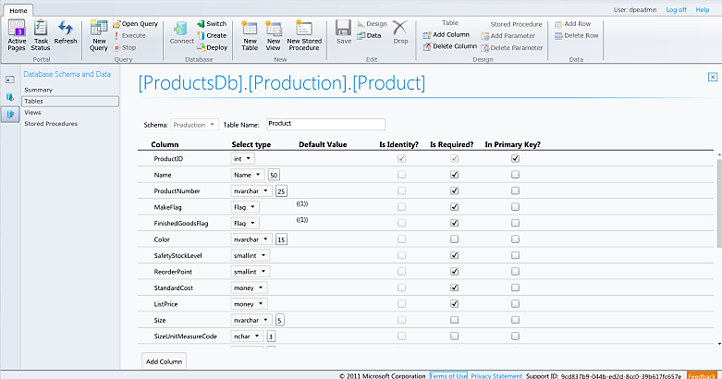
Familiar and Consistent Tools
Use familiar technologies
Supports Transact-SQL
Supports popular languages
.NET Framework (C#, Visual Basic, F#) via ADO.NET
C / C++ via ODBC
Java via Microsoft JDBC provider
PHP via Microsoft PHP provider
Supports popular frameworks
OData, Entity Framework, WCF Data Services, NHibernate
Supports popular tools
SQL Server Management Studio (2008 R2 and later)
SQL Server command-line utilities (SQLCMD, BCP)
CA Erwin® Data Modeler
Embarcadero Technologies DBArtisan®
Notes:
Slide Objectives:
Emphasize that there are three familiar tools for developers to use when interacting with Windows Azure SQL Database.
Speaking Points:
Visual Studio
Integrated Database Design Environment
Table Designer, T-SQL Editor, and Debugging
SQL Server Management Studio
Database migration via Data-Tier Applications
Import / Export Service
Manage.WindowsAzure.com
Unified management experience
Cross browser
Notes:
IntelliSense in T-SQL Editor
SQL Server Data Tools
Strive to make it consistent as possible
Intersection with the cloud
Bridging you to the new cloud world
Consistency to the new developer experience
Consistency with the new cloud model

Slide 15
Windows Azure SQL Database
Demo
Notes:
Provision Server in new portal
Create Database
Connect with SSMS 2012
From SQL Server 2012, create bacpac and migrate to Azure SQL Database

Slide 16
Architecture
Applications
Tools
ODBC
ADO.NET
TDS
Client Layer - Used by application to communicate directly with Azure SQL Database.
Connection Routing
Services Layer – Gateway between Client layer and Platform layer.
Billing
Provisioning
Platform Layer – Includes physical servicers and services that support the Services layer.
Server
Server
Server
SQL Server
SQL Server
SQL Server
Infrastructure Layer – IT administration and physical HW and OS.
SQL Fabric
SQL Fabric
SQL Fabric
Mgmt. Services
Mgmt. Services
Mgmt. Services
Infrastructure

Slide 17
Inside Windows Azure SQL Database
1
New Database Request
TDS Gateway
Front-end Node
TDS Session
2
Primary & Replica Databases Created
Backend Node Replica 1
Backend Primary Node
Backend Node Replica 2
SQL DB
SQL DB
SQL DB
Scalability and Availability: Fabric, Failover, Replication, and Load balancing
Notes:
Slide Objectives:
Explain how databases are provisioned and managed by the WA SQL Database service.
Emphasize that we are able to automate several aspects of the database for you including high availability by maintaining three replicas of data
Speaking Points:
Notes:
A request for a new database comes in. The TDS Gateway interrogates the request and looks at the protocol and handles the request accordingly.
The request is then sent to the master cluster which contains information regarding all backend nodes (load, etc).
[Jeff Currier] We keep a pool of buffered databases around for db create requests. When a user goes to make a request to create a database we simply go to the master cluster (GPM) to find where the current primary replica is for partition containing the list of these buffer databases. We then connect to that partition and take out one of the databases for our use. We then connect directly to that database stamping it with the new database name, server information.

Slide 18
SQL Federation
Scale Out Your Data
Integrated database partitioning
Multi-tenancy via flexible repartitioning
Add and remove database nodes seamlessly
Enables greater scalability and performance
Dynamic partitioning with no downtime
Notes:
Special considerations
A logical database can contain multiple federations
Distribution scheme supports int, bigint, guid, and varbinary types
Filtering routes connection to appropriate shard regardless of changes in partitions
Merge, fan-out queries and automatic distribution of schema changes not supported in initial release

Slide 19
SQL Federation
Demo
Notes:
Run small Federation script
Talk through syntax and DMVs
Execute split
Illustrate federation member navigation and queries
Show split with GUIDs
Show enhancements for Federations in SSMS
Show Federations in SQL Management Portal

Slide 20
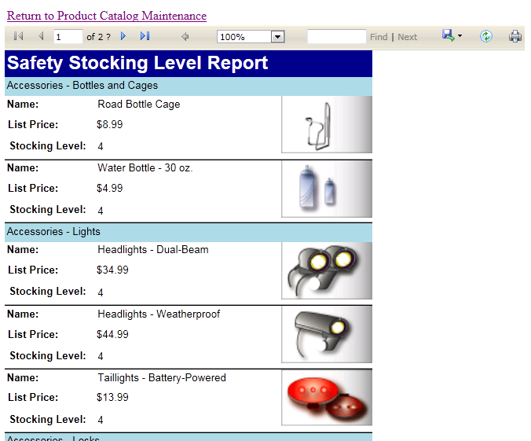
SQL Reporting
Visualize Your Data
Reporting delivered as cloud service
Elastically scales with demand
Familiar tools & programming model
Securely view & manage reports
Notes:
Get started quickly
Provision report server via Windows Azure Management Portal
Build reports with Reporting Services Report Designer
Deploy reports to report server
Render reports with Visual Studio ReportViewer controls
Use familiar technologies
Visual Studio Report Designer
RDL (Report Definition Language)
Report items and visualizations
Report Server Web Service / URL access
Visual Studio ReportViewer Control
Identity and access control
SQL authentication supported (no support for integrated authentication)
Admin user configured during provisioning
Admin user has all rights on server, use for administration only
Provision users using portal or web service
Add users to appropriate item (Browser, Publisher) and system roles (User, Admin)
Grant item-level permissions to folders or reports
Differences in comparison to Reporting Services
Focus on logical vs. physical administration
Report catalog and temporary database automatically provisioned
Windows Azure Management Portal replaces Report manager
SSL Required
Azure SQL Database data sources only
Unsupported Reporting Services features
Report Builder
Subscriptions, schedules, caching
Custom extensions
Report models
External images

Slide 21
SQL Data Sync
Azure SQL Databases
Synchronize Your Data
Database synchronization as a service
On-premises & Azure SQL Database
Configuration driven
Elastically scales with demand
SQL Server (On-Premises)
Notes:
Special considerations
Conflict resolution policy configured centrally (hub or client wins)
Sync direction configured between each client and the hub (to hub, from hub, bi-directional)
Sync schedule must be between 5 minutes and 1 month
Data sets include multiple tables and can be filtered, triggers are added to data set tables
Tables added to hub and client schemas
Agent must be installed for on-prem clients
Provisioning synchronization groups
Deploy database to hub and clients
Set synchronization schedule
Set conflict resolution policy
Define data set
Add Azure SQL Database clients to topology
Install agents on SQL Server clients and add them to topology using keys
Deploy topology
Operational considerations
Manual synchronization supported
Hub updates require one synchronization to distribute to all clients
Client updates require two synchronizations to distribute to all clients
Sync Framework triggers may affect application behavior

Slide 22
Azure Data Management
SQL Server in a Virtual Machine
Azure SQL Database
Azure Table Storage
Azure Blob Storage
Notes:
Slide Objectives:
Explain the offerings that Microsoft is providing in Azure for storing, querying, and managing data.
Speaking Points:
Notes:

Slide 23
Windows Azure Storage
Storage in the Cloud
Scalable, durable, and available
Anywhere at anytime access
Only pay for what the service uses
RESTful Web Services
Use from Windows Azure Compute
Use from anywhere on the internet
Notes:
This should be a recap as this session will dig deeper into the services.

Slide 24
Storage Libraries in Many Languages
C#/.NET
Python
Ruby
Perl
JavaScript (Node)
Java
PHP
Erlang
Common LISP
Objective-C
C#/VB on Windows Phone 7

Slide 25
New Features
Service Features
Shared Access Signatures for Tables and Queues
Expanded Blob Copy
Improved Blob Leasing
Improved Manageability
Locally Redundant Storage
Geo or Locally Redundant Storage
Storage Analytics Configuration
Storage Metrics Monitoring
Notes:
Shared Access Signatures (Signed URLs) for Tables and Queues – similar to the Shared Access Signature feature previously available for Blobs, this allows account owners to issue URL access to specific resources such as tables, table ranges, queues, blobs and containers while specifying granular sets of permissions. In addition, there are some smaller improvements to Shared Access Signatures for Blobs
Expanded Blob Copy – For Blobs, we now support copying blobs between storage accounts and copy blob (even within accounts) is performed as an asynchronous operation. This is available in the new version, but will only work if the destination storage account was created on or after June 7, 2012. Of course, Copy Blob operations within the same account will continue to work for all accounts
Improved Blob Leasing – Leasing is now available for blob containers, and allows infinite lease duration. In addition, lease durations between 15-60 seconds are also supported. Changing the lease id (in order to rotate the lease-id across your components) is now supported
Introducing Locally Redundant Storage - Storage users are now able turn off geo-replication by choosing Locally Redundant Storage (LRS). LRS provides highly durable and available storage within a single location (sub region).
Choosing Geo Redundant Storage or Locally Redundant Storage – By default storage accounts are configured for Geo Redundant Storage (GRS), meaning that Table and Blob data is replicated both within the primary location and also to a location hundreds of miles away (geo-replication). As detailed in this blog post, using LRS may be preferable in certain scenarios, and is available at a 23-34% discount compared to GRS. The price of GRS remains unchanged. Please note that a one-time bandwidth charge will apply if you choose to re-enable GRS after switching to LRS.
Configuration of Storage Analytics – While our analytics features (metrics and logging) have been available since last summer, configuring them required the user to call the REST API. In the new management portal, users can easily configure these features.
Monitoring Storage Metrics – Storage users can now also monitor any desired set of metrics tracked in your account via the management portal

Slide 26
Azure Data Management
SQL Server in a Virtual Machine
Azure SQL Database
Azure Table Storage
Azure Blob Storage
Notes:
Slide Objectives:
Explain the offerings that Microsoft is providing in Azure for storing, querying, and managing data.
Speaking Points:
Notes:

Slide 27
Azure Table Storage
NoSQL Data Storage
Fully managed PaaS
Key-value
Hierarchical
REST API
Geo replication
Account
Storage Account: MovieData
Table Name: Movies
Star Wars
Matrix
Fan Boys
Table
Entity
Notes:
Slide Objectives:
Define the table storage and differentiate it from a Windows Azure SQL Database
Since we are not showing a demo of table storage, provide some details on the concepts including tables, entitles, and accounts.
Speaking Points:
Notes:
Tables store entities
Entity schema can vary in the same table
Automatic scalability

Slide 28
Table Storage Concepts
Account
Table
Entity
Name =…
Email = …
customers
Name =…
EMailAdd=
contoso
Photo ID =…
Date =…
photos
Photo ID =…
Date =…
Notes:
Slide Objectives
Understand Tables
Speaker Notes
The Table service provides structured storage in the form of tables.
The Table service supports a REST API that is compliant with the ADO.NET Data Services REST API.
Developers may also use the .NET Client Library for ADO.NET Data Services to access the Table service.
Notes
http://msdn.microsoft.com/en-us/library/dd573356.aspx

Slide 29
No Fixed Schema
 | FIRST | LAST | BIRTHDATE
 | Wade | Wegner | 2/2/1981
 | Nathan | Totten | 3/15/1965
 | Nick | Harris | May 1, 1976
FAV SPORT
Canoeing
Notes:
Slide Objectives
Understand Flexible Entities
Speaker Notes
Tables store data as entities.
A table can contain entities of any shape
There is no fixed schema
There is no schema checking
There is no strong typing- not that Birthdate is stored as both a datetime value and as a string
Not that we can add additional columns
Notes
http://msdn.microsoft.com/en-us/library/dd573356.aspx

Slide 30
Azure Data Management
SQL Server in a Virtual Machine
Azure SQL Database
Azure Table Storage
Azure Blob Storage
Notes:
Slide Objectives:
Explain the offerings that Microsoft is providing in Azure for storing, querying, and managing data.
Speaking Points:
Notes:

Slide 31
Azure Blob Storage
Unstructured Data Storage
Managed service
Hundreds of gigabytes per blob in size
100TB per storage account
REST API
Geo-replication for disaster recovery
Notes:
Slide Objectives
Define the blob storage service and the benefits of the service
Speaking Points:
Notes:
The Blob service provides storage for entities, such as binary files and text files.
The REST API for the Blob service exposes two resources:
Containers
Blobs.
A container is a set of blobs; every blob must belong to a container.
The Blob service defines two types of blobs:
Block blobs, which are optimized for streaming.
Page blobs, which are optimized for random read/write operations and which provide the ability to write to a range of bytes in a blob.
Blobs can be read by calling the Get Blob operation. A client may read the entire blob, or an arbitrary range of bytes.
Block blobs less than or equal to 64 MB in size can be uploaded by calling the Put Blob operation.
Block blobs larger than 64 MB must be uploaded as a set of blocks, each of which must be less than or equal to 4 MB in size.
Page blobs are created and initialized with a maximum size with a call to Put Blob.
To write content to a page blob, you call the Put Page operation. The maximum size currently supported for a page blob is 1 TB.
Notes
http://msdn.microsoft.com/en-us/library/dd573356.aspx
Using the REST API for the Blob service, developers can create a hierarchical namespace similar to a file system. Blob names may encode a hierarchy by using a configurable path separator. For example, the blob names MyGroup/MyBlob1 and MyGroup/MyBlob2 imply a virtual level of organization for blobs. The enumeration operation for blobs supports traversing the virtual hierarchy in a manner similar to that of a file system, so that you can return a set of blobs that are organized beneath a group. For example, you can enumerate all blobs organized under MyGroup/.

Slide 32
Blob Storage Concepts
http://<account>.blob.core.windows.net/<container>/<blobname>
Account
Container
Blob
Pages/ Blocks
PIC01.JPG
images
Block/Page
PIC02.JPG
contoso
Block/Page
videos
VID1.AVI
Notes:
Slide Objectives
Understand the hierarchy of Blob storage
Speaker Notes
The Blob service provides storage for entities, such as binary files and text files.
The REST API for the Blob service exposes two resources:
Containers
Blobs.
A container is a set of blobs; every blob must belong to a container.
The Blob service defines two types of blobs:
Block blobs, which are optimized for streaming.
Page blobs, which are optimized for random read/write operations and which provide the ability to write to a range of bytes in a blob.
Blobs can be read by calling the Get Blob operation. A client may read the entire blob, or an arbitrary range of bytes.
Block blobs less than or equal to 64 MB in size can be uploaded by calling the Put Blob operation.
Block blobs larger than 64 MB must be uploaded as a set of blocks, each of which must be less than or equal to 4 MB in size.
Page blobs are created and initialized with a maximum size with a call to Put Blob.
To write content to a page blob, you call the Put Page operation. The maximum size currently supported for a page blob is 1 TB.
Notes
http://msdn.microsoft.com/en-us/library/dd573356.aspx
Using the REST API for the Blob service, developers can create a hierarchical namespace similar to a file system. Blob names may encode a hierarchy by using a configurable path separator. For example, the blob names MyGroup/MyBlob1 and MyGroup/MyBlob2 imply a virtual level of organization for blobs. The enumeration operation for blobs supports traversing the virtual hierarchy in a manner similar to that of a file system, so that you can return a set of blobs that are organized beneath a group. For example, you can enumerate all blobs organized under MyGroup/.

Slide 33
Windows Azure Storage
Demo
Notes:
1 – simple Example
2 – Real world – KINECT!

Slide 34
Azure Storage Architecture
3 Storage Layered Architecture
Legend
VIP
Partition
FE
Server
Load
FE
FE
Partition Master(s)
FE
FE
FE
Partition Server
Partition Server
Partition Server
Partition Server
Distributed File System Layer
Notes:
Here we can see that the Front-End layer takes incoming requests, and a given front-end server can talk to all of the partition servers it needs to in order to process the incoming requests. The partition layer consists of all of the partition servers, with a master system to perform the automatic load balancing (described below) and assignments of partitions. As shown in the figure, each partition server is assigned a set of object partitions (Blobs, Entities, Queues). The Partition Master constantly monitors the overall load on each partition sever as well the individual partitions, and uses this for load balancing. Then the lowest layer of the storage architecture is the Distributed File System layer, which stores and replicates the data, and all partition servers can access any of the DFS severs.
It is important to understand that partitions are not tied to specific partition servers, since the data is stored in the DFS layer. The partition layer can therefore easily load balance and assign partitions to different partition servers, since any partition server can potentially provide access to any partition.
The partition layer assigns partitions to partition severs based on each partition’s load. A given partition server may serve many partitions, and the Partition Master continuously monitors the load on all partition servers. If it sees that a partition server has too much load, the partition layer will automatically load balance some of the partitions from that partition server to a partition server with low load.

Slide 35
Scalability
Partition: Range of entities with same partition key value.
Partitions are fanned out based on load
They can be condensed when load decreases
Reads are load balanced against three replicas
Server 1
Server 2
Server 3
P1
P2
Pn
Notes:
CONSECUTIVE RANGE!

Slide 36
Scalability
PartitionKey
Unique identifier for the partition within a give table.
RowKey
Unique Identifier for an entity within a given partition.
Both Keys matter!
Define Primary Key
Forms a single clustered index
Very Fast
Partition Key + Row Key
Slower
Only Partition Key
No Row Key
Slowest
No Partition Key
No Row Key

Slide 37
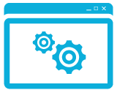
Hadoop On Windows Azure
Unstructured Data Storage
Managed service
Javascript console simplifies development
Integrate data with Hive ODBC driver
Excel integration
Preview: M/R, HDFS, Hive, Pig, Streaming & more
Hadoop Cluster
Azure Blob Storage
Notes:
Slide Objectives
Explain our implementation of Hadoop on Windows Azure
Speaking Points:
Notes:

Slide 38
Summary
Cloud services for the new world of data
Managed Services
Breadth of data types and programming models
Highly available and scalable
Cloud on your terms
Notes:
Slide Objectives:
Wrap up by summarizing the key themes that we’ve covered
Demo Flow:
Speaking Points:
Notes:

