Slide 1
Introduction To Windows Azure SQL Database
Name
Title
Microsoft Corporation

Slide 2


A Continuous Offering From Private To Public Cloud
Physical
Virtual
IaaS
PaaS
SaaS
Notes:
Slide Objectives:
Show Microsoft’ continuous Private to Public Cloud Offering, but this presentation will focus on Microsoft’s relational database PaaS offering.
Transition:
Microsoft provides a continuous solution from private cloud to the public cloud. No matter where you are on your technology roadmap we have a solution to fit your needs.
We are a trusted advisor and platform in the traditional enterprise and ISV space with new IaaS offerings that making it easier to bring this same level of trust and ease of use to the public cloud. However, Windows Azure SQL Database extends SQL Server capabilities to the cloud by offering SQL Server as a relational database service.
Speaking Points:
Announced New IaaS offering in June
SQL Database provides SQL Server as a relational service.
Notes:

Slide 3

Agenda
Architecture
Starting With The Basics
Create And Deploy Your Database
Secure Your Database
Exploring Advanced Capabilities

Slide 4
Architecture

Slide 5
A Server Is Not A Machine
SQL Server
A Machine
SQL Database Server
A TDS Endpoint
Notes:
Slide Objectives:
Understand that while there are physical SQL Server boxes behind the scenes, when connecting to SQL Database, you are not connecting to a physical server, but to a TDS endpoint.
Transition:
The key to understanding SQL Database is understanding while SQL Database is SQL Server, we do not interact with them in the same physical manner.
Speaking Points:
In an on-premises environment, we typically have physical access to the actual SQL Server server.
In Windows Azure, we do not have physical access to the actual server.
Notes:
It is important that the attendee understands that it IS INDEED SQL Server at the platform layer. There are physical boxes running SQL Server 2012 Enterprise Edition. However, due to the nature of the Azure environment to provide the high-availability and scalability necessary, access to the physical boxes is currently not supported.

Slide 6
How It Works
Client Layer
PHP
SQL Server
Applications
and Tools
WCF Data Services
Architecture
Client Layer - Used by application to communicate directly with SQL Database.
Services Layer – Gateway between Client layer and Platform layer.
Platform Layer – Includes physical servicers and services that support the Services layer.
Infrastructure Layer – IT administration of the physical HW and OS.
ODBC
ADO.NET
Tabular Data Stream (TDS)
TDS+SSL
Services Layer
Provisioning
Provisioning
Provisioning
…
Billing and Metering
Billing and Metering
Billing and Metering
…
Connection Routing
Connection Routing
Connection Routing
…
Platform Layer
SQL Server
SQL Server
SQL Server
…
SQL Database Fabric
SQL Database Fabric
SQL Database Fabric
…
Management Services
Management Services
Management Services
…
Infrastructure Layer
Notes:
Slide Objectives:
To understand the actual architecture that provides the enterprise-ready SQL Database service.
Transition:
Developers have spent years working with their technology of choice, and Microsoft wanted to ensure that the technologies and tools you use today will continue to work with SQL Database without learning a whole new set of technologies.
Speaking Points:
Familiar technology and tools
Similar architecture as that of on-premises
Additional layer providing server and database partitioning, client connection routing, and billing.
Same great SQL Server technology on the backend.
Additional services (SQL Database Fabric) to ensure SLAs are met and to ensure optimum performance.
Notes:
Client - The client layer resides closest to your application, and is used by your application to communicate directly with SQL Database. The client layer can reside on-premise in your datacenter or be hosted in Windows Azure. Because SQL Database provides the same tabular data stream (TDS) interface as SQL Server, you can use familiar tools and libraries to build client applications for data that is in the cloud.
Services - The services layer functions as a gateway between the client layer and the platform layer, where the data resides. The services layer provides three functions: provisioning, billing and metering, and connection routing.
The services layer provisions the databases that you specify with your Windows Azure platform account. The billing and metering aspect of the services layer enables multi-tenant support by providing monitoring and billing for database usage based on individual Windows Azure platform accounts. SQL Database is built on a scalable platform involving numerous physical servers; this layer handles all the connections routing between your application and the physical servers where your data resides.
Platform - The platform layer includes the physical servers and services that support the services layer. The platform layer consists of many instances of SQL Server, each of which is managed by the SQL Database fabric.
The SQL Database fabric is a distributed computing system composed of tightly integrated networks, servers, and storage. It enables automatic failover, load balancing, and automatic replication between physical servers.
Management services monitor the health of individual servers and enable automated installation of service upgrades and software patches.
Infrastructure - The infrastructure layer represents the IT administration of the physical hardware and operating systems that support the services layer.

Slide 7
What’s New
In the latest service update
Automated SQL Database Exports - Export transactional-consistent copies of your SQL Database to Storage.
Premium Tier – More powerful and predictable performance by dedicating reserved capacity.
Notes:
Slide Objectives:
Highlight what’s new in the latest SQL Database service update.
Transition:
In late September a service update was deployed to Windows Azure SQL Database that included new functionality.
Speaking Points:
Linked Server – This is a new component for database hybrid solutions spanning on-premises corporate networks and the Windows Azure cloud.
Recursive Trigger – Just like SQL Server 2012, the option can be configured via ALTER DATABASE dbname SET RECURSIVE_TRIGGERS ON|OFF
DBCC – The query optimizer uses statistics to estimate the cardinality or number of rows in the query result, which enables the query optimizer to create a high quality query plan.
Firewall Rules – different rules for different databases hosted on the same logical SQL Database server
Notes:

Slide 8
Starting With The Basics

Slide 9

The Basics
SQL Database
SQL Server database technology as a service
Fully Managed
Enterprise-ready with automatic support for HA
Designed to scale out elastically with demand
Ideal for simple and complex applications
Notes:
Slide Objectives:
Understand the overall concepts and benefits of SQL Database
Transition:
Let’s clear up any confusion and look at the basics of what SQL Database really is and some of its benefits.
Speaking Points:
The same great SQL Server database technology that you know, love, and use on-premises provided as a service
Enterprise-ready
Automatic support for High-Availability
Designed to scale on-demand to provide the same great elasticity
Notes:
High-availability – 3 copies of the database free for the cost of the one database. Always in sync. The cost to do this on-premises isn’t cheap. This is FREE in SQL Database.
Scalability using SQL Federation (discussed later in the presentation).

Slide 10
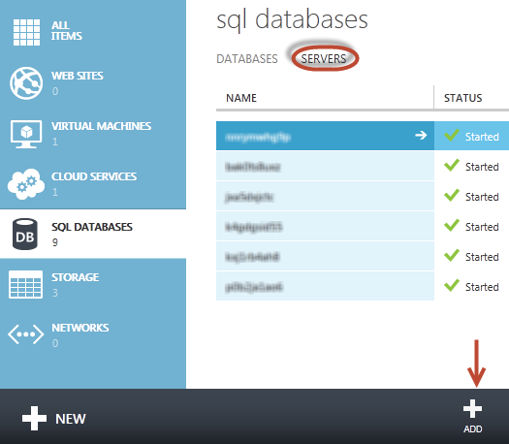
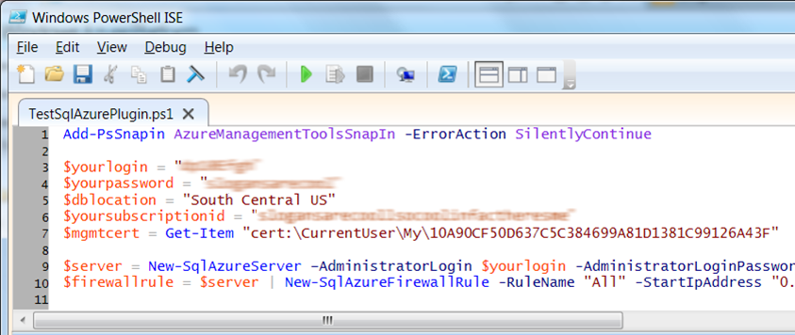
Server Provisioning
Server Defined
Service head that contains databases
Connect via automatically generated FQDN (xxx.database.windows.net)
Initially contains only a master database
Provision Servers Interactively
Log on to Windows Azure Management Portal
Create a SQL Database server
Specify admin login credentials
Add firewall rules and enable service access
Automate Server Provisioning
Use Windows Azure Platform PowerShell cmdlets (or use REST API directly)
wappowershell.codeplex.com
Notes:
Slide Objectives:
Show the different methods of provisioning a SQL Database server along with how easy it is. Plus, help the attendees understand what a SQL Database “server” really is.
Transition:
Provisioning an on-premises SQL Server box can be time consuming, costly, and at times, a challenge. With SQL Database, provisioning a “server” is painless, quick, and provisioned in a matter of seconds.
Speaking Points:
Provision servers interactively using the Management Portal
Automate server provisioning using the Windows Azure Management API or PowerShell.
Notes:
While the “server” is technically a TDS endpoint, much of the SQL Server process is similar. Administration login credentials are still needed for security, and more importantly defining service access is essential, and required, for maintaining the integrity of your server through firewall rules.

Slide 11
Creating A SQL Database Server
Demo
Notes:
Demo – Creating a SQL Database server DB through the Management Portal

Slide 12
Create And Deploy Your Database

Slide 13
Create Database…
Use Familiar Technologies
Transact-SQL
Languages
.NET Framework (C#, Visual Basic, F#) via ADO.NET
C / C++ via ODBC
Java via Microsoft JDBC provider
PHP via Microsoft PHP provider
Frameworks
OData, Entity Framework, WCF Data Services, NHibernate
Tools
SQL Server Management Studio (2008 R2 and later)
SQL Server command-line utilities (SQLCMD, BCP)
CA Erwin® Data Modeler
Embarcadero Technologies DBArtisan®
SQL Server Comparison
Focus on logical vs. physical administration
Database and log files automatically placed
Three high-availability replicas maintained for every database
Tables require a clustered index
Maximum database size is 150 GB
Unsupported SQL Server Features
Use command, distributed transactions, distributed views
Service Broker
Common Language Runtime (CLR)
SQL Agent
Native Encryption
Notes:
Slide Objectives:
Point out that 1) The same great technologies that developers use today on-premises works with SQL Database 2) high-level differences between on-premises and SQL Database 3) SQL Database features currently unsupported
Transition:
Creating, managing, and deploying a database in Windows Azure SQL Database isn’t difficult. The key is understanding the features that are supported and how SQL Database compares to on-premises SQL Server and the technologies that can be used with SQL Database.
Speaking Points:
The same great technologies that developers use today on-premises works with SQL Database, including developer languages, Frameworks, and Tools. Nothing new to learn!
SQL Server Comparison -> highlight the physical vs. logical administration. Developers and DBAs can now focus on things they love to do and not worry about the physical aspect.
Features unsupported by SQL Database -> Many of the unsupported features are hardware based and thus don’t need to be in SQL Database. Other features, such as encryption, are server-based and become a challenge in solving in a shared-environment.
Notes:
CLR data types ARE supported, SQLCLR is not yet supported.
Backup/Restore: PIT Coming; Import/Export can be used for backup to BLOB storage. Third-party backup products available via RedGate and Enzo.
Data can be stored encrypted but the encryption must be done at the application level.
Native encryption is being looked at.
**Linked Servers and Distributed Queries are now supported, linking a SQL Database instance from an on-premises server. Linking two SQL Database instances is NOT supported.

Slide 14
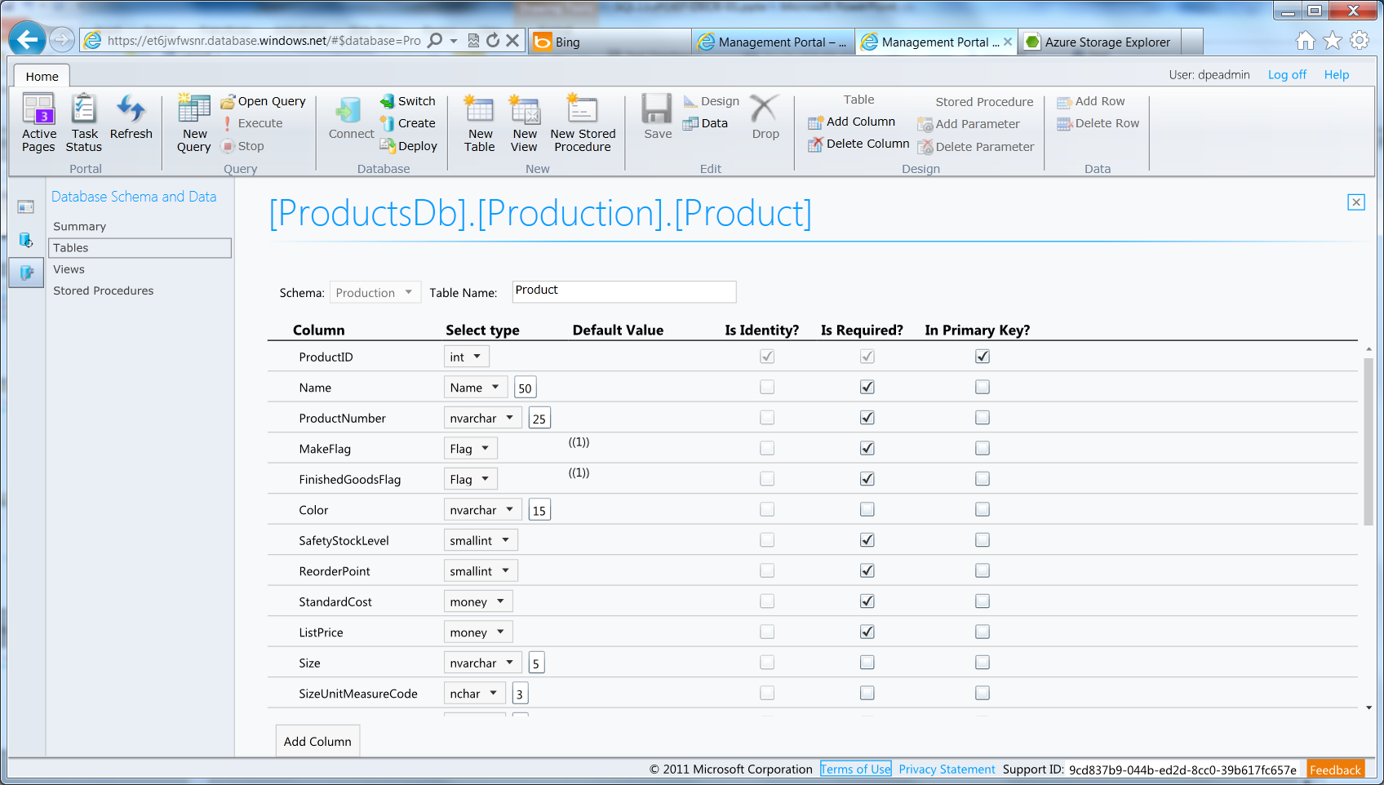
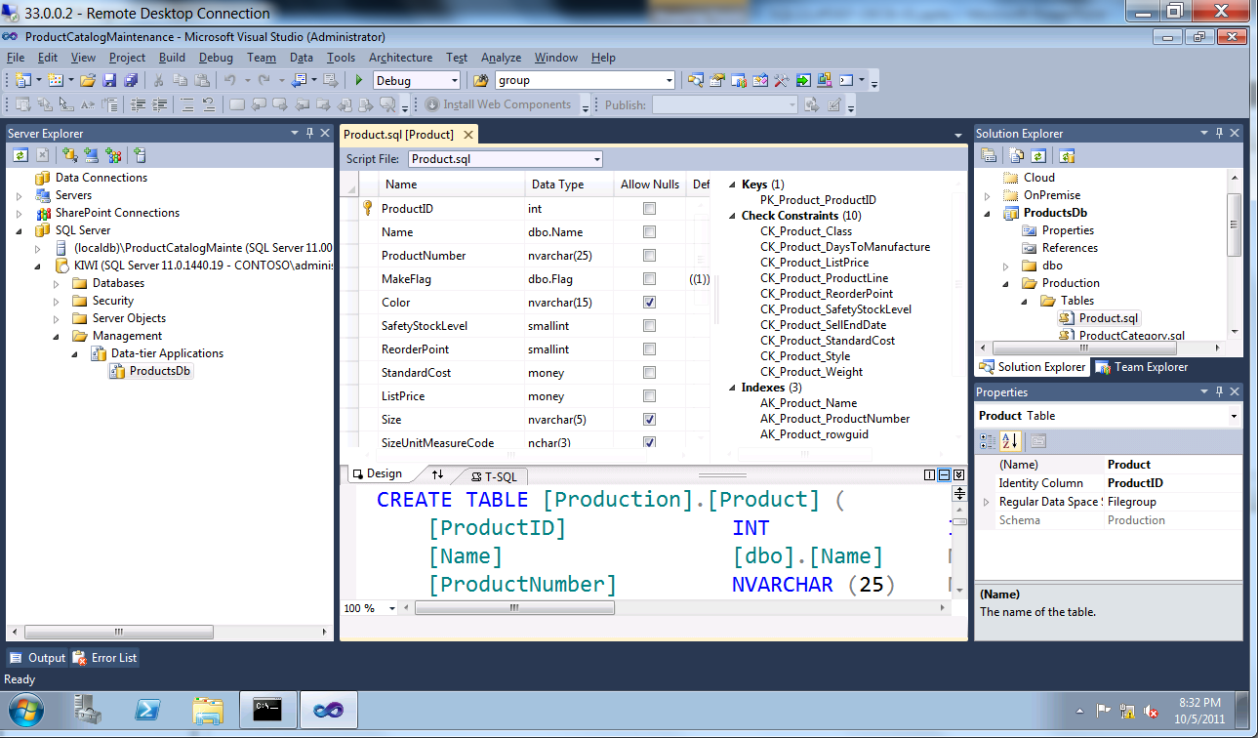
Enhanced Tooling
SQL Database Management Portal
Web designers for tables, views, stored procs
Interactive query editing and execution
SQL Server Data Tools (SSDT)
Visual Studio IDE for database development
Includes modern designers and projects with declarative, model-driven development
Develop and test in both connected and disconnected states
Platform targeting for both SQL Server (2005 and above) and SQL Database
Get it free with Web PI, with SQL Server 2012 and with Visual Studio 11
Notes:
Slide Objectives:
Highlight the set of tools for developers when interacting with Windows Azure SQL Database.
Transition:
Transition statement(s) to setup the slide
Speaking Points:
SQL Database Management Portal -> Cross Browser, Unified Management Experience
SQL Server Data Tools -> Integrated Database Design Environment, Table Designer, Debugging, T-SQL Editor
Notes:
IntelliSense in T-SQL Editor
SQL Server Data Tools
Strive to make it consistent as possible
Intersection with the cloud
Bridging you to the new cloud world
Consistency to the new developer experience
Consistency with the new cloud model

Slide 15
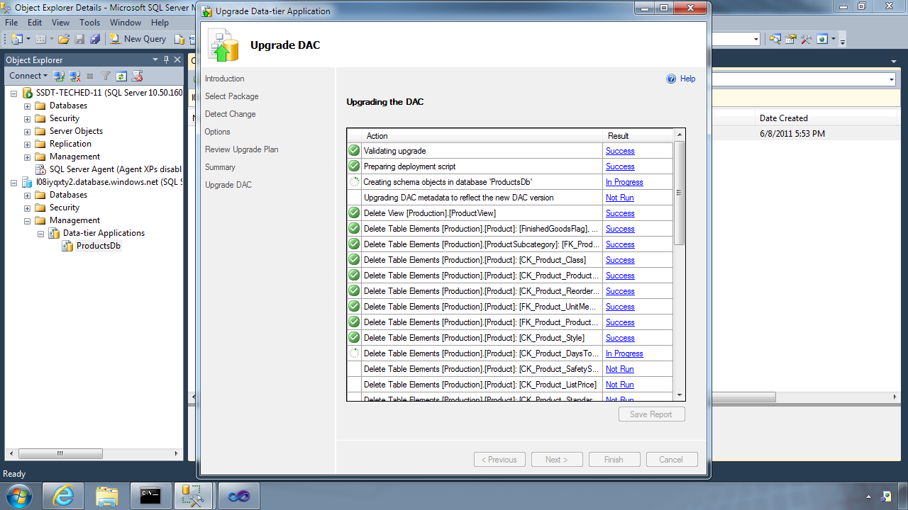
Database Deployment
Data-Tier Application Framework (DAC Fx)
Alternative to traditional script based approach
Dramatically simplifies deployment, migration and versioning of databases
Provides a single unit of deployment for schema (dacpac) or for schema + data (bacpac)
Supports automatic versioning of database schemas
Supports platform targeting for both SQL Server (2005 and above) and SQL Database
Build from scratch or extract from existing db
How To Get The Latest DAC Fx
With SQL Server Data Tools
With SQL Server 2012 Management Studio
With SQL Database Import/Export Service
Via sqldacexamples.codeplex.com
Notes:
Slide Objectives:
Discuss the deployment options for migrating your on-premises database to SQL Database.
Transition:
There are many ways to migrate your on-premises SQL Server database to Windows Azure SQL Database, but there have been great enhancements and improvements in both DAC and SSDT to dramatically improve and simplify deployment and migration options.
Speaking Points:
DAC Framework – A new unit of deployment called a bacpac which contains both schema AND data.
SQL Server Data Tools – Easily determine “Azure read” status. Provide single Publish capability.
Notes:
Both DAC and SSDT provide instant feedback as to the “azure-ready” status of your on-premises database. SSDT provides a single publish from source to destination, but DAC creates a deployment unit which can be stored in Azure storage or on-premises and used to create multiple SQL Database instances.

Slide 16
DAC Deployment From SQL Server Management Studio
Demo
Notes:
Demo – Migrating an on-premises database to SQL Database DB using SQL Server 2012 and dacpacs

Slide 17
Secure Your Database

Slide 18
There Are Two Ways To Secure A Database:
On The Server
Within The Database
Notes:
Slide Objectives:
Highlight the two areas where Windows Azure SQL Database can be secured.
Transition:
Security is vitally important and has not be overlooked. Windows Azure SQL Database takes security seriously.
Speaking Points:
Set security options on the server itself
Security within the database
Notes:
This doesn’t leave the application free of any responsibility…some settings are required to be set within the application.

Slide 19
Server Benefits
Server identity and access control
SQL authentication supported (No Integrated authentication)
The Admin login is similar to sa
Connect to master to administer logins
loginmanager: Server-Level security role for creating logins
dbmanager: Server-Level security role for creating databases
Notes:
Slide Objectives:
Highlight the important server security aspects and benefits of SQL Database security.
Transition:
From the server perspective, there are several things that should be things that should be considered when managing the security of your SQL Database.
Speaking Points:
No Integrated Authentication
Use Master to create and drop databases
The Admin login (which was created during server provisioning) is equivalent to sa. It has full rights on the server (and all databases) and should only be used for administration.
The loginmanager role is used for creating logins: membership in this role grants CREATE / ALTER / DROP Login privileges
The dbmanager role is used for creating databases: membership in this role grants CREATE / ALTER / DROP Database privileges
Manage logins with CREATE / ALTER / DROP LOGIN commands
Notes:
Although the server-level principal login is not a member of the two database roles dbmanager and loginmanager in the master database, it has all permissions granted to these two roles.

Slide 20
Database Benefits
Database identity and access control
Logins require an associated user account
The Admin login is automatically associated with dbo
The dbo has full rights in the database
Manage users with CREATE / ALTER / DROP USER commands
Add users to roles via sp_add_rolemember to grant privileges
Utilize schemas where appropriate
Notes:
Slide Objectives:
Highlight the important database security aspects and benefits of SQL Database security
Transition:
At the database level, you’ll notice security similarities as that of on-premises. Much of the same security design principles that apply on-premises also apply in SQL Database.
Speaking Points:
Logins must have an associated user account to connect to a database
The admin login is automatically associated with a special user known as dbo (database owner)
The dbo has full rights in the database and should only be used for administration
Manage users with CREATE / ALTER / DROP USER commands
Add users to system or user-defined database roles to grant privileges via sp_add_rolemember
Organize database objects into schema containers based upon common access control requirements, and grant privileges to schema containers instead of individual objects for better productivity
Notes:

Slide 21
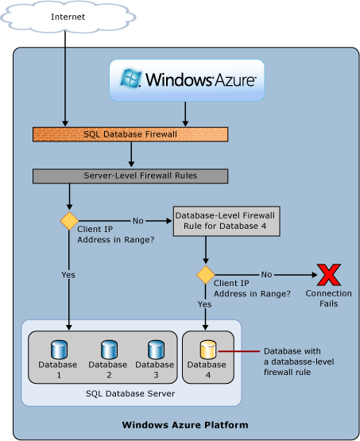
SQL Database Firewall
Securing your data
IP Address-based access control for SQL Database
Rules can be defined at the server and database
No IP authorized by default
Configurable using the SQL Database Portal and REST API
Option to disable/enable access from applications hosted in Windows Azure
Notes:
Slide Objectives:
Illustrate the how SQL Database Firewall
Transition:
Transition statement(s) to setup the slide
Speaking Points:
By default, no-one is allowed to access the database.
Server Rules enable clients to access your entire SQL Database server
Database rules enable clients to access individual databases within your SQL Database server
Rules are originating IP Address-based.
Notes:
Maximum of 128 Rules
Rather than using a REST API like the other Azure storage services, SQL Database is accessed via Tabular Data Stream (TDS), the same protocol used by Microsoft SQL Server (operating over port TCP/1433). To help protect the data, the SQL Database firewall prevents all access to your SQL Database server until you specify which computers have permission.
Initially, all access to your SQL Database server is blocked by the SQL Database firewall; connection attempts originating from the Internet or Windows Azure will not be able to reach your SQL Database server. In order to begin using your SQL Database server, you must go to the SQL Database Portal and specify one or more firewall settings that enable access to your SQL Database server. Use the firewall settings to specify which IP address ranges from the Internet are allowed, and whether or not Windows Azure applications can attempt to connect to your SQL Database server.

Slide 22

SQL Database Firewall
Internet
Securing your data
IP Address-based access control for SQL Database
Rules can be defined at the server and database
No IP authorized by default
Configurable using the SQL Database Portal and REST API
Option to disable/enable access from applications hosted in Windows Azure
Services Layer
SQL Database Firewall
Services Layer
Notes:
Slide Objectives:
Illustrate the how SQL Database Firewall
Transition:
Transition statement(s) to setup the slide
Speaking Points:
By default, no-one is allowed to access the database.
Server Rules enable clients to access your entire SQL Database server
Database rules enable clients to access individual databases within your SQL Database server
Rules are originating IP Address-based.
Notes:
Maximum of 128 Rules
Rather than using a REST API like the other Azure storage services, SQL Database is accessed via Tabular Data Stream (TDS), the same protocol used by Microsoft SQL Server (operating over port TCP/1433). To help protect the data, the SQL Database firewall prevents all access to your SQL Database server until you specify which computers have permission.
Initially, all access to your SQL Database server is blocked by the SQL Database firewall; connection attempts originating from the Internet or Windows Azure will not be able to reach your SQL Database server. In order to begin using your SQL Database server, you must go to the SQL Database Portal and specify one or more firewall settings that enable access to your SQL Database server. Use the firewall settings to specify which IP address ranges from the Internet are allowed, and whether or not Windows Azure applications can attempt to connect to your SQL Database server.

Slide 23
Application Connectivity
Connecting To SQL Database
TDS (Tabular Data Stream) protocol over TCP/IP supported
SSL required
Use firewall rules to connect from outside Microsoft data center
ASP.NET EXAMPLE:
Considerations And Best Practices
login: [login]@[server]
Idle connections
Long running transactions
DoS guard
Failover events
Throttling
Connection pooling and Retry logic
Latency introduced for updates
No cross-database dependencies
<connectionStrings>
<addname="AdventureWorks"connectionString=
"Data Source=[server].database.windows.net;
Integrated Security=False;
Initial Catalog=ProductsDb;
User Id=[login];
Password=[password];
Trusted_Connection=False;
Encrypt=true;"
providerName="System.Data.SqlClient"/>
</connectionStrings>
Notes:
Slide Objectives:
Highlight application connectivity requirement, considerations and best practices to SQL Database.
Transition:
While connecting to SQL Database is fairly straight forward, there are some general considerations and recommended coding practices when developing Windows Azure SQL Database applications.
Speaking Points:
Login:
Idle connections terminated after 30 minutes
Long running transactions terminated after 24 hours
DoS guard terminates suspect connections with no error message
Failover events terminate connections
Throttling may generate errors…which leads to:
Implement Connection Pooling and Retry logic to handle transient failures
Latency introduced for updates due to HA replicas
No cross-database dependencies: resultsets from different database must be combined in the application tier (Fan out queries)
Notes:

Slide 24
Exploring Advanced Capabilities

Slide 25
Explore Advanced Capabilities
Rapid innovation
Improved engineering efficiencies
Quarterly service update cadence
Improved operational agility
Powerful new services Visualize data with SQL Reporting
Synchronize data with SQL Data Sync
New developer opportunities
Devices connected to continuously available cloud services
Consumer applications
SaaS applications
Notes:
Slide Objectives:
Introduce the additional services and capabilities on top of SQL Database
Transition:
Windows Azure SQL Database provides the enterprise-ready relational database capabilities in the cloud, but SQL Database includes additional capabilities and services that make SQL Database even more powerful.
Speaking Points:
Powerful services that provide improved efficiencies and operational agility
Quarterly updates -> instead of waiting 18 months for a Service Pack, SQL Database is updated quarterly
Opportunities for the developer to work with cloud services and develop applications for new markets
Notes:
SQL Reporting -> Recently made generally available to the public, now brings highly-available and scalable reporting to the cloud
SQL Data Sync -> Data Synchronization without the headaches of learning SQL Replication
SQL Federation -> On-demand database scalability without application downtime

Slide 26
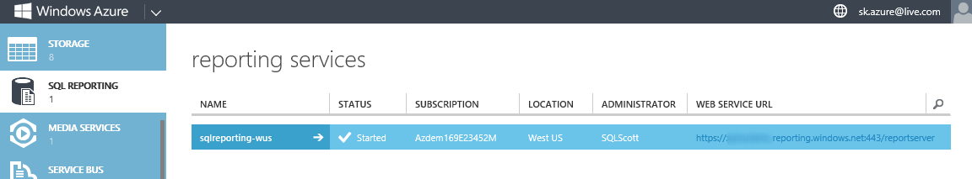
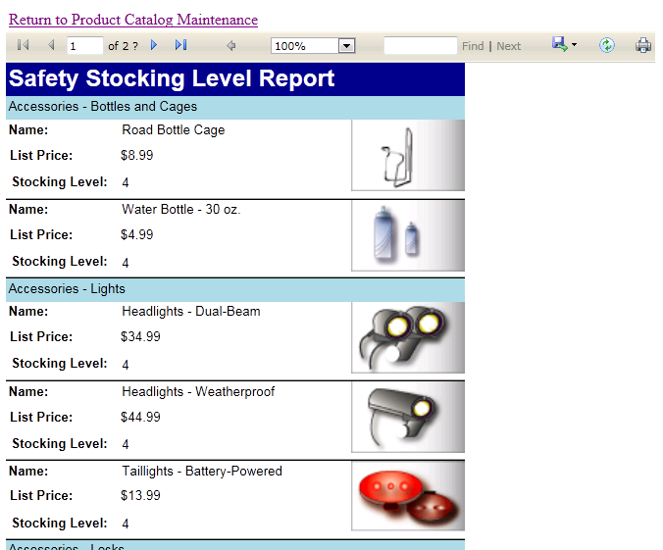
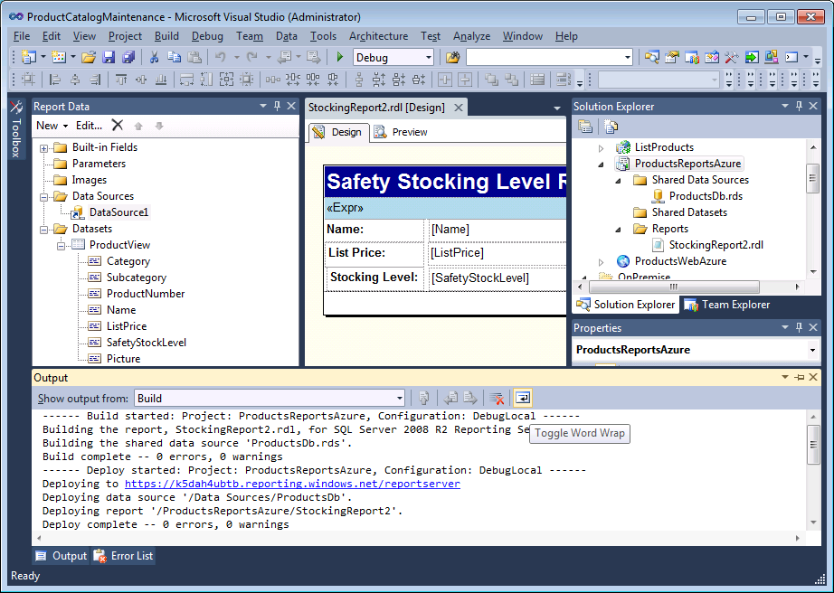
SQL Reporting
Visualize your data
SQL Server Reporting Services technology as a service
Ideal for operational reporting against SQL Database data
Enterprise-ready with automatic support for HA
Designed to scale elastically with demand
Rapid Provisioning
Notes:
Slide Objectives:
Define the SQL Reporting service and use it as another example of a managed service we’re providing today for databases, but that will extend more broadly in the future.
Transition:
The same great reporting service you know and love on-premises has been extended to the cloud and offered as a highly-available service on SQL Database
Speaking Points:
SQL Reporting is based on SQL Server Reporting Services offered as a service
Automatic High Availability through the benefits of the Azure platform
Provision a report server in only minutes with just a few clicks of the mouse
No need to install your own reporting services instance or apply updates
Developers can deliver highly visual and interactive reports as an integrated part of a Windows Azure based solution.
Build reports using same familiar tools
Notes:
http://msdn.microsoft.com/en-us/library/windowsazure/gg430130

Slide 27
SQL Data Sync
SQL Database (US)
Data Synchronization
Microsoft Sync Framework technology as a service
Ideal for scheduling synchronization between data sets hosted in SQL Database or SQL Server
Uses a hub and spoke topology
No Coding required
SQL Database (Hub)
SQL Server (OnPrem)
SQL Database (WE)
Notes:
Slide Objectives:
Introduce the data sync service as an added capability on top of SQL Database
Transition:
Finally, a solution that allows developers to easily create and schedule bi-directional synchronizations without investing in maintaining custom sync software.
Speaking Points:
Leverage the Microsoft Windows Azure platform and Microsoft SQL Azure without the necessity of creating and managing your own synchronization code.
Conflict resolution
Bi-directional
Based on the Sync Framework
NO CODE!
Notes:
http://msdn.microsoft.com/en-us/library/windowsazure/hh456371

Slide 28
SQL Data Sync
Demo
Notes:
Demo – Creating a SQL Data Sync (SQL Azure to SQL Azure)

Slide 29
Thank You

Slide 30

Appendix

Slide 31
SQL Database Billing Rates (As of February 2012)
Database Size | Price Per Database Per Month
0 to 100 MB | Flat $4.995
> 100 to 1 GB | Flat $9.99
> 1GB to 10 GB | $9.99 for first GB, $3.99 per additional GB
> 10 GB to 50 GB | $45.954 for first 10 GB, $1.998 for each additional GB
> 50 GB to 150 GB | $145.874 for first 50 GB, $0.999 for each additional GB
Based on graduated rate based on database size
Charged at monthly rate per database
Amortized over month -> calculated on daily basis
No Transaction Charges
Data Transfers
North America and Europe regions $0.05 - $0.12 per GB outbound
Asia Pacific region $0.12 - $0.19 per GB outbound
All inbound data transfers are at no charge.
Notes:
Slide Objectives:
Understand the SQL Database pricing
Transition:
Speaking Points:
Reduced database rates as of February 2012
Notes:
http://www.windowsazure.com/en-us/pricing/details/#data-management
http://www.windowsazure.com/en-us/pricing/details/#data-transfers

Slide 32
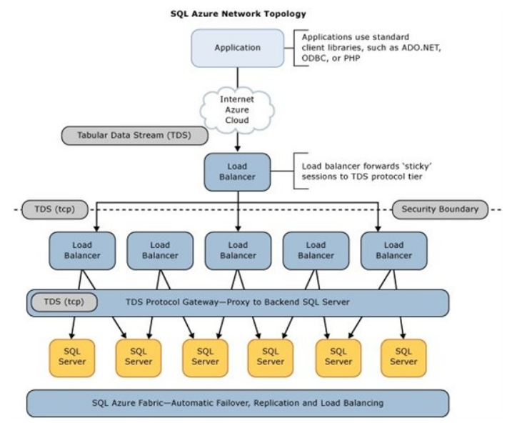
SQL Database Architecture

