Slide 1
Migrating to Windows Azure SQL Database
Name
Title
Microsoft Corporation

Slide 2

Agenda
DACFx & Import / Export Service
Other Migration Tools
Best Practices

Slide 3
DAC Fx and the SQL database Import / Export Service

Slide 4

Terminology
Some Definitions
DAC – Data-tier Application
DACFx – DAC Framework
DACPAC –Schema only artifact
BACPAC – Deployment artifact containing schema and data
Notes:
DAC – a self-contained deployment entity that defines all of the objects of a SQL Server database which can be packaged into a single portable artifact.
DACFx – the client-side tools for building and processing DAC packages and export files
DACPAC – File format used by the DACFx to represent the full definition of an application.
BACPAC – File format used by the DACFx to represent the full definition of an application as well as its data.

Slide 5
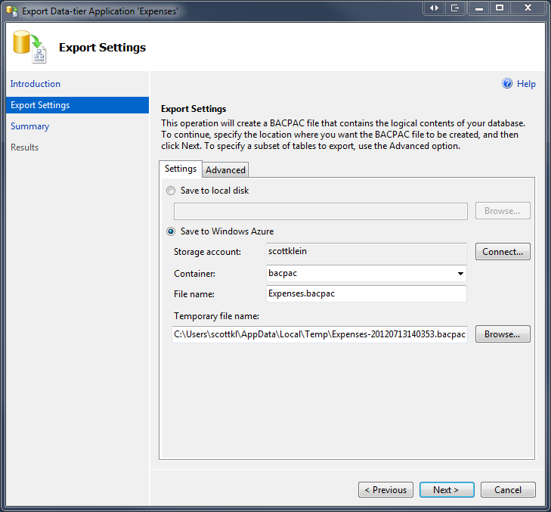
DAC Fx (DAC Framework)
Client DAC Components
DACFX client library installed automatically by SQL Server
No need for additional client libraries or MSIs
Wizards provided in SSMS to create and distribute DACPAC/BACPAC
Simplify packaging and deployment of databases
Notes:
Bypass any need for client libraries or MSIs
Databases exported to a BACPAC using the client side tools can be uploaded to Windows Azure BLOB storage and imported using the service. Similarly, databases exported to a BACPAC using the service can be imported using the client side tools.
The DAC framework provides a set of services for database developers and administrators and is currently available in two forms:
Hosted services such as the new SQL Azure Import/Export Service The service tools do not require any of the DAC components to be installed on your machine (only .Net 4), and it submits jobs against a Microsoft service that is running in Windows Azure. The actual import or export is performed within the service.
Redistributable client side tools such as the DAC Framework The client side tools require the DAC Framework and other components to be installed, and run on your local machine.

Slide 6
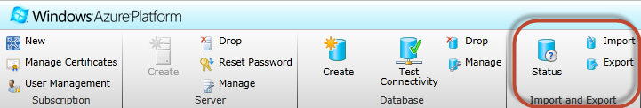
Import/Export Service
Simplified Migration
Import/Export between Windows Azure SQL Database and Blob Storage
Export and Import a logical backup file containing schema definition and data
Copy databases between SQL Database servers
Migrate from SQL Server on-premises to SQL Database
Notes:
Bypass any need for client libraries or MSIs

Slide 7





Architecture
Windows Azure
Blob Storage
SQL Database
DAC Fx Import/Export service
SQL Database
Blob Storage
SQL Database Service Import / Export
BACPAC
Copy
DACFx
Import/Export Service
On-Premises
SQL Server 2005, 2008/R2, 2012
DAC Fx
Client-Side Tools (SSMS and SSDT)
BACPAC
Upload/
Download
Import / Export Request (REST)
On-Premises
Client-side Import/Export
Notes:
The new Import/Export Service for SQL Azure is now live. The service will directly import or export between a SQL Azure database and Windows Azure BLOB storage. The service complements the client side tools already available. Databases exported to a BACPAC using the client side tools can be uploaded to Windows Azure BLOB storage and imported using the service. Similarly, databases exported to a BACPAC using the service can be imported using the client side tools.

Slide 8
Service Benefits
Included with the Service
Automated Service Endpoint
Integrated Portal Experience
Performance via data center side deployment
Connection Resiliency
Selective Export
Progressive Status Reporting
Notes:
Perf - The service has implemented a new connection pooling and parallelization strategy to deliver significantly improved performance for all types of databases. While actual results may vary, the average import or export should now be approximately three times faster! ALSO - we do all the processing, so we can handle multiple import/export requests all over the world and you don’t need to do anything other than submit some simple import/export requests
Res - Several connectivity issues both transient and permanent have been identified and addressed in order to provide a more reliable experience.
SI - Customers who only want to export certain tables for performance reasons or because the data doesn’t change often can provide a list of tables to export. The resultant BACPAC will contain the full schema definition plus the table data only for the specified tables. The selectively exported BACPAC can be imported just like a fully exported BACPAC. For now, the sample EXE must be used to submit these types of requests. Customers using the service’s REST endpoints directly can always bypass the EXE.
PR - The current progress for a request will be shown as a percentage in order to provide better feedback on the current state of the request.

Slide 9
Requirements
On-Premises
SQL Server 2012
All necessary components are installed
SQL Server* 2008 R2, 2008, 2005
Data-tier Application Framework
ScriptDOM
System CLR Types
Windows Azure
Storage Account
SQL Azure Server
Note:
The dependencies are not needed if you plan on only using the service
Notes:
You can either install SSMS and get all the components for free –or- install the specific dependencies and call the APIs directly and/or use the reference CLI which is here: http://sqldacexamples.codeplex.com/releases/view/80705
2012 – All necessary component installed
2008 R2 to 2000 – DACFx, T-SQL Language Service, ScriptDOM, SMO, System CLR Types, DAC ImportExport Service Client Executable (1.4.1)
To use the service you need to have a blob and sql azure account/server setup already and you only need to use the EXE or the wizard in the sql azure portal to perform the import/export. You don’t need all the dependencies if you plan on only using the service

Slide 10
Limitations
Not Supported
SQL Variant Data Type
No transactional consistency
Database must be SQL Database compatible
Secrets not migrated (passwords, encrypted procs, etc.)
No support for SQL Server 2000
Notes:
Source database should be in Read-Only mode while export occurs (or have no write activity against it)

Slide 11
Import / Export Service
demo
Notes:
Demo – Creating a SQL Azure DB through the Management Portal

Slide 12
Other Migration Tools

Slide 13
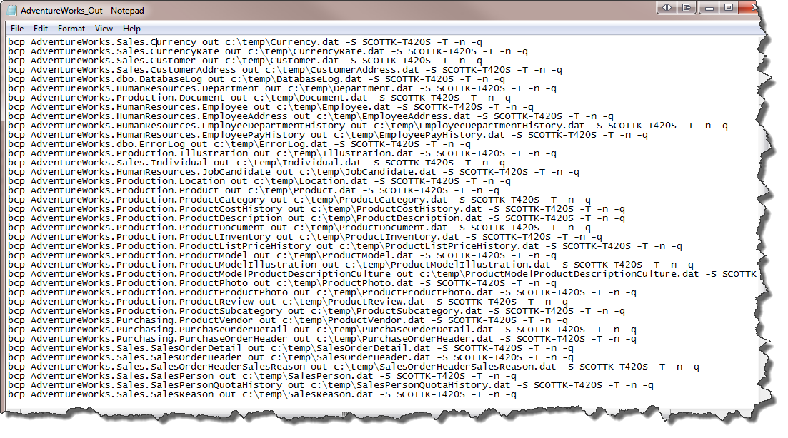
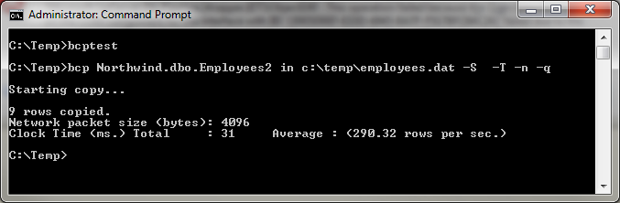
BCP Utility
Bulk Copy
Quick and Efficient
Built-in Retry
Easy to Maintain
Flexible
Logging
Notes:
Fast
Maintain – even if schema changes
Flexible – can specify batch size, packet size
Limitations:
Schema must already exist
Syntax – many options…hard to figure out if new to bcp

Slide 14
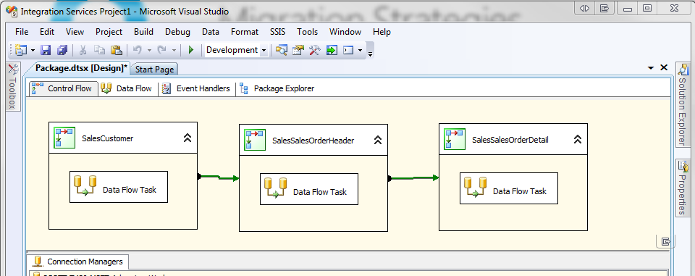
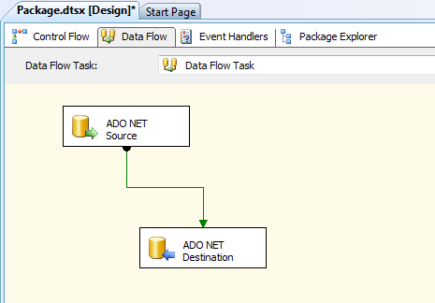
SQL Server Integration Services
Data Integration and Transformation
Graphical UI
Easy to Maintain
Built-in Logging
No Code
Create Custom Tasks
Notes:
Fast
Maintain – even if schema changes
Limitations:
Schema must already exist
Syntax – many options…hard to figure out if new to bcp

Slide 15
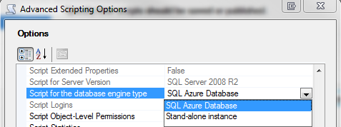
Generate Scripts Wizard
Built-in SQL Database Scripting
Script for Windows Azure SQL Database
Include Schema and Data
Included with SQL Server Management Studio
Scripting accuracy
Notes:
Fast
Maintain – even if schema changes
Limitations:
Schema must already exist
Syntax – many options…hard to figure out if new to bcp

Slide 16
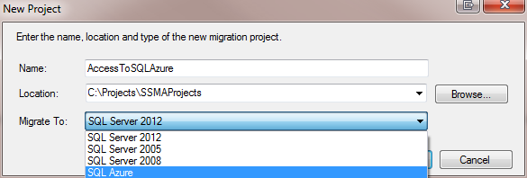
SQL Database Migration Assistants
Additional Platforms
Support for Sybase, Oracle, MySQL, Access
Reduce cost and migration risk
Multi-threading and globalization support
SQL Server 2012 support
Notes:
Fast
Maintain – even if schema changes
Limitations:
Schema must already exist
Syntax – many options…hard to figure out if new to bcp

Slide 17
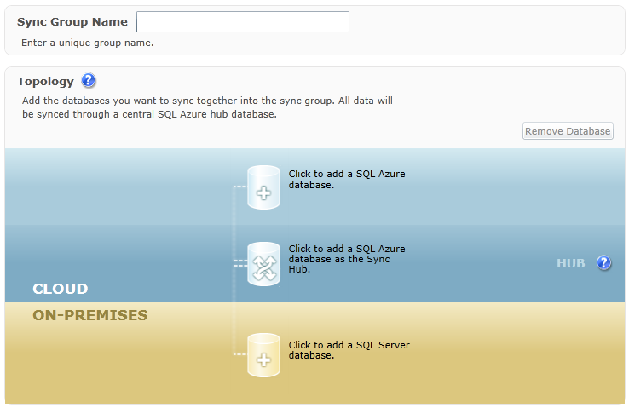
SQL Data Sync Service
Azure-based Sync Service
Scale service based on need
No Code
Conflict Handling
Logging and Monitoring
Notes:
Intro – in fact, SQL Azure data sync services is so important that the development of the sync framework 4.0 was put on hold and all developers focused on the release of the sql azure data sync.
Extend – rather than replacing by synching on-premise SQL Server to SQL Azure
Conflict – easily handle issues where same data is changed in multiple locatons

Slide 18
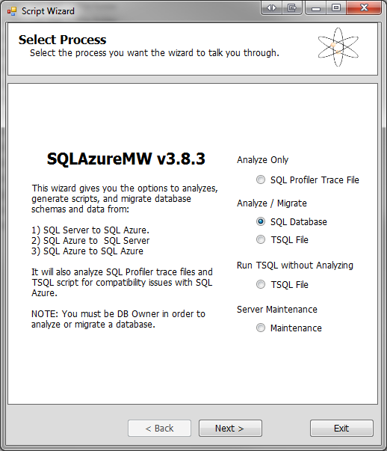
SQL Migration Wizard
Open-source Solution
Interactive Wizard
SQL Database Compatibility Analysis
Schema and Data
No code
Notes:
Not officially supported by Microsoft

Slide 19
Best Practices

Slide 20
Migration Considerations
Database Size
Objects
Data
Data Types
Frequency
Transactional Consistency
Technology Proficiency
Easiest != Best
You can pick more than one…

Slide 21
Consider the Options
Tools | Schema | SQL Azure Compat Checks | Data | Data Transfer Efficiency | Notes
BCP | No | N/A | Yes | Good | Efficient transfer of data to existing table
SSMS Generate Scripts wizard | Yes | Some | Yes | Poor | Good for smaller databases Has explicit option for SQL Azure script generation
SQL Server Import & Export Data | No | N/A | Yes | Good | Simple UI on top of SSIS; also available in SSMS
SSIS | No | N/A | Yes | Good | Most flexibility
SQL Azure Migration Wizard | Yes | Yes | Yes | Good | Great capabilities; e.g. evaluate trace files Open source on CodePlex; Not supported by MSFT
DAC (BACPAC) | Yes | Yes | Yes | N/A | Entity containing all database objects including data Full SQL Azure support
DAC Database Import/Export | Yes | Yes | Yes | Good | Export/import of DAC plus data with DAC framework Preview available now on SQL Azure Labs; final release with SQL Server codenamed “Denali” Service for cloud-only support coming soon
SQL Database Copy | Yes | N/A | Yes | Good | Create transactionally consistent copy of SQL Azure database Currently within the same data center

