Slide 1
Windows Azure SQL Federation
Name
Title
Microsoft Corporation

Slide 2

Agenda
Scalability
SQL Federation
Federation Architecture
Management
Best Practices

Slide 3
Scalability

Slide 4
Database Scalability
Scale-up
Single database that houses all the data of an application
Hard to handle peak load
OK with exponential incremental cost
Scale-Out
Multiple databases spread over multiple independent nodes
Cost effective, commodity class hardware
Typical patterns: Sharding and Horizontal Partitioning
Notes:
Slide Objectives:
Understand the difference between Scale-up and Scale-out, their patterns and behaviors and the scenarios in which each might be implemented.
Transition:
To understand SQL Federation one must first understand the differences between the Scale-up and Scale-out models.
Speaking Points:
Scale-up
Implies a single database on a single server.
Scaling this model means adding more cpu/ram.
Hardware is not commodity class.
Handling peak loads is difficult to handle
Scale-out
Load (databases) spread across multiple independent nodes
Cost effective through use of commodity class hardware
Typical use patters: Horizontal partitioning
Typically called Sharding
Notes:
Scale-up class of hardware typically have high administration cost due to its complex configuration and management requirements.

Slide 5
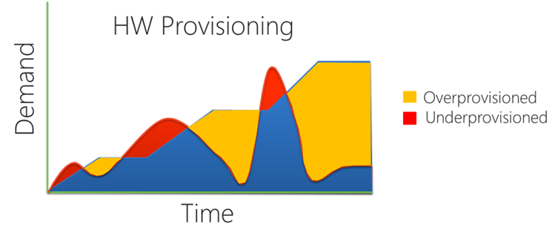
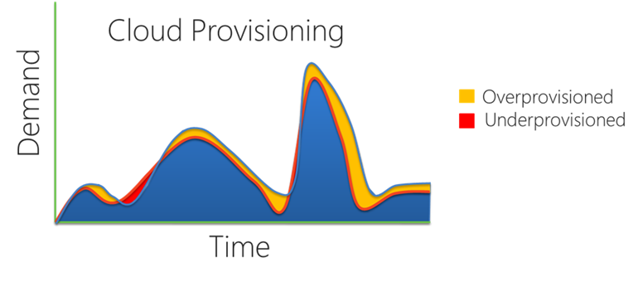
Scalability Model For The Cloud
Cloud Applications
Require Scale Beyond Scale-Up
Demand the Best Economics
Best Price/Performance
Elasticity + Pay-as-you-go
Notes:
Slide Objectives:
Understand how on-demand partitioning can reduce cost, reduce the overprovisioned and under provisioned scenarios, and how applications can benefit from this scale-out model.
Transition:
There is a new set of workloads in the cloud that are beyond the scale-up model. A model is needed that scales beyond a small handful of nodes.
Speaking Points:
Graphs show provisioning. Under and over capacity (on top). On the bottom is the cloud provisioning model – a lot less red and yellow … a lot less cycles of over and under capacity. Expand and shrink the pool of databases without any downtime.
Economically, scale-out provides the best price/performance.
Many commodity nodes for the economics
The Elasticity plus the pay-as-you-go model satisfies the cloud scale model
Notes:
Require - Massive aggregate capacity: 100s of nodes available for use
Best – Many commodity nodes for the economics
Reduce – Reduce overcapacity : take advantage of cloud provisioning model

Slide 6
SQL Federation

Slide 7
SQL Federation
Database Elasticity
Extend the scalability model to the database tier
Add and remove SQL Database nodes via database partitioning (Federations)
Scale on demand to your traffic without any downtime
Larger User Traffic
Front
Tier
SQL Database
Front
Tier
Front
Tier
Front
Tier
Single Database
User Traffic
LB
Front
Tier
LB
Front
Tier
SQL Azure
Front
Tier
Middle
Tier
Front Tier
Middle Tier
Notes:
Slide Objectives:
Understand how SQL Federation extends the scalability model to the database tier
Transition:
Database elasticity also aligns with all of the other Windows Azure principles around scalability and elasticity, applying them to the server side of things so that you don’t need to worry about them.
Speaking Points:
With SQL Federation, we’re extending the scalability model to the database tier.
Scale your data tier on demand without any downtime, and without any applications changes.
Notes:
Extending the model of the front tier and the middle tier of the application scale out model. Canonical 3-Tier application scales by adding and removing node. You stand up a few servers on the front tier, a few servers in the middle tier, then the database, then you open up the doors. Users start pouring in, and as user load goes up, you add more servers.
However, what do you do with the database? You have to buy a bigger machine. They idea with Federations is to extend the multi-node scalability model into the database, making the database elastic.

Slide 8
Why Use SQL Federation?
Database Scalability
Create an elastic database tier that can expand and contract with your applications workload without downtime
Gain practically unlimited scale by harnessing 100s of SQL Database nodes
SQL Database
Notes:
Slide Objectives:
Understand why SQL Federation can be used to provide the elasticity at the data tier of an application
Transition:
There are many ways to scale an application and database, so why use SQL Federation? Several key points:
Speaking Points:
Elasticity at the data tier. Let your data layer expand and contract based on the loads of the application.
Get around the single database size limitation
No database or application downtime
Scale to practically an unlimited number of SQL Database nodes
No application changes
No data caching at the application
Notes:
Any notes go here

Slide 9
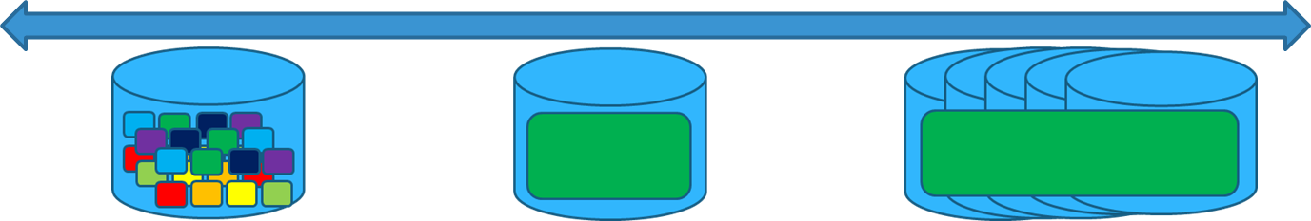

Why Use SQL Federation?
Simplified Multi-tenancy
Build Multi-tenant Solutions
Efficient management of tenant placement and re-placement
Simplified Development and Administration
Robust programming and connectivity model with native tooling
Same great programming model using existing tools
Multiple-tenants per database
Single tenant per database
Multiple databases per tenant
Notes:
Slide Objectives:
Foundation for how SQL Federation provides a simple model for mutli-tenancy architecture, as well as providing a development and administration model built on known and native tools.
Transition:
Database multi-tenancy can be difficult. Can you make a static decision on how many tenants to fit into a database? Yet, if you never have to decide and can change your mind, this is the power behind SQL Federation.
Speaking Points:
Simplified multi-tenancy in SQL Federation means an efficient method and management of tenant placement and re-placement upon repartitioning.
Simplified development and administration means the implementation of the sharding pattern inside of SQL Database natively. Very few databases do this.
Built entirely on SQL Server using the same great programming model with all the great existing tools
T-SQL Extended
Notes:
This is the power behind Federations…to allow you to change your mind. You can put 1000 people on there. If it looks like it is not working out, you can split the database, and have 500 and 500. If you need to you can split even further. You don’t have to be stuck. If a certain customer grows into a large “gold package” customer, you can give them a dedicated node (which is the middle section of the diagram). This is the best part of the whole thing is that you can change your mind and scale with demand and capacity and load. 100s of nodes and 100s of databases.

Slide 10
Who Are SQL Federation for?
A Few Examples
Web Scale DB Solutions
Multi-tenant Saas ISVs
Workloads with Spikes, Bursts, Peaks, etc…
NoSQL Applications
Notes:
Slide Objectives:
Outline a common base and pattern for who should use SQL Federation.
Transition:
Performance and scalability is important to everyone, but is SQL Federation the scalability golden rule?
Speaking Points:
SQL Federation is meant for those applications that deal with peaks and valleys and need the elasticity of scaling up and down to overcome the overprovisioned and underprovisioned scenarios.
Web Scale DB solutions
Existing NoSQL applications that need the big scale
Notes:
Apps that need big data, big scale, massive parallelism, eventual consistency, lightweights local storage, semi structured data etc.

Slide 11
SQL Federation Architecture

Slide 12
Architecture
Federation
An object contained within a user database
Defines the scheme for the federation
Represent the database being sharded
Federation Root
Database that houses the federation object
Federation Member
System managed SQL databases
Contain part, or “slices” of data
Federations
SalesDB
Orders_federation
Orders_federation
Orders_Fed
Federation Root
Federation Members
CREATE FEDERATION fed_name(fed_key_label fed_key_type distribution_type)
Notes:
Slide Objectives:
Provide a basic understanding of the SQL Federation architecture, the different components, and how they interact and relate to each other.
Transition:
Understanding how SQL Federation work necessitates an understanding of the underlying architecture and components. It is actually fairly simple and easy to stand one up.
Speaking Points:
Federation - An object, just like a table or stored procedure, but this object is special. Unlike a table or stored procedure, this object scales “out” of the database.
Federation Root – Contains the Federation Object. The central repository for information (federation metadata) about distribution of scaled-out data.
Federation Member – A physical container holding “parts” of the data. They are slices of data. Managed by the federation dynamically as data is repartitioned.
Notes:
It is up to you as to how many you get, entirely based on how you partition the data. The great thing is that your application does know, nor does it need to know, about how many federation members there are.

Slide 13
Architecture Cont.
Federation Key
The key used for data distribution
int, bigint, guid, varbinary
Atomic Unit
Represent a single instance of a federation key.
All rows in all federated tables with the same federation key value.
Federations
Member: range [1000, 2000)
SalesDB
Orders_federation
Orders_federation
AU PK=5
AU PK=25
AU PK=35
Orders_Fed
AU PK=5
AU PK=25
AU PK=35
AU PK=1005
AU PK=1025
AU PK=1035
Federation Root
Federation Members
Atomic Units
Notes:
Slide Objectives:
Architecture Continued: Provide a basic understanding of the SQL Federation architecture, the different components, and how they interact and relate to each other.
Transition:
Continuing on the architecture and components…
Speaking Points:
Federation Key - The key that determines how you distribute, or partition your data. CustomerID, ProductID, etc.
Atomic Unit - The collection of rows that belong to a single instance of the federation key.
Notes:
Federation Key –Distribution scheme supports int, bigint, guid, and varbinary types
Atomic Units – Customer 55 may have some customer information (address, phone, demographic) along with some orders and a collection of order details. All of those things are an atomic unit, and we promise not to split those any further. They are guaranteed to stay in a single node.

Slide 14
Architecture Cont.
Federated Table
Contains only atomic units for member’s key range
Reference Table
Non-Federated table
Notes:
Slide Objectives:
Architecture Continued: Provide a basic understanding of the SQL Federation architecture, the different components, and how they interact and relate to each other.
Transition:
Continuing on the architecture and components…
Speaking Points:
Federated Table – Tables that are spread across federation members
Reference Table – Tables that are not federation aware. Fully contained within a member. Typically contain static data (states, zip codes, etc).
Notes:

Slide 15
Repartitioning
Dynamic Partitioning
SPLIT members to spread workloads over to more nodes
DROP members to shrink back to fewer nodes
ALTER FEDERATION Orders_Fed SPLIT AT (tenant_id=7500)
SalesDB
Orders_federation
Orders_federation
Orders_Fed
[5000, 7500) & [7500, 10000)
[5000, 10000)
Notes:
Slide Objectives:
Understand how repartitioning works in SQL Federation
Transition:
The whole concept behind SQL Federation is to scale up and scale down; elastically partition on demand. Partitioning means splitting members to distribute the load.
Speaking Points:
Split members to spread the load. A split splits one member into two.
Drop members to scale down into fewer nodes.
Notes:
Version 1 supports split and drop. Split and drop allow you to manipulate the collection of databases within the federation. The split provides the partitioning functionality. In this example we have a few federation members, one which contains orders with id’s 5000 to 10,000, and the command splits it in the middle, at 7500. what happens is that in the background we create two databases, and copy the appropriate data to the two new databases and copy 5000 to 7500 to one database and the rest to the other database. We then delete the original member database. LEFT Inclusive, right exclusive. 7500 in the range low.

Slide 16
Reliable Routing
Built-in Data-Dependent Routing (DDR)
Ensure apps can discover where the data is just-in-time
No “Shard Map” caching
Guaranteed member routing
USE FEDERATION Orders_Fed (tenant_id=7509)
SalesDB
Orders_federation
Orders_federation
Orders_Fed
[5000, 7500) & [7500, 10000)
Notes:
Slide Objectives:
Discuss how connection routing works to provide a reliable, dependent data routing.
Transition:
With repartitioning understood, knowing how connections are routed and data is discovered to guarantee appropriate routing is nxt.
Speaking Points:
Routing guaranteed even during a repartition is in process (Filtering routes connection to appropriate shard regardless of changes in partitions)
No map caching at the application level, thus no changes to the application.
Notes:
Similar to that of the USE DATABASE statement, partitioning, or re-partitioning on the backend provides a guarantee that says “how am I going to find this id?”. For example, id 7501 used to be in this
A, but now it’s in this B, but the application doesn’t know that, so how do I find it? I need a way to navigate to it.
If you have to cache this information, what many developers have done when writing their own sharding functionality, this kind of split now creates an invalid cache. Or a cache in which you need to “re-cache”. So, everyone keeps writing this code over and over again. However, by taking this functionality to the server side, we can give you a command that easily directs you to the appropriate member. So instead of saying “Use DATABASE” and then taking you to that database, Federations know a lot about your schema, so you just supply a key and WE’LL take you to the right database.
Think of this like a hotel

Slide 17
SQL Federation
Demo
Notes:
Demo – SQL Federation
Create new database
Run ContosoExpenseFed_DB.sql
As it is executing, explain script
Open ContosoExpenseFed_Split
Walk through each statement

Slide 18
Management

Slide 19
New Dynamic Management Views
Monitoring and Troubleshooting
sys.dm_federation_operations - Returns one row per SPLIT or DROP operation, containing information on the progress of an operation and any error conditions or the operation.
sys.dm_federation_operation_members - Returns federation members involved in a federation operation
sys.dm_federation_operation_errors - Returns information on errors that occur during a SPLIT or DROP operation
sys.dm_federation_operation_error_members - Returns a list of members involved in federation operations that failed due to errors.
Notes:
Slide Objectives:
DMVs that provide new Transact-SQL statements, functions and views that can be used to create, alter, and monitor federations. Additionally, existing items have been altered to return federation information
Transition:
These DMVs return information on currently executing federation operations
Speaking Points:
Notes:
Any notes go here

Slide 20
New Dynamic Management Views
Monitoring and Troubleshooting
sys.federations - Returns the federations within a database
sys.federation_distributions - Returns the distribution type and data types used by a federation
sys.federation_members - Returns Information on member to federation associations
sys.federation_member_distributions - Returns distribution information about members within a federation
sys.federation_table_columns - Returns specialized federation properties of federated tables
Notes:
Slide Objectives:
DMVs that provide new Transact-SQL statements, functions and views that can be used to create, alter, and monitor federations. Additionally, existing items have been altered to return federation information
Transition:
These DMVs return metadata information for existing federations
Speaking Points:
Notes:
Any notes go here

Slide 21
Dynamic Management Views
View Federation History
sys.federation_history - Returns historical information about a federation
sys.federation_distribution_history - Returns historical information about the distribution type and data types used by a federation
sys.federation_member_history - Returns historical information for each member of a federation
sys.federation_member_distribution_history - Returns historical information about the distribution range for federation members.
NOTE:
Cleanup of historical data is performed automatically every two weeks.
Notes:
Slide Objectives:
DMVs that provide new Transact-SQL statements, functions and views that can be used to create, alter, and monitor federations. Additionally, existing items have been altered to return federation information
Transition:
These DMVs return historical information on federation operations
Speaking Points:
Cleanup is triggered by operations that update the log information. This can result in historical information being retained for longer than two weeks if no new operations have been performed.
Notes:

Slide 22
Best Practices

Slide 23
Best Practices And Design Considerations
Federations
Normalize your data model all the way
Apply Scale-First design principles
Select Table Groups that need Scale-out
Federation Keys and Atomic Units
Target latency and scale sensitive queries
Ensure transaction boundaries
Distribute the app workload equally across members
Fit in the scale-up limit
Unique Key Generation
Identity
Uniqueidentifier
Notes:
Slide Objectives:
Highlight design considerations and best practices when working with SQL Federation.
Transition:
Several questions need to be addressed when working with SQL Federation. With an understanding of the architecture and the design patterns, the question then becomes, what to partition on? What are the table groups?
Speaking Points:
Federations
Federations mimics the data modeling process. Think Database Normalization. Federation is really an extension of database normalization
Once you are done with that there are set of principles that you can apply that really make your database scalable
Federation keys and Atomic Units
Latency – picking your federation key is critical for latency and scale sensitive queries.
Boundaries – Make sure your transactional boundary is within a single atomic unit.
Workload – Affective distribution of the workload across the nodes is critical for efficiency and true scalability
Scale – ensure that the largest customer can fit into the scale-up limit.
Unique key Generation
Identities -> generate a sequential number without gaps but cause problems when Merging.
Uniqueidentifier -> can be generated any tier of application and are guaranteed to be unique
Notes:
How do I know what to partition on? Luckily, Federations mimics the data modeling process. Think Database Normalization. This is really an extension of database normalization. You do the things you would typically do when designing a database. You discover what you want to model and the scenarios, but it basically boils down to a normalization process.
Once you are done with that there are set of principles that you can apply that really make your database scalable. These principles apply to many scenarios, such as if you are creating your own sharding solution.
The first being that of picking or selecting your Table Groups. A group of tables that represent a set of entities. For example, the AdventureWorks database has a products table, but there is also a related table called ProductCategories. Those two tables are product tables, product entities, or entities of the product. Customer is another example. Customers have customer addresses, etc. it all depends on how you model your entities…but you can also think of a collection of tables that make up a group of things that I interact with. When I work with a customer, these are the tables I transact with. Order and orderdetails, for example. They have relationships…customers have many orders.
Next, identify which ones you want to scale out and put them on a federation. Now, you are not limited to a single Federation. You may say, products and orders will be highly transactional, so you may need two Federations.
-------------------------------------------------------------------
Still applying the Scale-First design, the next step is to determine how to distribute this data. How do I partition this data? For example, Orders. Do I select Order ID or maybe Order date? Maybe customer ID? I may want to track orders by customer to track shipments, etc. When I log into the portal, I log in with a customer id. It makes it easy for me to navigate the data with my customer id. However, just like data modeling, the right answer is different.
-> Latency –What are the queries that I want to run fast in my environment, and make sure your federation key is part of that. For example, if you come into the system with a customerid, it is easy to navigate and work with that. But if you come in with an order date, that makes it a little more challenging. Look at your application. What are the type of queries I want to execute against my federations to run fast in my environment.
-> Boundaries –At any moment in time you customer 55 and 56 could be found in different members. You need to work within a single atomic unit.
-> Workload –You want to be able to look across all of your members and see them ALL working. Computational capacity.
-> Scale – If customer 55 fills up the entire database, that’s not good. You need to pick a key that really ensures your granular enough for the system. So if you have customers that are really large, you may want to split on something else or a composit key that will allow the customer to be split the customer into separate databaes.
-------------------------------------------------
Identities are good in several ways: it guarantees that it will generate a sequential number and that those values will be generated without gaps.
Problems: Those guarantees are fairly expensive. ID generation could be a bottleneck…every record needs to pass through an id generation before being inserted. The other problem is that you don’t know the id until the record is actually commited.
Other problem: merging
Unique id’s don’t have to be a bottleneck; can be generated any tier of application and are guaranteed to be unique.

Slide 24
Fan-out Queries
Cross-Federation Queries
Process data across federation members
Union or aggregate data across members
Utilize Unaligned queries
Member / Summary processing
*Not in Version 1.
Notes:
Slide Objectives:
Understand the distributed query concept in SQL Federation using Fan-out queries
Transition:
While distributed transactions and DTC (Distributed Transactions Coordinator) are not support in SQL Database, the ability to aggregate data from multiple nodes is a simple solution to provide distributed query processing.
Speaking Points:
Fan-out is a technique for querying data in your federation, across many federation members.
With fan-out queries the member query is always there but summary query may not be needed. For example if you are simply doing DML or DDL, fan-out would only have a member query but no summary query is needed. It is only when you need post processing, you need the summary query.
Unaligned: a query that is unaligned to the federation key. Coming into a federation member and asking “where is john”? Which customer id’s are those?
Processing: 1 member level query – executes on each member and collects the results, then a summary query that post processes and union alls the result sets. For example, if you are looking for top 10, your first going to get the top 10 from every member, so you need to do a post process query that sorts the results from all the member queries then does another top 10.
Notes:
Version 1 does not support fan-out queries. Write a single query that hits all the members all at once. Right now, this is something that you currently need to write on your own. It is coming.
Fan-out queries are much like map/reduce in that it is formed in 2 parts;
Member query is the piece that is sent over to all members involved in the query and
Summary query is the query that is the post processing piece to allow condensing the results from the member query to desired final result-set.

Slide 25
Fan-out Queries
Demo
Notes:
Demo – SQL Federation Fan-out
http://federationsutility-scus.cloudapp.net/
Use FanOutQuery.sql
Show code, on page on how member queries are executed

