Slide 1
Windows Azure SQL Federation
Name
Title
Microsoft Corporation

Slide 2

Agenda
Scalability
SQL Federation
Federation Architecture
Management
Best Practices

Slide 3
Scalability

Slide 4
Database Scalability
Scale-up
Single database that houses all the data of an application
Hard to handle peak load
OK with exponential incremental cost
Scale-Out
Multiple databases spread over multiple independent nodes
Cost effective, commodity class hardware
Typical patterns: Sharding and Horizontal Partitioning
Notes:
Scale-up class of hardware typically have high administration cost due to its complex configuration and management requirements.

Slide 5
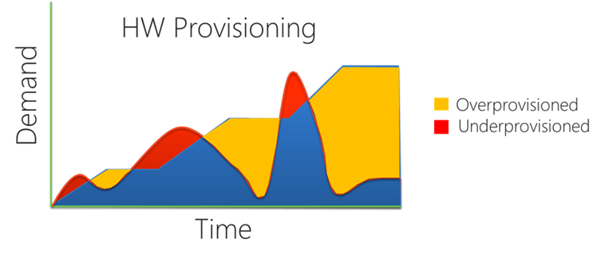
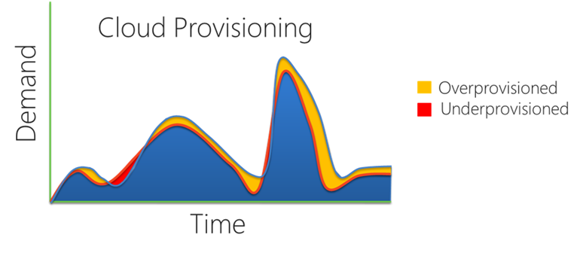
Scalability Model For The Cloud
Cloud Applications
Require Scale Beyond Scale-Up
Demand the Best Economics
Best Price/Performance
Elasticity + Pay-as-you-go
Notes:
Require - Massive aggregate capacity: 100s of nodes available for use
Best – Many commodity nodes for the economics
Reduce – Reduce overcapacity : take advantage of cloud provisioning model
Satisfy the cloud scale model
Sql is great for classic application
But when it comes to cloud, there is a new set of workloads that are beyond the scale up model. We need a scale out model that scales beyond the 10 or 20 nodes.
Comodety hardware >
Federation satisfy both economies of scale plus best economics
Graphs show provisioning…under and over capacity (on left)…on right is the cloud provisioning model – a lot less red and yellow … a lot less cycles of over and under capacity. Expand and shrink the pool of databases without any downtime.

Slide 6
SQL Federation

Slide 7
SQL Federation
Database Elasticity
Extend the scalability model to the database tier
Add and remove SQL Database nodes via database partitioning (Federations)
Scale on demand to your traffic without any downtime
Larger User Traffic
Front
Tier
SQL Database
Front
Tier
Front
Tier
Front
Tier
Single Database
User Traffic
LB
Front
Tier
LB
Front
Tier
SQL Azure
Front
Tier
Middle
Tier
Front Tier
Middle Tier
Notes:
Canonical 3-Tier application scales by adding and removing node
Extending the model of the front tier and the middle tier of the application scale out model (which has been the norm for the past decade or so). You stand up a few servers on the front tier, a few servers in the middle tier, then the database, then you open up the doors. Users start pouring in, and as user load goes up, you add more servers.
However, what do you do with the database? You have to buy a bigger machine. They idea with Federation is to extend the multi-node scalability model into the database. Be able to say “yep, we can add more nodes, we can repartition and get more computational capacity”. It is making the database elastic.
This is also aligned with all of the other Windows Azure principles around scalability and elasticity, and applying them to the server side of things so that you don’t need to worry about them.

Slide 8
Why Use SQL Federation?
Database Scalability
Create an elastic database tier that can expand and contract with your applications workload without downtime
Gain practically unlimited scale by harnessing 100s of SQL Database nodes
SQL Database

Slide 9
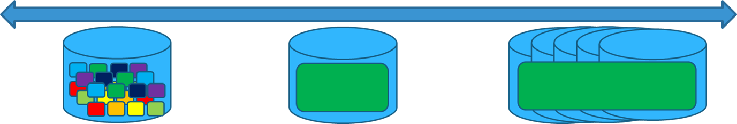
Why Use SQL Federation?
Database Multi-tenancy
Build Multi-tenant Solutions
Tenant Management with Federations
Multiple-tenants per database
Single tenant per database
Multiple databases per tenant
Notes:
Single tenants per db works… But what about very small tenants and very large tenants?
Federations makes tenant placement and replacement easy.
Change your tenant placement any time without downtime.
- Get around the single database size limit, throttline.
Best economics -> Again, elasticity, but no downtime required. Scale based on demand and only pay for what you use.
Simplified -> How many tenants can you fit into a database. Can you make a static decision about 10, 20, 100, 1000? If you have to decide and statically stick with that decision, it is a hard one. If you never have to decide and can change your mind about it, it is an easy one. This is the power behind Federations…to allow you to change your mind. You can put 1000 people on there. If it looks like it is not working out, you can split the database, and have 500 and 500. If you need to you can split even further. You don’t have to be stuck. If a certain customer grows into a large “gold package” customer, you can give them a dedicated node (which is the middle section of the diagram). This is the best part of the whole thing is that you can change your mind and scale with demand and capacity and load. 100s of nodes and 100s of databases.
This is the implementation of the sharding pattern inside of sql azure natively. Very few databases do this. The great thing is that it is built entirely in SQL Server using the same great programming model using all the great existing tools. Extending T-SQL.

Slide 10
Who Are SQL Federation for?
A Few Examples
Web Scale DB Solutions
Multi-tenant Saas ISVs
Workloads with Spikes, Bursts, Peaks, etc…
NoSQL Applications
Notes:
Apps that need big data, big scale, massive parallelism, eventual consistency, lightweights local storage, semi structured data etc.

Slide 11
SQL Federation Architecture

Slide 12
Architecture
Federation
An object contained within a user database
Defines the scheme for the federation
Represent the database being sharded
Federation Root
Database that houses the federation object
Federation Member
System managed SQL databases
Contain part, or “slices” of data
Federations
SalesDB
Orders_federation
Orders_federation
Orders_Fed
Federation Root
Federation Members
CREATE FEDERATION fed_name(fed_key_label fed_key_type distribution_type)
Notes:
Root: The central repository for information (federation metadata) about distribution of scaled-out data.
Member: A physical container covering the full range of data for a federation. Managed by the federation dynamically as data is repartitioned. Each federation member contain parts of federations data and are system managed SQL databases.
A logical database can contain multiple federations

Slide 13
Architecture Cont.
Federation Key
The key used for data distribution
int, bigint, guid, varbinary
Atomic Unit
Represent a single instance of a federation key.
All rows in all federated tables with the same federation key value.
Federations
Member: range [1000, 2000)
SalesDB
Orders_federation
Orders_federation
AU PK=5
AU PK=25
AU PK=35
Orders_Fed
AU PK=5
AU PK=25
AU PK=35
AU PK=1005
AU PK=1025
AU PK=1035
Federation Root
Federation Members
Atomic Units
Notes:
Federation Key – The key that determines how you distribute, or partition your data. CustomerID, ProductID, etc.
Distribution scheme supports int, bigint, guid, and varbinary types
Atomic Units – The collection of rows that belong to a single instance of the federation key. So, customer 55 may have some customer information (address, phone, demographic) along with some orders and a collection of order details. All of those things are an atomic unit, and we promise not to split those any further. They are guaranteed to stay in a single node.

Slide 14

Architecture Cont.
Federated Table
Contains only atomic units for member’s key range
Reference Table
Non-Federated table

Slide 15
Repartitioning
Dynamic Partitioning
SPLIT members to spread workloads over to more nodes
DROP members to shrink back to fewer nodes
ALTER FEDERATION Orders_Fed SPLIT AT (tenant_id=7500)
SalesDB
Orders_federation
Orders_federation
Orders_Fed
[5000, 7500) & [7500, 10000)
[5000, 10000)
Notes:
This is what we support in version 1. Split and drop allow you to manipulate the collection of databases within the federation. The split provides the partitioning functionality. In this example we have a few federation members, one which contains orders with id’s 5000 to 10,000, and the command splits it in the middle, at 7500. what happens is that in the background we create two databases, and copy the appropriate data to the two new databases and copy 5000 to 7500 to one database and the rest to the other database. We then delete the original member database. LEFT Inclusive, right exclusive. 7500 in the range low.

Slide 16
Reliable Routing
Built-in Data-Dependent Routing (DDR)
Ensure apps can discover where the data is just-in-time
No “Shard Map” caching
Guaranteed member routing
USE FEDERATION Orders_Fed (tenant_id=7509)
SalesDB
Orders_federation
Orders_federation
Orders_Fed
[5000, 7500) & [7500, 10000)
Notes:
Routing guaranteed even during a repartition is in process (Filtering routes connection to appropriate shard regardless of changes in partitions)
The other magic is happen is similar to that of the USE Database statement. The great is that as things are partitioning, or re-partitioning, on the backend, you need a guarantee that says “how am I going to find this id?”. For example, id 7501 used to be in this partition, but now it’s in this partition, but the application doesn’t know that, so how do I find it? I need a way to navigate to it.
If you have to cache this information, what many developers have done when writing their own sharding functionality, this kind of split now creates an invalid cache. Or a cache in which you need to “re-cache”. So, everyone keeps writing this code over and over again. However, but taking this functionality to the server side, we can give you a command that easily directs you to the appropriate member. So instead of saying “Use DATABASE” and then taking you to that database, Federations know a lot about your schema, so you just supply a key and WE’LL take you to the right database.
Think of this like a hotel

Slide 17
Management

Slide 18
New Dynamic Management Views
Monitoring and Troubleshooting
sys.federations - Returns the federations within a database
sys.federation_distributions - Returns the distribution type and data types used by a federation
sys.federation_members - Returns Information on member to federation associations
sys.federation_member_distributions - Returns distribution information about members within a federation
sys.federation_table_columns - Returns specialized federation properties of federated tables

Slide 19
Dynamic Management Views
View Federation History
sys.federation_history - Returns historical information about a federation
sys.federation_distribution_history - Returns historical information about the distribution type and data types used by a federation
sys.federation_member_history - Returns historical information for each member of a federation
sys.federation_member_distribution_history - Returns historical information about the distribution range for federation members.
NOTE:
Cleanup of historical data is performed automatically every two weeks.
Notes:
Cleanup is triggered by operations that update the log information. This can result in historical information being retained for longer than two weeks if no new operations have been performed.

Slide 20
Best Practices

Slide 21
Best Practices And Design Considerations
Federations
Normalize your data model all the way
Apply Scale-First design principles
Select Table Groups that need Scale-out
Federation Keys and Atomic Units
Target latency and scale sensitive queries
Ensure transaction boundaries
Distribute the app workload equally across members
Fit in the scale-up limit
Unique Key Generation
Identity
Uniqueidentifier
Notes:
So, the question is, how do I know what to partition on? Luckily, Federations mimics the data modeling process. Think Database Normalization. This is really an extension of database normalization. You do the things you would typically do when designing a database. You discover what you want to model and the scenarios, but it basically boils down to a normalization process.
Once you are done with that there are set of principles that you can apply that really make your database scalable. These principles apply to many scenarios, such as if you are creating your own sharding solution.
The first being that of picking or selecting your Table Groups. A group of tables that represent a set of entities. For example, the AdventureWorks database has a products table, but there is also a related table called ProductCategories. Those two tables are product tables, product entities, or entities of the product. Customer is another example. Customers have customer addresses, etc. it all depends on how you model your entities…but you can also think of a collection of tables that make up a group of things that I interact with. When I work with a customer, these are the tables I transact with. Order and orderdetails. They have relationships…customers have many orders.
Next, identify which ones you want to scale out and put them on a federation. Now, you are not limited to a single Federation. You may say well, products and orders will be highly transactional, so you may need two Federations.
-------------------------------------------------------------------
Still applying the Scale-First design, the next step is to determine how to distribute this data. How do I partition this data? For example, Orders. Do I select Order ID or maybe Order date? Maybe customer ID? I may want to track orders by customer to track shipments, etc. When I log into the portal, I log in with a customer id. It makes it easy for me to navigate the data with my customer id. However, just like data modeling, the right answer is different.
-> Latency – picking your federation key is critical for latency and scale sensitive queries. What are the queries that I want to run fast in my environment, and make sure your federation key is part of that. For example, if you come into the system with a customerid, it is easy to navigate and work with that. But if you come in with an order date, that makes it a little more challenging. Look at your application. What are the type of queries I want to execute against my federations to run fast in my environment.
-> Boundaries – Make sure your transactional boundary is within a single atomic unit. At any moment in time you customer 55 and 56 could be found in different members. You need to work within a single atomic unit.
-> Workload – bathroom example. After a session, look at how many people are lined up in front of the mens bathroom vs. the womens bathroom. This is not an effective distribution of the workload. The same can be applied to federation keys. So in some cases, order date wouldn’t be the best fedeation key because that member is getting all the traffic. Not a good workload distribution. You want to be able to look across all of your members and see them ALL working. Computational capacity.
-> Scale – ensure that the largest customer, customer id for example, can fit into the scale-up limit. Meaning, if customer 55 fills up the entire database, that’s not good. You need to pick a key that really ensures your granular enough for the system. So if you have customers that are really large, you may want to split on something else or a composit key that will allow the customer to be split the customer into separate databaes.
-------------------------------------------------
Identities are good in several ways: it guarantees that it will generate a sequential number and that those values will be generated without gaps.
Problems: Those guarantees are fairly expensive. ID generation could be a bottleneck…every record needs to pass through an id generation before being inserted. The other problem is that you don’t know the id until the record is actually commited.
Other problem: merging
Unique id’s don’t have to be a bottleneck; can be generated any tier of application and are guaranteed to be unique.

Slide 22
Fan-out Queries
Cross-Federation Queries
Process data across federation members
Union or aggregate data across members
Utilize Unaligned queries
Member / Summary processing
*Not in Version 1.
Notes:
Version 1 does not support fan-out queries. Write a single query that hits all the members all at once. Right now, this is something that you currently need to write on your own. It is coming.
Unaligned: a query that is unaligned to the federation key. Coming into a federation member and asking “where is john”? Which customer id’s are those?
Processing: 1 member level query – executes on each member and collects the results, then a summary query that post processes and union alls the result sets. For example, if you are looking for top 10, your first going to get the top 10 from every member, so you need to do a post process query that sorts the results from all the member queries then does another top 10.

Slide 23
SQL Federation
Demo
Notes:
Demo – SQL Federation
Create Federation (specify fed key)
Query system federation tables showing Federation, fed members, etc.
Split
Use Different federation members (USE FEDERATION)
Query data

Slide 24
Fan-out Queries
Demo
Notes:
Demo – SQL Federation
Create Federation (specify fed key)
Query system federation tables showing Federation, fed members, etc.
Split
Use Different federation members (USE FEDERATION)
Query data

