Slide 1
Windows Azure SQL Reporting
Name
Title
Microsoft Corporation

Slide 2

Agenda
Overview
Architecture
Features
Walkthrough
Notes:
Slide Objectives:
Discuss the Agenda
Transition:
The topics discuss will cover the following topics with demos spread throughout.
Speaking Points:
Overview
Architecture
Features
Walkthrough
Notes:
Any notes go here

Slide 3
Overview

Slide 4

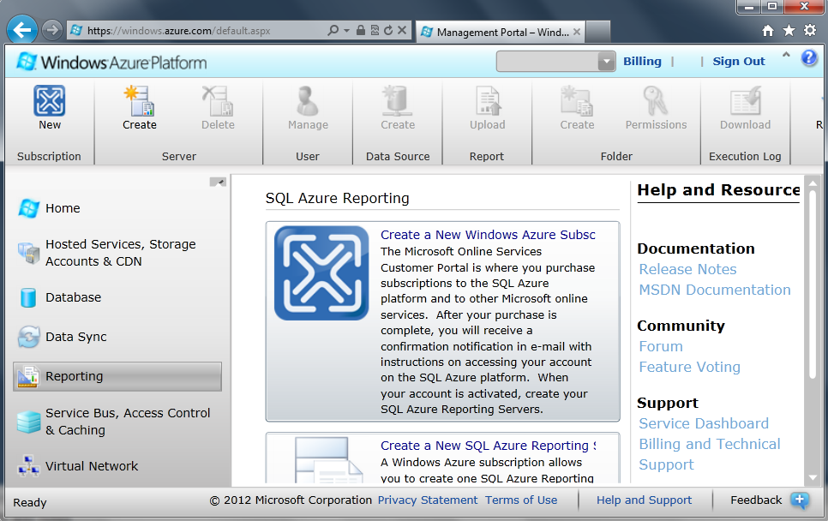
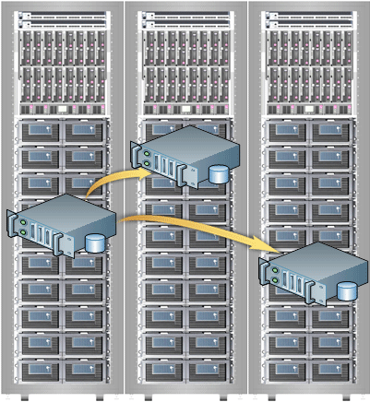

SSRS → Windows Azure SQL Reporting
Reporting Services
SQL Database connectivity
Azure infrastructure
Windows Azure portal
Datacenters worldwide
Notes:
Slide Objectives:
Provide a foundation and some background into the purposes behind SQL Reporting
Transition:
It all begins with SSRS a product you already know, and we made with work with Azure. Then we made a way for you to interact with the engine (the SQL Reporting service), then we added SQL Azure connectivity, the ability to use SQL Azure for your reports, then we made it available in our world-wide data centers to it’s available to you around the world.
Speaking Points:
Based on existing SQL Server Reporting technology provided as a service
Available in the existing portal, but not yet in the Preview portal
Available Worldwide
Notes:
Any notes go here

Slide 5

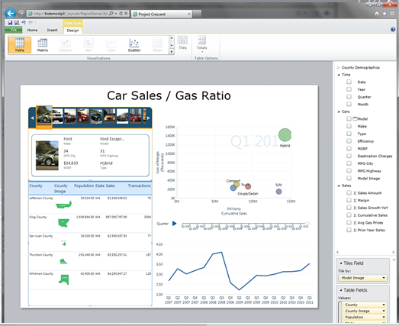

SQL Reporting
Same Cloud Benefits
Enterprise-class scalability
Automatic support for High-Availability
Rapid provisioning
Trusted and familiar security model
Global Distribution
SQL Database
Notes:
Slide Objectives:
Highlight the great SQL Reporting benefits
Transition:
SQL Reporting provides a plethora of high-valued benefits in addition to the fact that it is based on well established SQL Server Reporting Services. These benefits are simply the result that SQL Reporting
Speaking Points:
SQL Reporting is based on the Windows Azure Platform and uses the same architecture for scalability and high availability for report servers
Create or delete your report servers in minutes, as needed by your business cycle. To further support scalability, you can choose from one of the globally distributed data centers.
SQL Reporting is designed to support elastic scale. You only pay for what you use and can add or release excess capacity, depending on your needs.
Notes:

Slide 6
Architecture

Slide 7
Architecture – What’s Under The Hood
RS GPM
Tenant Data
http://server.reporting.windows.net/reports/report.rdl
Load Balancer
Gateway
Gateway
Gateway
Directory Services
RS Instance
Allocation + Service
RS Instance
Monitor/Comm
[SLA & Usage]
[Performance]
[Traces & Logs]
SLA Conformation
RS Instance
Monitor/Comm
[SLA & Usage]
[Performance]
[Traces & Logs]
Monitor/Comm
[SLA & Usage]
[Performance]
[Traces & Logs]
Load Balancing
Operations
RS Engine
Monitoring
[Alerting]
[Performance]
[Traces & Logs]
RS Engine
RS Engine
Customer Service
Billing/Usage
SQL Database
Notes:
Slide Objectives:
Understand the underlying SQL Reporting architecture and its interaction with the other Windows Azure services.
Transition:
Although SQL Reporting is based on SQL Server Reporting technology, the architecture is different in order to take advantage of the many benefits of the Windows Azure platform and services.
Speaking Points:
Referencing a web service endpoint pointing to report1.rdl
Request comes through the load balancer will hit a few application tiers – intelligent meta data routing tier much like the way SQL database have been implemented.
Smart routing (request is processed and sent to next best rs instance)..increase control and security or the availability of the system. If a particular report takes down a node, quickly stop routing requests to that node.
Multi-tenant – each tenant will get their own catalog and tempdb database…since it is built on SQL Database technology
Data tier used for SQL Reporting is SQL Database.
Application tier is built on Windows Azure for scalability
Security – authentication mechanism is basic auth – because reporting is built on SQL Database…inherits a lot of the same security mechanisms.
Notes:
Any notes go here

Slide 8
Features

Slide 9
Key Features
SQL Server Reporting as a Service
Rich Reporting Experience
Manageability
Familiar Development Tools
High Availability and Scalability
Notes:
Slide Objectives:
Highlight the key features of SQL Reporting
Transition:
While many of the great SQL Reporting features have their roots coming from SQL Server Reporting, other key features come from the simple fact that SQL Reporting can take advantage of the Windows Azure platform and services.
Speaking Points:
View reports using Report Viewer control or Web browser
Easy to design visual and interactive reports
Administrative overhead removed. No need to procure, license, install or maintain hardware.
Author and publish reports using familiar tools
No scalability and high availability management overhead
Removes administrative overhead. There is no need to procure, license, install or maintain server hardware and software, which allows you to focus on developing and delivering reporting solutions for your users and less on infrastructure.
99.9 % SLA
Notes:
Any notes go here

Slide 10
Feature Comparison
 | SSRS | Azure SSRS
Tooling | BIDS, Report Builder | BIDS, Report Builder
Data Sources | Assorted Data Sources | SQL Database
Report Management | Report Manager or SharePoint | Windows Azure Developer Portal, URL Browsing
Developer | Custom Data Sources, assemblies, etc. | No extensibility yet
Security Model | Windows Authentication | SQL Database Authentication
Notes:
Slide Objectives:
Quick feature comparison between on-premises SQL Server Reporting Services and SQL Reporting
Transition:
The table compares features between SQL Server Reporting Services (SSRS) configured in native mode and SQL Reporting.
Speaking Points:
Much of the great tooling experience is supported
Some limitation in the Data Sources area – only SQL Database is supported in SQL Reporting
SQL Database authentication. Permissions to reports and report-related items are controlled by role assignment.
Notes:
No extensions are supported in this release.

Slide 11
Security
SQL Reporting Security Model
Credentials not saved in report definition
Shared data sources
Same roles and permissions model as SSRS
Separate Catalog and TempDB for each Tenant
SQL Database username and password authentication
Notes:
Slide Objectives:
Understand the SQL Reporting Security model and how SQL Reporting implements security to ensure data safety
Transition:
SQL Reporting follows specific guidelines for managing the security of SQL Reporting report servers, reports, and report-related items.
Speaking Points:
Provide report readers with a URL, user name, and password to the report server account.
Create and deploy shared data sources for reports to a folder on the report server, and to store credentials for each shared data source on the report server.
Report items inherit security based on report folder permissions, similar behavior as SQL Server Reporting.
Notes:
Strings such as the report server URL, username, and password, are protected information, and must be stored in the <appSettings> section in the Web.config or App.config file of your application. As a best practice, encrypt this data in your configuration file.
If you assign specific permissions to a folder, you break the inheritance for permissions in the folder hierarchy.

Slide 12
Programmability Interface
SQL Reporting API
API from SSRS available in SQL Reporting
Extend SQL Reporting to develop additional features
Upload/Export Reports
Set Configuration
Notes:
Slide Objectives:
Highlight the SOAP API available to provide custom reporting solutions
Transition:
Interact with the report server Web service by using the SOAP API. This API provides several Web service endpoints for report management and execution.
Speaking Points:
The Web service endpoints currently support report management and execution to enable development of custom reporting solutions.
The API allows for report deployment and export of data, as well as reporting configuration and report execution.
Notes:
Any notes go here

Slide 13
Render Reports Using SOAP API
rsExecutionContext = new ReportExecutionService();
rsExecutionContext.LoadReport("/Folder/ReportName", null);
//render report to required format byte[] result = rsExecutionContext.Render(reportFormat,
null,
out extension,
out encoding,
out mimeType,
out warnings,
out streamIDs);
Notes:
Slide Objectives:
An example of using the SOAP API to render a report
Transition:
This slide illustrates how to use the SOAP API to render a report.
Speaking Points:
In this example, the Render method is called to process a specific report and render the report in a specified format.
Report formats include XML, HTML4.0, Excel, Word, HTML3.2, CSV, PDF, and IMAGE.
Notes:
Any notes go here

Slide 14
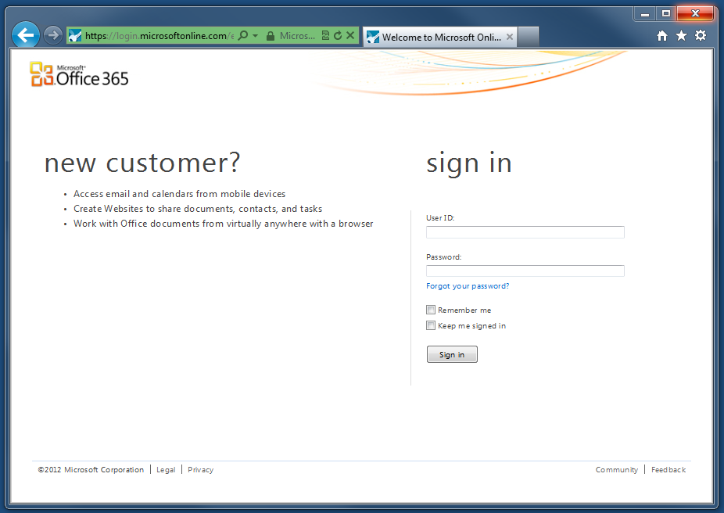
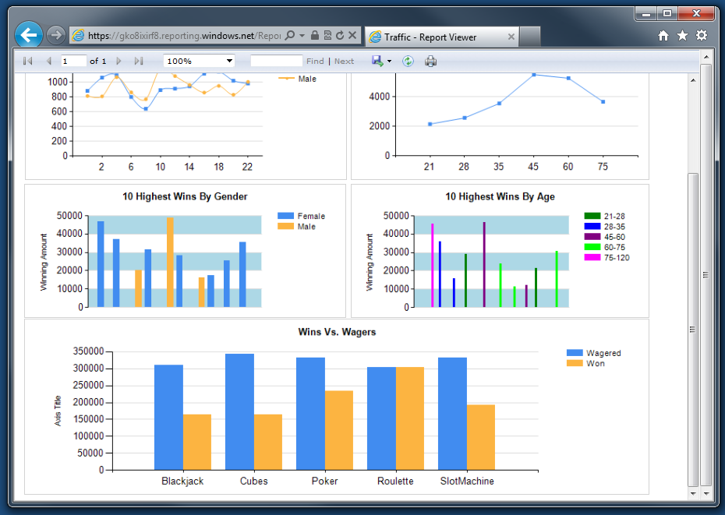
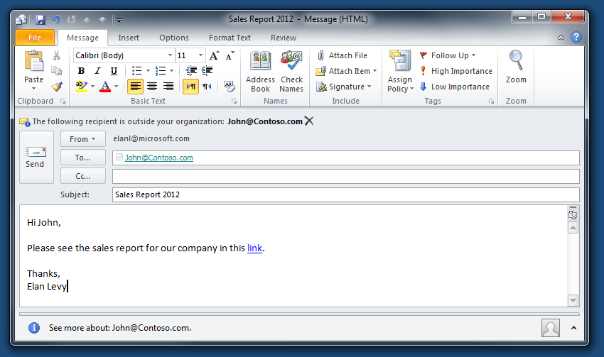
Accessibility
Direct URL Access
Send a URL in an email
Embed in a website
Embed in SharePoint / SharePoint Online
Notes:
Slide Objectives:
Outline different methods for accessing a SQL Reporting report
Transition:
Three are multiple ways to view SQL Reporting reports that provide the flexibility a reporting solution should have.
Speaking Points:
A link to the report can be embedded as a URL in an email
View reports via the application embedded ReportViewer control that point to the hosted report
Through SharePoint / SharePoint Online
Notes:
Any notes go here

Slide 15
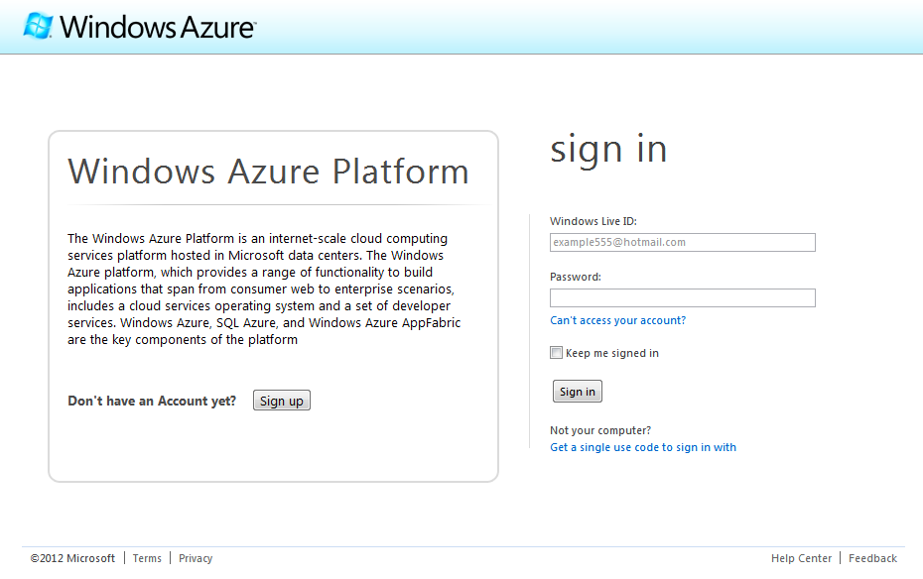
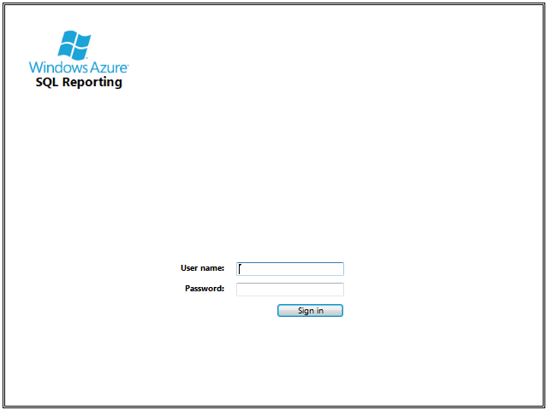
Availability
Who can use it?
Anyone with a Windows Azure Subscription
Any authorized user can view a report
Notes:
Slide Objectives:
Describe the different types of report availability for SQL Reporting.
Transition:
One of the great foundational principles of SQL Reporting is that it encompasses the same security model for SQL Server Reporting Services, and as such, makes report creation and execution by users extremely flexible.
Speaking Points:
Anyone with a Windows Azure subscription can create and manage reporting servers
Any authorized user can view a report
Notes:
Trial is available at WindowsAzure.com

Slide 16
SQL Reporting Management
Demo
Notes:
Demo –SQL Reporting Management
Provision Server
User Management

Slide 17
Walkthrough

Slide 18
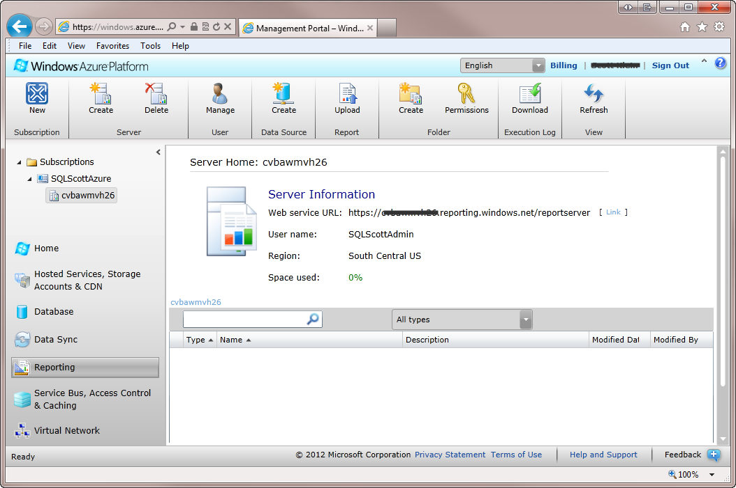
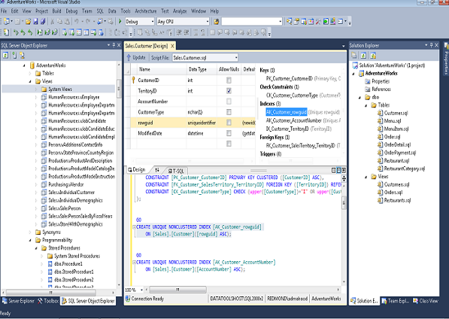
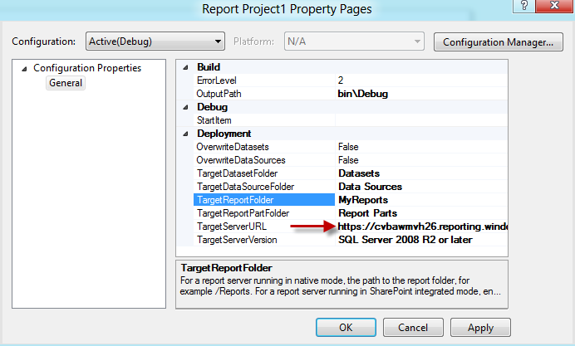
Sample
Server Creation
Server
Administrator
Report Creation
SQL Server Data Tools
Business Intelligence Development Studio
Report Deployment
Set properties
Deploy single or multiple reports
Notes:
Slide Objectives:
Quick end-to-end illustration showing how to begin using SQL Reporting
Transition:
Here is a quick sample overview of the end-to-end process from provisioning a SQL Reporting server to creating and deploying a report.
Speaking Points:
Log in to the current portal
Select the Reporting node
Create a new Reporting server
Open SQL Server Data Tools
Create a Report
Set the properties on the report
Deploy the report
Notes:
Properties are identical to those of on-premise, but the TargetServerURL must include the name of the server. https://<ServerName>.reporting.windows.net/reportserver
For a single report, right mouse click the report and click deploy. For all reports, right mouse click the project and click deploy.

Slide 19
SQL Reporting – Creation and Deployment
Demo
Notes:
Demo – Creating and Deploying a report to SQL Reporting
Open SSDT
Create simple Report
Deploy report
Access report via server

Slide 21
Pricing
The price is correlated to usage:
No servers → No Charge
Servers are charged by the hour
Every hour a server may render up to 200 reports for $0.88/hour
SQL Reporting scales automatically: each clock hour in which more than 200 reports are generated is billed another Reporting Instance hour ($0.88)
Notes:
Slide Objectives:
Point out SQL Reporting pricing
Transition:
Like other services on the Windows Azure Platform, SQL Reporting is designed to support elastic scale. You only pay for what you use and can add or release excess capacity, depending on your needs. Based on your day-to-day, month-to-month, or seasonal requirements, you can easily and quickly add subscriptions and report servers to extend the capacity of your SQL Reporting environment and delete subscriptions and servers to decrease it.
Speaking Points:
$0.88 per hour per reporting instance
1 Reporting Server instance for 1 day, staying within the 200 reports per hour = $21.12
Notes:
For example, if you deployed 1 reporting instance for 1 day during the billing cycle and during that 1 day you stayed within 200 reports per hour except for one hour, where you initiated 250 reports, you would pay $22.00.

