Slide 1
Windows Azure SQL Reporting
Name
Title
Microsoft Corporation

Slide 2

Agenda
Overview
Architecture
Features
Walkthrough

Slide 3
Overview

Slide 4

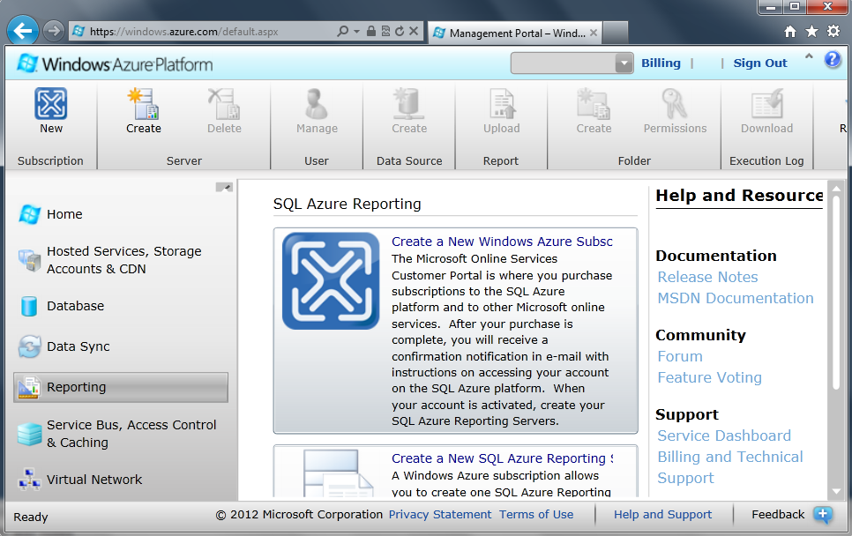
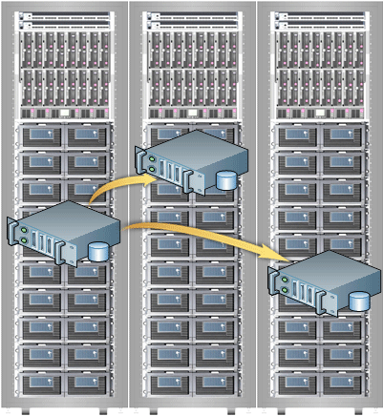

SSRS → Windows Azure SQL Reporting
Reporting Services
SQL Azure connectivity
Azure infrastructure
Windows Azure portal
Datacenters worldwide
Notes:
It all begins with SSRS a product you already know, and we made with work with Azure. Then we made a way for you to interact with the engine (the SQL Reporting service), then we added SQL Azure connectivity, the ability to use SQL Azure for your reports, then we made it available in our world-wide data centers to it’s available to you around the world.

Slide 5

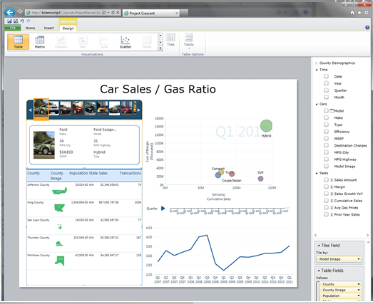

SQL Reporting
Same Cloud Benefits
Enterprise-class scalability
Automatic support for High-Availability
Rapid provisioning
Trusted and familiar security model
Global Distribution
SQL Database

Slide 6
Architecture

Slide 7
Architecture – What’s Under The Hood
RS GPM
Tenant Data
http://server.reporting.windows.net/reports/report.rdl
Load Balancer
Gateway
Gateway
Gateway
Directory Services
RS Instance
Allocation + Service
RS Instance
Monitor/Comm
[SLA & Usage]
[Performance]
[Traces & Logs]
SLA Conformation
RS Instance
Monitor/Comm
[SLA & Usage]
[Performance]
[Traces & Logs]
Monitor/Comm
[SLA & Usage]
[Performance]
[Traces & Logs]
Load Balancing
Operations
RS Engine
Monitoring
[Alerting]
[Performance]
[Traces & Logs]
RS Engine
RS Engine
Customer Service
Billing/Usage
SQL Database
Notes:
Referencing a web service endpoint pointing to report1.rdl
Request comes through the load balancer will hit a few application tiers – intelligent meta data routing tier much like the way SQL database have been implemented.
Smart routing (request is processed and sent to next best rs instance)..increase control and security or the availability of the system. If a particular report takes down a node, quickly stop routing requests to that node.
Multi-tenant – each tenant will get their own catalog and tempdb database…since it is built
Built on top of SQL Database…data tier used for SQL Reporting is SQL Database.
Application tier is built on Windows Azure for scalability
Security – authentication mechanism is basic auth – because reporting is built on SQL Database…inherit a lot of the security mechanisms...

Slide 8
Features

Slide 9
Key Features
SQL Server Reporting as a Service
Rich Reporting Experience
Manageability
Familiar Development Tools
High Availability and Scalability
Notes:
View reports using Report Viewer control or Web browser
Easy to design visual and interactive reports
Administrative overhead removed. No need to procure, license, install or maintain hardware.
Author and publish reports using familiar tools
No scalability and high availability management overhead
99.9 % SLA

Slide 10
Feature Comparison
 | SSRS | Azure SSRS
Tooling | BIDS, Report Builder | BIDS, Report Builder
Data Sources | Assorted Data Sources | SQL Database
Report Management | Report Manager or SharePoint | Windows Azure Developer Portal, URL Browsing
Developer | Custom Data Sources, assemblies, etc. | No extensibility yet
Security Model | Windows Authentication | SQL Database Authentication

Slide 11
Security
SQL Server Reporting as a Service
Credentials not saved in report definition
Shared data sources
Same roles and permissions model as SSRS
Separate Catalog and TempDB for each Tenant
SQL Database username and password authentication
Notes:
Prompt - Alternatively, a report author can set data source credentials to Prompt. After report readers login to the SQL Reporting portal, they must then type the login user name and password for each data source when they run the report.
Passwords stored securely on the report server, separate of the .rdl
Help manage credentials in a single location
Author and publish reports using familiar tools

Slide 12
Programmability Interface
SQL Reporting API
API from SSRS available in SQL Reporting
Extend SQL Reporting to develop additional features
Upload/Export Reports
Set Configuration

Slide 13
Render Reports Using SOAP API
rsExecutionContext = new ReportExecutionService();
rsExecutionContext.LoadReport("/Folder/ReportName", null);
//render report to required format byte[] result = rsExecutionContext.Render(reportFormat,
null,
out extension,
out encoding,
out mimeType,
out warnings,
out streamIDs);

Slide 14
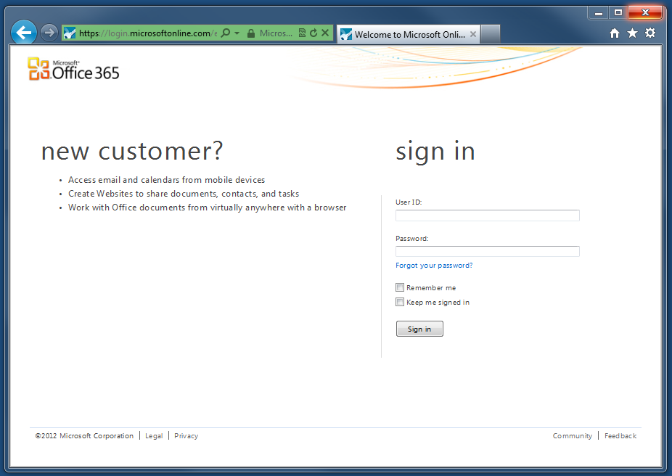
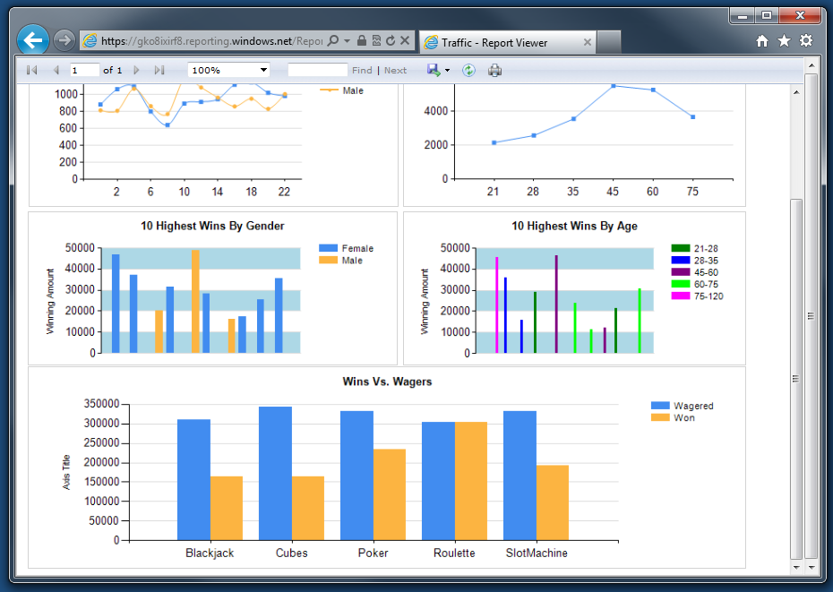
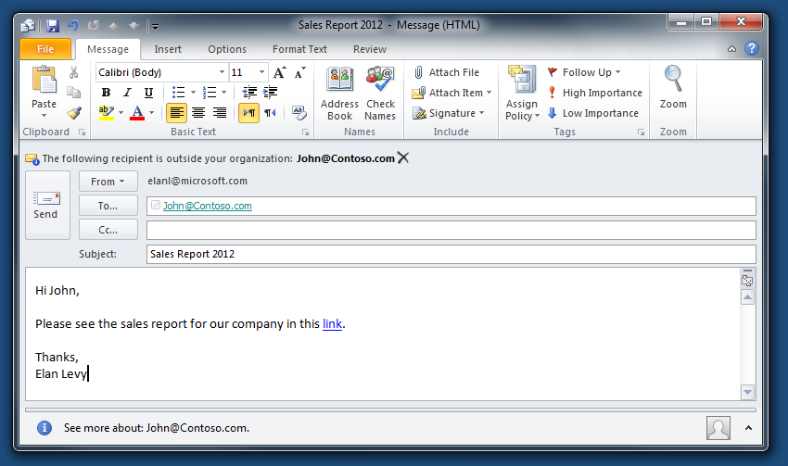
Accessibility
Direct URL Access
Send a URL in an email
Embed in a website
Embed in SharePoint / SharePoint Online

Slide 15
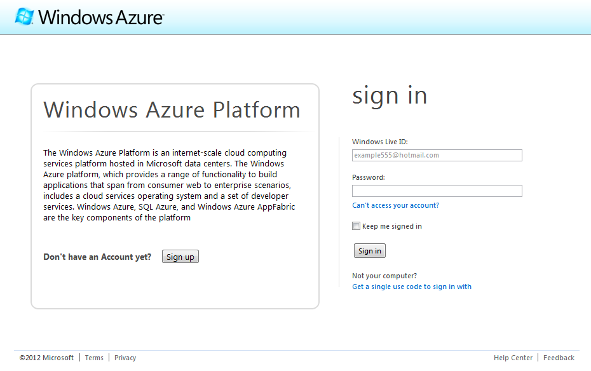
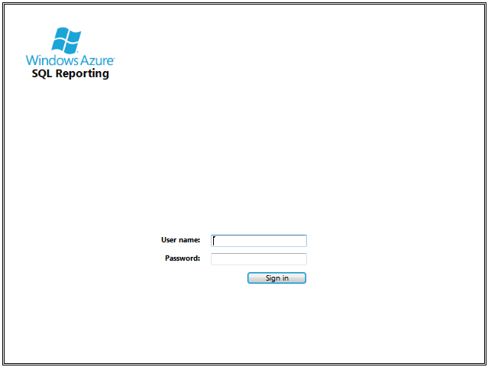
Availability
Who can use it?
Anyone with a Windows Azure Subscription
Any authorized user can view a report

Slide 16
SQL Reporting Management
Demo
Notes:
Demo –SQL Reporting Management
Provision Server
Tools Exploration (SSDT)

Slide 17
Walkthrough

Slide 18
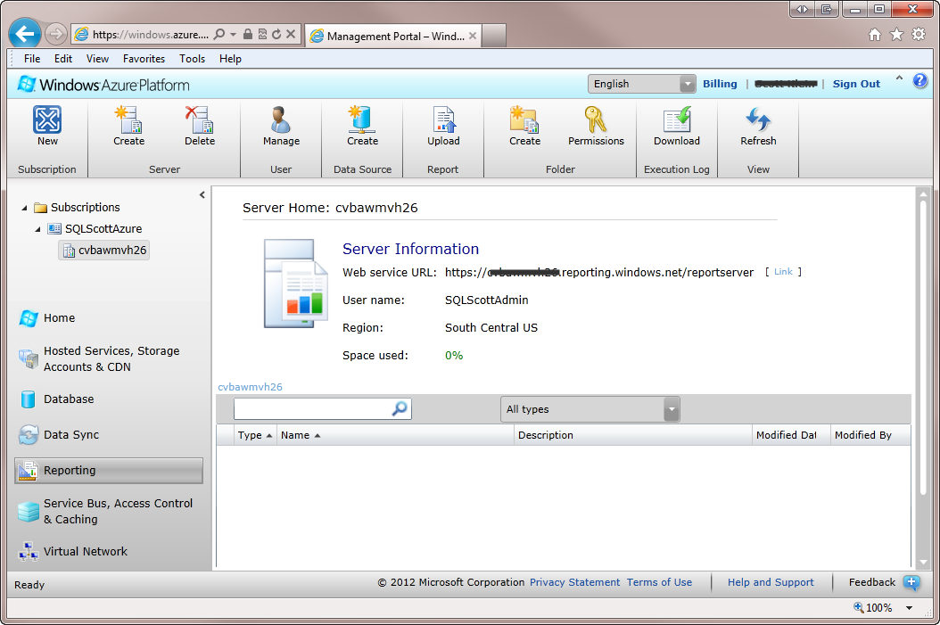
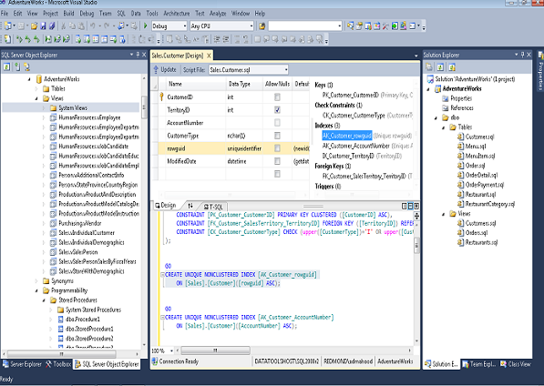
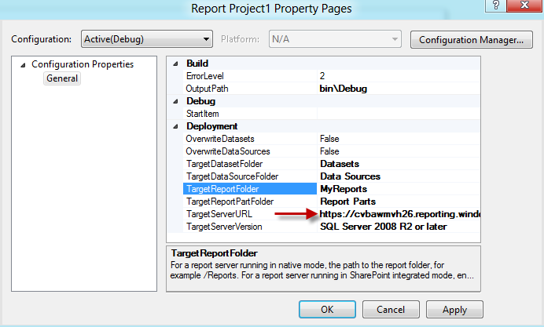
Sample
Server Creation
Server
Administrator
Report Creation
SQL Server Data Tools
Business Intelligence Development Studio
Report Deployment
Set properties
Deploy single or multiple reports
Notes:
Properties are identical to those of on-premise, but the TargetServerURL must include the name of the server. https://<ServerName>.reporting.windows.net/reportserver
For a single report, right mouse click the report and click deploy. For all reports, right mouse click the project and click deploy.

Slide 19
SQL Reporting – Creation and Deployment
Demo
Notes:
Demo – Creating and Deploying a report to SQL Reporting
Open SSDT
Create simple Report
Deploy report
Access report via server

Slide 21
Pricing
The price is correlated to usage:
No servers → No Charge
Servers are charged by the hour
Every hour a server may render up to 200 reports for $0.88/hour
SQL Reporting scales automatically: additional instances of 200 reports will cost $0.88/hour

