Slide 1

Index R(x): Prescriptions for Performance Improvement
Find presentation, Excel spreadsheet, & T-SQL code at
https://github.com/SQLXL/SQLXL
Data Saturday Phoenix 2024
Bill Sanscrainte
Bill@Sanscrainte.com

Slide 2

sp_WhoIsActive?
Bill Sanscrainte linkedin.com/in/billsanscrainte Bill@Sanscrainte.com
SQL Server since 6.5
1984 - Executed first SQL statement leading first data warehouse project
1994 - Started independent Data Consulting practice
2001 - Began version 1 of SQLXL tools
Record holder for most SQL Cruises as a student - SQL Server 10, Oracle 2

Slide 4
Free Stuff!
All T-SQL code, Excel workbook, & this presentation on Github
Up to 8 hours free consulting!
For volunteers helping to improve SQLXL_Index
Notes:
49:00
*26K lines of T-SQL and VBA*
Willing to trade up to 8hours consulting time to help make this a useful tool for the SQL community

Slide 5

Special thanks to these and other SQL community contributors!
Brent Ozar | Tim Ford | Grant Fritchey | Aaron Bertrand
Kevin Kline | Sean McCown | Andy Yun | Jonathan Kehayias
Jes Borland | Kendra Little | Paul Randall | Dmitri Korotkevitch
Tom Collins | Pinal Dave | Kimberly Tripp | Niko Neugebauer
Erik Darling | Phil Factor | Edward Pollack | Monica Rathbun
Glenn Berry | Kalen Delaney | Ahmad Yaseen | Kendall vanDyke
Gail Shaw | Jason Strate | Ola Hallengren | Thomas LaRock
Notes:
Shout out to these and others whose community contributions went into this presentation
Future Adds:
Jared Westover

Slide 6
Agenda
Why are you here?
Client story
Signs that tuning indexes may be your best choice
Introduce a new approach to index tuning
Index performance hurts
Prioritizing the hurt
Prescribing index fixes
Index sourcing & diagnostics
Free Stuff!
Questions?
Notes:
1:00

Slide 7
Why are you here?
“Poorly designed indexes and a lack of indexes are primary sources of database application
bottlenecks”
learn.microsoft.com 04/04/2023
Notes:
Microsoft says it best - It’s all about the indexes

Slide 8
Client Story - Introduction
Business: Membership & Event Management services
Application has always been “slow” and getting “slower”
Problem: Application “got Kaboomed!” when really busy – 50,000+ connections
SQL Server became non-responsive (DAC anyone?)
Restarted server
3 days to recover - untangle members, events, and payments
Lost several big customers
Platform
AWS via “Lift & Shift” from on-premise
SQL 2016 Enterprise
32 cores, 240GB RAM, 2TB data
No SQL monitoring tools
Notes:
Crash - think Taylor Swift & Ticketmaster

Slide 9
Signs Tuning Indexes May Help - Business
Are the original Architects & Designers available?
Otherwise refactoring application will take much longer
Can developers be spared to refactor the application?
If not, index changes can be done by others
Are application functionality testers available?
Index changes (typically) require no functional testing
Do you have money to spend for more bigger faster hardware?
Index changes will work on existing hardware. May just take a little longer
How long before the next activity peak?
Changes can be done piecemeal, starting with highest priority improvements
Can we make the next several Maintenance Windows bigger?
With Enterprise Edition, changes can be made online (no outage window)

Slide 10
Client Story - Answers - Signs Tuning Indexes May Help - Business
Are the original Architects & Designers available?
Several corporate buyouts and retirements later all are gone
Can developers be spared to refactor the application?
Hard feature delivery dates committed to key clients
Are application functionality testers available?
Testing staff fully committed
Do you have money to spend for more faster hardware?
After lift & shift to cloud, costs now > 3x previous on-premise expenses
How long before the next activity peak?
Peaks arrive unannounced, controlled by customer demand
Can we make the next several Maintenance Windows bigger?
SQL 2016 Enterprise Edition - Yay!
Notes:
6 out of 6 on the Business scale
Particular note: lift & shift to cloud ended up costing more than 3X on premise
Particular note: SQL 2016 Enterprise Edition

Slide 11
Signs Tuning Indexes May Help - Technical
Does CPU usage grows exponentially as users grow linearly?
Query executions are getting in each others way
Any Poison Wait Types - RESOURCE_SEMAPHORE, THREADPOOL ?
As memory & CPU use explodes, less and less resource available for next query
Are there “high” Lock & Latch Waits?
Too many indexes, lots of table and index scanning, lock escalations
Is SOS_SCHEDULER_YIELD wait type high?
Parallelism, long running query tasks shuffled from CPUs back to work queues
Have indexes not been tuned in recent memory?
Pretty much the universal condition. A (key) component of Technical Debt
Are performance issues addressed with missing index recommendations?
OK when you have no other choice

Slide 12
Client Story - Answers - Signs Tuning Indexes May Help - Technical
Does CPU usage grows exponentially as users grow linearly?
CPU pegs 100% easily
Any Poison Wait Types - RESOURCE_SEMAPHORE, THREADPOOL ?
Poison wait types grow exponentially as application gets busier
Are there “high” Lock & Latch Waits?
Wait types grow exponentially as application gets busier
Is SOS_SCHEDULER_YIELD wait type “high”?
Wait types grow exponentially as application gets busier
Have indexes not been tuned in recent memory?
Current team cannot remember when was last done
Are performance issues addressed with missing index recommendations?
Client’s “goto” solution for customer performance complaints
Notes:
6 out of 6 on the technical scale
Particular note: Developers has free reign to add missing index recommendations

Slide 13
New Tuning Approach - SQLXL_Index
Pareto’s Law (or the “80/20 Rule”)
“80% of consequences come from 20% of causes”
Ask SQL Server “Where does it hurt?”
Costs to Create, Read, Update, Delete (“CRUD”) data in tables
Identify the biggest hurts
Prescribe index fixes
Fix the biggest hurts
Make comprehensive index data available for further analysis
Notes:
04:00
AKA 80/20 rule
Others tell you “the patient is bleeding” not “what wound do you close first?”

Slide 14
Performance Hurt - Metrics
Waits
Locks
Buffer usage
Missing indexes
Page splits
Page merges
Forwarded fetches (on heaps)
Large Objects (LOB) reads
Index scans
Table lookups
Read to write ratio
Total writes
Notes:
Lumped hurts into 12 categories
Go into each in a little detail

Slide 15
Performance Hurt
Waits
Locks
Buffer
Missing
Splits
Merges
Fetches
LOB Reads
Scans
Lookups
Read/Write
Writes
Time index activity waited on another resource
Measure: counts & time spent waiting on:
Locks “logical” operations, including transaction(s) - on pages, rows
Latches “physical” operations - data pages moving memory <-> disk
Notes:
05:15
Wait - not going to get into threads and scheduler

Slide 16
Performance Hurt
Waits
Locks
Buffer
Missing
Splits
Merges
Fetches
LOB Reads
Scans
Lookups
Read/Write
Writes
Secure transactional compliance with ACID requirements
Atomicity, Consistency, Isolation, Durability
Measure: counts
Locking pages, rows
Lock promotions (row -> page -> partition -> table)
Attempts
Successes
Fails = attempts - successes
Notes:
ACID - atomicity, consistency, isolation, durability

Slide 17
Performance Hurt
Waits
Locks
Buffer
Missing
Splits
Merges
Fetches
LOB Reads
Scans
Lookups
Read/Write
Writes
Proportion of index (including heaps) in the buffer cache
More buffer usage is more bad, especially for OLTP
Exclude in-memory objects (always 100%)
Measure: pages in memory/total reserved pages allocated
Notes:
6:00

Slide 18
Performance Hurt
Waits
Locks
Buffer
Missing
Splits
Merges
Fetches
LOB Reads
Scans
Lookups
Read/Write
Writes
Suggestions from the optimizer to improve a single query
Measures:
Count of times query executed
Average query cost estimate
Estimated percent reduction in query cost
Notes:
The “Silver Bullet”

Slide 19
Missing Index Limitations (from Microsoft)
Only considers nonclustered, rowstore, disk-based indexes
No clustered, columnstore, XML, spatial, full-text, hash, unique, filtered, materialized views
Uses estimates from first optimization of a single query
No consideration for key column parameter sniffing
Metrics not update after actual execution(s)
First 600 only, any more ignored. Cleared for a table on DDL change or rebuild
Suggested index key columns listed by table column creation order, not selectivity
Not weighted based on total number of times table was queried
Ignores internal (e.g. full text, spatial) & system-generated tables (CDC, SVN, LDG)
Adds included columns to cover query, without weighing cost / benefit
No reference to existing indexes or previous recommendations - causes overlaps!
No suggestions for trivial query plans
Suggests missing index for non-persisted computed columns
Only one from each query, even if several were suggested in plan XML
Queries with only inequality predicates have less accurate query cost
Does not consider existing nonclustered columnstore in deciding on a “missing” index
Notes:
From Microsoft itself!

Slide 20
Performance Hurt
Waits
Locks
Buffer
Missing
Splits
Merges
Fetches
LOB Reads
Scans
Lookups
Read/Write
Writes
Can’t fit inserted / updated data into an existing data page
Creates a new data page(s)
Splinters old & new data between existing & new page
Extra write I/O
Measure: count of
Index leaf level splits
Index tree level splits
column_value_push_off_row_count (to LOB storage)

Slide 21
Performance Hurt
Waits
Locks
Buffer
Missing
Splits
Merges
Fetches
LOB Reads
Scans
Lookups
Read/Write
Writes
Opposite of split - squeeze 2 data pages into 1
Row deletion or column update frees up space
Marks empty page for cleanup
Extra write I/O
Measure: count of
Index leaf level merges
Index tree level merges
column_value_pull_in_row_count (from LOB storage)

Slide 22
Performance Hurt
Waits
Locks
Buffer
Missing
Splits
Merges
Fetches
LOB Reads
Scans
Lookups
Read/Write
Writes
Heap - updated record grows too large for page
Causes page split
Data physically moved out of original insertion sequence
Extra I/O - additional read(s) from following forwarding record pointer to moved page
Measure: count of forward fetched rows
Notes:
corrected by creating clustered index -or- table rebuild

Slide 23
Performance Hurt
Waits
Locks
Buffer
Missing
Splits
Merges
Fetches
LOB Reads
Scans
Lookups
Read/Write
Writes
Big data types
TEXT, NTEXT
IMAGE
VARCHAR(MAX), NVARCHAR(MAX)
VARBINARY(MAX)
XML
Maintained in off-row pages
Special allocations - LOB_DATA & ROW_OVERFLOW_DATA
Requires extra maintenance for pointers to new location
Extra I/O
Measure: count of off-row pages fetched
Notes:
Omits bulk operations

Slide 24
Performance Hurt
Waits
Locks
Buffer
Missing
Splits
Merges
Fetches
LOB Reads
Scans
Lookups
Read/Write
Writes
Start at the top of the index (table if a heap) & read all leaf-levels
Until you hit bottom
Or TOP (###) - if index keys match ORDER BY columns
Required for all “non-Sargable” (Search Argument-able) predicates
Measure: count of range scans
Notes:
“Better” indexes get ”Seeked” - still may involve scan from that point

Slide 25
Performance Hurt
Waits
Locks
Buffer
Missing
Splits
Merges
Fetches
LOB Reads
Scans
Lookups
Read/Write
Writes
Index keys & included columns don’t “cover” query needs
Extra seek(s) to underlying physical table using:
Heaps & RID (Row IDentifier)
Clustered index & uniquifier (if not unique)
Measure: count
Lookups
Notes:
“Better” indexes get ”Seeked” - still may involve scan from that point

Slide 26
Performance Hurt
Waits
Locks
Buffer
Missing
Splits
Merges
Fetches
LOB Reads
Scans
Lookups
Read/Write
Writes
“Gooder” indexes are read way way more than they are written to
Suggestion: Read “4+” times per write - because writes can require:
Transaction Locks
Exclusive Latches
Uniquifier/RID (Row IDentifier) generated on insert
no unique clustered index
Page splits
Page merges
Page delete
Ghost cleanup (of deletes)
Physical log file write
Physical data file write
Measure: Count of reads/count of writes

Slide 27
Performance Hurt
Waits
Locks
Buffer
Missing
Splits
Merges
Fetches
LOB Reads
Scans
Lookups
Read/Write
Writes
Aggregate amount of page changes to table & index data
Measure: count
Inserts
Updates
Deletes
Notes:
“Better” indexes get ”Seeked” - still may involve scan from that point

Slide 28
Prioritizing Hurt - SQLXL_Index
For each index hurt metric
Total by table
Total by instance/database
Compute each table’s metric fraction of entire instance/database
Apply metric weighting factor
Some metrics more important than others
Available as runtime parameter for SQLXL_Index
Total up all weighted metric fractions by table
Present results in descending hurt order
Notes:
08:00
Why by table - it’s where the data lives

Slide 29
Weighting* the Hurt (default values)
Waits - times & counts ++++++
Locks - count, promotion attempts & fails ++++
Buffer cache +++++
Missing index - usage weighted +++++
Page splits, merges, value push off / pull in ++++
Forwarded fetches (heaps) ++++
LOB - fetch, overflow fetch ++
Scans & lookups (% of table reads) ++
Read to write ratio - operations, usage ++
Writes - operations, usage +++
Redundancy ++
* SQLXL_Index Runtime Parameters
Notes:
Parameterized in SQLXL_Index
Reflect your server’s operational metrics
Aggregated to Table level

Slide 30
Client Story - SQLXL_Index Priority Findings
21 tables (4% of total)
82% of weighted index hurt

Slide 31
SQLXL_Index Priority Display - Excel
Sample Data - Microsoft’s WideWorldImporters_FULL
EXECUTE [DataLoadSimulation].[PopulateDataToCurrentDate]
Add some special illustrative cases
Notes:
Using Excel, use the metrics to filter & create your own priorities!

Slide 32

Notes:
Automagically transferred to Excel via macros and ADODB connection
Dropdown - select columns displayed. 258 columns at last count
24 hurt metrics, computed as percent of instance/database
For each table - RowStore, ColumnStore, Indexed View,
Aggregate Priority Score descending
Specific hurt percent of “total”
Columns highlighted “good” green to “bad” red
not all good or all bad

Slide 33
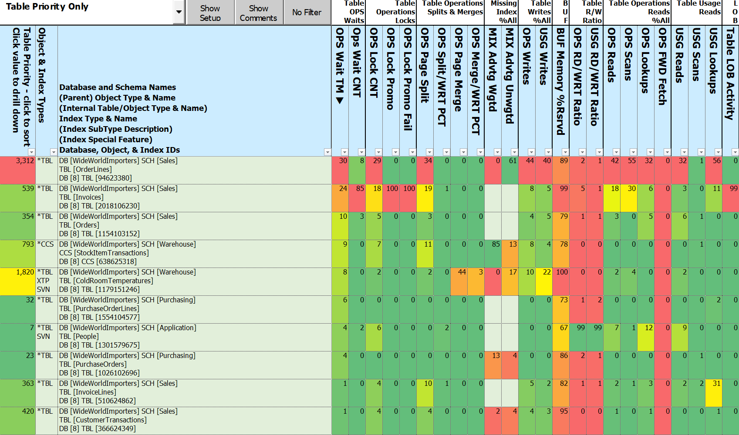
Notes:
So hurt can be spread unevenly across the pain metrics

Slide 34
Client Story - SQLXL_Index Priority Findings
Those tables make sense, but …
What do we need to do to make the hurt go away?
Need specific, actionable prescriptive actions
Based on detailed performance metrics and diagnostics
At the individual index level
Prioritized by table

Slide 35
Prescription Development - Legacy Approach
If you are lucky ☺ - your monitoring tool may have some answers
If not, start diagnosing with
Expert Performance Indexing in Azure SQL and SQL Server 2022 (Great Book!)
Brent Ozar’s sp_BlitzIndex
Glenn Berry’s 89 (2022) Diagnostic Information Queries
Aaron Bertrand’s 40 table property queries
Lots of community one-off scripts - use webbernet searches
Painstakingly execute each script in SSMS
Copy/paste results to spreadsheet(s)
Notes:
4:00
Others tell you “the patient is bleeding” not “what wound do you close first?”
Brent Ozar - most complete of the tools out there
Glenn Berry - version specific
Aaron Bertrand’s - things like heaps, too many indexes

Slide 36
Prescription Development - Legacy Approach (continued)
Search for ideas on how to organize results into groups. Examples:
Berry: “Look at most frequently modified indexes and statistics (Query 78) (Volatile Indexes)”
Bertrand: “SQL Server Tables with More Than Five Indexes”
Ozar: “Low Fill Factor on Clustered Index (Check ID 40)”
Group your results
For each group, create prescriptive actions to take by index
Make sure to include the “It Depends” factors
Wish you had a way to organize by table
Wish you had a way to prioritize actions
Notes:
Now that you have your results …

Slide 37
Prescription Development - New Approach
Execute SQLXL_Index
Display index prescriptions in descending order of hurt
Notes:
Time consuming

Slide 38
Prescriptions - SQLXL_Index
97 Prescriptions (as of latest version)
8 Categories
Retain
Replace
Request
Reject
Remove
Review
Refresh
Refactor
Notes:
What are the 8 things you can do the indexes on a table?

Slide 39
Prescriptions
Retain
Replace
Request
Reject
Remove
Review
Refresh
Refactor
Existing indexes “As Architected & Designed”
Clustered
Constraints - primary key, unique, foreign key
History tables - Change Data Capture, System Versioned, Ledger
Special indexes - full-text, spatial, XML, columnstore
Required by others - e.g. unique index supporting a full-text index
Indexes with no writes
Internal tables

Slide 40
Prescriptions
Retain
Replace
Request
Reject
Remove
Review
Refresh
Refactor
Existing Indexes with updatable nonclustered columnstore
Low usage nonclustered rowstore
Low read/write ratio
Missing indexes with significant query usage
Weight potential impact against total table reads
Requires SQL 2016+ Enterprise

Slide 41
Prescriptions
Retain
Replace
Request
Reject
Remove
Review
Refresh
Refactor
New Index
Clusters on heaps with significant usage
Covers for foreign key constraints
With missing index recommendation
Valuable missing indexes

Slide 42
Prescriptions
Retain
Replace
Request
Reject
Remove
Review
Refresh
Refactor
Missing index recommendations
That don’t add significant value
Table has / will have nonclustered columnstore

Slide 43
Prescriptions
Retain
Replace
Request
Reject
Remove
Review
Refresh
Refactor
Existing indexes
Cost more than benefit - less than 4 reads per write
Least used redundant index (same sequence)
Redundant foreign key constraint
Notes:
Same keys different sequence (“overlap”)
Keys “contained” in another bigger index

Slide 44
Prescriptions
Retain
Replace
Request
Reject
Remove
Review
Refresh
Refactor
“It Depends” for indexes tagged previously – such as:
Non-persisted computed column in definition
High page compression failures
Non-default properties - e.g. duplicate key messages are suppressed
Potential filtered index – wide range of rows per lead index key
Potential temporary based on name

Slide 45
Prescriptions
Retain
Replace
Request
Reject
Remove
Review
Refresh
Refactor
Existing Indexes
Update statistics
<= 30 days old
stats modification_counter > 0.5% of row count
Rebuild/organize columnstores with “significant” delta tables

Slide 46
Prescriptions
Retain
Replace
Request
Reject
Remove
Review
Refresh
Refactor
Retained indexes benefiting from structural changes
Clustered rowstore index not “NUSE”
Narrow, Unique, Static, Ever increasing
Nonclustered rowstore additional key(s) don’t improve selectivity
FILL FACTOR = 100% and hi page splits (> 5% since restart / last DDL)
Lead key is ORDERED UNIQUE & index property [IS_UNIQUE] = 0

Slide 47
Client Story – Priority Table Prescription Implementation
Build “prior week” baseline
Implemented prescriptions on 21 tables (4%)
Restart server
Capture new statistics
Compute week over week comparison
Note: mostly similar “regular” (non-peak) workloads
Notes:
Fixes applied & server restarted

Slide 48
Client Story - Priority Prescription Improvements
Wait time (as % of total)
RESOURCE_SEMAPHORE -71%
THREADPOOL -67%
SOS_SCHEDULER_YIELD -63%
LCK_* & PAGELATCH_* -52%
Index hurt (versus previous period)
Waits - times & counts -77%
Locks - count, promotion attempts & fails -62%
Scans & lookups (% of table reads) -58%
Read to write ratio - operations, usage -47%
Writes - operations, usage -43%
Page splits, merges, Value push off / pull in -39%
Buffer cache usage - 0%
Notes:
Fixes applied & server restarted

Slide 49
Notes:
Dashboard
Getting to the Action
Click on Table Level priority
Display changes to Index details

Slide 50
Notes:
Enable Optimize for Sequential key new in 2019

Slide 52
SQLXL_Index Diagnostics - Sourcing
89* DMVs & DMFs, 940* columns
Objects
Server, instance, database, tables, views, SQL TVFs
History - Change Data Capture, System Versioned, Ledger
Internal tables - auto generated - for XML, spatial, full-text, history, …
Indexes, foreign keys, constraints, missing indexes …
Metadata
Columns, sequences, identities, partitions, statistics, computed columns …
Configurations, settings, parameters, extended properties …
182* operational metrics - sizes, stats, waits, locks, splits/merges, reads, writes, …
Aggregates reset on index rebuild/stats recompute/DDL change/server start …
Around 28* seconds to collect & process on problem server
* As of latest version
Notes:
How did we come up with prescriptions? We diagnosed the symptoms.

Slide 53
SQLXL_Index Metadata & Metric Sources (as of latest version)
Server Database=> @@ Functions DBCC TRACESTATUS msdb.sys.availability_replicas msdb.sys.change_tracking_databases msdb.sys.database_scoped_configurations msdb.sys.databases msdb.sys.dm_db_index_operational_stats msdb.sys.dm_db_index_usage_stats msdb.sys.dm_db_missing_index_columns msdb.sys.dm_db_missing_index_details msdb.sys.dm_db_missing_index_group_stats msdb.sys.dm_db_missing_index_group_stats_query msdb.sys.dm_db_missing_index_groups msdb.sys.dm_exec_query_plan msdb.sys.dm_exec_query_stats msdb.sys.dm_exec_sessions msdb.sys.dm_exec_sql_text msdb.sys.dm_hadr_availability_replica_states msdb.sys.dm_os_buffer_descriptors msdb.sys.dm_os_sys_info msdb.sys.servers SERVERPROPERTY Function | cdc.change_table sys.allocation_units sys.change_tracking_tables sys.check_constraints sys.column_store_row_groups sys.column_type_usages sys.columns sys.computed_columns sys.data_spaces sys.database_automatic_tuning_options sys.database_files sys.database_query_store_options sys.database_scoped_configurations sys.default_constraints sys.dm_db_column_store_row_group_operational_stats sys.dm_db_column_store_row_group_physical_stats sys.dm_db_incremental_stats_properties sys.dm_db_partition_stats sys.dm_db_stats_properties sys.dm_db_xtp_hash_index_stats sys.dm_db_xtp_index_stats sys.dm_db_xtp_memory_consumers sys.dm_db_xtp_Nonclustered_index_stats sys.dm_db_xtp_object_stats sys.dm_db_xtp_table_memory_stats sys.dm_sql_referencing_entities sys.dm_xtp_system_memory_consumers sys.edge_constraint_clauses sys.edge_constraints sys.extended_properties sys.filegroups sys.foreign_key_columns sys.foreign_keys sys.fulltext_catalogs | sys.fulltext_index_catalog_usages sys.fulltext_index_columns sys.fulltext_indexes sys.function_order_columns sys.hash_indexes sys.identity_columns sys.index_columns sys.index_resumable_operations sys.indexes sys.internal_partitions sys.internal_tables sys.key_constraints sys.objects sys.partition_functions sys.partition_schemes sys.partitions sys.schemas sys.sequences sys.spatial_index_tessellations sys.spatial_indexes sys.sql_expression_dependencies sys.sql_modules sys.stats sys.stats_columns sys.table_types sys.tables sys.triggers sys.types sys.views sys.xml_indexes sys.xtp_memory_consumers sys.xtp_Nonclustered_index_stats sys.xtp_object_stats

Slide 54
SQLXL_Index - 451* Diagnostics (SQL Version aware)
Items that “stand out”
Non-default properties, settings, parameters - e.g. DOP, CTFP
High proportion of a metric - e.g. waits, locks, splits, merges
Unused, underused, or empty objects
“Good to know”
“Key” configuration info - server, instance, database, query store …
Dates: Last read / written / modified / created / statistics updated …
Index “Synergies” - sequence, overlaps, contained …
Sizes, metrics, restrictions, limits …
Anti-Patterns
Big includes
Uncovered foreign keys with missing index recommendations
* As of latest version. Yes that’s an important number if you’re a Ray Bradbury fan.
Notes:
Non-Default - Cost threshold for Parallelism
History and Internal Tables given a pass (mostly)
Version Aware - don’t ding SQL 2012 for new feature in SQL 2022
Link to BlitzIndex when same item found (57 items)

Slide 55
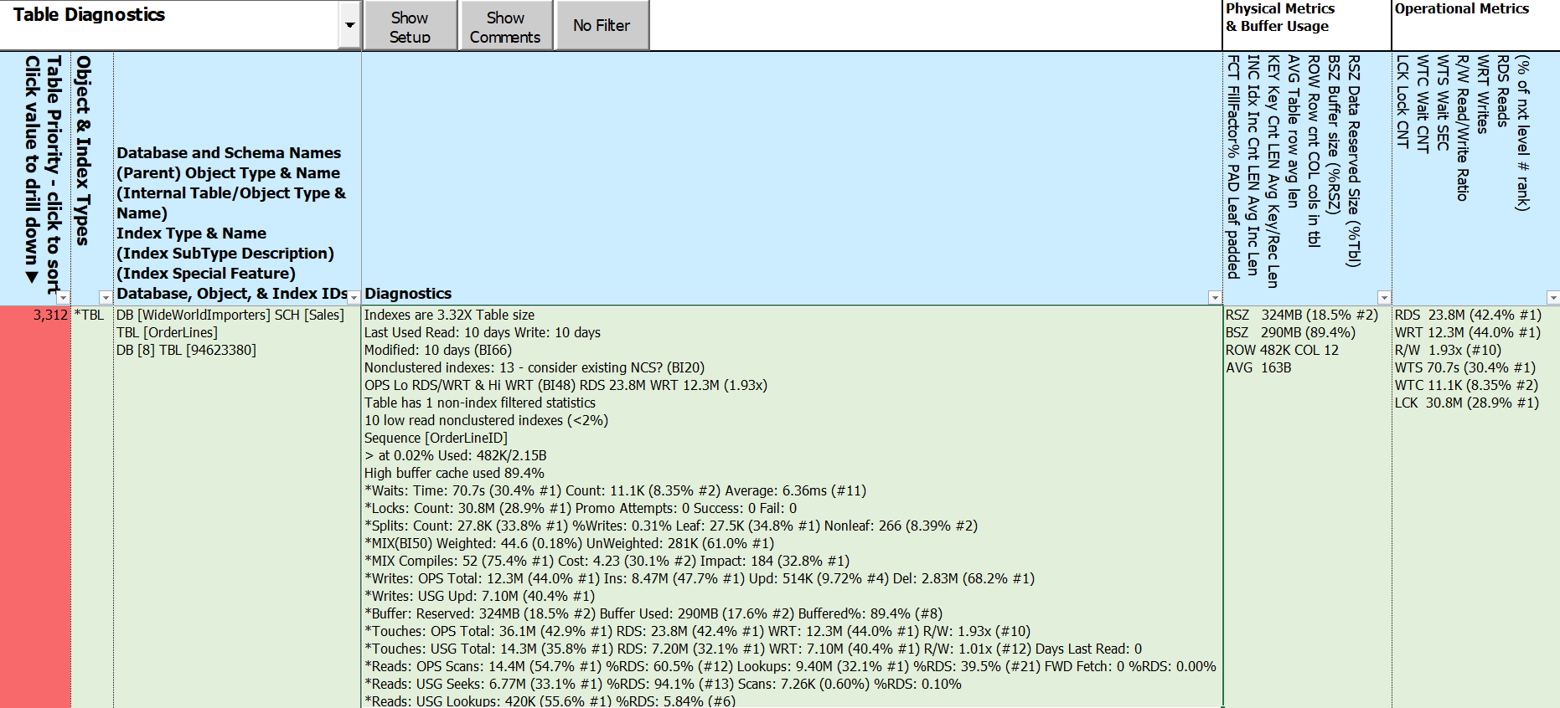
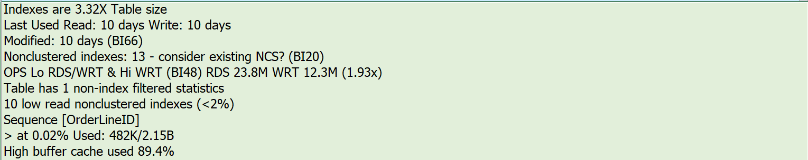

Slide 56
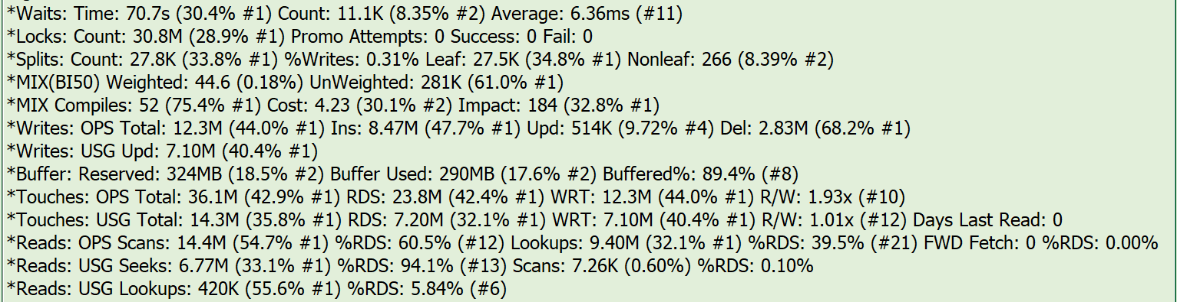
Notes:
BI #

Slide 57
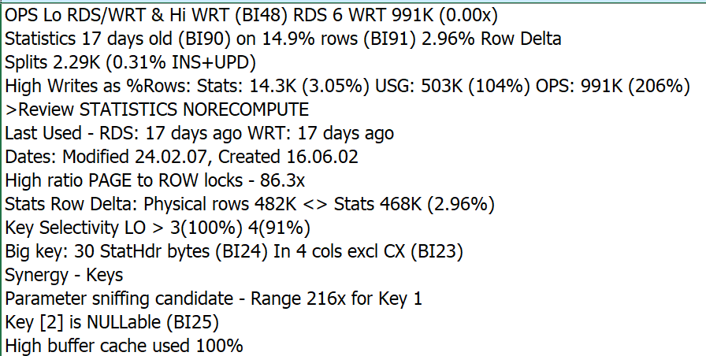
Notes:
Selected priority columns

Slide 58
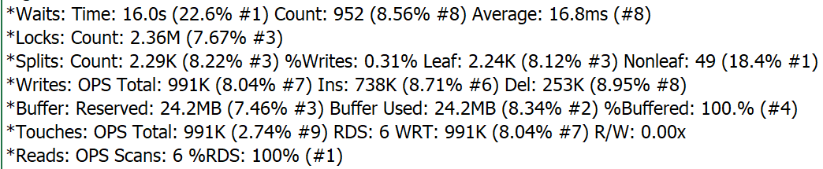
Notes:
Selected priority columns

Slide 59
What about Index Metadata and Other Metrics?
It’s in the spreadsheet
258 columns – details on
Foreign key constraints
Table & column constraints
Statistics names and filter definitions
Extended properties
All usage metrics
All Operational metrics - including in-memory & columnstores
Index Metadata
Notes:
45:30

Slide 60
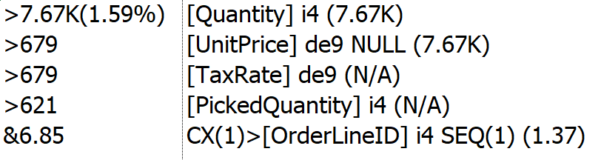
Notes:
46:00

Slide 61
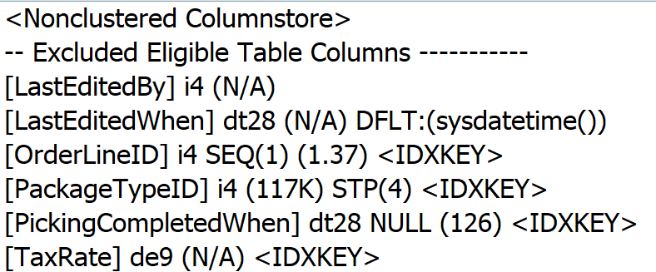
Notes:
43:00

Slide 62
Implementing Index Fixes - A method
Clone structure of target database
Apply changes to clone to produce prescribed “end state”
Create delta scripts using favorite DDL comparison tool: target -> ”end state”
Scripting DDL changes best left to “experts”
Create “rollback code” by comparing in the opposite direction
Apply delta scripts to target database
Re-compare “end state” to target database
Address any discrepancies
Execute rollback code if SHTF
*IMPORTANT* Batch changes by table
More time consuming to script & execute
Expedites (inevitable) rollbacks
Notes:
47:30
Depending on where problem occurs at what stage in the process, rollback code may be incomplete
Many DDL comparison tools batch up all related activities - can be difficult to unwind if failure

Slide 63
Implementing Index Fixes - Guidelines
Much interdependency between indexes, data elements, and Applications
Clustered index changes work fastest with no other indexes
Audit & History tables may needs dropping & rebuilding
Foreign keys and other constraints may need dropping and rebuilding
Dropped indexes may be important on Secondary
There’s never enough Log file space
Use Incrementalism
Bite size pieces, priorities first
Consider DISABLE indexes before dropping
Re-run SQLXL_Index after each set of changes
Assess performance delta
Rinse & Repeat until “done” ☺
Notes:
50:00
Ignoring Duplicate keys - inserted rows violating uniqueness are ignored
possible data and application issues
Allowing row & page locks
Computed columns - persisted in index
Filtered indexes
Indexed views

Slide 64
Client Story – The End
Good News - Next 50,000+ user event came up CPU max 32%, no issues reported
Even better - No performance complaints!
Completed most of the remaining index prescriptions
Replace many least-used indexes with nonclustered columnstores
Drop indexes not adding value
Add high-value missing indexes, heap clusters, & foreign key covers
Address indexes with uniqueness issues, key overlaps, or extraneous keys
Review/change instance & database level properties
Notes:
51:00

Slide 65
Free Stuff!
All T-SQL code, Excel workbook, & this presentation on Github
Up to 8 hours free consulting!
For volunteers to help improve SQLXL_Index:
Identifying edge cases
Bug hunts & error handling
Azure (all flavors)
Special indexes - XML, full-text, spatial, hash
Tables – history (CDC, SVN, LDG), graph, internal
SQL table valued functions (TVF)
Additional procedure execution parameters
Excel workbook labeling, cell comments, and navigation
Documentation (what’s that?)
Notes:
52:00

Slide 66
Summary
Tuning indexes may be the easiest way to start improving performance
SQL Server lets us know where to concentrate our efforts
Prioritize your index tuning – biggest bang for smallest buck
Actionable prescriptions make tuning decisions simpler
Diagnostic data helps to show factors behind the priorities and prescriptions
Incremental changes can minimize unforeseen outcomes
Please help improve SQLX_Index!
Notes:
53:00

Slide 67
There are no stupid
Questions?
Notes:
54:00

Slide 68
Session Evaluations

Slide 69
Thanks for coming!
Bill Sanscrainte
linkedin.com/in/billsanscrainte
Bill@Sanscrainte.com
Find presentation, Excel spreadsheet, & T-SQL code at
https://github.com/SQLXL/SQLXL
Link to sp_Blitz_Index Checks
https://github.com/BrentOzarULTD/SQL-Server-First-Responder-Kit/blob/dev/Documentation/sp_BlitzIndex_Checks_by_Priority.md
Notes:
59:30

