Slide 1

Index R(x): Prescriptions for Performance Improvement
Find presentation, Excel spreadsheet, & T-SQL code at
https://github.com/SQLXL/SQLXL
Data Saturday Phoenix 2024
Bill Sanscrainte
Bill@Sanscrainte.com
Notes:
*00:00*

Slide 2

sp_WhoIsActive?
Bill Sanscrainte linkedin.com/in/billsanscrainte Bill@Sanscrainte.com
SQL Server since 6.5
1984 - Executed first SQL statement leading first data warehouse project
1994 - Started independent Data Consulting practice
2001 - Began version 1 of SQLXL tools
Record holder for most SQL Cruises as a student - SQL Server 10, Oracle 2

Slide 3
Agenda
Why are we here?
Client success story
Signs tuning indexes may help
New approach to index tuning
Free Stuff!
Questions?

Slide 4
Why are we here?
“Poorly designed indexes and a lack of indexes are primary sources of database application
bottlenecks”
learn.microsoft.com 04/04/2023
Notes:
Indexes are primary sources of bottlenecks

Slide 5
Client Story - Once Upon a Time
Business: Membership & Event Management services
Application: has always been “slow” and getting “slower”
Problem: Application failed when really busy
SQL Server became non-responsive (DAC anyone?)
Restarted server
3 days to recover - untangle members, events, and payments
Lost several big customers
Platform
AWS via “Lift & Shift” from on-premise
SQL 2016 Enterprise
32 cores, 240GB RAM, 2TB data
No SQL monitoring tools
Notes:
Crash - think EventBrite

Slide 6
Signs Tuning Indexes May Help - Business
Are the original Architects available?
Otherwise designing application changes will take much longer
Can developers be spared to refactor the application?
Index changes can be done by others
Are application functionality testers available?
Index changes (typically) require no functional testing
Do you have money to spend for more bigger faster hardware?
Index changes will work on existing hardware. May just take a little longer
Is there some time before the before the next activity peak?
Index changes can be done piecemeal, starting with highest priority
Can we make the Maintenance Window bigger?
With Enterprise Edition, changes can be made online (no outage window)
Notes:
“NO” answer is bad

Slide 7
Client Story - Answers - Signs Tuning Indexes May Help - Business
Are the original Architects available?
NO! Several corporate buyouts and retirements later all are gone
Can developers be spared to refactor the application?
NO! Hard feature delivery dates committed to key clients
Are application functionality testers available?
NO! Testing staff fully committed
Do you have money to spend for more faster hardware?
NO! After lift & shift to cloud, costs now > 3x previous on-premise expenses
Is there some time before the before the next activity peak?
NO! Peaks arrive unannounced, controlled by customer demand
Can we make the Maintenance Window bigger?
NO! Customers clamoring for more availability
Notes:
All answers are “NO” - 6 out of 6 on the Business scale
Particular note: lift & shift to cloud ended up costing more than 3X on premise
Particular note: SQL 2016 Enterprise Edition

Slide 8
Signs Tuning Indexes May Help - Technical
Does CPU usage grows exponentially as users grow linearly?
Query executions are getting in each others way
Any Poison Wait Types - RESOURCE_SEMAPHORE, THREADPOOL ?
As memory & CPU use explodes, less and less resource available for next query
Are there “high” Lock & Latch Waits?
Too many indexes, lots of table and index scanning, lock escalations
Is SOS_SCHEDULER_YIELD wait type high?
Parallelism, long running query tasks shuffled from CPUs back to work queues
Have indexes not been tuned in recent memory?
Pretty much the universal condition. A key component of Technical Debt
Performance “fixed” by missing index recommendations or Data Tuning Advisor?
Leads to a lot of redundancy
Notes:
05:00
YES answer is good

Slide 9
Client Story - Answers - Signs Tuning Indexes May Help - Technical
Does CPU usage grows exponentially as users grow linearly?
YES! CPU pegs 100% regularly
Any Poison Wait Types - RESOURCE_SEMAPHORE, THREADPOOL ?
YES! Poison wait types grow exponentially as application gets busier
Are there “high” Lock & Latch Waits?
YES! Wait types grow exponentially as application gets busier
Is SOS_SCHEDULER_YIELD wait type “high”?
YES! Wait types grow exponentially as application gets busier
Have indexes not been tuned in recent memory?
YES! Current team cannot remember when was last done
Are performance issues addressed with missing index recommendations?
YES! Client’s “goto” solution for customer performance complaints
Notes:
All answers are “YES” - 6 out of 6 on the technical scale
Particular note: Developers has free reign to add missing index recommendations

Slide 10
New Tuning Approach - SQLXL_Index
Pareto’s Law (or the “80/20 Rule”)
“80% of consequences come from 20% of causes”
Ask SQL Server “Where does it hurt?”
Costs to Create, Read, Update, Delete (“CRUD”) data in tables
Identify the biggest hurts
Prescribe index fixes
Fix the biggest hurts
Notes:
*07:00*
AKA 80/20 rule
Others tell you “the patient is bleeding” not “what wound do you close first?”

Slide 11
Performance Hurt - SQL Metrics
Waits
Locks
Buffer usage
Missing indexes
Page splits
Page merges
Forwarded fetches (on heaps)
Large Object (LOB) reads
Index scans
Table lookups
Read to write ratio
Total writes
Notes:
*08:00*
Lumped hurts into 12 categories
Go into each in a little detail

Slide 12
Performance Hurt
Waits
Locks
Buffer
Missing
Splits
Merges
Fetches
LOB Reads
Scans
Lookups
Read/Write
Writes
Index-related activity waited on another SQL resource
Measure: counts & time spent waiting on:
Locks “logical” operations, including transaction(s) - on pages, rows
Latches “physical” operations - data pages moving memory <-> disk
Hurt: longer execution time
Notes:
06:15
Wait - not going to get into threads and scheduler

Slide 13
Performance Hurt
Waits
Locks
Buffer
Missing
Splits
Merges
Fetches
LOB Reads
Scans
Lookups
Read/Write
Writes
Controls for transactional compliance with ACID requirements
Atomicity, Consistency, Isolation, Durability
Measure: counts
Locking pages, rows
Lock promotions (row -> page -> partition -> table)
Attempts
Successes
Fails = attempts - successes
Hurt: longer execution time, more I/O
Notes:
06:45
ACID - atomicity, consistency, isolation, durability

Slide 14
Performance Hurt
Waits
Locks
Buffer
Missing
Splits
Merges
Fetches
LOB Reads
Scans
Lookups
Read/Write
Writes
Proportion of index in the buffer cache
Exclude in-memory objects (always 100%)
Measure: pages in memory/total reserved pages allocated
Hurt: More I/O
Notes:
07:15

Slide 15
Performance Hurt
Waits
Locks
Buffer
Missing
Splits
Merges
Fetches
LOB Reads
Scans
Lookups
Read/Write
Writes
Suggestions from the optimizer to improve a single query
Measures:
Count of times query executed
Average query cost estimate
Estimated percent reduction in query cost
Hurt: inefficient execution, more I/O & buffer
NOTE: comes with many limitations
Notes:
07:45

Slide 16
Performance Hurt
Waits
Locks
Buffer
Missing
Splits
Merges
Fetches
LOB Reads
Scans
Lookups
Read/Write
Writes
Split: Can’t fit inserted / updated data into an existing data page
Creates new data page & splinters data between pages
Merge: deletion or column update frees up space
Squeeze 2 data pages into 1, marks empty page for cleanup
Measure: counts of
Index leaf level splits / merges
Index tree level splits / merges
column_value_push_off_row / column_value_pull_in_row
to/from LOB storage
Hurt: more I/O
Notes:
08:30

Slide 17
Performance Hurt
Waits
Locks
Buffer
Missing
Splits
Merges
Fetches
LOB Reads
Scans
Lookups
Read/Write
Writes
Heap - updated record now too large, causes page split
Data physically moved out of original insertion sequence
Measure: count of forward fetched rows
Hurt: More I/O - additional read(s) following forwarding record pointer to moved page
Notes:
09:30
corrected by creating clustered index -or- table rebuild

Slide 18
Performance Hurt
Waits
Locks
Buffer
Missing
Splits
Merges
Fetches
LOB Reads
Scans
Lookups
Read/Write
Writes
Big data types
TEXT, NTEXT
IMAGE
VARCHAR(MAX), NVARCHAR(MAX)
VARBINARY(MAX)
XML
Maintained in off-row pages
Special allocations - LOB_DATA & ROW_OVERFLOW_DATA
Requires extra maintenance for pointers to new location
Measure: count of off-row pages fetched
Hurt: more I/O
Notes:
*10:00*
Omits bulk operations

Slide 19
Performance Hurt
Waits
Locks
Buffer
Missing
Splits
Merges
Fetches
LOB Reads
Scans
Lookups
Read/Write
Writes
Start at the top and read all pages
Until you hit bottom
Or TOP (###) - if index keys match ORDER BY columns
Measure: count of range scans
Hurt: more I/O
Notes:
10:30
“Better” indexes get ”Seeked” - still may involve scan from that point

Slide 20
Performance Hurt
Waits
Locks
Buffer
Missing
Splits
Merges
Fetches
LOB Reads
Scans
Lookups
Read/Write
Writes
Index keys & included columns don’t “cover” query needs
Extra seek(s) to physical data row
Measure: count of Lookups
Hurt: more I/O
Notes:
11:00
“Better” indexes get ”Seeked” - still may involve scan from that point

Slide 21
Performance Hurt
Waits
Locks
Buffer
Missing
Splits
Merges
Fetches
LOB Reads
Scans
Lookups
Read/Write
Writes
“Gooder” indexes are read way way more than they are written to
Benchmark: Read “4+” times per write - because writes require:
Transaction Locks
Exclusive Latches
Uniquifiers or RIDs (Row IDentifier) created on non-unique insert
Page splits
Page merges
Page deletes
Ghost cleanup (of deletes)
Physical log file writes
Physical data file writes
Measure: Count of reads / count of writes
Hurt: much pain for little gain
Notes:
11:30

Slide 22
Performance Hurt
Waits
Locks
Buffer
Missing
Splits
Merges
Fetches
LOB Reads
Scans
Lookups
Read/Write
Writes
Aggregate amount of page changes to table & index data
Measure: counts of Index Operations & Index Usage
Inserts
Updates
Deletes
Hurt: more I/O
Notes:
12:00

Slide 23
Prioritizing Hurt - SQLXL_Index
For each hurt metric
Total by table
Total by instance (or 1 database)
Compute table’s percent of total instance
Apply weighting factor to metrics
Some hurts more important than others
Available as runtime parameter for SQLXL_Index
Total up all weighted metric fractions by table
Present results in descending order of hurt
Notes:
*15:00*
Why by table - it’s where the data lives

Slide 24
Weighting the Hurt
Default Weights (runtime parameters)
Waits - times & counts ++++++
Locks - count, promotion attempts & fails ++++
Buffer cache +++++
Missing index - usage weighted +++++
Page splits, merges, value push off / pull in ++++
Forwarded fetches (heaps) ++++
LOB - fetch, overflow fetch +
Scans & lookups (% of table reads) ++
Read to write ratio - operations, usage +++
Writes - operations, usage +++
Notes:
13:00
Parameterized in SQLXL_Index
Reflect your server’s operational metrics
Aggregated to Table level

Slide 25
Client Story - SQLXL_Index Priority Findings
21 tables (4% of total)
82% of weighted index hurt
Notes:
*16:00*
Stunning insight - a lot less work to make significant improvement in performance

Slide 26

Notes:
Sample Data - Microsoft’s WideWorldImporters_FULL
Run SQLXL_Index
Display in Excel
Automagically transferred to Excel via macros and ADODB connection
Dropdown - select columns displayed- 258 columns at last count
24 hurt metrics, computed as percent of instance/database
For each table - RowStore, ColumnStore, Indexed View,
Aggregate Priority Score descending
Specific hurt percent of “total”
Columns highlighted “good” green to “bad” red
not all good or all bad

Slide 27
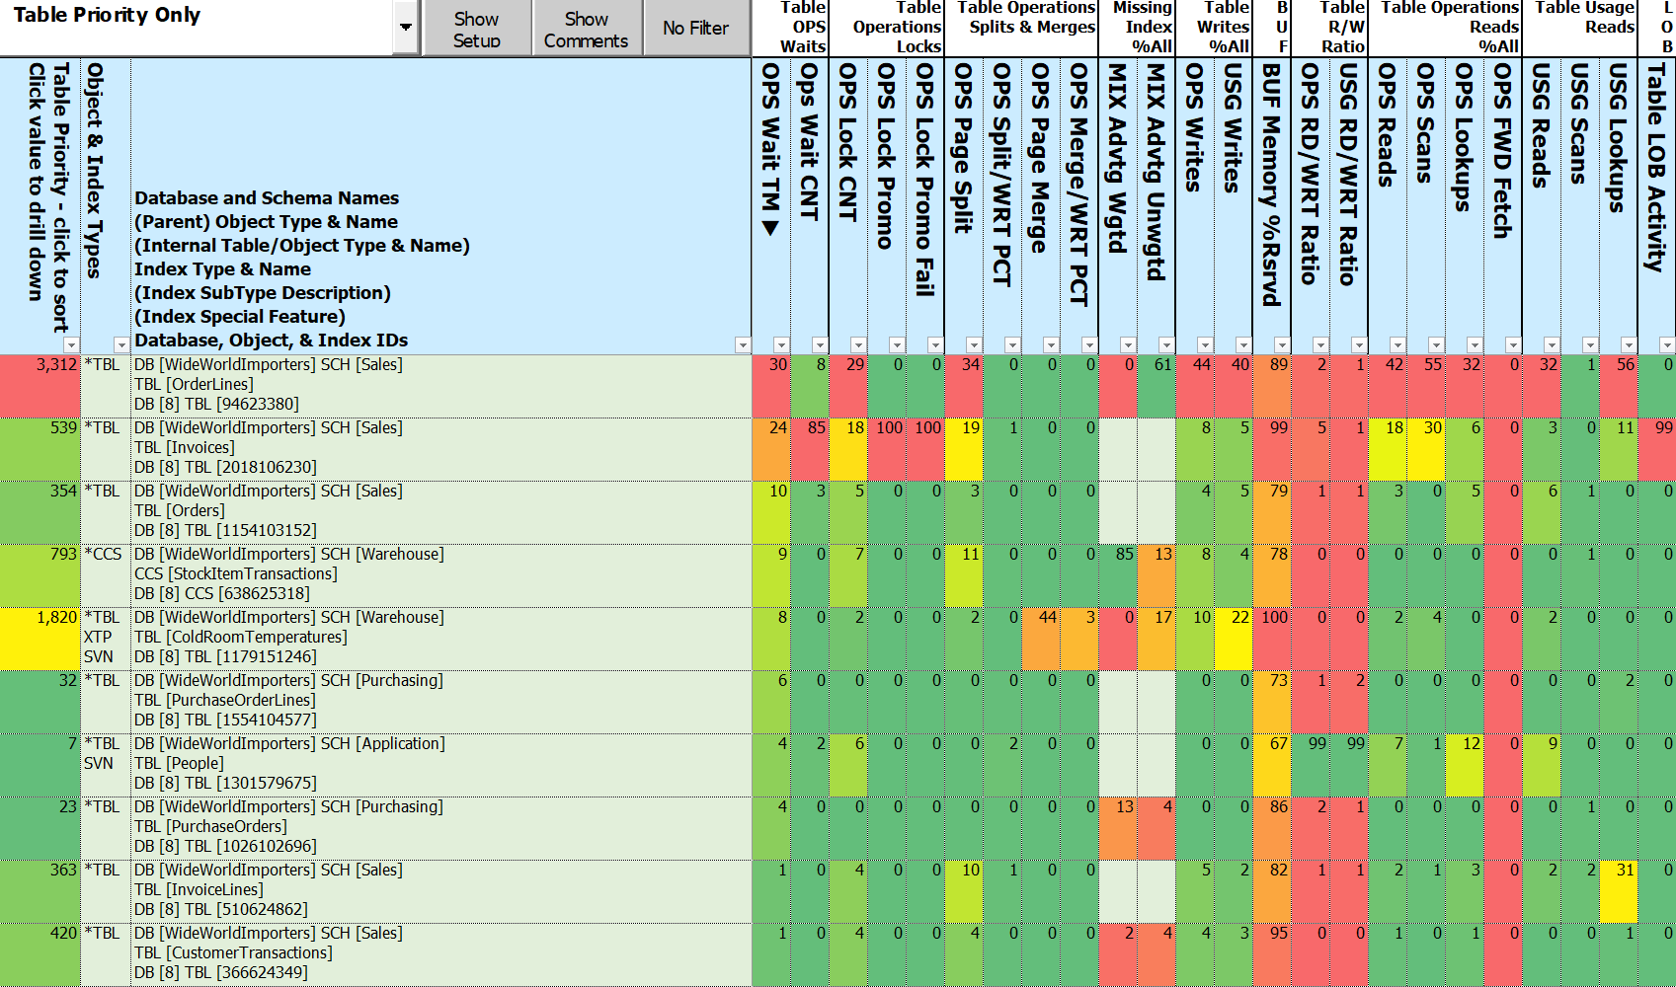
Notes:
So hurt can be spread unevenly across the pain metrics

Slide 28
Client Story - SQLXL_Index Priority Findings
Those priority tables make sense, but …
What do we need to do to make the hurt go away?
Need specific, actionable prescriptive actions
Based on metrics and diagnostics
At the individual index level

Slide 29
Prescription Development - Legacy Approach
If you are lucky ☺ - your monitoring tool may have some answers
If not, lots of community scripts available
Painstakingly execute each script in SSMS
Copy/paste results to spreadsheet(s)
Group your results
Line by line decide what action to take
Make sure to include the “It Depends” factors
Notes:
Others tell you “the patient is bleeding” not “what wound do you close first?”
It depends - index covering a unique constraint

Slide 30
Prescription Development - New Approach
Execute SQLXL_Index
In Excel, display index prescriptions in descending order of hurt

Slide 31
SQLXL_Index Prescriptions
97 detailed prescriptions (as of latest version)
8 Action categories
Retain
Replace
Request
Reject
Remove
Review
Refresh
Refactor
Notes:
*24:00*
What are the 8 things you can do the indexes on a table?

Slide 32
Prescription Categories
Retain
Replace
Request
Reject
Remove
Review
Refresh
Refactor
Existing indexes “As Architected & Designed”
Clustered
Constraints - primary key, unique, foreign key
History tables - Change Data Capture, System Versioned, Ledger
Special indexes - full-text, spatial, XML, columnstore
Required by others - e.g. unique index supporting a full-text index
Indexes with no writes
System internal tables

Slide 33
Prescription Categories
Retain
Replace
Request
Reject
Remove
Review
Refresh
Refactor
Existing Indexes with updatable nonclustered columnstore
Low usage nonclustered rowstore
Low read/write ratio
Missing indexes with low calculated value
Requires SQL 2016+ Enterprise

Slide 34
Prescription Categories
Retain
Replace
Request
Reject
Remove
Review
Refresh
Refactor
New Index
Clustereds on heaps with significant usage
Covers for foreign key constraints
With missing index recommendation
Valuable missing indexes

Slide 35
Prescription Categories
Retain
Replace
Request
Reject
Remove
Review
Refresh
Refactor
Missing index recommendations
That don’t add significant value
Table has / will have nonclustered columnstore
Notes:
Especially once weighted by share of reads

Slide 36
Prescription Categories
Retain
Replace
Request
Reject
Remove
Review
Refresh
Refactor
Existing indexes
Cost more than benefit - less than 4 reads per write
Least used redundant index (same sequence)
Redundant foreign key constraint
Notes:
Same keys different sequence (“overlap”)
Keys “contained” in another bigger index

Slide 37
Prescription Categories
Retain
Replace
Request
Reject
Remove
Review
Refresh
Refactor
“It Depends” for indexes tagged previously - such as:
Non-persisted computed column in definition
High page compression failures
Potential filtered index - wide range of rows per lead index key
Potential temporary based on name

Slide 38
Prescription Categories
Retain
Replace
Request
Reject
Remove
Review
Refresh
Refactor
Existing Indexes
Update statistics
stats modification_counter
Rebuild/organize columnstores with “significant” delta tables

Slide 39
Prescription Categories
Retain
Replace
Request
Reject
Remove
Review
Refresh
Refactor
Retained indexes benefiting from structural changes - examples
Clustered rowstore index not “NUSE”
Narrow, Unique, Static, Ever increasing
Nonclustered rowstore additional key(s) don’t improve selectivity
FILL FACTOR = 100% and hi page splits (> 5% since restart / last DDL)

Slide 40
Client Story - Priority Table Prescription Implementation
Build “prior week” baseline statistics
Apply prescriptions on 21 tables (4%)
Restart server
Capture new statistics
Compare week over week results
Note: “mostly similar” non-peak workloads
Notes:
*30:00*
Fixes applied & server restarted

Slide 41
Client Story - Priority Prescription Improvements
Wait time % of total versus previous week
RESOURCE_SEMAPHORE -71%
THREADPOOL -67%
SOS_SCHEDULER_YIELD -63%
LCK_* & PAGELATCH_* -52%
Index hurts versus previous week
Waits - times & counts -77%
Locks - count, promotion attempts & fails -62%
Scans & lookups (% of table reads) -58%
Read to write ratio - operations, usage -47%
Writes - operations, usage -43%
Page splits, merges, Value push off / pull in -39%
Buffer cache usage - 0%
Notes:
Fixes applied & server restarted

Slide 42
Notes:
Dashboard
Getting to the Action
Click on Table Level priority
Display changes to Index details

Slide 43
Notes:
Sorted by index type, Foreign Key, Missing Indexes, History tables, Internal Tables
Sorting available on column heads
Enable Optimize for Sequential key new in 2019

Slide 45
SQLXL_Index Diagnostics - Sourcing
89 DMVs & DMFs, 940 columns - as of latest version
182 operational metrics - sizes, stats, waits, locks, splits/merges, reads, writes, …
Around 28 seconds to collect & process on problem server
Notes:
*37:00*
How did we come up with prescriptions? We diagnosed the symptoms.

Slide 46
SQLXL_Index - 451 Diagnostics (SQL Version aware)
Items that “stand out” - like
Non-default properties, settings, parameters
High proportion of a hurt or other metric - e.g. waits, locks, splits, merges
“Good to know” - like
“Key” configuration properties - server, instance, database, query store …
Dates: Last read / written / modified / created / statistics updated …
Anti-Patterns - like
Big included columns
Uncovered foreign keys with missing index recommendations
Notes:
*43:00*
Non-Default - Cost threshold for Parallelism
History and Internal Tables given a pass (mostly)
Version Aware - don’t ding SQL 2012 for new feature in SQL 2022
Link to BlitzIndex when same item found (57 items)

Slide 47
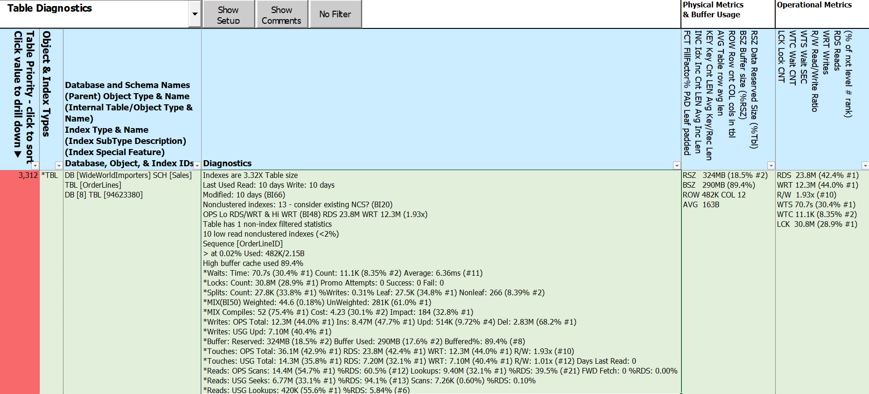
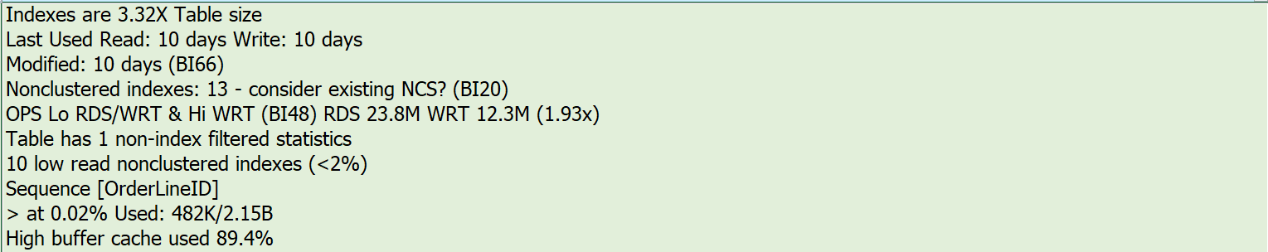
Notes:
Diagnostics split into 2 elements
Things to know
High pain metrics and related values
BlitzIndex Checks (BI##)

Slide 48
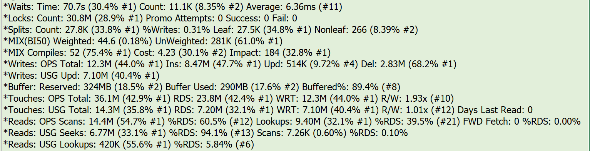
Notes:
Hurts & related metrics
3 elements per hurt - metric type, metric total, percent instance, ranking

Slide 49
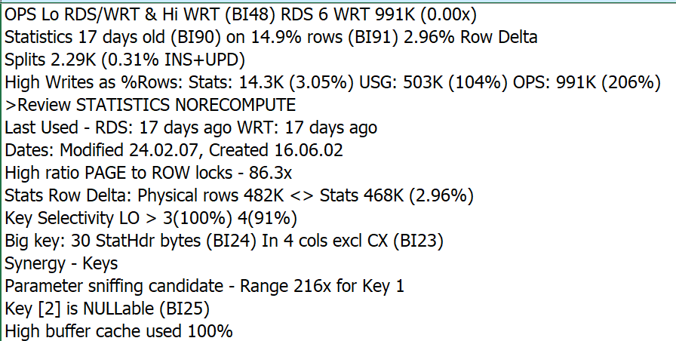
Notes:
Nonclustered Rowstore
To be replaced by existing NCS
BlitzIndex Checks (BI##)

Slide 50
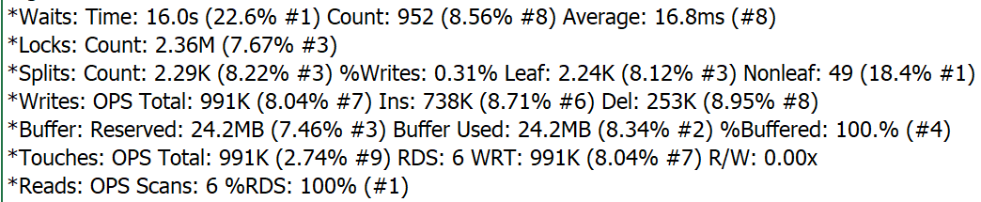
Notes:
Selected priority columns

Slide 51
What about Index Metadata and Other Metrics?
It’s in the spreadsheet
258 columns - details on
Foreign key constraints
Table & column constraints
Statistics names and filter definitions
Extended properties
All usage metrics
All Operational metrics - including in-memory & columnstores
Metadata - index, table, database, instance
Notes:
*47:00*

Slide 52
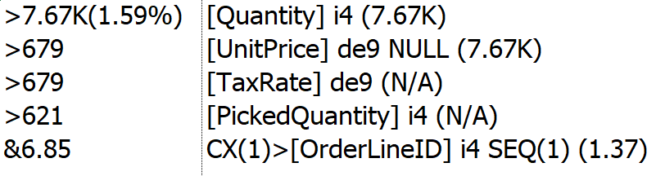
0.00%
- 8.54%

Slide 53
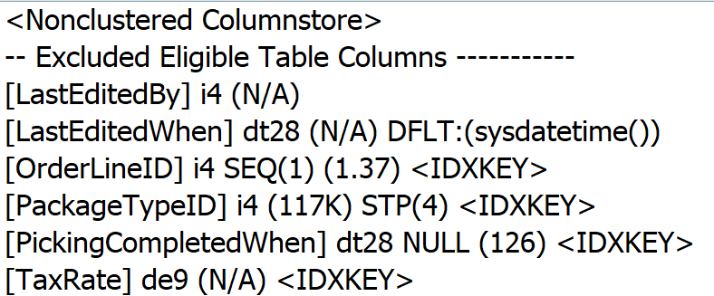

Slide 54
Implementing Index Fixes - A method
Clone structure of target database
Apply changes to clone to produce prescribed “end state”
Create delta scripts using favorite DDL comparison tool: target -> ”end state”
Scripting DDL changes best left to “experts”
Create “rollback code” by comparing in the opposite direction
Apply delta scripts to target database
Re-compare “end state” to target database
Address any discrepancies
Execute rollback code if SHTF
*IMPORTANT* Batch changes by table
More time consuming to script & execute
Expedites (inevitable) rollbacks
Notes:
*50:00*
Depending on where problem occurs at what stage in the process, rollback code may be incomplete
Many DDL comparison tools batch up all related activities - can be difficult to unwind if failure

Slide 55
Client Story - They Lived Happily Ever After
Good News - Even bigger event SQL CPU max 32%, no issues reported
Even better - No performance complaints!
Completed most of the remaining index prescriptions
Replace many least-used indexes with nonclustered columnstores
Drop indexes not adding value
Add high-value missing indexes, heap clusters, & foreign key covers
Address indexes with uniqueness issues, key overlaps, or extraneous keys
Review/change instance & database level properties
Notes:
51:45

Slide 56
Free Stuff!
All T-SQL code, Excel workbook, & this presentation on Github
Up to 8 hours free consulting!
For volunteers to help improve SQLXL_Index:
Identifying edge cases
Bug hunts & error handling
Azure (all flavors)
Special indexes - XML, full-text, spatial, hash
Tables - history (CDC, SVN, LDG), graph, internal
SQL table valued functions (TVF)
Additional procedure execution parameters
Excel workbook labeling, cell comments, and navigation
Documentation (what’s that?)
Notes:
52:30

Slide 57
Summary
Tuning indexes may be the easiest way to start improving performance
SQL Server lets us know where to concentrate our efforts
Prioritize your index tuning - biggest bang for smallest buck
Actionable prescriptions make tuning decisions simpler
Diagnostic data helps to show factors behind the priorities and prescriptions
Incremental changes can minimize unforeseen outcomes
Please help improve SQLX_Index!
Notes:
53:30

Slide 58
There are no stupid
Questions?
Notes:
*54:00*

Slide 59
Session Evaluations
Notes:
*59:00*

Slide 60
Thanks for coming!
Bill Sanscrainte
linkedin.com/in/billsanscrainte
Bill@Sanscrainte.com
Presentation, spreadsheet, & T-SQL @ https://github.com/SQLXL/SQLXL
Also See:
Brent Ozar’s sp_BlitzIndex
Glenn Berry’s 89 (2022) Diagnostic Information Queries
Aaron Bertrand’s 40 table property queries
Expert Performance Indexing in Azure SQL and SQL Server 2022 (Great Book!)
Link to sp_Blitz_Index Checks:
https://github.com/BrentOzarULTD/SQL-Server-First-Responder-Kit/blob/dev/Documentation/sp_BlitzIndex_Checks_by_Priority.md
Notes:
59:30

