Slide 1
Student information system
Guide : Shradhdha Doshi
Agravat Kashyap
Kaneria DIvyesh

Slide 2
Introduction
As a student, you can use your Student Information System to access your subject materials online like ppts, docx file, pdf file, and any other documents, save your personal documents, access library services, complete administration requirements, find out about other services offered which are not directly related to your studies and much, much more.
In Student Information System student can easily download different data as per it requirement. Faculty will upload the different type of data. And student are download its . other different module are there into Student Information System like Video links , software support , drop box, so that all features are student will use.

Slide 3
Main three modules
1.Administrator
2.Expart Faculty
3.Student

Slide 4
Purpose
1.Goal :
Replace the physical data transfer system.
Provide better interface between students and faculties. Provide all subjects wise materials at one place.
Easily share materials.
Easily get the information about the event and academic calendar

Slide 5
Objectives
The main objective of student information system web site is provide the better facility
to the student for their study and other education related activities.
· This application runs on any system so every module can take an
advantage of this.
· Secure Registration and profile management facilities for student and
faculty.
All the data or information as per the student requirements are provided within very short period of time.

Slide 6
Scope
Student can easily access the web site , student who has the member of this web site they can check the new updates ,content and any new activites perform in the

Slide 7
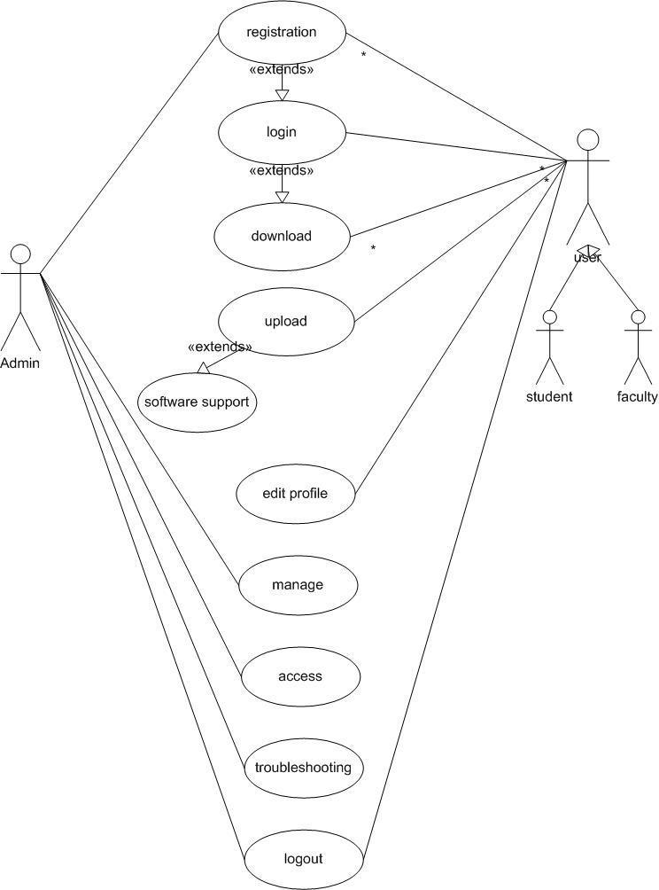
Use case diagram

Slide 8
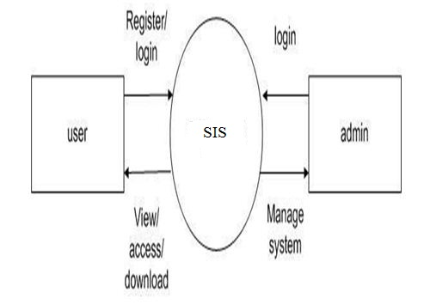
Context diagram

Slide 9
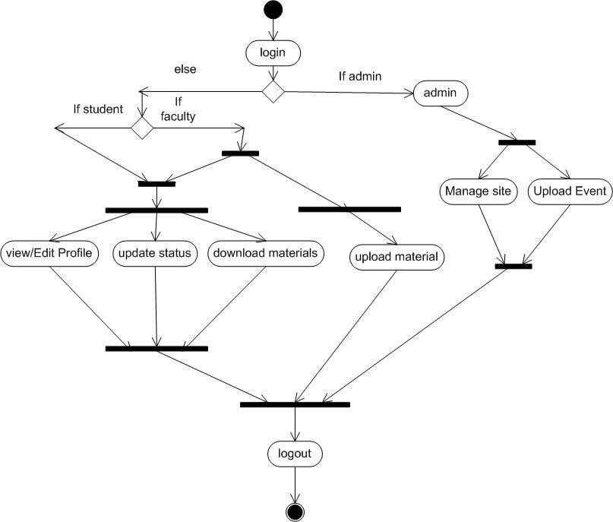
Activity diagram

Slide 10
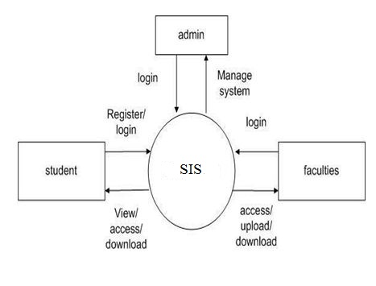
DFD (level 0)

Slide 11
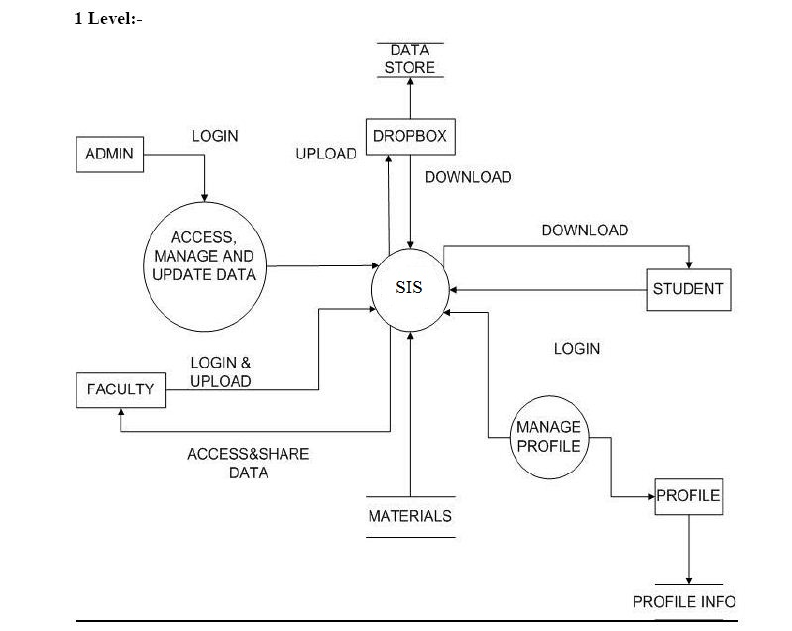
DFD (level 1)

Slide 12
Thank You
Any queries?

