Slide 1
BS 7925-2: The Software Component Testing Standard
Stuart C . Reid Cranfield University Stuart.Reid@rmcs.cranfieldm.uk
Reid, S. C. (2000). BS 7925-2: The Software Component Testing Standard. Quality Software, 2000. Proceedings. First Asia-Pacific Conference on (Vol.50, pp.139-148). IEEE.

Slide 2
What is BS 7925-2 ?
BS 7925-2 was conceived in early 1989 with the aim of being the first of a number of software testing standards developed by members of the British Computer Society Specialist Interest Group in Software Testing (SIGIST)

Slide 3
The content of BS 7925-2
BS 7925-2 comprises two parts:
the normative part
The normative part comprises six clauses
the informative annexes
provide support to the normative part by providing examples and advice

Slide 4
The normative part
1. Scope 2. Normative References 3. Definitions 4. Process 5. Test Case Design Techniques 6. Test Measurement Techniques

Slide 5
1.Scope
stating that it specifies a process for dynamic component testing and techniques for the design and measurement of that testing
For example, it excludes static testing and testing in other phases of the life cycle, such as integration, system and acceptance testing
It also explains that the functional (black box) techniques apply to components written in any language, whereas the structural (white box) techniques are restricted to the testing of components written in procedural languages

Slide 6
2-3.Normative references and definitions
The ‘normative references’ clause lists other standards referenced by BS 7925-2 and includes only BS 7925- 1 , the Vocabulary of testing terms
Because BS 7925-2 is intended to be the first of a number of software testing standards. All definitions used in BS 7925-2 are presented in BS 7925-1, the Vocabulary of testing terms

Slide 7
4. Process
It mandates that at the project level there must be a project component test strategy and a project component test plan.
It also mandates that each component to be tested must have a specification from which it is possible to derive the expected outcome for a given set of inputs

Slide 8
4. Process
The project component test strategy requires the specification of:
the test case design techniques, which must be selected from clause 5 (see part 5)
the criterion for test completion (including rationale for its selection), which must be measured using techniques chosen from clause 6 (see part 6)
the degree of independcnce of the testers
the approach to component testing (e.g. isolation, top-down, bottom-up, etc.);
the test environment, including both hardware and software requirements;
the test process to be used for software component testing - the generic component test process from BS 7925-2 is illustrated in Figure 2

Slide 9
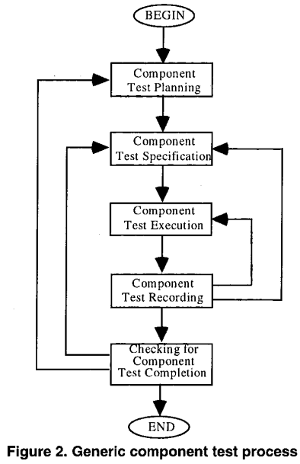
4. Process
The project component test plan requires the specification of dependencies between component tests, and their sequence.
The sequence of activities defined by the generic test process must he followed for each test case.
More specific requirements for each of the individual activities of the process are described in the following subsections.

Slide 10
4. Process
Specify test strategy and test plan, and listing any exceptions

Slide 11
4. Process
1. Specify test inputs for each test, selected using a test case design technique from clause 5 (see 5).
2. Specify the expected outcomes for each test – in advance.
3. Document the point of each test.
4. All test cases shall be repeatable.

Slide 12
4. Process
Each test case in the test specification shall be run.

Slide 13
4. Process
1. Check and record the results of each test.
2. Analyse the reasons for failure to subsequently allow the removal of the fault.
3. Record the test coverage achieved (in terms of the test completion criterion).
4. Record the test configuration.

Slide 14
4. Process
Check whether the test completion criterion is satisfied

Slide 15
5. Test case design techniques
In the project component test strategy, the choice of test case design technique(s) to be used to generate the test inputs in the Component Test Specification activity must be documented
It is mandated that this choice must be made from the test case design techniques defined in clause 5, which are listed below:
Equivalence Partitioning
Boundary Value Analysis
State Transition Testing
Cause-Effect Graphing
Syntax Testing
Statement Testing
Branch/Decision Testing
Data Flow Testing
Branch Condition Testing
Branch Condition Combination Testing
Modified Condition Decision Testing
LCSAJ (Linear Code Sequence And Jump) Testing
Random Testing
Other Testing Techniques

Slide 16
6. Test measurement techniques
Test measurement techniques are handled in a similar manner to the test case design techniques. The project component test strategy must include the choice of test measurement technique(s) to be used as a test completion criterion in the Component Test Recording activity
This choice must be made from the test measurement techniques defined in clause 6, which are listed below:
Equivalence Partition Coverage
Boundary Value Analysis Coverage
State Transition Coverage
Cause-Effect Coverage
Statement Coverage
Branch/Decision Coverage
Data Flow Coverage
Branch Condition Coverage
Branch Condition Combination Coverage
Modified Condition Decision Coverage
LCSAJ (Linear Code Sequence And Jump) Coverage
Other Test Measurement Techniques

Slide 17
6. Test measurement techniques
There is not a direct correspondence between the test case design techniques and test measurement techniques. Therefore, it is not necessary tochoose the same test measurement technique and test case design technique
In fact, the practice of using functional (black box) test case design techniaues and structural (white box) test measurement techniques is recommended.
Functional techniques are effective at detecting errors of omission, while structural techniques can only detect errors of commission.
BS 7925-2 recommends that the test coverage levels chosen as test completion criteria should, wherever possible, be 100%. Strict definitions of test coverage levels have sometimes made this level of coverage impracticable, however the definitions in clause 6 of BS 7925-2 have been defined to allow infeasible coverage items to be discounted from the calculations thus making 100%coverage an achievable goal.

Slide 18
The End …

