Slide 1







CURRENT TECHNOLOGY USAGE AND TRENDS
RAMISETTY SAISRINIVAS
AUGUST 18th 2024

Slide 2



OUTLINE
Executive Summary
Introduction
Methodology
Results
Visualization – Charts
Dashboard
Discussion
Findings & Implications
Conclusion
Appendix

Slide 3

EXECUTIVE SUMMARY
Competitive Nature of IT Industry: The IT industry is dynamic and competitive, necessitating continuous updates to programming skills and database knowledge.
Project Objective: This project aims to analyze and identify key trends within the IT industry.
Key Areas of Analysis:
• Current Technology Usage: Assessing the current state of programming languages, databases, and platforms used.
• Future Technology Trends: Predicting upcoming trends in programming languages, databases, and platforms.
• Demographics in IT Industry: Understanding the distribution of gender, age, and education levels in IT.
The goals of the this presentation is (1) Identifying top Programming Languages in the industry. (2) Top Database Skills in high demand. (3) Popular IDEs among professionals.

Slide 4

INTRODUCTION
Emerging Trends and Future Skills:
• Top Programming Languages in Demand
• Top Database Skills in Demand
• Popular IDEs
Data Collecting Sources:
• Job Postings
• Training Portals
• Surveys
Role of Data Analyst:
• Context: Working in a global IT and business
consulting firm known for expertise in IT
solutions.
• Objective: Regularly analyze data to identify
future skill requirements and keep pace with
changing technologies

Slide 5

METHODOLOGY
Data Sources:
• Stack Overflow
• Survey Data Technologies:
• Current Trends: Based on Language, Database, Platform & Web Frame used or worked.
• Future Trends: Interest in learning new Language, Database, Platform & Web Frame.
• Demographics Data:
• Gender (Man and Woman), Age, Formal Education Level & Countries
• Data Filtering:
• Cleaned empty or Null entries
• Filtered to include only Man and Woman
• Illustration and Analysis Tools:
• Python Libraries: Numpy, Matplotlib, Pandas & Seaborn
• IBM Cognos Analytics Dashboard
• Jupyter Notebook: Data Cleaning, Data Science Analysis

Slide 6
RESULTS
Comparison Results:
• Programming Language Trends
• Compare current and future trends in programming languages.
• Database Trends
• Analyze current versus future database usage trends.
• IDE Trends
• Evaluate the changes in popularity of IDEs over

Slide 7
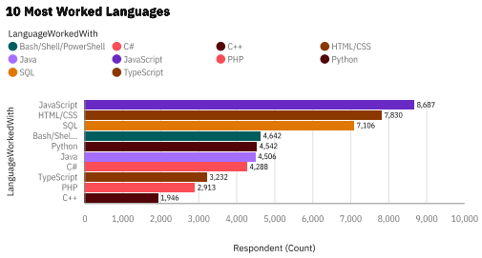
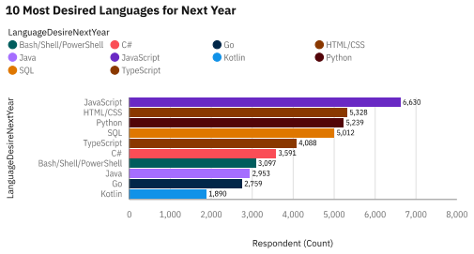
PROGRAMMING LANGUAGE TRENDS
Current Year
Next Year
< Bar chart of top 10 programming languages for the next year goes here.>

Slide 8
PROGRAMMING LANGUAGE TRENDS - FINDINGS & IMPLICATIONS
Findings
JavaScript is the top most demanded for current and future programming language.
Significantly Increasing desire for Python
The trends of programming language has shifted
Top 5 language:
JavaScript, Python, HTML, SQL, TypeScript
Implications
JavaScript is still most popular and widely used in programming language in IT industry.
The Desire Skill for programming language has certainly Shifted
Python has become a new desired and required skills in IT industry.

Slide 9
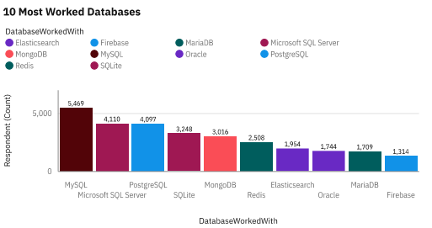
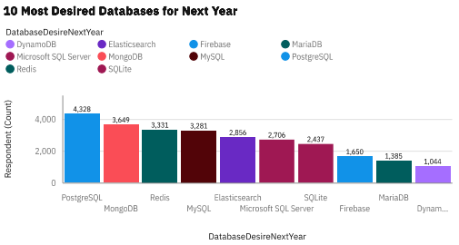
DATABASE TRENDS
Current Year
Next Year

Slide 10
DATABASE TRENDS - FINDINGS & IMPLICATIONS
Findings
PostgreSQL, MongoDB, Redis have become the most desired Database.
MongoDB, Redis, Elasticsearch are becoming increasingly popular for desired Database roughly 10,000 increased in respondents.
Oracle Database has become less popular and less desired
Implications
PostgreSQL, MongoDB, Redis, MySQL, Elasticsearch are the desired and most used Database.
Mongo Db, Redis, Elasticsearch have new and better functionalities or services.
• Oracle Database is to avoid

Slide 11

DASHBOARD
https://github.com/SR000777/Data-Analytics-and-Visualization-Capstone-Project-IBM.git

Slide 12
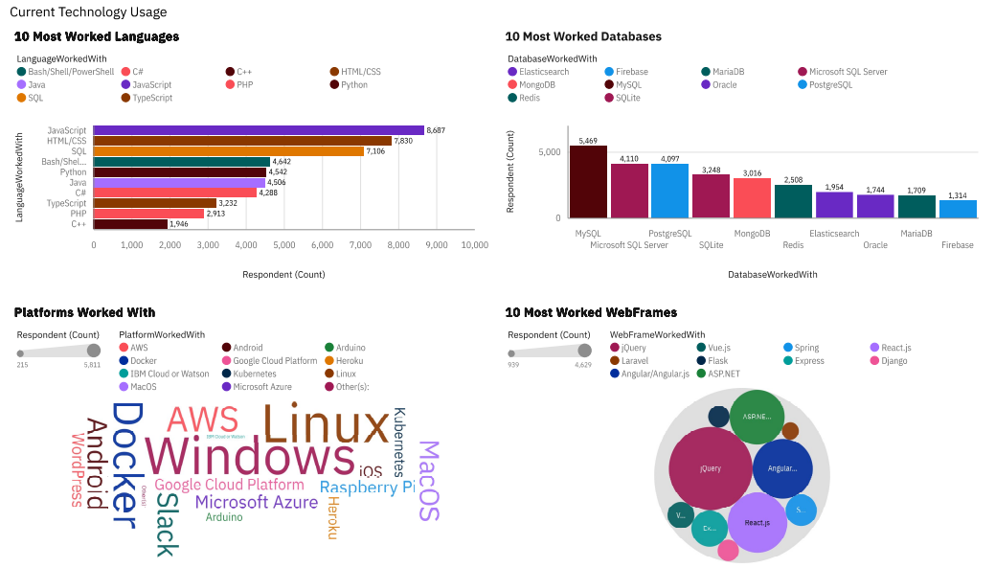
DASHBOARD TAB 1

Slide 13
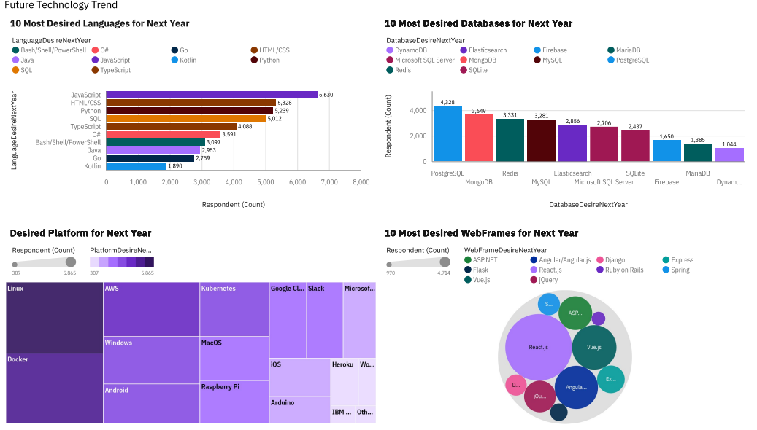
DASHBOARD TAB 2

Slide 14
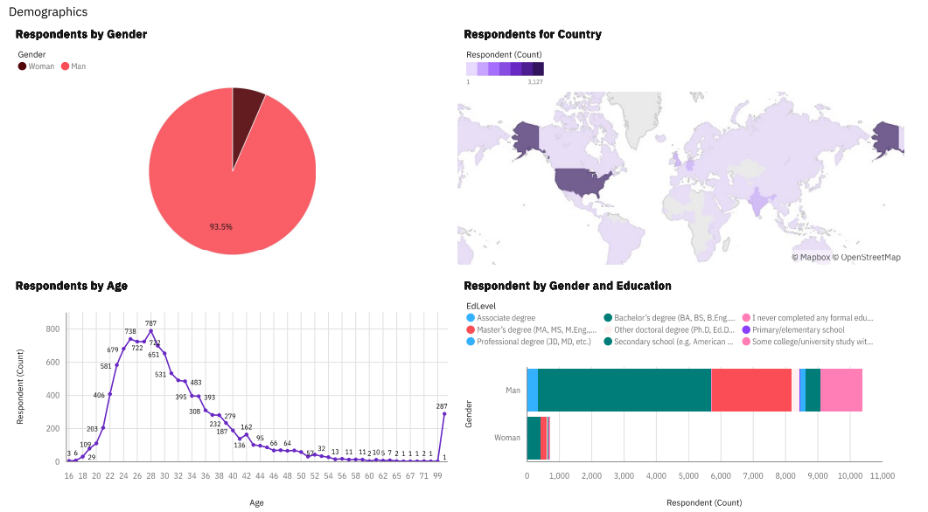
DASHBOARD TAB 3

Slide 15
DISCUSSION
MUST-HAVE SKILLS AND DESIRABLE FUTURE TRENDS:
1. Languages are gaining significant popularity
• JavaScript
• Python
• HTML/CSS
• SQL
• TypeScrip
2. Databases which are becoming more popular options
• PostgreSQL
• MongoDB
• Redis
• MySQL
• Elasticsearch
3. Popular IDEs:
• React.js
• Angular/Angular.js
• Vue.js
• jQuery
• ASP.NET

Slide 16
OVERALL FINDINGS & IMPLICATIONS
Findings
Top Desired Programming Languages:
• JavaScript, Python, HTML/CSS, SQL,
TypeScript
Top Desired Databases:
• PostgreSQL, MongoDB, Redis, MySQL, Elasticsearch
Popular IDEs:
• React.js, Angular/Angular.js, Vue.js, jQuery, ASP.NET
The trends shows a drastic changes in Desire for next year programming languages, Database and IDEs
Implications
Future Skills Requirements implements:
• Programming Language:
• JavaScripts, Python, HTML/CSS,SQL, TypeScript
Database:
• PostgreSQL, MongoDB,Redis, MySQL, Elasticsearch
IDEs:
• React.js, Angular/Angular.js,Vue.js , jquery & ASP.net
There are a few Databases that are also increasingly desire such like DynamoBd
The numbers of Skills requirements to be able to be competitive in the IT industry has been changing in the vast development and redefine of current technology

Slide 17

CONCLUSION
• Unbiased Data Analysis:
• Open source data from Stack Overflow helps avoid data bias.
• Shift in Technology Trends:
• Changes in current technology usage highlight the need for updated skills.
• Updated Skill Requirements:
• Programming Languages:
• JavaScript, Python, HTML/CSS, SQL, TypeScript
• Databases:
• PostgreSQL, MongoDB, Redis, MySQL, Elasticsearch
• IDEs:
• React.js, Angular/Angular.js, Vue.js, jQuery, ASP.NET
• Key Takeaway:
• To remain competitive, IT professionals must adapt to evolving trends in programming languages, databases, and IDEs.

