Slide 1
Project FORESIGHT
Demand & Inventory Intelligence for NorthBay Living
Executive readout · Data Science engagement
Forecast · stock-risk early warning · planning dashboard · scoring service

Slide 2
The bottom line
What FORESIGHT found in NorthBay's own data
Rs 372,519
capital locked in overstock
88 SKUs to clear
Rs 17,931
sales at risk from stockouts
16 SKUs to reorder now
37%
more accurate than the current guess
forecast beats seasonal-naive baseline
Recommendation: clear the top overstocked SKUs to free working capital, and raise replenishment on the flagged best-sellers before the peak. Both lists are prioritised by rupees at stake in the dashboard.

Slide 3
What we built
The four asks in the brief — all delivered
• A weekly, SKU-level demand forecast that beats a naive baseline honestly.
• A stockout / overstock early-warning that says what to reorder and what to clear.
• A rupee figure on every risk, so Finance can prioritise by cash impact.
• A dashboard the ops team can use unaided, plus a deployed scoring service.
All of it re-runs end-to-end from the raw extract with one command — the client can refresh it next month.

Slide 4
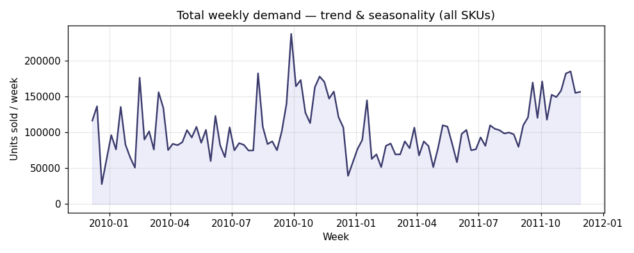
The data, cleaned and trusted
11,187,647 units across 4,730 SKUs, Dec 2009 – Dec 2011.
Cleaning removed, with a logged reason for each:
• 19,494 cancellations / returns
• 6,166 non-positive qty or price rows
• 33,666 duplicate lines
• 4,676 non-product codes (postage, fees)
94% of rows retained — a clean, auditable base.
Note: inventory positions are modelled (the raw feed is sales-only); on a live engagement they are replaced by NorthBay's stock table.

Slide 5
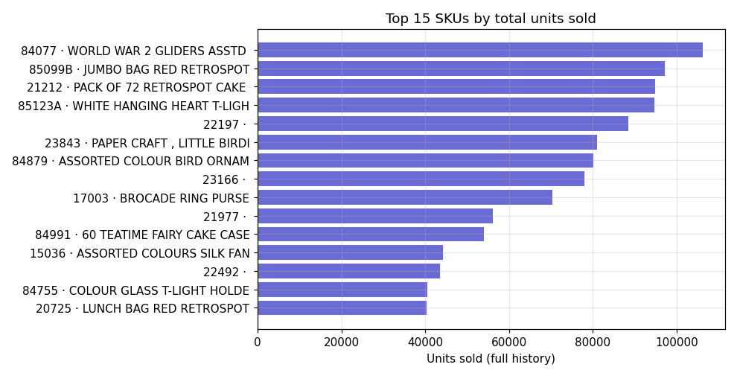
What the demand data says
1. The top 20% of SKUs drive 78% of all units — focus reorder effort here.
2. 23% of the year's volume lands in Nov–Dec — reorder must lead the peak by the lead time.
3. ~12 SKUs sold near-zero in the last 8 weeks — cash sitting in dead stock, ready to clear.

Slide 6
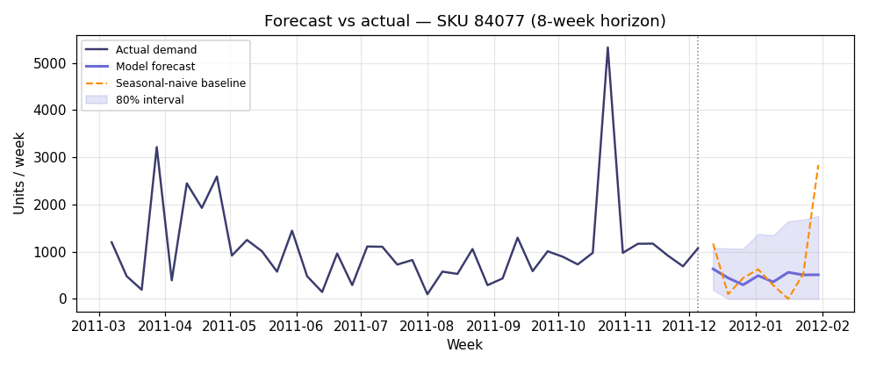
The forecast — and why you can trust it
We compare every model against a seasonal-naive baseline on a fair, rolling backtest — the honest test for a forecast.
Model error (WAPE): 0.56
Baseline error (WAPE): 0.89
→ 37% more accurate than the baseline.
Lower is better. WAPE = total error ÷ total demand. Validated with rolling-origin backtesting; no future data ever enters a feature.

Slide 7
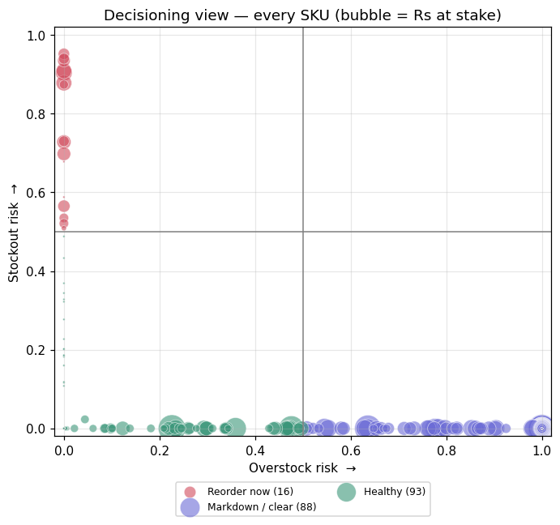
From forecast to decision
Every SKU placed on a stockout vs overstock grid
Reorder now — high stockout risk: replenish before it runs out.
Markdown / clear — high overstock: discount to free capital.
Healthy — leave as is.
Watch / volatile — erratic; review by hand.
Every SKU carries a recommended action and the rupees at stake, so the team can triage hundreds at a glance instead of reading a table.

Slide 8
Do this first — prioritised by rupees
Reorder now (top 5)
• 40016 · CHINESE DRAGON PAPER LANTERNS — Rs 3,539
• 23203 · JUMBO BAG VINTAGE DOILY — Rs 2,840
• 22149 · FELTCRAFT 6 FLOWER FRIENDS — Rs 2,742
• 85152 · HAND OVER THE CHOCOLATE SIGN — Rs 1,913
• 22866 · HAND WARMER SCOTTY DOG DESIGN — Rs 1,575
Markdown / clear (top 5)
• 85099B · JUMBO BAG RED RETROSPOT — Rs 29,036
• 21137 · BLACK RECORD COVER FRAME — Rs 24,143
• 22910 · PAPER CHAIN KIT VINTAGE CHRIST — Rs 23,493
• 22423 · REGENCY CAKESTAND 3 TIER — Rs 23,357
• 21915 · RED HARMONICA IN BOX — Rs 13,189

Slide 9
Accuracy & limitations — the honest version
• The model beats the baseline by 37% WAPE — real, but demand is spiky, so treat forecasts as a guided range, not a promise.
• Forecasts come with an 80% interval; the further out, the wider it gets.
• Inventory positions in this demo are modelled — plug in NorthBay's real stock table to make the rupee figures exact.
• New / long-tail SKUs have little history and are flagged low-confidence, not silently forecast.
• Everything is reproducible and seeded, so the numbers can be re-created and audited.

Slide 10
How NorthBay uses it
• Planning dashboard — filter by category/SKU, see forecast vs actual and the prioritised reorder / markdown list. Built for the ops team, no data scientist required.
• Scoring service (API) — ask for any SKU and get its forecast + risk back; supports single or batch lookups.
• Monthly refresh — one command re-runs the whole pipeline on the latest extract.
Deliver it like a consultant. Defend it like a scientist.

