Slide 1
Visualize and analyze energy data
Sergio Robledo
8/9/2018

Slide 2
Data summary
Data Acquired from December 2006 – November 2010
Energy Consumption (Watt-hour)
Sub Meter 1: Kitchen
Dishwasher
Oven
Microwave
Sub Meter 2: Laundry Room
Washing Machine
Tumble Drier
Refrigerator
Light
Sub Meter 3: Water-Heater & Air-Conditioner

Slide 3
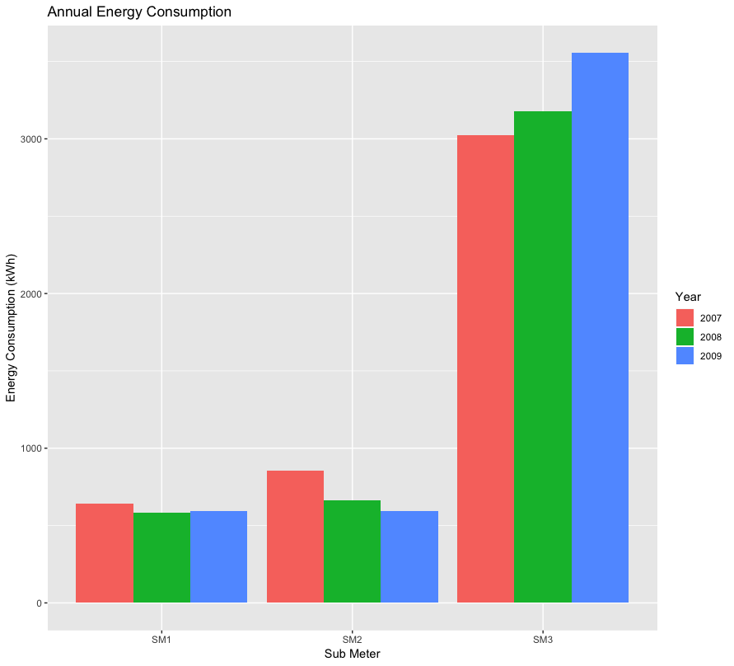
Annual energy consumption
Sub Meter 3
Highest Energy Consumption
Increasing trend per year
Sub Meter 2
Decreasing Yearly Trend
Sub Meter 1
No annual trending behavior

Slide 4
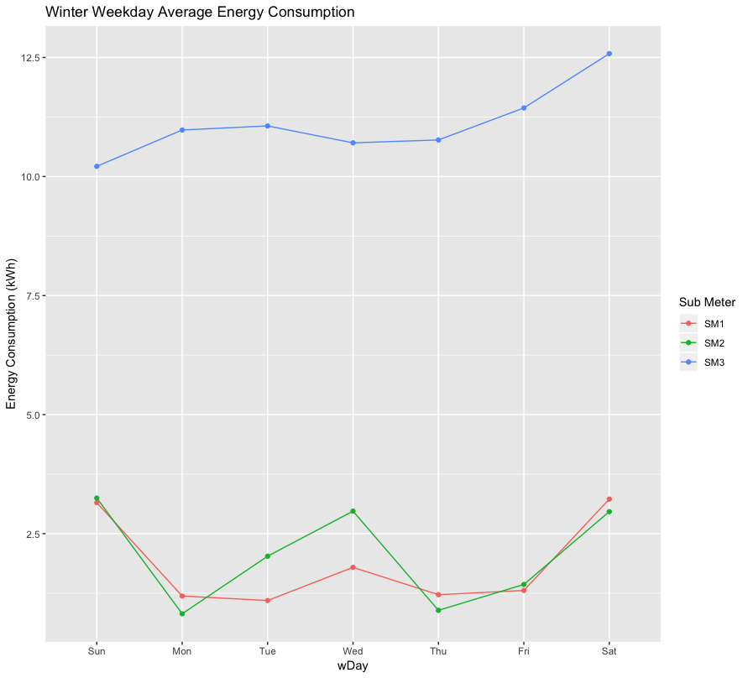
Winter Daily Average Energy Consumption
Sub Meter 1 (Kitchen)
Peaked Weekends
Saturday & Sunday
Sub Meter 2 (Laundry Room)
Similar Behavior as SM1
Peaked on Weekends
Saturday & Sunday
Peaked on Wednesday too
Sub Meter 3 (Heater & A/C)
Increasing trend from Sun - Sat
Peaked Saturday
Minimum Consumption on Sundays

Slide 5
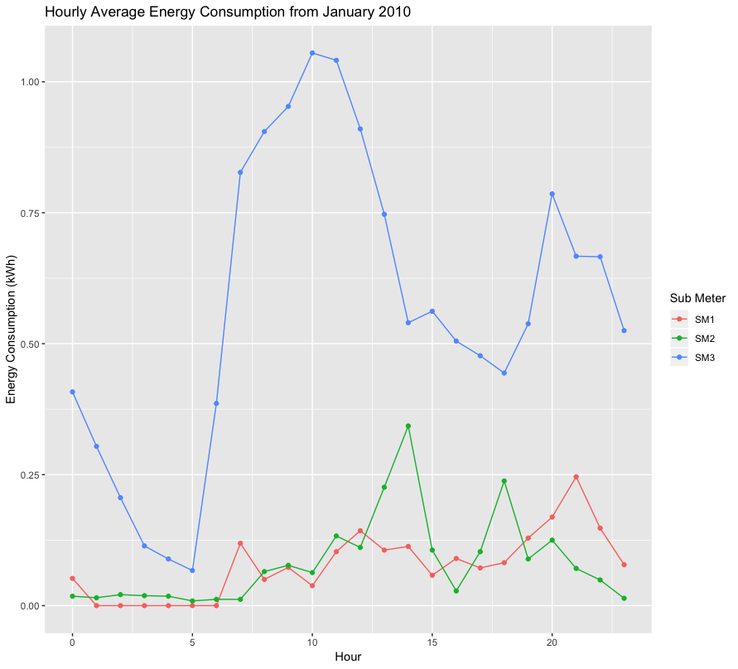
Hourly Energy consumption average for January 2010
Sub Meter 1 (Kitchen)
Peaked at 9 PM
Averaged Zero Consumption
1am to 6 am
Sub Meter 2 (Laundry Room)
Peaks at 2 pm & 6 pm
Never Averaged Zero Consumption
Probable Reason: Refrigerator
Sub Meter 3 (Heater & A/C)
Rapid Energy Increase from 5 am – 10 am
Rapid Energy Decreases from…
11 am – 2 pm
10 pm – 3 am

Slide 6
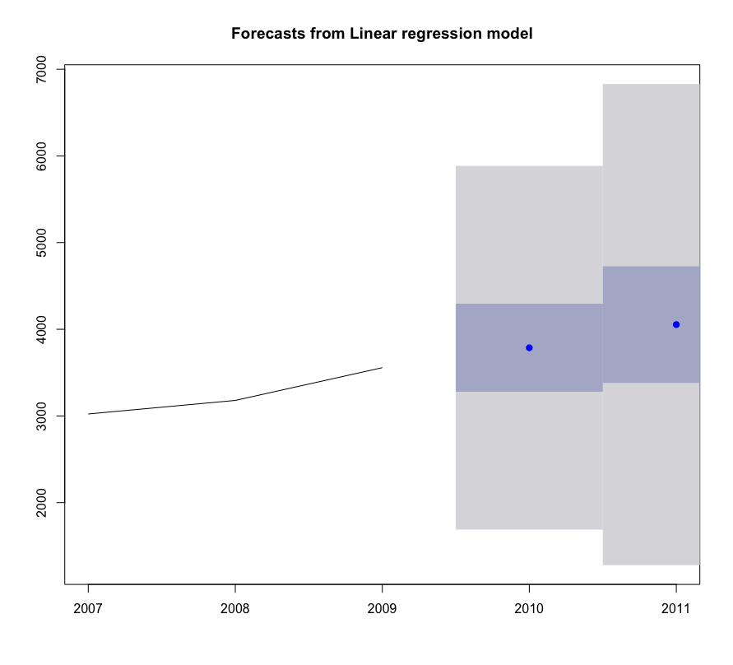
Annual Energy Consumption Forecasts for Sub Meter 3: years 2010 & 2011
Increasing Trend
Confidence Level: 85%
Predicted Energy Consumption
2010 = 3,786.881 kWh
2011 = 4,053.869 kWh
Shaded Blue-Grey Area
80% Prediction Interval
Shaded Grey Area
95% Prediction Interval

Slide 7
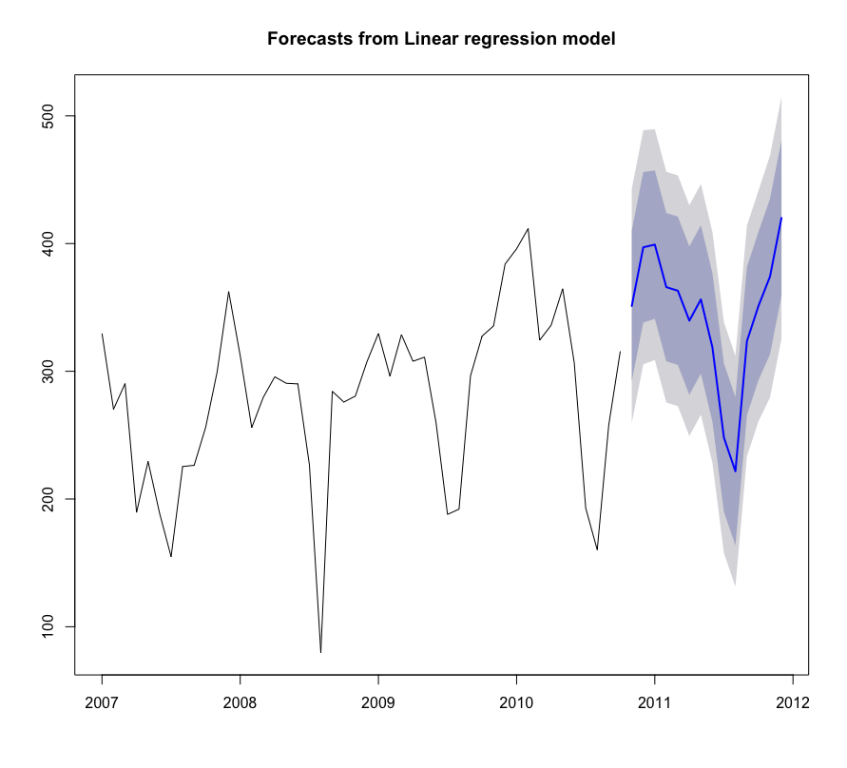
Monthly Total Energy Consumption Forecast
Sub Meter 3 (kWh)
Heater & Air Conditioner
Data Available:
Jan 2007 – Oct 2010
Dates Forecasted:
Nov 2010 - Dec 2011
Energy Consumption Trends
Low Consumption in Summer
High Consumption in Winter

Slide 8
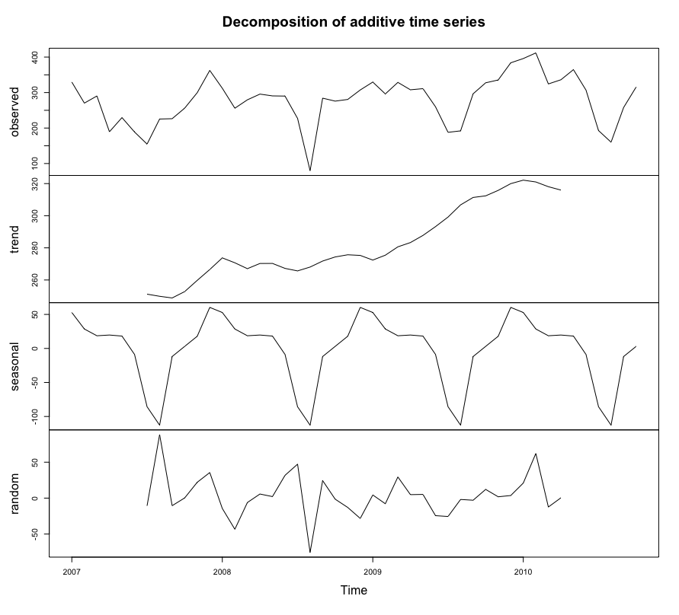
Monthly ENERGY CONSUMPTION decomposition
Observed Values (kWh)
Sub Meter 3
Jan 2007 – Oct 2010
Observed Trends
Overall trend:
Increasing over time
Seasonal trend:
Peaks on December
0.06 kWh
Lowest on August

Slide 9
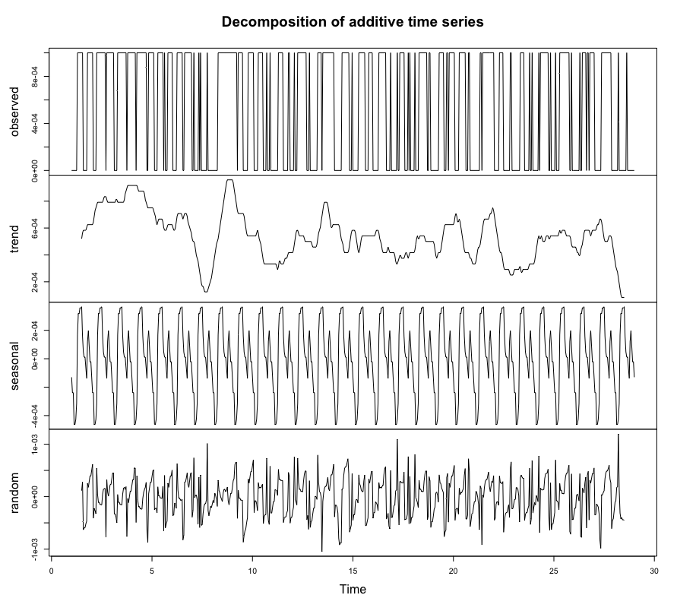
Average HOURLY ENERGY CONSUMPTION DECOMPOSITION
Observed Values (kWh)
Sub Meter 3: Heater & AC
February 2010
Observed Trends
Overall Trend:
None
Daily Trend:
Peak Consumption @ Noon
Lowest Consumption @ 5am

Slide 10
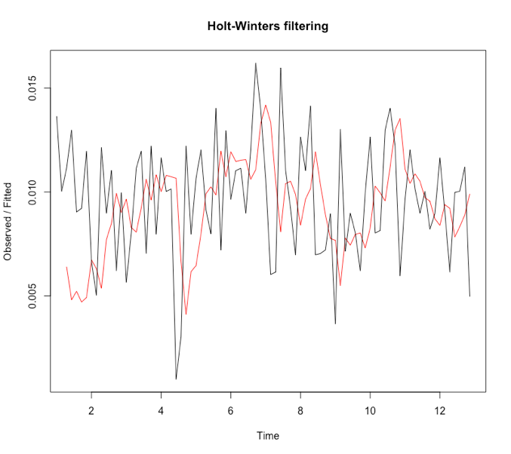
Holt Winters Filtering
Data Observed
Sub Meter 3 (kWh)
2010 Fall
September – November
Black Line: Observed Values
Red Line: Holt Winters Forecast
Error = Difference Between Both Lines

Slide 11
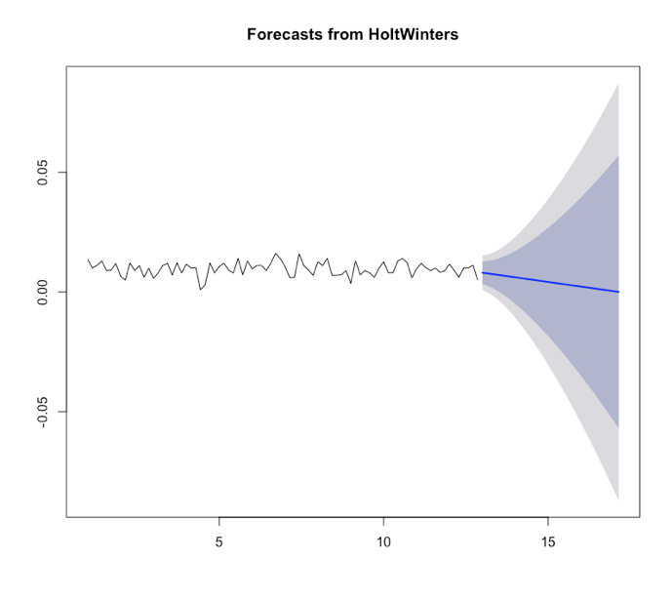
Holt Winters Forecast
Forecasted December 2010
Sub Meter 3 (kWh)
Using 2010 Fall Data
Downward trend
Blue Shaded Area: 80% Predictions
Grey Shaded Area: 95% Predictions
Is it an accurate forecast?
Plot errors from Filtering

Slide 12
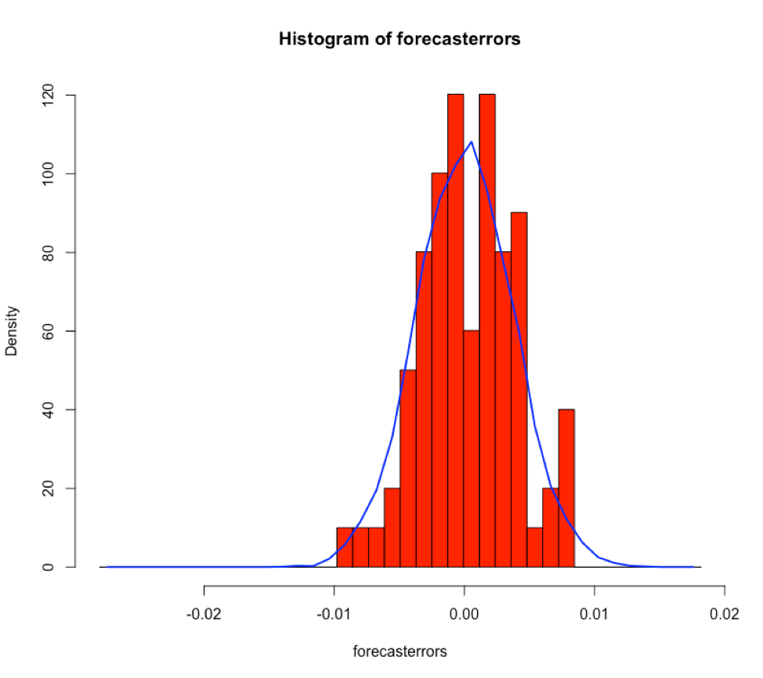
Histogram Plot of Forecast Errors
Histogram of Holt Winter Forecast Errors
Sub Meter 3 (kWh)
December 2010 Forecast Errors
Blue Line shows errors’ behavior
Error Average = About 0
Accurate Forecast
Previous Slide Predictions are Valid

Slide 13
Correlations & Relationships
Highest Energy Consumed on Saturdays
Sub Meter 3 Consumes Most Energy (kWh)
Water-Heater & Air Conditioner
Increasing yearly
Summer has Lowest Consumption of Energy
Winter has Highest Consumption of Energy
Maximum and Minimum Daily Energy Consumption
Maximum Energy used Midday
Minimum Energy usage Midnight-Dawn

Slide 14
Summary Statement & End Goal
Project Goal
Discover energy consumption insights based on historical data
Predict future energy consumption
Project End Goal Reached
Correlations and relationships were found through visualizations of time data
We were able to predict future energy consumption data based on given data
Summary Statement
Energy Consumption is strongly correlated with time of day, month of the year, and ultimately annual trends were discovered.
Energy usage for laundry room decreased year to year
Energy usage for the water-heater and air conditioner increased with each year

Slide 15
Business Recommendations
Charge a lower rate for electricity on Mondays, Tuesdays and Thursdays
Lowest energy consumed on these days
Increase electricity consumption charge rate on weekends
Most electricity used during Saturdays
Invest in wall thermal insulation for the building
Less energy usage during the cold months
Winter had highest energy consumption of all seasons
Offer tenants an estimate of next month’s energy bill using predictive models
Gives them perspective to see how much they could save if they consciously put in effort to conserve energy and follow home developer’s tips
Consider alternative and renewable sources of electricity
Long-term money savings & possible earnings for providing the building’s generated source of energy to tenants

Slide 16
Lessons LEarned
Learned how to evaluate forecasting model’s accuracy
ACF Analysis
Box Test
Plotting Residual Errors
Decomposition
Ability to find all kinds of trends in the data
Seasonal
Overall Trend
Time Series Filtering
dp1yr functions
Mutate
Filter
Group_by
Summarize

