Slide 1
Sandeep Raman R
Final Project
3/21/2024 Annual Review

Slide 2
Fake Text Detection using KerasNLP
3/21/2024 Annual Review

Slide 3


AGENDA
3/21/2024 Annual Review

Slide 4

PROBLEM STATEMENT
In today's digital age, the proliferation of fake news and misleading information has become a significant concern.
Detecting fake or deceptive text is crucial for maintaining trust and reliability in information sources.
This project aims to develop a deep learning model using KerasNLP to detect fake text.
The term "fake news" refers to fabricated or misleading information presented as genuine news.
It can range from entirely fictional stories to partially true but distorted content aimed at deceiving readers.
Fake news can be created and spread through various mediums, including social media, websites, blogs, and messaging platforms.
The proliferation of fake news is often driven by malicious actors seeking to influence public opinion, manipulate narratives, or generate clickbait for financial gain.
3/21/2024 Annual Review

Slide 5

PROJECT OVERVIEW
In today's digital age, the proliferation of Large Language Models (LLMs) has led to an increase in AI-generated content, posing challenges in distinguishing between human-authored and AI-generated text. This project focuses on developing a text classification model using KerasNLP, specifically leveraging the DebertaV3Classifier, to accurately identify essays generated by LLMs compared to those written by humans.
The project begins by acquiring a diverse dataset containing essays labeled as either human-authored or AI-generated. External datasets are also incorporated to enhance model training and validation. The text data undergoes preprocessing steps such as tokenization, padding, and vectorization using KerasNLP's preprocessing capabilities, ensuring compatibility with the model architecture.
The core of the project lies in building a DebertaV3-based text classification model within a stratified k-fold cross-validation framework. This approach ensures the model's robustness and generalization across different subsets of the data. Hardware resources like GPU or TPU are utilized for efficient model training, and advanced callbacks are implemented for learning rate scheduling, model checkpointing, and Weights & Biases logging to monitor training progress and performance metrics.
3/21/2024 Annual Review

Slide 6

WHO ARE THE END USERS?
Content Platforms and Social Media Companies: Platforms hosting user-generated content, such as social media platforms, online forums, and blogging sites, can use this AI-generated text detection system to identify and moderate content generated by AI models. This helps in maintaining authenticity, reducing misinformation, and ensuring compliance with community guidelines.
Educational Institutions and Researchers: Educational institutions and researchers can benefit from this system to differentiate between essays or textual content created by students or authors versus AI language models. This can aid in plagiarism detection, academic integrity, and educational research related to AI-generated content.
Content Creators and Writers: Writers, journalists, bloggers, and other content creators can use this tool to verify the authenticity of textual content, ensuring that their work is not misrepresented or plagiarized by AI-generated text.
News and Media Organizations: News agencies and media organizations can leverage this system to verify the authenticity of news articles, reports, and opinion pieces, helping to combat fake news and misinformation.
Government and Regulatory Bodies: Government agencies and regulatory bodies can use AI-generated text detection systems for content monitoring, regulatory compliance, and ensuring that legal and ethical standards are met in online content.
General Public: The general public can indirectly benefit from improved content authenticity and reduced misinformation across various online platforms, leading to a more trustworthy and credible online environment.
3/21/2024 Annual Review

Slide 7

YOUR SOLUTION AND ITS VALUE PROPOSITION
Data Acquisition and Preparation: We utilize a combination of provided datasets and external sources containing labeled essays as human-authored or AI-generated. The text data undergoes preprocessing, including tokenization, padding, and vectorization, using KerasNLP's preprocessing tools.
Model Building: Our model architecture is based on DebertaV3, a state-of-the-art transformer model, implemented through KerasNLP's DebertaV3Classifier. This enables us to capture intricate patterns and features necessary for distinguishing between human and AI-generated text.
Training Process: We employ a stratified k-fold cross-validation approach to train the model effectively, ensuring robustness and generalization across different essay types. Leveraging available hardware resources such as GPUs or TPUs optimizes the training process.
Evaluation and Validation: Model performance is evaluated using standard metrics like accuracy, AUC (Area Under the ROC Curve), and loss. We analyze validation results to select the best-performing model based on these metrics.
Deployment and Reporting: Optionally, we deploy the trained model for inference on new data or real-time applications. A comprehensive report detailing the project's methodology, results, and insights is generated, contributing valuable knowledge to the field of AI-generated text detection.
3/21/2024 Annual Review

Slide 8

THE WOW IN YOUR SOLUTION
Stratified k-fold Cross-Validation: By employing a robust stratified k-fold cross-validation strategy, the model's performance is rigorously evaluated across different data subsets. This approach enhances the model's generalization and robustness, ensuring reliable predictions on unseen data.
Hardware Utilization: The project maximizes hardware resources such as GPU or TPU for efficient model training. This not only accelerates the training process but also allows for the exploration of larger datasets and more complex model architectures.
Advanced Callbacks: The implementation of advanced callbacks for learning rate scheduling, model checkpointing, and Weights & Biases logging adds a layer of sophistication to the training process. These callbacks enable fine-tuning of model parameters, real-time monitoring of training metrics, and comprehensive experiment tracking.
Model Interpretability: The project prioritizes model interpretability, exploring techniques to understand the model's decision-making process. This not only enhances trust in the model's predictions but also provides actionable insights for further model refinement and optimization.
Impactful Applications: The solution's impact extends beyond the technical realm, addressing real-world challenges related to information integrity, content moderation, and combating misinformation. By accurately detecting AI-generated text, the project contributes to fostering transparency and trust in textual data across diverse domains.
3/21/2024 Annual Review

Slide 9


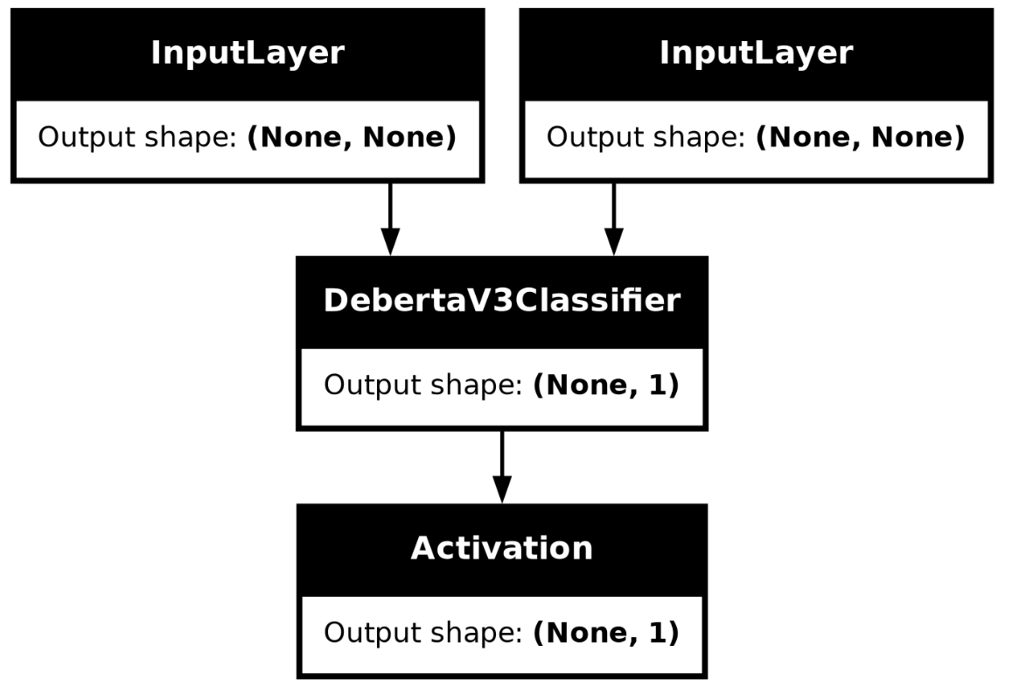
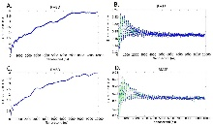
MODELLING
3/21/2024 Annual Review

Slide 10
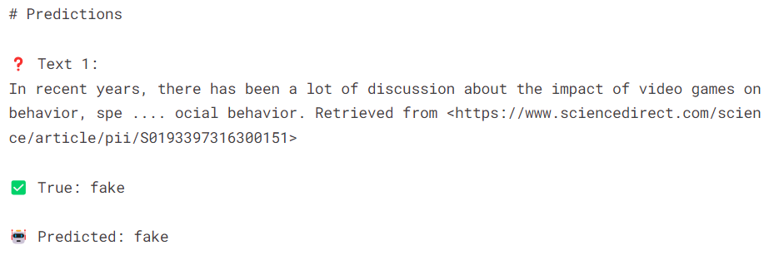
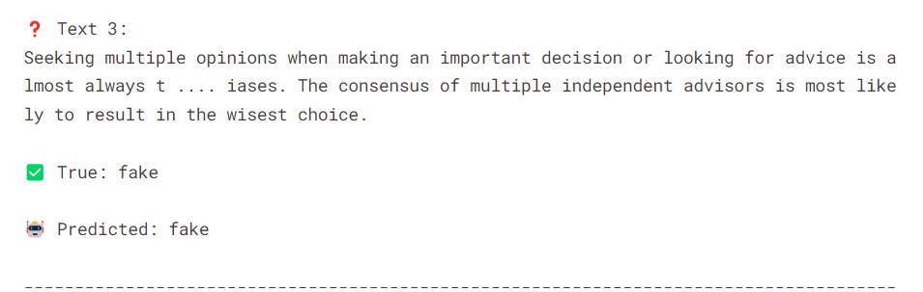
RESULTS
Demo Link
3/21/2024 Annual Review

