Slide 1
Multi-Agents Sharing Single-Model on Identical Environments
Broker
Worker #1
Env. #1
Worker #2
Env. #2
Gradients
MQTT Server
Transfer_Update
Worker #n
Env. #n
Pub Topic: Update
Transfer_Update
Sub Topic: Episode_Details
Success_Done
Fail_Done
Pub Topic: Episode_Details Success_Done
Fail_Done
Sub Topic: Update Transfer_Update
<number>

Slide 2
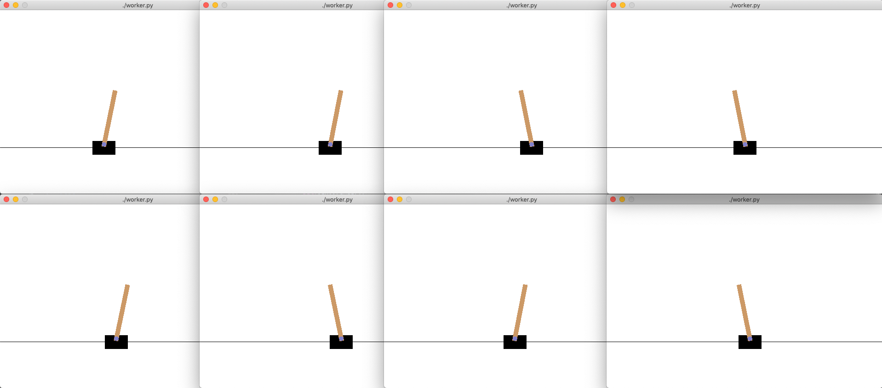
<number>

