Slide 1

EE204: Analog Circuits
EE230: Analog Labs
Lecture-0
Sandip Mondal
Assistant Professor IIT Bombay

Slide 2

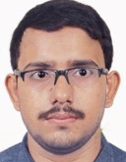
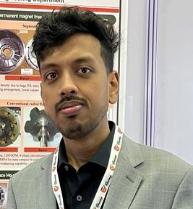

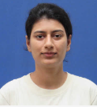
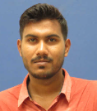
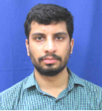
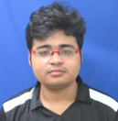
Shoubhik De (PhD)
Jitendra Kumar (Ph.D.)
West Bengal
BIHAR
Alok Kumar (Ph.D.)
Riya Sharma (PhD)
BIHAR
UP
Atul Sachan(PhD)
Kharalkar Ajinkya Dilip (PhD)
UP
MAHARASTRA
Tanveer Molla (MTech)
West Bengal
2

Slide 3
Lecture Schedule and Course Materials
Lectures: Wednesday 11:05 - 12:30 Friday 11:05 - 12:30
Tutorial: To be decided
https://www.ee.iitb.ac.in/sandip/teaching.html
3

Slide 4
Grading
*Four Quizzes: 10 % (Surprises)
*Every class Quizzes: 20 % (SAFE)
*Mid-sem: 20 %
*End-sem: 40 %
*Class Notes: 10 % (Min 3 pages/class)
Optional Project work: 10-100 % (Project dependent)
* TC Applies
4

Slide 5
Class Note Submission Link
Submit Minimum 3 Pages Note within 24 hours
(Minimum word limit 2500. No maximum limit. The document should be the editable format (docs, note pad etc)
Moodle
https://moodle.iitb.ac.in/login/index.php
Turnitin software (https://www.turnitin.com/) will be used to check the plagiarism from books, online documents or other student’s notes.

Slide 6
Term and Condition (TC)
Attendance | Grading System
> 90 % | Grading will be based on 100% of your obtain percentage
80% 89% | Grading will be based on 80% of your obtain percentage
70% 79% | Grading will be based on 70% of your obtain percentage
60% 69% | Grading will be based on 60% of your obtain percentage
50% 59% | Grading will be based on 50% of your obtain percentage
<50% | Fail (Except project)
6

Slide 7
Disciplines in classroom
Classroom Behavior Be attentive in the lectures. Do not join for the sake of attendance. Ask questions.
Academic Honesty
It is expected that students in EE204 will maintain the highest standards of academic honesty. In particular, it is expected that in the course of taking a test or examination, students will not (1) accept information of any kind from others and give information to others (2) No googling the answers.
7

Slide 8
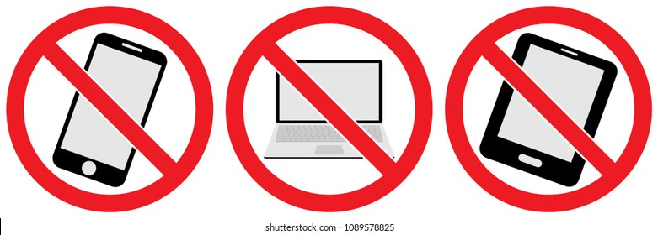
Term and Condition (TC)
No Electronics are allowed in class
ONLY PEN-PAPER
(except during Quizzes)
8

Slide 9
References
Foundations of Electrical Engineering by L. S. Bobrow Electrical Engineering Fundamentals by Vincent Del Toro
Alternate reading for much of the material covered in this course can be found in numerous texts. Some recent ones are: • Foundations of Analog and Digital Electronic Circuits by A. Agarwal and J.Lang • Principles and Applications of Electrical Engineering by G. Rizzoni • Solid State Electronic Devices, by B. G. Streetman • Semiconductor device Fundamentals by R. Pierret • Digital Microelectronics, by H. Haznedar
9

Slide 10
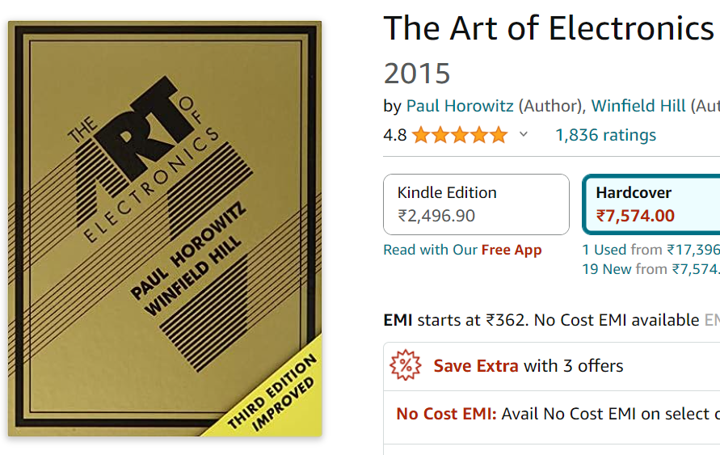
References
10

Slide 11
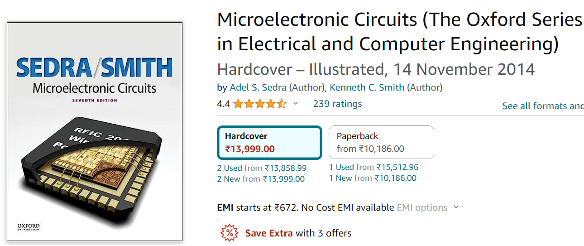
References
11

Slide 12
Syllabus
Biasing of discrete devices and integrated circuits, Low frequency amplifiers, Feedback amplifiers, Frequency response of amplifiers and high frequency effects, Internal stages of OPAMP Difference amplifier, Intermediate stage amplifier, Level shifter, Output buffer, Linear applications of OPAMP, Non-Linear applications of OPAMPS, Wave generation with OPAMP, Active filters, Oscillators, Regulators, Power amplifiers.
12

Slide 13
EE204: Project Proposal-1 (10%) Designing cost-effective spin-coating system
Spin coating is a unique technique used in semiconductor manufacturing industries to fabricate thin uniform films on a flat substrate. A Spin Coater is an electrical system used for spin coating and is one of the most universal equipment in any laboratory dealing with devices.
(1) Most marketable spin coating systems are extremely expensive (> US $2000) and come with features and specifications not essentially desirable for fabricating and experimenting with semiconductor devices.
(2) The cost of this instrument should not act as a warning for groups intending to venture into fabricating and experimenting with simple devices, hence the effort in this direction.
(3) This system must be designed with your own expenditure and should be below Rs. 10000/-
Max vacancy: 5 groups (2 person/group)

Slide 14
EE204: Project Proposal-2 (30%) Digitalization of Hospital at IIT Bombay
As you know a small Hospital is located at IIT Bombay campus. There are many doctors who offer medical services for 24 hrs. However, they write a prescription on paper which is also called a Medical book for the patent. There is the possibility that you may lose your medical book due to some reason. Hence you will be losing your medical history. The main goal of this project is to
(1) designing a software/app for doctors in order to store patent information in digital form.
(2) Paper-made medical book is not required. Doctor can access your medical history through your student ID number.
(3) The software/app will be accessible by the patent and doctor from outside the hospital
(4) If the student is not well, the app will automatically send an email to the course instructor. No pink slip is required.
(5) The app will be available in the pharmacy. You may go directly to the pharmacy to collect your medicine.
Max vacancy: 3 groups (2 person/group)

Slide 15
EE204: Project Proposal-3 (100%) Artificial Intelligence using NAND memory
Blur image processing would be done using NAND memory technology. The main goal of this project is to
(1) Used FTDI controller and connect with computer
(2) Design the software/firmware using Python programming.
(3) Cleaning of blur images should be performed using the system
(4) File the patent
Max vacancy: 2 groups (2 person/group)

Slide 16
Project Registration Link
You can registrar for ONLY ONE project
https://rb.gy/zz44w
No credit if you are unable to complete the project

Slide 17
What you need to buy?
Bread board
Digital Multimeter
Single Standard Wires (Multi-color)
Resistance box
Capacitor box
17

