Slide 1

Lecture 11
September 15, 2023
1

Slide 2
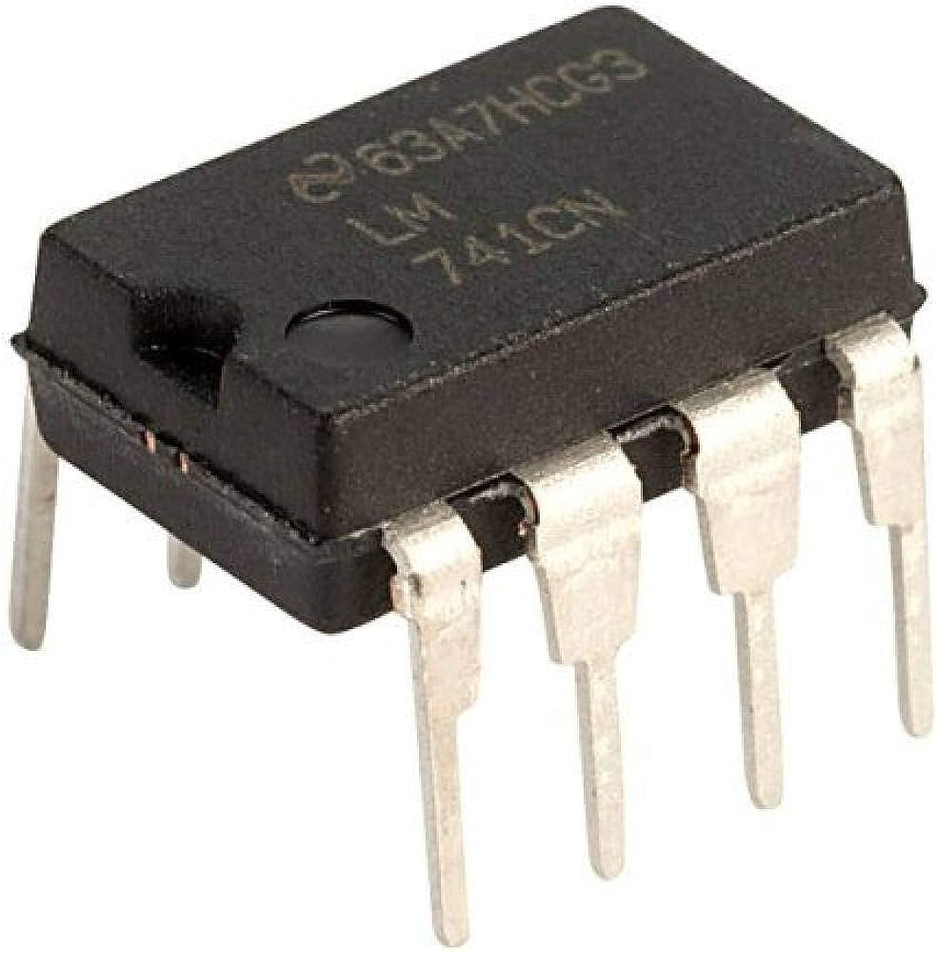
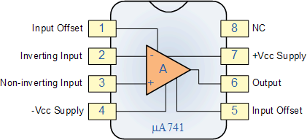
Ideal OPAMP
Adder, Subtractor, Differentiator, Amplifier, Integrator
2

Slide 3









Ideal OPAMP
Differential inputs → Single ended Output
$i_{N}$=0
Infinite→ i/p resistance
$$−$$
$$V_{0}$$
$$+$$
Zero → O/p resistance
$$+$$
_
$i_{P}$=0
$$V_{N}$$
$$+$$
_
$$V_{P}$$
$A_{V}\text{→}$ Open loop gain → Infinite
$$ZERO COMMON MODE GAIN$$
3

Slide 4












Inverting Amplifier
$$V_{DD}=5V$$
$$+$$
$$−$$
$$V_{Out}=−AV_{P}$$
$$ac$$
$V_{BE}$=0V
$$−$$
$$+$$
$V_{EE}$=-5V
$$V_{out}$$
$$A_{V}$$
$$V_{in}$$
4

Slide 5






Non-Inverting Amplifier
$$V_{DD}=5V$$
$$−$$
$$V_{Out}=AV_{P}$$
$V_{BE}$=0V
$$+$$
$$+$$
$$ac$$
$V_{BE}$=-5V
$$V_{out}$$
$$−$$
$$A_{V}$$
$$V_{in}$$
5

Slide 6


Follower and Inversion
A
$$−$$
C
B→C Follower
A→C Inversion
B
$$+$$
6

Slide 7

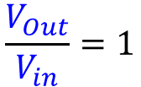
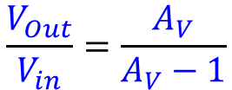





Unity Gain Buffer
$$V_{DD}=5V$$
$$V_{Out}=A_{V}(V_{P}−V_{N})$$
$$+$$
$$+$$
$$V_{Out}$$
$$V_{Out}=A_{V}(V_{in}−V_{Out})$$
$$Vin$$
$$−$$
$$−$$
$$\frac{V_{Out}}{V_{in}}=\frac{A_{V}}{A_{V}−1}$$
$V_{EE}$=-5V
$$\frac{V_{Out}}{V_{in}}=1$$
7

Slide 8












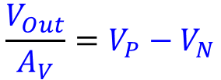











Inverting Amplifier
Simplified Circuit
$$i_{2}$$
$$R_{2}$$
$$i_{2}$$
$$R_{2}$$
$$R_{1}$$
$$V_{DD}=5V$$
$$R_{1}$$
$$V_{N}$$
$$+$$
$$−$$
$$+$$
$$i_{1}$$
$$V_{Out}$$
$$i_{1}$$
$$V_{Out}$$
$$Vin$$
$$Vin$$
$$−$$
$$V_{P}$$
$$−$$
$$+$$
$$V_{Out}=A_{V}(V_{P}−V_{N})$$
$$V_{EE}=−5V$$
$$\frac{V_{Out}}{A_{V}}=V_{P}−V_{N}$$
$V_{P}−V_{N}$=0
$$V_{P}=V_{N}$$
Virtual short between $V_{P}$ and $V_{N}$
8

Slide 9


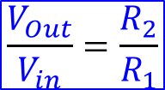
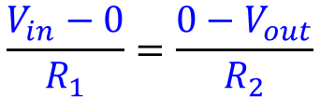
Inverting Amplifier
Simplified Circuit
$$i_{2}$$
$$R_{2}$$
$$i_{2}$$
$$R_{2}$$
$$R_{1}$$
$$V_{DD}=5V$$
$$R_{1}$$
$$V_{N}$$
$$+$$
$$−$$
$$+$$
$$i_{1}$$
$$V_{Out}$$
$$i_{1}$$
$$V_{Out}$$
$$Vin$$
$$Vin$$
$$−$$
$$V_{P}$$
$$−$$
$$+$$
$V_{N}$→ Virtual Grounded = 0
$$V_{EE}=−5V$$
Hence $i_{1}=i_{2}$
$$\frac{V_{in}−0}{R_{1}}=\frac{{0−V}_{out}}{R_{2}}$$
$$\frac{V_{Out}}{V_{in}}=\frac{R_{2}}{R_{1}}$$
Close Loop gain
9

Slide 10



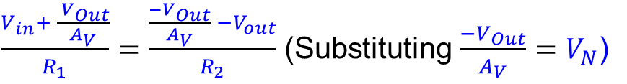



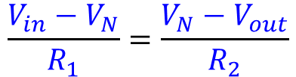


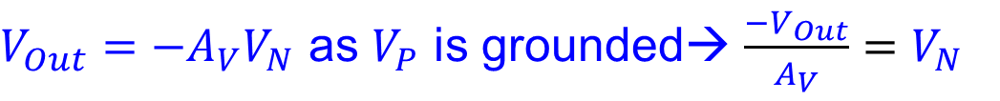






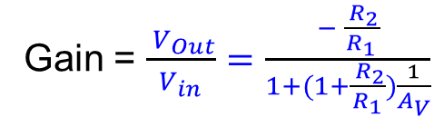
Effect of finite Open loop Gain
$$V_{Out}=A_{V}(V_{P}−V_{N})$$
$V_{Out}=−{A_{V}V}_{N}$ as $V_{P}$ is grounded→ $\frac{−V_{Out}}{A_{V}}=$ $V_{N}$
$$i_{2}$$
$$R_{2}$$
$$\frac{V_{in}−V_{N}}{R_{1}}=\frac{{V_{N}−V}_{out}}{R_{2}}$$
$$R_{1}$$
$$V_{DD}=5V$$
$$+$$
$$−$$
$\frac{V_{in}+ \frac{{ V}_{Out}}{A_{V}}}{R_{1}}=\frac{{\frac{−V_{Out}}{A_{V}} −V}_{out}}{R_{2}}$ (Substituting $\frac{−V_{Out}}{A_{V}}=$ $V_{N}$)
$V_{N}$
$$i_{1}$$
$$V_{Out}$$
$$Vin$$
$$−$$
$V_{P}$
Gain = $\frac{{ V}_{Out}}{V_{in}}=\frac{− \frac{{ R}_{2}}{R_{1}}}{1+(1+\frac{{ R}_{2}}{R_{1}})\frac{1}{A_{V}}}$
$$Condition: \left(1+\frac{{ R}_{2}}{R_{1}}\right)≪A_{V}$$
$$+$$
$$V_{EE}=−5V$$
If $R_{1}$= 500 $Ω$ and $R_{2}$= 20 k$Ω$ the Gain = $− \frac{{ R}_{2}}{R_{1}}$ = - 40
10

Slide 11



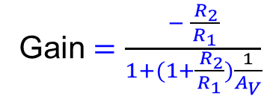

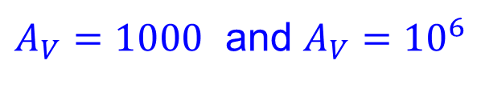
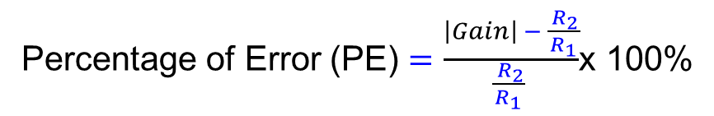
Percentage of Error
$A_{V}=1000$ and $A_{V}={10}^{6}$
Gain $=\frac{− \frac{{ R}_{2}}{R_{1}}}{1+(1+\frac{{ R}_{2}}{R_{1}})\frac{1}{A_{V}}}$
${For A}_{V}=1000 , Gain=38.424$
${For A}_{V}={10}^{6}, Gain=39.$998
Percentage of Error (PE) $=\frac{\left|Gain\right| − \frac{{ R}_{2}}{R_{1}}}{\frac{{ R}_{2}}{R_{1}} }$x 100%
$${For A}_{V}=1000 , PE=3.94\%$$
${For A}_{V}={10}^{6}, PE=0.004$%
If the ${ A}_{V}={10}^{6}$ is 50% OFF then Gain = 39.996
11

Slide 12
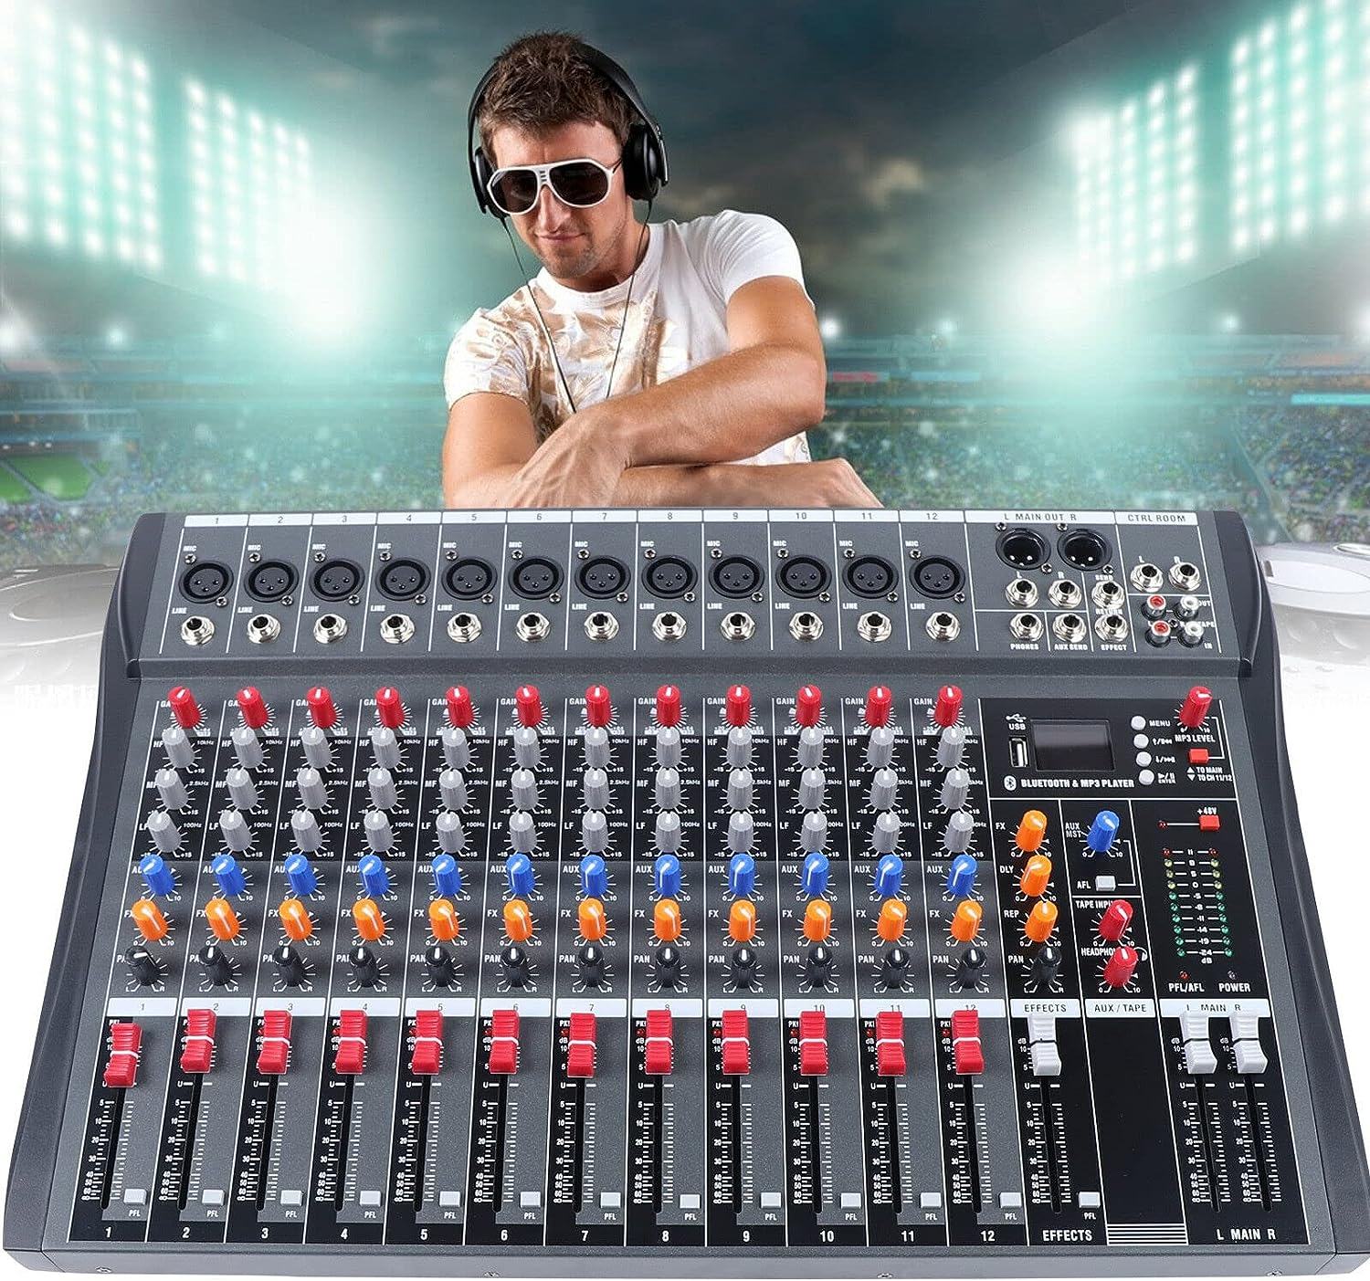
Audio Mixer
12

Slide 13
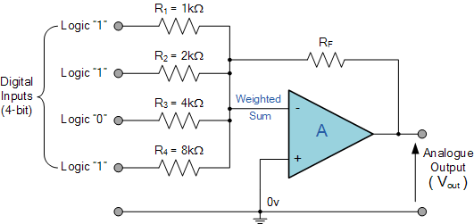




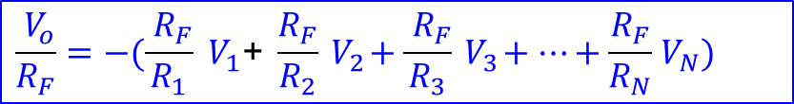








OPAMP-Summing Amplifier
$$V_{1}$$
$$i_{1}$$
$$i_{F}$$
$$V_{2}$$
$$i_{2}$$
$$V_{3}$$
$$i_{3}$$
$$V_{N}$$
$$N$$
$$i_{N}$$
$i_{1}+$ $i_{2}+i_{3}+…+i_{N}$ = $i_{F}$
$$\frac{{ V}_{o}}{R_{F}}=−(\frac{{ R}_{F}}{R_{1}}{ V}_{1}\text{+ }\frac{R_{F}}{R_{2}}{ V}_{2}+\frac{{ R}_{F}}{R_{3}}{ V}_{3}+…+\frac{R_{F}}{R_{N}}{ V}_{N})$$
$\frac{{ V}_{1}}{R_{1}}$ + $\frac{{ V}_{2}}{R_{2}}+\frac{{ V}_{3}}{R_{3}}+…+\frac{{ V}_{N}}{R_{N}}=−\frac{{ V}_{o}}{R_{F}}$
13

Slide 14


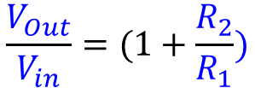











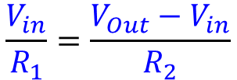



OPAMP-Non Inverting Amplifier
$$R_{2}$$
$$i_{2}$$
$$V_{Out}=A_{V}(V_{P}−V_{N})$$
$$R_{1}$$
$$V_{DD}=5V$$
$$V_{N}=V_{in}$$
$$−$$
$$i_{1}=i_{2}$$
$$V_{in}$$
$$i_{1}$$
$$V_{Out}$$
$$\frac{V_{in}}{R_{1}}=\frac{V_{Out}−V_{in}}{R_{2}}$$
$$+$$
$$+$$
$$Vin$$
$$V_{EE}=−5V$$
$$\frac{V_{Out}}{V_{in}}=(1+\frac{R_{2}}{R_{1}})$$
$$−$$
What is the effect of finite open loop gain?
14

Slide 15





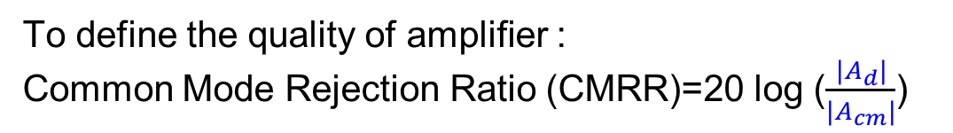

Differential Amplifier
$$V_{icm}+\frac{V_{id}}{2}$$
+
$${V_{P}=V}_{icm}+\frac{V_{id}}{2}$$
$${V_{Out}}_{}$$
Differential Amplifier
$${V_{N}=V}_{icm}−\frac{V_{id}}{2}$$
-
$$V_{icm}−\frac{V_{id}}{2}$$
$${V_{Out}=A_{d}V}_{id}+A_{cm}V_{icm}$$
Differential
Gain
Common mode
Gain
To define the quality of amplifier :
Common Mode Rejection Ratio (CMRR)=20 log ($\frac{{|A}_{d}|}{{|A}_{cm}|}$)
CMRR→ ideally infinite
15

Slide 16
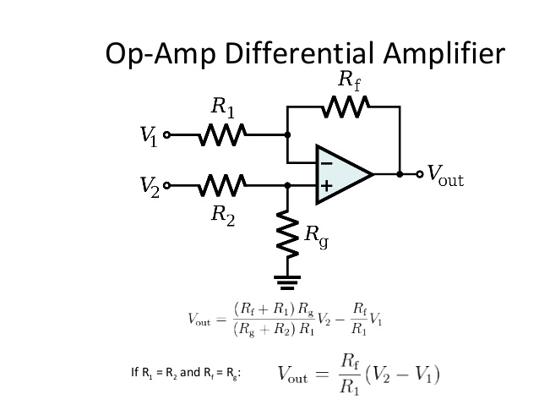






OPAMP-Differential Amplifier (Subtractor)
$$R_{2}$$
$$R_{1}$$
$$V_{i1}$$
$$V_{i2}$$
$$R_{3}$$
$$R_{4}$$
16

Slide 17







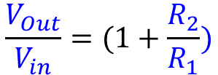







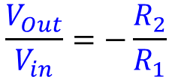













OPAMP-Differential Amplifier (Subtractor)
$$R_{2}$$
$$i_{2}$$
$$R_{2}$$
$$i_{2}$$
$$R_{1}$$
$$V_{DD}=5V$$
$$R_{1}$$
$$V_{DD}=5V$$
$$−$$
$$+$$
$$−$$
$$V_{in}$$
$V_{N}$
$$i_{1}$$
$$V_{Out}$$
$$i_{1}$$
$$V_{Out}$$
$$Vin$$
$$−$$
$V_{P}$
$$+$$
$$+$$
$$+$$
$$Vin$$
$$V_{EE}=−5V$$
$$V_{EE}=−5V$$
$$−$$
$$\frac{V_{Out}}{V_{in}}=−\frac{R_{2}}{R_{1}}$$
$$\frac{V_{Out}}{V_{in}}=(1+\frac{R_{2}}{R_{1}})$$
17

Slide 18

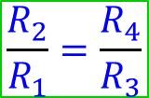

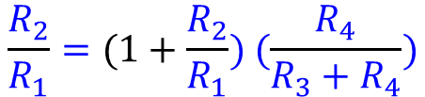

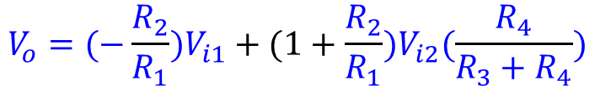



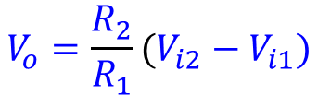
OPAMP-Differential Amplifier (Subtractor)
$$R_{2}$$
$$R_{1}$$
$${V_{o}=(−\frac{R_{2}}{R_{1}})V}_{i1}+(1+\frac{R_{2}}{R_{1}})V_{i2}(\frac{R_{4}}{R_{3}+R_{4}})$$
$$V_{i1}$$
$$V_{i2}$$
$$R_{3}$$
Conditions
$$R_{4}$$
$$\frac{R_{2}}{R_{1}}=(1+\frac{R_{2}}{R_{1}}) (\frac{R_{4}}{R_{3}+R_{4}})$$
$$\frac{R_{2}}{R_{1}}=\frac{R_{4}}{R_{3}}$$
$${V_{o}=\frac{R_{2}}{R_{1}}(V_{i2}−V}_{i1})$$
18

Slide 19
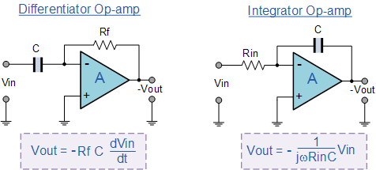
OPAMP-Differentiator & Integrator
19

