Slide 1

Lecture 15
October 13, 2023
1

Slide 2








MOSFET-Operation
$$V_{DS}=V_{GS}−V_{TH}$$
+
$$V_{G}$$
-
Gate (G)
Source (S)
GND
-
$$V_{D}$$
+
Drain (D)
Body (B)
Metal
GND
Oxide
GND
GND
N+
N+
P+
V(x)
P- Substrate
L
x
dx
0
$$Q=CV=C(V−V_{TH})$$
Channel charge: $Q_{d}\left(x\right)=W C_{ox} \left(V_{GS}−V(x)−V_{TH}\right)$
$$Q_{d}\left(0\right)=W C_{ox} \left(V_{GS}−V_{TH}\right)$$
$$Q_{d}\left(L\right)=W C_{ox} \left(V_{GS}−V_{TH}−V_{DS}\right)$$
Pinch off Point
$Q_{d}\left(L\right)=$ 0
When $V_{DS}=V_{GS}−V_{TH}$
2

Slide 3

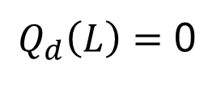



Pinch off point
$$V_{DS}=V_{GS}−V_{TH}$$
+
$$V_{G}$$
-
Gate (G)
Source (S)
GND
-
$$V_{D}$$
+
Drain (D)
Body (B)
Metal
GND
Oxide
GND
GND
N+
N+
P+
Pinch off
V(x)
P- Substrate
L
x
dx
0
$Q_{d}\left(L\right)=$ 0
When $V_{DS}=V_{GS}−V_{TH}$
Pinch off Point
3

Slide 4





Beyond Pinch off
$$V_{DS}≫V_{GS}−V_{TH}$$
+
$$V_{G}$$
-
Gate (G)
Source (S)
GND
-
$$V_{D}$$
+
Drain (D)
Body (B)
Metal
GND
Oxide
GND
GND
N+
N+
P+
Pinch off
V(x)
P- Substrate
x
$$L_{1}$$
dx
0
$${v=\frac{I_{d}}{Q_{d}}}_{}$$
Carrier velocity increases drastically
Electron shoot through depletion region and arrive at drain
The device is in saturation region
4

Slide 5


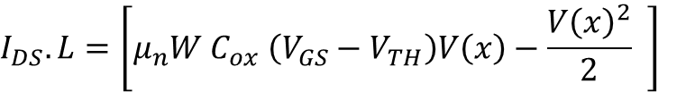


Beyond Pinch off
$$V_{DS}≫V_{GS}−V_{TH}$$
$$\int_{x=0}^{x=L_{1}}{I_{DS}\left(x\right) dx}=\int_{V\left(x\right)=0}^{V\left(x\right)=(V_{GS}−V_{TH})}{W C_{ox} \left(V_{GS}−V\left(x\right)−V_{TH}\right).μ_{n} dV(x)}$$
$$I_{DS}.L=\left[μ_{n}W C_{ox} \left(V_{GS}−V_{TH}\right)V\left(x\right)−\frac{{V\left(x\right)}^{2}}{2} \right]$$
$$V_{GS}−V_{TH}$$
0
$$I_{DS}=μ_{n}\frac{W}{L} C_{ox} \frac{{\left(V_{GS}−V_{TH}\right)}^{2}}{2}$$
$$I_{DS}=\frac{1}{2}μ_{n}\frac{W}{L} C_{ox}{\left(V_{GS}−V_{TH}\right)}^{2}$$
$\left(V_{GS}−V_{TH}\right)$→ Over drive voltage/ $V_{dsat}$
$\left(V_{DS}>V_{dsat}\right)$→ for saturation region operation
5

Slide 6

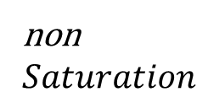








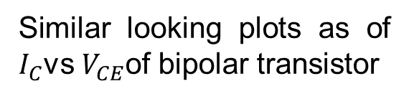
MOSFET-Operation
$$I_{DS}$$
non
$$Saturation$$
$$Saturation$$
$$V_{GS3}$$
$$V_{GS2}$$
Similar looking plots as of $I_{C}$vs $V_{CE}$of bipolar transistor
$$V_{GS1}$$
$$V_{DS}$$
$$\left(V_{GS1}−V_{TH}\right)$$
$$\left(V_{GS3}−V_{TH}\right)$$
$$\left(V_{GS2}−V_{TH}\right)$$
6

Slide 7




Bipolar Transistor and MOSFET
Bipolar transistor
MOSFET
Device as switch or resistor
Saturation
Linear Triode
$V_{CE}<0.3V$
$V_{DS}<(V_{GS}−V_{TH})$
Device useful amplification
Active
Saturation
$V_{CE}>0.3V$
$V_{DS}≥(V_{GS}−V_{TH})$
Definition of saturation in Bipolar and MOSFET is very different → Can be confusing
7

Slide 8





Channel Length Modulation Effect
+
$$V_{G}$$
-
Gate (G)
Source (S)
GND
-
$$V_{D}$$
+
Drain (D)
Body (B)
Metal
GND
Oxide
GND
GND
N+
N+
P+
Pinch off
$$L^{′}$$
P- Substrate
$$ΔL$$
L
0
dx
$V_{DS}$
$$L^{′}$$
Effect of channel length modulates with $V_{DS}$
8

Slide 9
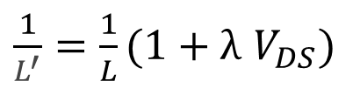

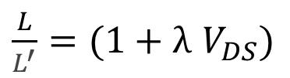
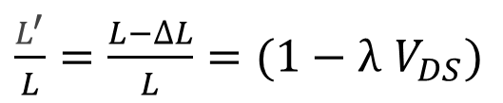
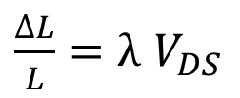

Channel Length Modulation Effect
$\frac{∆L}{L}=λ$ $V_{DS}$
(In saturation)
$\frac{L^{′}}{L}=\frac{L−∆L}{L}=(1−λ$ $V_{DS})$
Using Taylor series expansion
$\frac{L}{L^{′}}=(1+λ$ $V_{DS})$
$When λ$ $V_{DS}≪1$
$\frac{1}{L^{′}}=\frac{1}{L}(1+λ$ $V_{DS})$
Original Saturation equation,
$$I_{DS}=\frac{1}{2}μ_{n}\frac{W}{L^{′}} C_{ox}{\left(V_{GS}−V_{TH}\right)}^{2}$$
9

Slide 10


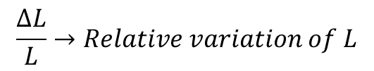











Channel Length Modulation Effect
Substituting
$\frac{1}{L^{′}}=\frac{1}{L}(1+λ$ $V_{DS})$
$λ$→Channel length modulation co-efficient
$$\frac{∆L}{L}→Relative variation of L$$
$$I_{DS}=\frac{1}{2}μ_{n}\frac{W}{L} C_{ox}{\left(V_{GS}−V_{TH}\right)}^{2}(1+λ V_{DS})$$
$$Larger L and smaller→λ$$
$$λ→Process Technology dependent parameter$$
$$V_{GS3}$$
$$I_{DS}$$
$$V_{GS2}$$
$$V_{GS1}$$
$$\left(V_{GS1}−V_{TH}\right)$$
$$\left(V_{GS3}−V_{TH}\right)$$
$$\left(−V_{A}=−\frac{1}{λ}\right)$$
$$V_{DS}$$
$$\left(V_{GS1}−V_{TH}\right)$$
10

