Slide 1

Lecture 19
Nov 1, 2023
1

Slide 2
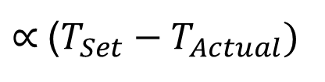
Proportional Temperature Controller
Thermocouple as temperature sensor
Heater voltage as 100V DC/5A
Why proportional temperature controller ?
Drawback of On/OFF controller:
Temperature is Low → Heater ON
Temperature is High → Heater OFF
In proportional controller the heater voltage $∝$Error
$∝$($T_{Set}−T_{Actual})$
2

Slide 3




Thermocouple as Temp sensor
Output, $V_{o}=(T_{1}−T_{2})×S$
Thermocouple
Heater
$$T_{1}=100℃$$
$$T_{2}=0℃$$
$$S=sensitivity=40μV/℃$$
$$V_{o}=\left(T_{1}−T_{2}\right)×S=100×40μV=40mV$$
3

Slide 4




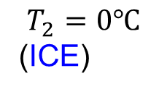


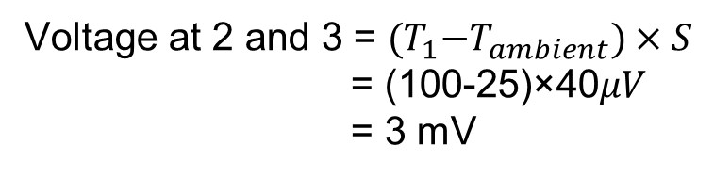
Single junction thermocouple
Two junction thermocouple
Single junction thermocouple
$$2$$
Ambient
$$3$$
$$25℃$$
$$1$$
$$T_{1}=100℃$$
$$T_{2}=0℃$$
(ICE)
$$T_{1}=100℃$$
Voltage at 2 and 3 = ${(T}_{1}−T_{ambient})×S$
= (100-25)×40$μV$
= 3 mV
Drawback:
If ambient temperature changes then the output voltage will change
4

Slide 5

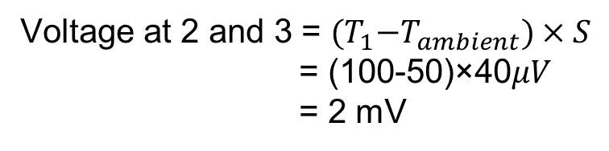


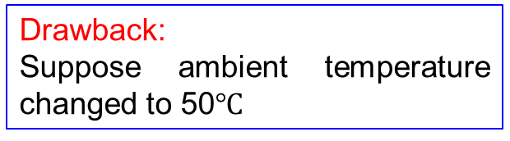


Single junction thermocouple
Single junction thermocouple
$$2$$
Drawback:
Suppose ambient temperature changed to 50$℃$
Ambient
$$3$$
$$50℃$$
$$1$$
$$T_{1}=100℃$$
Voltage at 2 and 3 = ${(T}_{1}−T_{ambient})×S$
= (100-50)×40$μV$
= 2 mV
Hence we need to compensate the ambient temperature
5

Slide 6

Ambient temperature measurement
Single junction thermocouple
$$2$$
Ambient
$$3$$
LM335
$$1$$
Output
$$T_{1}=100℃$$
$$15V$$
Ambient temperature must be measured using another sensor LM335
6

Slide 7



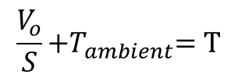

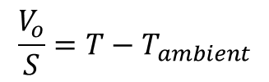


Ambient temperature measurement
Single junction thermocouple
$$2$$
Ambient
$$3$$
LM335
$$1$$
Output
$$T_{1}=100℃$$
$$15V$$
Once you measure ambient temperature of the block then you can find the actual temperature,
Thermocouple voltage = $V_{o}=\left({T−T}_{ambient}\right)S$
$$\frac{V_{o}}{S}={T−T}_{ambient}$$
$$\frac{V_{o}}{S}{+T}_{ambient}=T$$
7

Slide 8










Ambient temperature measurement
$$24 kΩ$$
Single junction thermocouple
$$1 kΩ$$
+15V
$$−$$
$$2$$
Ambient
$$+$$
$$40μV/℃$$
-15V
$$3$$
LM335
$$1$$
$$T_{1}=100℃$$
$$+15V$$
Output
8

Slide 9



















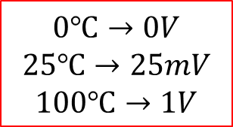









Output voltage corresponding to temp.
$$24 kΩ$$
Single junction thermocouple
$$1 kΩ$$
+15V
$$−$$
$$100 kΩ$$
$$2$$
Ambient
$$+$$
$$40μV/℃$$
$$100 kΩ$$
-15V
$$−$$
$$3$$
LM335
$$1$$
$$100 MΩ$$
$$25℃$$
$$R_{f}$$
741
$$T_{1}=26℃$$
$$0.25V$$
$$+$$
$$R_{1}$$
+15V
$$−2.73V$$
$$−$$
$$−25mV$$
$$−1mV$$
$$−15V$$
$$+$$
$$10mV/℃$$
$$−26mV$$
$$R_{2}$$
$$+5V$$
-15V
$$0℃→0V$$
$$25℃→25mV$$
$$100℃→1V$$
$$2.73V$$
9

Slide 10













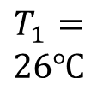














Output voltage corresponding to temp.
Single junction thermocouple
$$24 kΩ$$
$$1 kΩ$$
+15V
$$−$$
$$100 kΩ$$
$$2$$
Ambient
$$+$$
$$−50mV$$
$$40μV/℃$$
$$100 kΩ$$
R
-15V
$$−$$
R
$$3$$
LM335
R
$$1$$
$$100 MΩ$$
+15V
741
+15V
$$T_{1}=$$
$$26℃$$
$$25℃$$
$$R_{f}$$
$$−$$
$$+$$
$$−$$
$$0.25V$$
R
$$R_{1}$$
$$+$$
$$+$$
+15V
-15V
$$−2.73V$$
$$−$$
-15V
+15V
$$−15V$$
$$+$$
$$10mV/℃$$
$$R_{2}$$
$$+5V$$
-15V
$$100mV$$
$$50mV$$
$${(T_{s}−T}_{am})$$
2.5V
$$2.73V$$
10

Slide 11







Set temperature different from actual temp
R
+15V
R
Set temp = 100$℃$
Actual temperature = 100-8.2=91.8$℃$
+15V
+15V
$$−$$
$$−$$
$$+$$
$$+$$
-15V
-15V
8.2mV
8.2V
7V
Heater
$$1$$
$${(T_{s}−T}_{am})$$
gain=1000
11

Slide 12
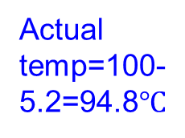
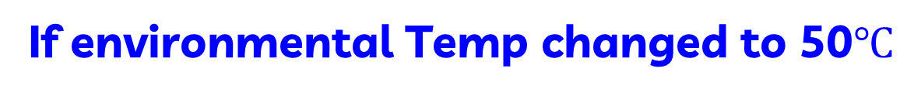

If environmental Temp changed to 50$℃$
Drawback
R
+15V
R
Thermocouple
Heater
+15V
+15V
$$−$$
$$−$$
$$+$$
$$+$$
-15V
-15V
100$℃$
5.2mV
5.2V
4V
Actual temp=100-5.2=94.8$℃$
Because environment temp is 50C
gain=1000
12

