Slide 1

Lecture 3
August 16, 2023
1

Slide 2
Transistor
2

Slide 3
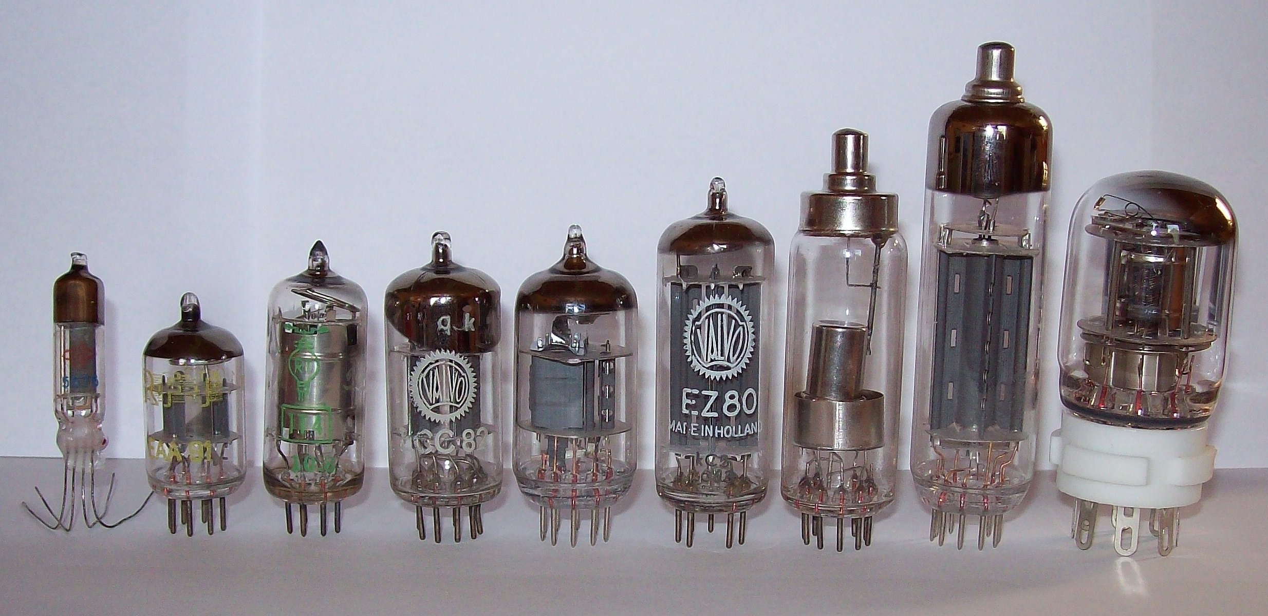
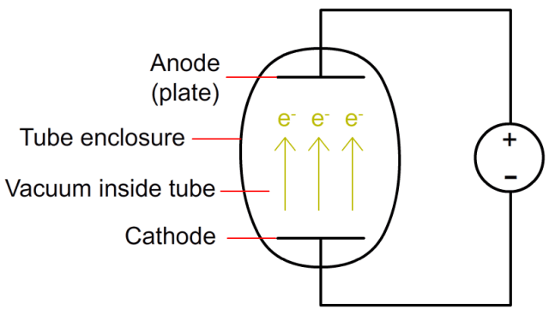
Vacuum Tube-Diode
3

Slide 4
Vacuum Tube-Diode
Radio was there and the diode also was there at that time. So what is the new that they have made?
4

Slide 5
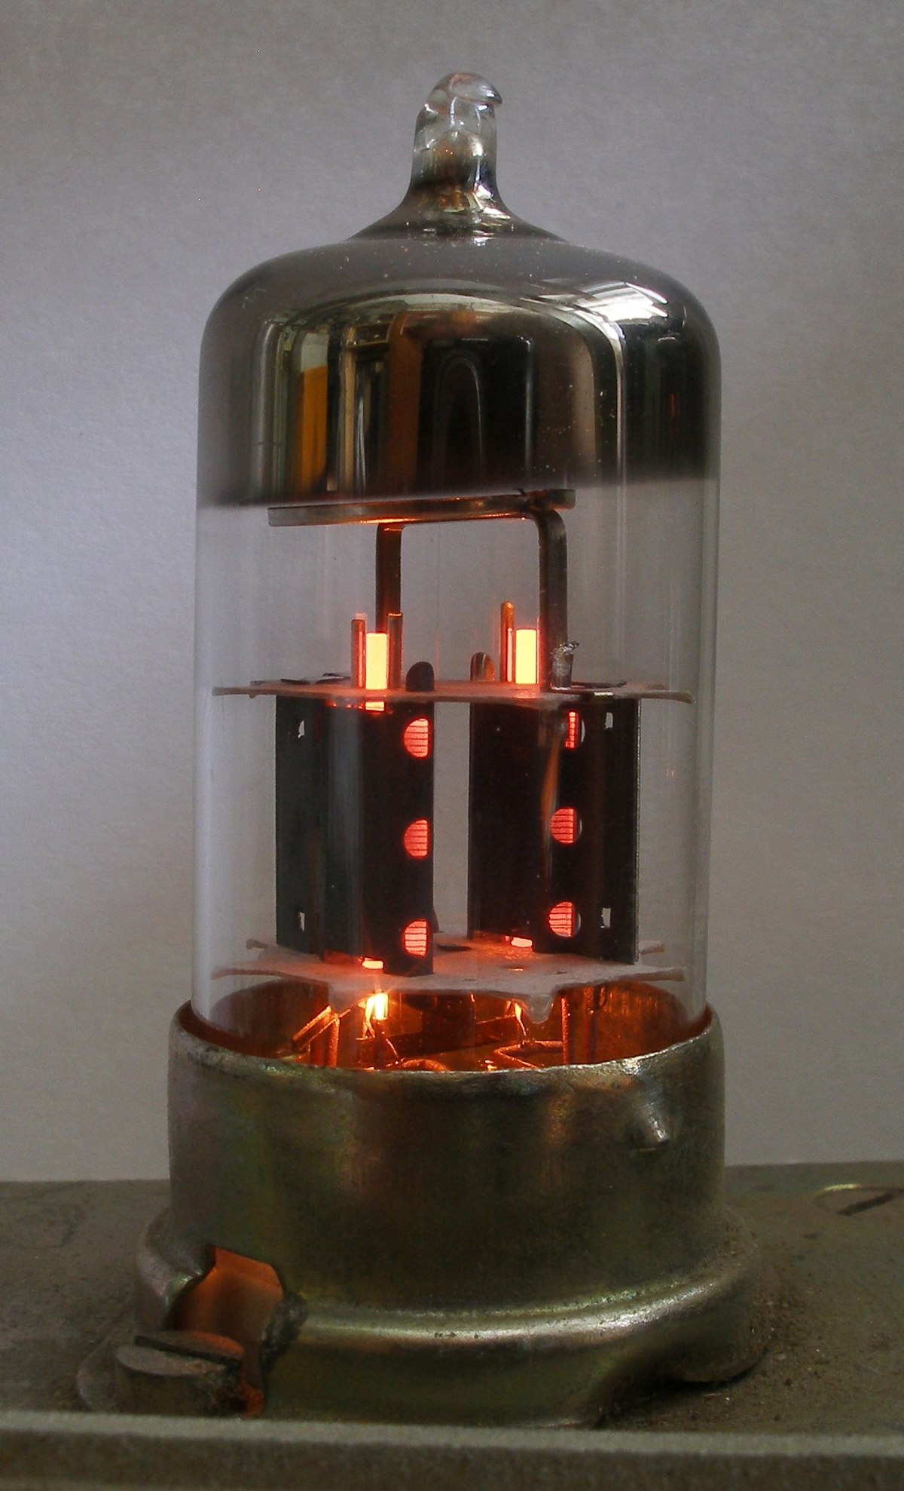
Vacuum Tube-Triode
200V
→ 100V
300V
Gride
If the vacuum tube was there, then what was the need for Transistor?
5

Slide 6
Transistor
Surface charged
Gold
N
6

Slide 7
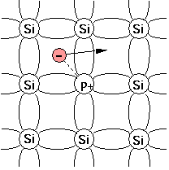
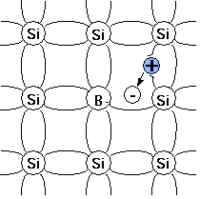
Semiconductor (n-p-n Transistor)
n-Silicon
p-Silicon
n-Silicon
7

Slide 8
Semiconductor (Transistor)
Acceptor ion
Donner ion
Hole
Emitter
Junction
Electron
Collector
Junction
+
-
+
-
+
-
+
-
+
-
+
+
-
+
-
+
-
+
-
+
-
+
-
+
-
+
-
+
+
-
+
-
+
-
+
-
+
-
+
-
+
-
+
-
+
+
-
+
-
+
-
+
-
+
-
+
-
+
-
+
-
+
+
-
+
-
+
-
+
-
+
-
+
-
+
-
+
-
+
+
-
+
-
+
-
p-Silicon
n-Silicon
p-Silicon
8

Slide 9
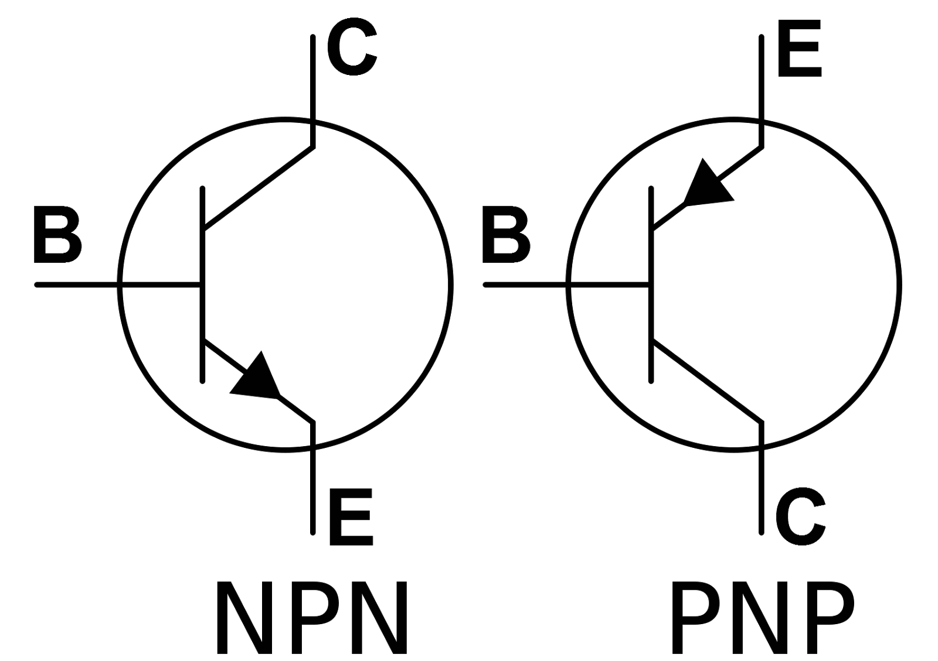
Semiconductor (Transistor)
9

Slide 10


























Current component – pnp transistor
$$J_{E}$$
$$J_{C}$$
$$I_{E}(p)$$
$$I_{C1}(p)$$
$$E$$
$$I_{E}$$
$$I_{C}$$
$$C$$
$$p$$
$$n$$
$$p$$
$$I_{E}\left(p\right)−I_{C1}(p)$$
$$I_{CO}(p)$$
$$I_{E}(n)$$
$$I_{CO}$$
$$+$$
$$+$$
$$V_{EB}$$
$$I_{CO}(n)$$
$$V_{CB}$$
$$−$$
$$−$$
$$V_{EE}$$
$$V_{CC}$$
$$I_{B}$$
$$B$$
10

Slide 11
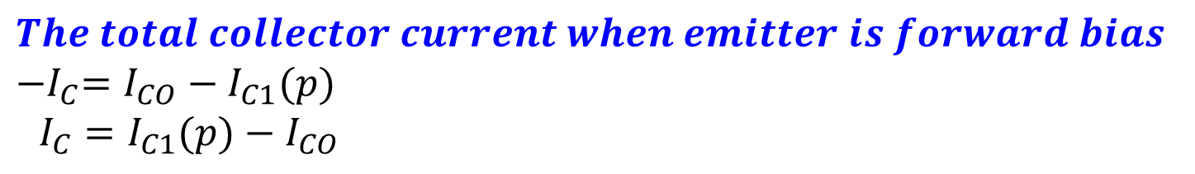
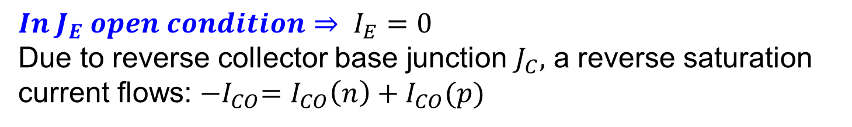


Current component – pnp transistor
Emitter current
$$I_{E}=I_{E}\left(p\right)+I_{E}(n)$$
As the emitter doping is much higher than the base doping in a commercial transistor, $I_{E}≈I_{E}\left(p\right)$
$$In J_{E} open condition⇒ I_{E}=0$$
Due to reverse collector base junction $J_{C},$ a reverse saturation current flows: ${−I}_{CO}=I_{CO}\left(n\right)+I_{CO}(p)$
$$The total collector current when emitter is forward bias$$
$${−I}_{C}=I_{CO}−I_{C1}(p)$$
$I_{C}=I_{C1}(p)−I_{CO}$
11

Slide 12
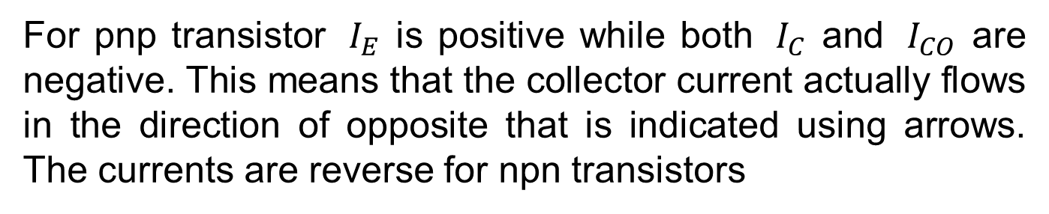
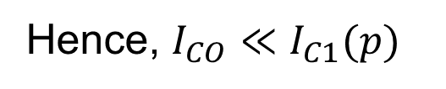


Current component – pnp transistor
$$Usually,{ I}_{CO} is in μA$$
$${ I}_{C} is in mA$$
Hence, $I_{CO}≪I_{C1}(p)$
For pnp transistor ${ I}_{E}$ is positive while both ${ I}_{C}$ and ${ I}_{CO}$ are negative. This means that the collector current actually flows in the direction of opposite that is indicated using arrows. The currents are reverse for npn transistors
12

Slide 13
$$α and β of a Transistor and their relation$$
$α$= dc current gain = $−\frac{{ I}_{C}}{{ I}_{E}}$→ In CB configuration
Small signal short ckt current gain $α^{′}$= $−\frac{∆{ I}_{C}}{{ ∆I}_{E}} |$ ${ V}_{CB}$=constant
$β (or h_{FE})$= max. current gain = $\frac{{ I}_{C}}{{ I}_{B}}$→ In CE configuration
Small signal short ckt max. current gain $β^{′}$= $\frac{∆{ I}_{C}}{{ ∆I}_{B}} |$ ${ V}_{CE}$=constant
13

Slide 14
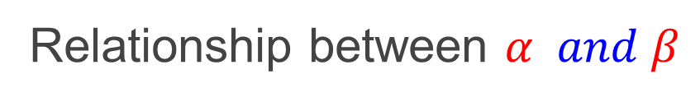
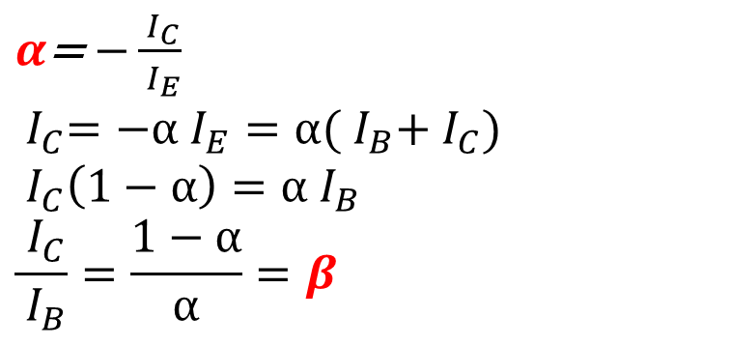

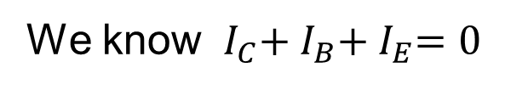
Relationship between $α and β$
We know ${ I}_{C}+{ I}_{B}+{ I}_{E}=0$
$$−{ I}_{E}={ I}_{B}+{ I}_{C}$$
$α$= $−\frac{{ I}_{C}}{{ I}_{E}}$
$${ I}_{C}=−α{ I}_{E}=α({ I}_{B}+{ I}_{C})$$
$${ I}_{C}\left(1−α\right)=α{ I}_{B}$$
$$\frac{{ I}_{C}}{{ I}_{B}}=\frac{1−α}{α}=β$$
14

Slide 15

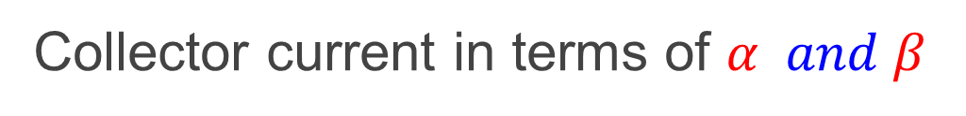
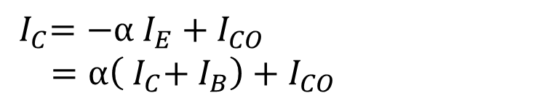
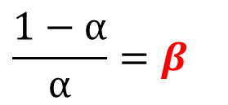
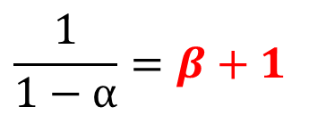


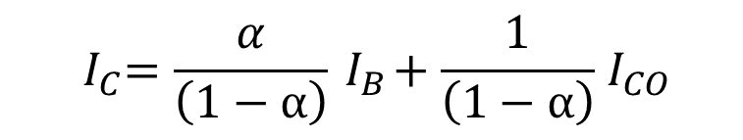
Collector current in terms of $α and β$
$$More acurate expression$$
$${ I}_{C}=−α{ I}_{E}+{ I}_{CO}$$
$=α\left({ I}_{C}+{ I}_{B}\right)+{ I}_{CO}$
$${ I}_{C}\left(1−α\right)=α{ I}_{B}+{ I}_{CO}$$
$${ I}_{C}=\frac{α}{\left(1−α\right)}{ I}_{B}+\frac{1}{\left(1−α\right)}{ I}_{CO}$$
$$\frac{1−α}{α}=β$$
$${ I}_{C}=β{ I}_{B}+(β+1{) I}_{CO}$$
$$\frac{1}{1−α}=β+1$$
15

Slide 16


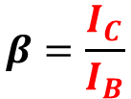

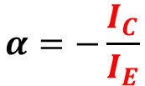

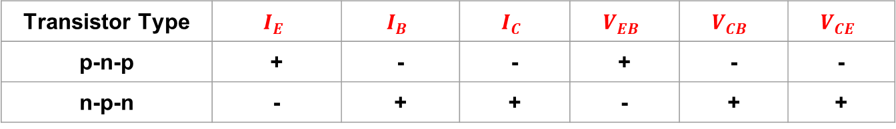


Transistor –Biasing
$$V_{EB}(Emitter −Base voltage)$$
$$I_{B}(Base current)$$
$$V_{CB}(Collector −Base voltage)$$
$$I_{C}(Collector current)$$
$$V_{CE}(Collector −Emitter voltage)$$
$$I_{E}(Emitter current)$$
$$α=−\frac{I_{C}}{I_{E}}$$
$$β=\frac{I_{C}}{I_{B}}$$
Signs of currents & voltage for normal transistor operation
Transistor Type | $$I_{E}$$ | $$I_{B}$$ | $$I_{C}$$ | $$V_{EB}$$ | $$V_{CB}$$ | $$V_{CE}$$
p-n-p | + | - | - | + | - | -
n-p-n | - | + | + | - | + | +
16

Slide 17
MOSFET and Inverter
17

Slide 18
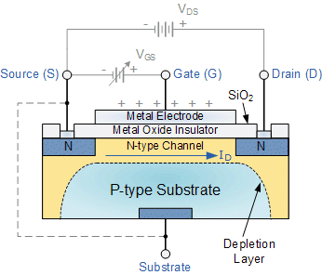
MOSFET
18
10 October 2023
Souvik Mahapatra (EE/IITB)
18

Slide 19
MOSFET Inverter (CMOS Technology)
VDD
PMOS
G
D
S
B
VDD
IN
OUT
GND
G
S
D
B
NMOS
GND
19
10 October 2023
Souvik Mahapatra (EE/IITB)
19

Slide 20
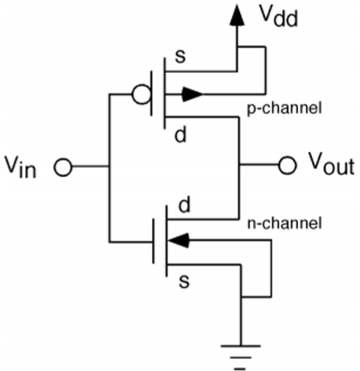
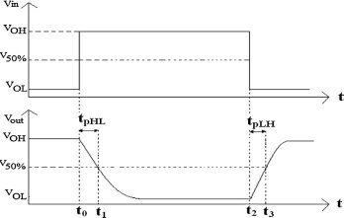
MOSFET Inverter (CMOS Technology)
20
10 October 2023
Souvik Mahapatra (EE/IITB)
20

